Slide 1
NOGRR282 Updates
Patrick Gravois
Principal Operations Engineer
LLWG Meeting
February 19, 2026

Slide 2
NOGRR282 Updates - Agenda
ERCOT 1/30/2026 comments
DWG feedback (includes AEP’s 12/25/2025 comments)
Onward Energy 1/23/2026 comments
Data Center Coalition 2/9/2026 comments and ERCOT response discussion
Next Steps

Slide 3
ERCOT Comments – 1/30/2026
ERCOT submitted comments regarding NOGRR282 on 1/30/2026 to address the following items:
  Renumber Section 2.14, Voltage Ride-Through Requirements for Large Electronic Loads, to Section 2.15 since Section 2.14 is now used for advanced grid support requirements for inverter-based Energy Storage Resources (ESRs), implemented in NOGRR272, Advanced Grid Support Requirements for Inverter-Based ESRs.
  Revise frequency and voltage ride-through requirement exemption language in paragraph (1) of Section 2.6.4 and Section 2.15.
  Respond to Tesla comments submitted on 12/18/2025. Added language to Section 2.15(6) and Section 2.15(3)(e) to explicitly allow LEL to implement load-transfer scheme to meet ride-through requirements.
  Revise the active power recovery time for post-disturbance Large Electronic Load (LEL) consumption from one second to two seconds.

Slide 4
DWG Feedback (AEP’s comments)
DWG discussed NOGRR282 on 2/12/2026
Preparing to present feedback to ROS on 3/5/2026
AEP’s 12/5/2025 comments were addressed (No other comments from TSPs received)
  AEP proposed the following frequency ride-through (FRT) curve (below left)
  ERCOT and DWG members expressed desire to increase the high-frequency ride-through thresholds as per AEP’s comments; but keep low frequency thresholds as is (below right)
  May reassess if technical comments received from LEL developers (none so far)
AEP’s Proposed FRT curve
DWG’s Proposed FRT curve
Frequency (f) in (Hz) | Minimum Ride-Through Time (seconds)
f > 61.863.0 | May ride-through or trip
61.2 < f ≤ 61.863.0 | 299
58.8 ≤ f ≤ 61.2 | continuous
57.058.2 ≤ f < 58.8 | 299
f < 57.058.2 | May ride-through or trip
Frequency (f) in (Hz) | Minimum Ride-Through Time (seconds)
f > 61.863.0 | May ride-through or trip
61.2 < f ≤ 61.863.0 | 299
58.8 ≤ f ≤ 61.2 | continuous
57.0≤ f < 58.8 | 299
f < 57.0 | May ride-through or trip

Slide 5
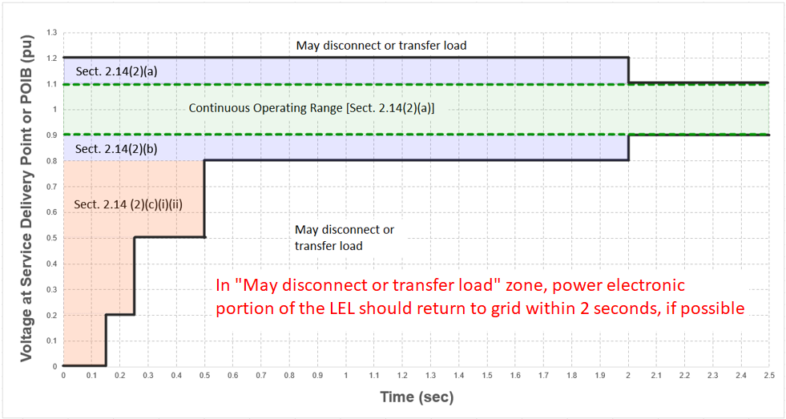
DWG Feedback (AEP’s comments)
AEP’s comments continued. Proposed adding following language to 2.15(3)(e):
  When a voltage disturbance causes the voltage at the Service Delivery Point or POIB to exceed the boundaries of the ride-through range as specified in Table A of paragraph (2) above, either exceeding 1.2 per unit voltage or exceeding the minimum ride-through time durations, a UPS-equipped LEL shall return to at least 90% of its pre-disturbance consumption level from the grid within one second of voltage at the Service Delivery Point or POIB returning to the continuous range (0.90 ≤ V ≤ 1.10) unless UPS battery charge has decreased to within TBD percent of the charge necessary to initiate transfer to back up generation.
  ERCOT expressed concern that the proposed language may not be technology neutral
  In response, AEP proposed following revision: “if the LEL has not been tripped, transferred to a backup generation source, or transfer to a backup generation source has not already been initiated, to return to at least 90 percent of pre-disturbance grid consumption level within two seconds of voltage conditions beyond those defined in paragraph (3) above at the Service Delivery Point or POIB returning to the continuous range (0.90 ≤ V ≤ 1.10).”
  ERCOT agrees with concept in theory, but is concerned AEP’s revised language could result in LELs decided to trip outside ride-through curve; need language to encourage desired performance

Slide 6
DWG Feedback
DWG discussed change of post-fault active power recovery time from 1 second to 2 seconds in ERCOT’s 1/30/2026 comments
  Reviewed ERCOT’s presentation from 1/22/2026 LLWG
  DWG agrees change is acceptable
DWG discussed overcurrent allowance of 125% during voltage sag in 2.15(3)(d)
  Some LEL developers have expressed desire to extend to 150% to allow for constant power for voltage sags down to 0.7pu (could improve ability to ride-through)
  To be discussed at SPWG on 2/24/2026 to determine if overcurrent due to constant power would trigger protection systems operations
  DWG members would like to include a duration limitation in the 2.15(3)(d) language such as “during voltage disturbance/sag” or “no more than 0.5 sec”
ERCOT to submit comments addressing DWG feedback closer to March ROS

Slide 7
Onward Energy’s Comments – 1/23/2026
Onward Energy’s comments expressed concern that NOGRR282 is not clear which requirements apply when an LEL and Generation Resource are connected behind the same POI (co-located), and how ERCOT would determine which NOG requirements apply when an LEL and/or Generation Resource trip during an event
ERCOT responded on 2/16/2026
  ERCOT will be able to determine if an LEL or Generation Resource/ESR tripped (or reduced consumption/output) during a frequency or voltage disturbance event
  Telemetry is required on LELs and Generation Resources/ESRs
  ERCOT also has telemetry from POI of co-located facilities
  ERCOT may request disturbance monitoring data from TSPs, REs, and QSEs
  ERCOT could send out RFIs to aid in its analysis
  After initial investigation of the event:
    If LEL tripped or reduced consumption following system disturbance, ERCOT would verify if non-exempt LEL complied with NOG sections 2.6.4 and 2.15
    If Generation Resource/ESR tripped or reduced output following a system disturbance, ERCOT would verify if GR/ESR complied with NOG sections 2.6.2 and 2.9
  Applicability clearly defined in appropriate NOG sections, so no language revisions needed

Slide 8
Data Center Coalition Comments – 2/9/2026
DCC 2/9/2026 comments
ERCOT response

Slide 9
Next Steps
ERCOT is seeking to receive technical comments on NOGRR282 by end of February
Will review additional comments at March LLWG (rescheduled to March 13)
If DWG and SPWG endorse NOGRR282 as written with ERCOT comments, ROS vote could occur on April 2

Slide 10
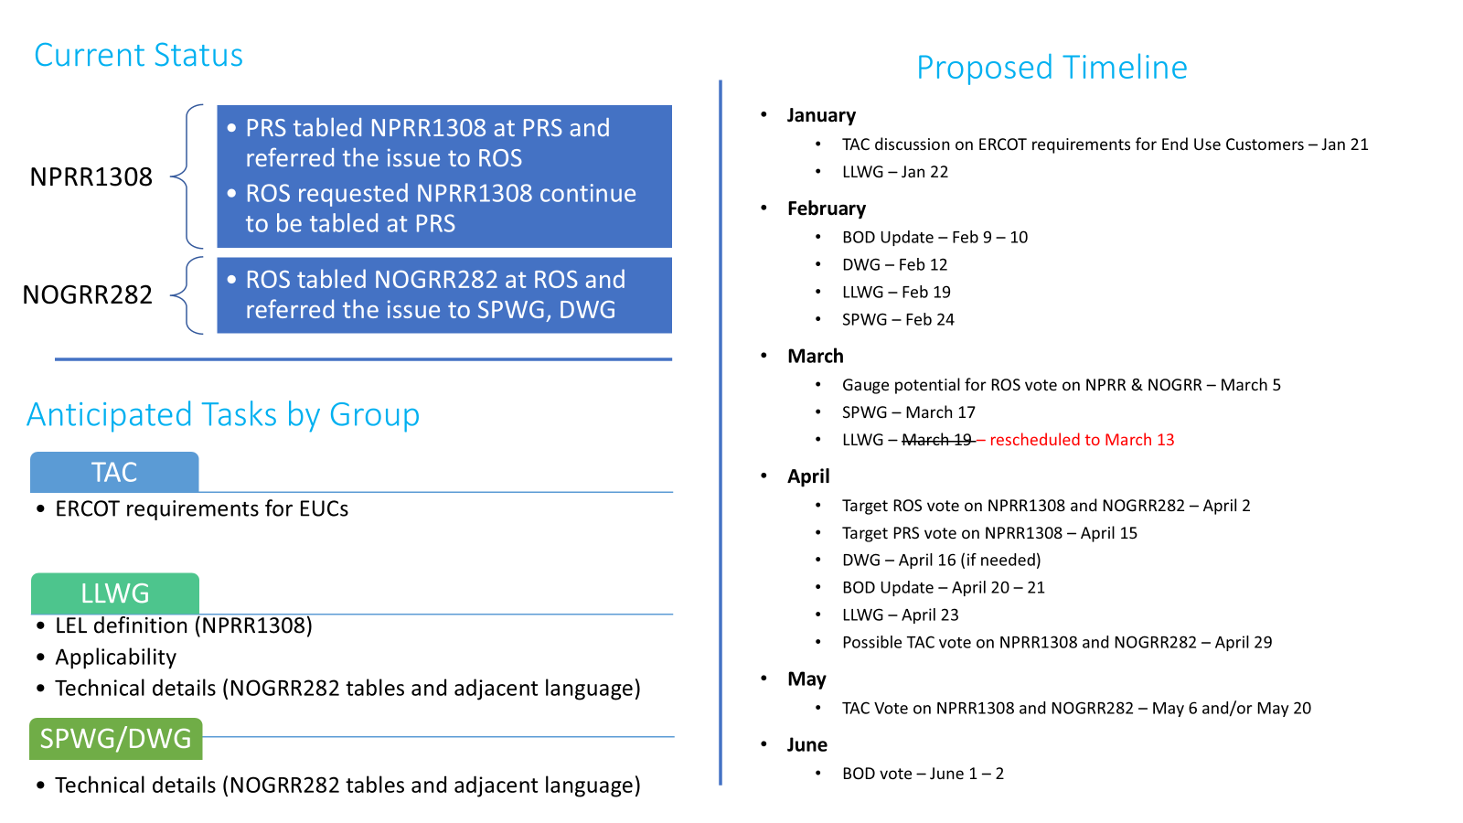
NPRR1308 and NOGRR282 Timeline

