Slide 1

NERC EMSWG Update
Wei Qiu, NERC EA
ERCOT TWG Conference Call
February 19, 2026

Slide 2
2026 Work Plan
2026 Monitoring and Situational Awareness Technical Conference - (in person)
Location: TBD
Date: Tue. 10/6 - Wed. 10/7
Risk and Mitigations for Losing EMS Functions Reference Document v5 (biennial) 2026 Q3

Slide 3
2026 Work Plan
More discussions
AI/ML
Renewable resources
EMS in Cloud Computing
External Modelling
Lessons Learned
EMS best practice
FERC orders

Slide 4
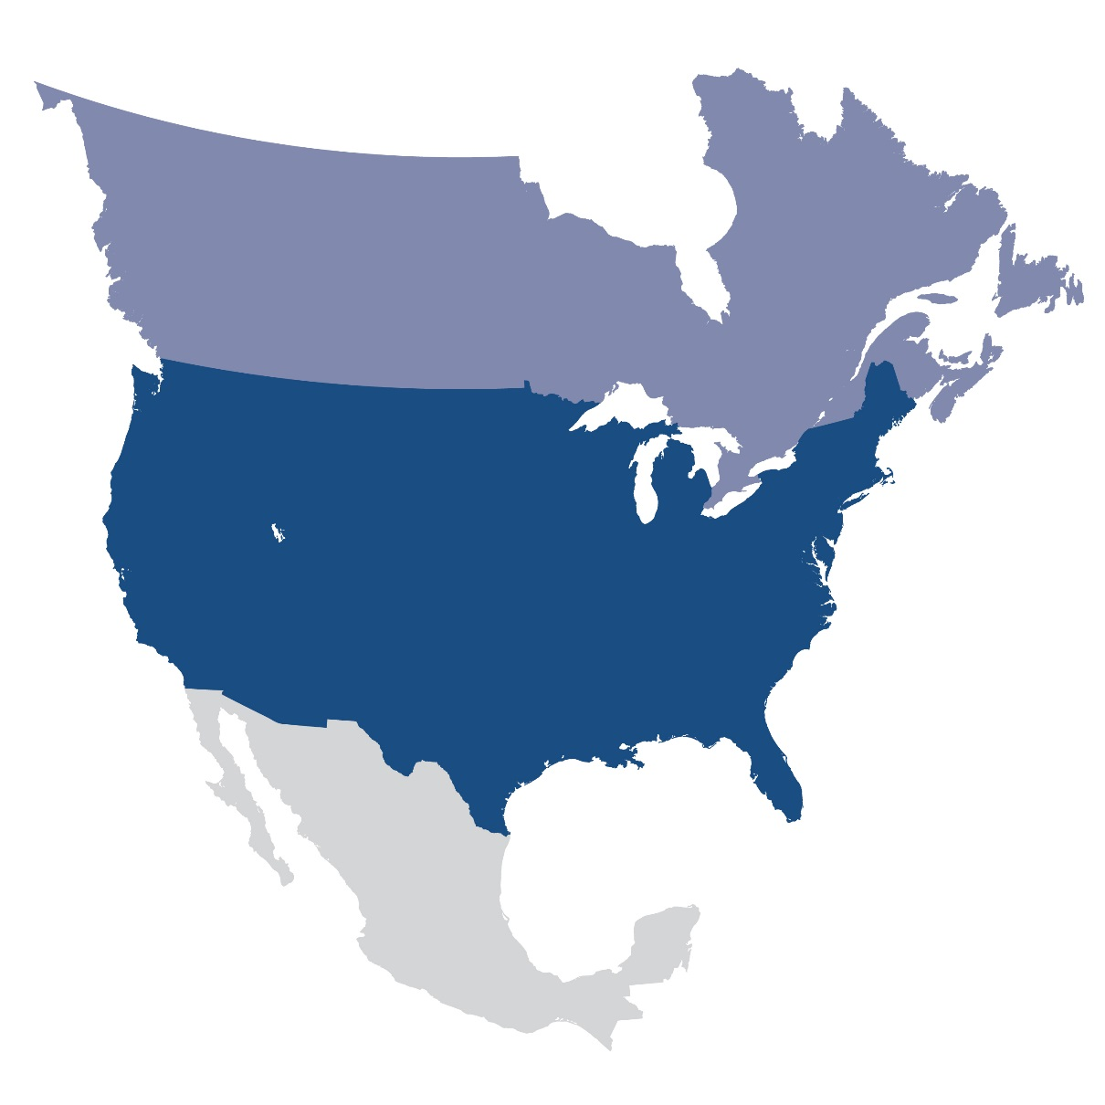
Questions and Answers
Contact Information:
wei.qiu@nerc.net

