Slide 1
SCR820 – Real-Time Operator Communication System (RTOC)
Preethi Meher & Christelle Seri
Feb 19, 2026

Slide 2
SCR820
Agenda
  Status updates
  Project timeline overview
  MPIM Access
  Demo
  Primary Contacts

Slide 3
Status Updates
Project updates
  ERCOT internal operator logging feature went live in Dec 2025
  Messaging feature deployed and under testing in staging
  MIS proxy setup to enable external user access
  Development updates
  EMS data interface development is in progress to provide:
    SOL Exceedance data
    EEA related alarms
  Communication template creation screens under development
  Admin screens for internal use in progress

Slide 4
SCR820 – Project Timelines
Project Timeline
Phase | Milestone | Target Date
Planning | Requirements & Design Finalized | Complete
Development | Development & Internal ERCOT Testing | Apr 2026
Testing | TOs/QSEs Testing | Mar 2026 – Apr 2026
Parallel Ops | Dual Operation Phase | May 2026
Go Live | Full Launch | June 2026

Slide 5
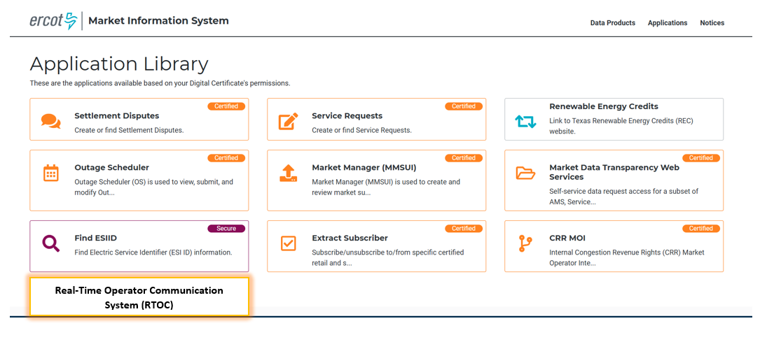
Tool Access
Access control
  Application access will be granted via digital certificates
  New roles must be added to the certificate for authorization
    Operator (RTOC_M_OPERATOR)
    ReadOnly (RTOC_M_VIEW)
  Link will be available on mis.ercot.com application library
Available to request

Slide 6
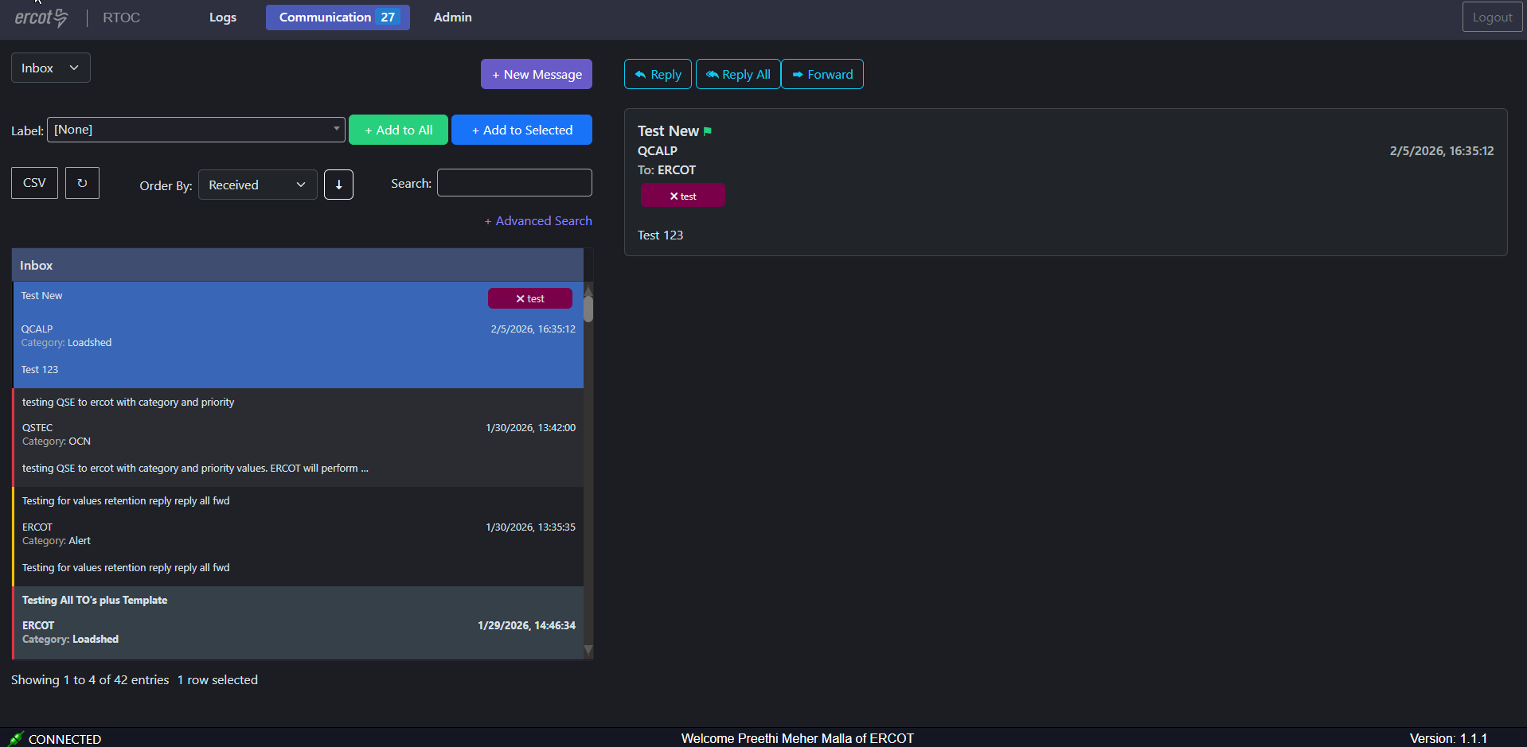
Communication Page - Demo

Slide 7
Key Highlights
What messages will RTOC handle?
Anything that requires a hotline call today
Examples include:
  Operational alerts
  Outage notifications
  System conditions
These same communications will now be delivered through RTOC for centralized access
How will notifications work?
Audible alerts for critical messages when logged in.
Visual notifications for operational updates.
API integration is under consideration
How Will RTOC Handle QSE Relationships?
Main QSE will have access to the tool
Main QSE should communicate on behalf of sub-QSEs

Slide 8
Provide Primary Contact Information
We need your help to streamline communication for RTOC Market Testing.
Please share the following details for your organization:
Primary Contact Name
Email Address
Role/Designation
Why?
To provide testing-related communications
Share application URL, updates, and instructions promptly
How to Submit:
Email your details to: Preethi.MeherMalla@ercot.com, Sreenivas.Badri@ercot.com
Deadline: 3/13/2026

Slide 9
SCR820
Thank you

