Slide 1
ERCOT Technology Working Group (TWG)
February 19, 2026

Slide 2
ERCOT TWG
WELCOME

Slide 3
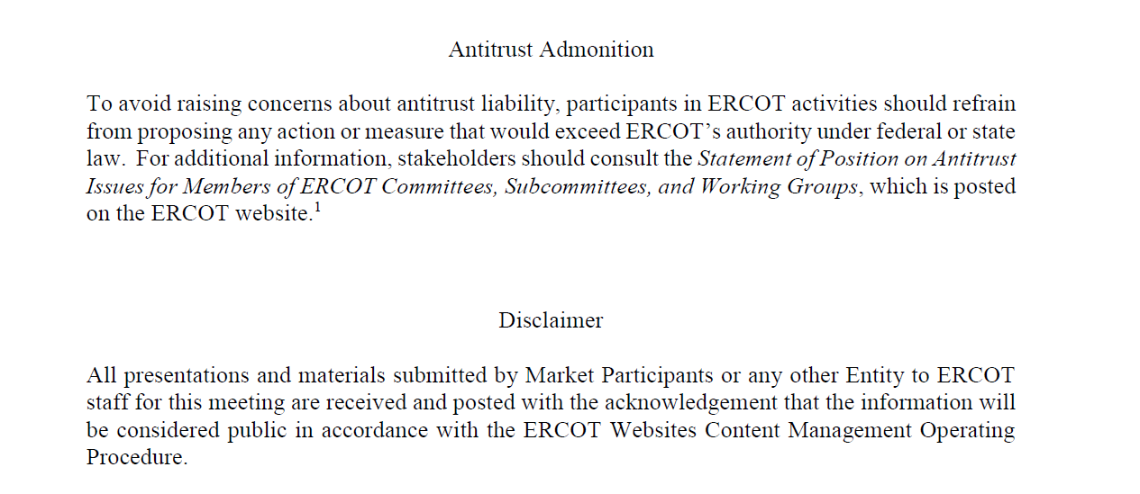
ERCOT TWG

Slide 4
ERCOT TWG Agenda
Item # | Item Description | Presenter | Start Time
1 | Antitrust admonition | Sreenivas Badri | 2:00 PM
2 | General updates (TWG charter and Vice-Chair Nominations) | Sreenivas Badri | 2:02 PM
3 | NERC EMS WG updates | Wei Qui | 2:05 PM
4 | Project Updates | Troy Anderson | 2:15 PM
5 | 2026 Feb & March Release (R2 & R3) changes Market Submissions CDR and ISM Reports | Katherine Li/Jamie Lavas | 2:25 PM
6 | DPC Process Automation Tool updates | Yugendher Karedla | 2:40 PM
7 | SCR820 – Real-Time Operator Communication Tool updates and demo | Preethi Meher/Christelle Seri | 2:50 PM
8 | Outage Scheduler Enhancements Project – Go-Live update | Katherine Li | 3:05 PM
9 | Public Website Cipher Security Hardening | Leo Angele | 3:10 PM
10 | Future Ready Identity and MP Services Portal updates | Nicholas Jessett | 3:20 PM
11 | Read-Only EMS on Cloud – objective and scope | Sreenivas Badri | 3:35 PM
12 | Large Load Curtailment Manager project updates | Sruthi Hariharan/Nitika Mago | 3:45 PM
13 | Round Table Discussion Future Topics of Interest | Tanner Holder | 3:55 PM
14 | Adjourn | Tanner Holder | 4:00 PM

Slide 5
TWG
2026-2027 TWG Charter – Final Version – Sreenivas Badri/TWG
Vice-Chair Nominations – Sreenivas Badri

Slide 6
NERC EMSWG Updates
NERC EMSWG updates – Wei Qui

Slide 7
Project updates
Project updates – Troy Anderson

Slide 8
2026 February and March (R2 & R3) Release changes
Market Submissions – Katherine Li
CDR and ISM Reports – Jamie Lavas

Slide 9
DPC Process Automation
DPC Process Automation Tool updates – Yugendher Karedla

Slide 10
SCR820 – Real-Time Operator Communication Tool updates
SCR820 – Real-Time Operator Communication Tool updates
– Preethi Meher/Christelle Seri

Slide 11
Outage Scheduler (OS) Enhancements Project – MOTE Testing
Outage Scheduler (OS) Enhancements Project – MOTE Testing
– Katherine Li

Slide 12
Public Website Cipher Security Hardening
Public Website Cipher Security Hardening – Leo Angele

Slide 13
Future Ready Identity and MP Services Portal updates
Future Ready Identity and MP Services Portal updates – Nicholas Jesset

Slide 14
Read-Only EMS – Objective and Scope
Read-Only EMS on Cloud – objective and scope
– Sreenivas Badri

Slide 15
Large Load Curtailment Manager
Large Load Curtailment Manager Project updates
– Sruthi Hariharan/Nitika Mago

Slide 16
ERCOT TWG – Round Table Discussion
ERCOT TWG – Round Table Discussion
Future Topics of Interest
Topics and presentations from TWG members

Slide 17
ERCOT TWG
Thank You
You can reach Sreenivas at
Sreenivas.Badri@ercot.com and Tanner at tholder@tnsk.com

