Slide 1
Pre-Batch Trial
Large Load Working Group 2/19/26
Clayton Greer, Chief Strategy Officer

Slide 2
What is a Pre-Batch Trial
A Pre-Batch Trial is a Testing and Level-setting Exercise
  Tests model onboarding processes
    Setting the base model
  Test the GridAstra Software:
    Accuracy
    Functionality
    Time to completion
    Performance under stress
  Test post processing
    What upgrades were recommended
    TSP interaction – construction costs, timing, etc.
    Post process review – mini RPG or new process?
    Development of revised transmission, load and contingency files based on results
    Test post processing scenarios of load participation (50% of load fails to commit for instance)
  Determine if a “pre-processing” step makes sense
    Upgrades that are preferred (double circuit construction with only one circuit)
    Upgrades that are off limits (upgrading lines that can’t be taken out of service)
Provides optionality
  Satisfactory results could provide opportunities for action
Pre-batch trial: because “trust me, it’ll converge” is not a test plan.

Slide 3
Load Flow Fundamentals
Three legs of the Modeling Stool
  Generation – Moving the electrons
  Load – Using the electrons
  Transmission – Connecting the two
Optimal Study Results
  Study results steadily move from “Reality Based” to “Assumptions Driven” based on size
    Load level is based on actual projects (real after security posted)
    Transmission is what we are solving for
    Generation is the variable
  To the extent generation locations are accurately predicted, the transmission solution is accurate
  Inaccuracies are likely corrected in future studies
    Unloaded lines will quickly become used by other loads under study
Assumptions Driven
Reality Based
The good news: the model is deterministic. The bad news: our inputs are not.

Slide 4
Establishing the Initial Model
Transmission Includes:
  RTP Upgrades
  RPG Upgrades
  Other?
Generation Includes:
  All standard Planning steps
    No reserves needed
    Increase NOIE gen
    DC Ties
    Etc.
  New generation assumptions
SB6 Compliant Load Steps:
  Create Reasonable Cut Points
    Approved to Energize
    Approved Steady State
    Sites in Progress
    RTP/RPG sites
    Additional sites in progress
  Theoretically could solve entire queue
The base model is the part where we all agree on a shared fiction before we argue about details

Slide 5
Trial Run
Step 1 – Establish model(s) and load sets for study
  Determine which model sets will be used for study
    Examine possible additional cases useful for study
  Track timing of model creation and note possible improvements for steady state
  Determine load sets that could provide useful data points on the solution
    Obvious ones – Appd to Energize, Appd Steady State
    Additional cuts – By age, by ease of install, by region, by TSP…
    Try to get to a full study of all load in queue
Step 2 – Run model
  Idea is a functionality test
    Time to solve
    Quality of solve
    When does it break
  Also run scenarios
    Different %’s of dropouts from the Batch
    Different methods of restudy
Step 3 – Post Processing Process
  Communicate results to TSPs
  TSPs provide data on schedule timing and costs
  ERCOT cross references this scheduling to capacity releases
  ERCOT cross references costs to interconnections
  ERCOT builds reports and issues samples
“A study is the art of turning uncertainty into the most precisely wrong answer possible… so we can all argue about the third decimal place with confidence.”

Slide 6
Evaluation Steps
There will be a general “Lessons Learned”
  What went well/what can be improved
  Did the model perform in an acceptable timeline
  Were the results accurate/consistent
  Did the post processing phase point to a need for preprocessing
    Prevent “No-Go” projects for even being considered
    Encourage “easy” project options
  Was the interaction with the TSPs effective/consistent
  Does 6 months appear “right-sized”
There will be a discovery phase before results matter
  Should uncover a number of items not previously recognized
There will also be an opportunity to make the results “matter”
“Lessons Learned”—the industry’s polite way of saying “we found new ways to suffer.”

Slide 7
Opportunity to Use Results
There is no prohibition on an engineer studying anything they feel is needed
  Nothing in Protocols, Rule or Law can prevent that
  What is done with the results is another story
Upon study conclusion
  A post study of the results could determine an optimum effective level
    For instance, the “Approved to Energize” level could be selected and projects commenced if needed to serve that load
    A “no projects needed” level could be set and those associated loads approved to energize
    Or any other level that appears logical
  The PUC can weigh in on the level to provide clarity on ultimate project approvals
  An RPG-like review can be performed if needed if the timeline can be very short
  Everything processed normally from there
Would save time
  Recovers the Protocol writing period by keeping the process moving forward
“We can either use these results now, or we can recreate them later under deadline pressure… and I’m trying to reduce everyone’s caffeine dependence.”

Slide 8
Next Steps
ERCOT publishes a detailed Pre‑Batch Trial test plan
  Scope,
  Test cases,
  Metrics,
  Acceptance criteria,
  Decision gates
Define inputs and change control
  Base cases/versions,
  RTP/RPG upgrades,
  Gen assumptions,
  Load blocks for study
Joint ERCOT/TSP workflow definition for preprocessing:
  Exactly what gets changed/blocked/supported, by whom, in what format, and when.
Joint ERCOT/TSP workflow definition for post‑processing:
  Upgrades mapping/sceduling,
  Costs,
  Capacity release dates, and
  Standard report outputs
Quantify time required for post‑processing and agree on target turnaround/SLA-style expectations
Confirm tooling and automation approach (GridAstra configuration, scripts/templates, file naming, audit trail, repeatability)
Run end‑to‑end pilot
Document lessons learned and finalize the plan for future batches
“Let’s do a pilot run first—because discovering a missing step at scale is called ‘an agenda item.’”

Slide 9
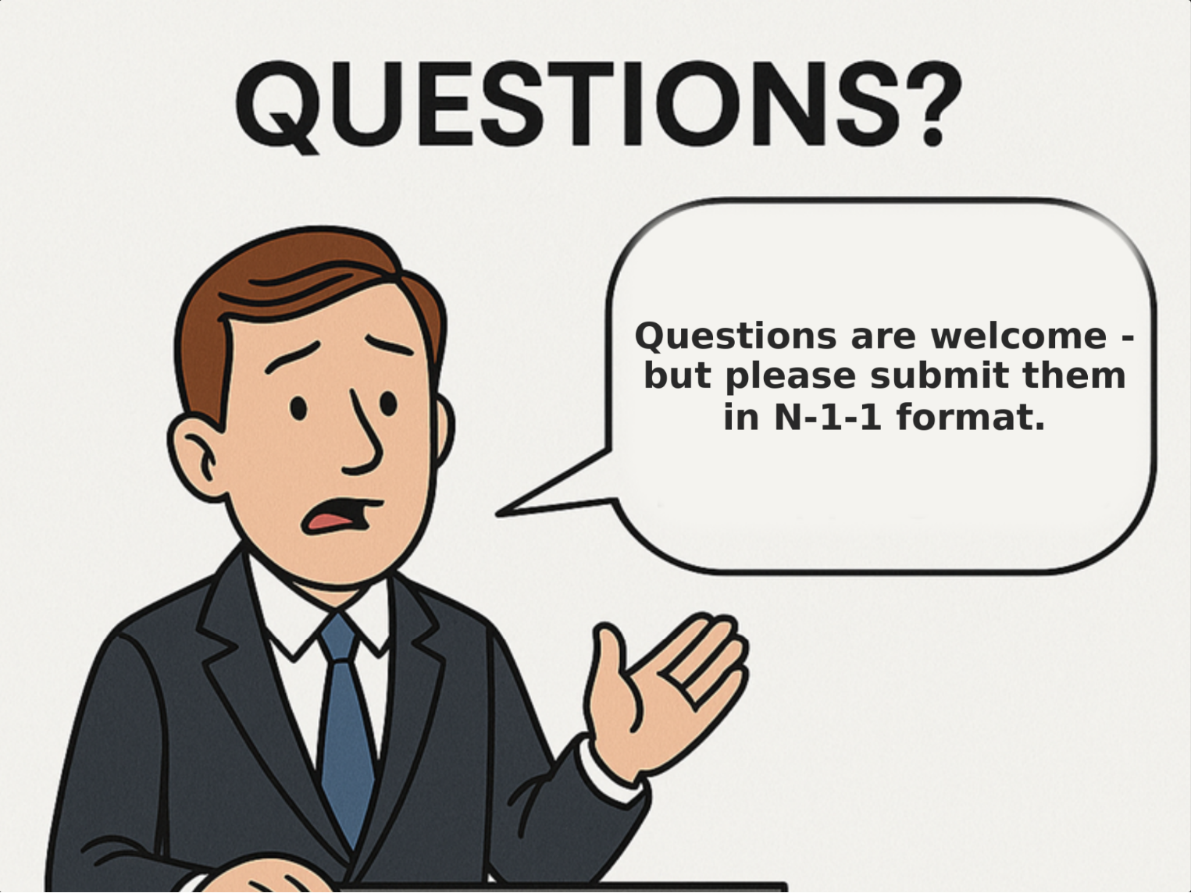
Questions?

