Slide 1
ERCOT Frequency Events
January 2026
ERCOT
Operations Planning
PDCWG | Feb 18, 2026

Slide 2
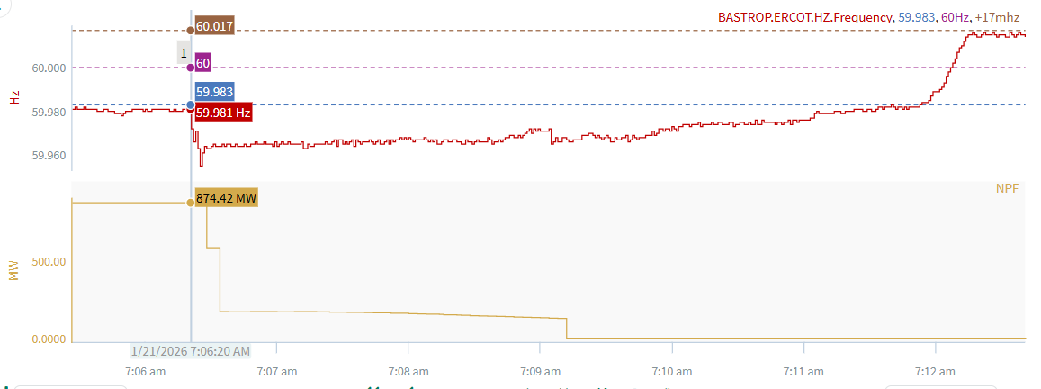
1/21/2026 7:06:20 (Non-FME)
Notes:
The combine cycle partially tripped while carrying ~702 MW
Starting Frequency: 59.981 Hz
Minimum Frequency: 59.955 Hz
A-C Time : 5 seconds
Recovery Time(back to deadband): 5 minutes 33 seconds
ECRS Released: 0 MW
Trip Reason: Unknown at this time
Contextual Information: A total of 380 MW of regulation Up was deployed during the event.
Reason for no selection: Partial trip and C point is 59.955

Slide 3
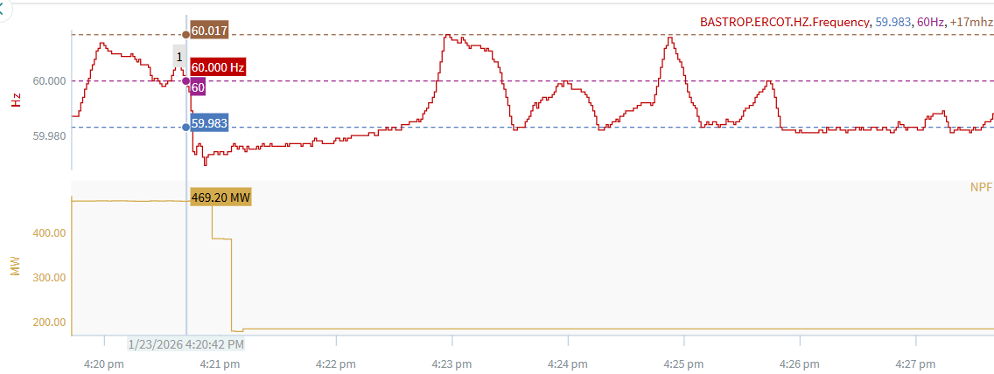
1/23/2026 16:20:42 (Non-FME)
Notes:
The combine cycle partially tripped while carrying ~291 MW
Starting Frequency: 60.000 Hz
Minimum Frequency: 59.973 Hz
A-C Time : 5 seconds
Recovery Time(back to deadband): 1 minutes 53 seconds
ECRS Released: 0 MW
Trip Reason: Unknown at this time
Contextual Information: A total of 380 MW of regulation Up was deployed during the event.
Reason for no selection: Partial trip and C point is 59.955

Slide 4
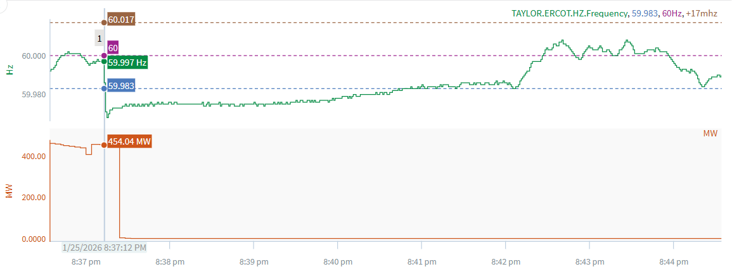
1/25/2026 20:37:12 (Non-FME)
Notes:
The unit experienced runback while carrying ~445 MW and tripped offline
Starting Frequency: 59.997 Hz
Minimum Frequency: 59.968 Hz
A-C Time : 3 seconds
Recovery Time(back to deadband): 3 minutes 35 seconds
ECRS Released: 0 MW
Trip Reason: Air preheater issues
Contextual Information: A total of 160 MW of regulation Up and a manual offset of 400 MW was deployed during the event.
Reason for no selection: C point is 59.968

Slide 5
Questions?
Thank you!

