Slide 1
NDSWG Meeting
February 2026

Slide 2
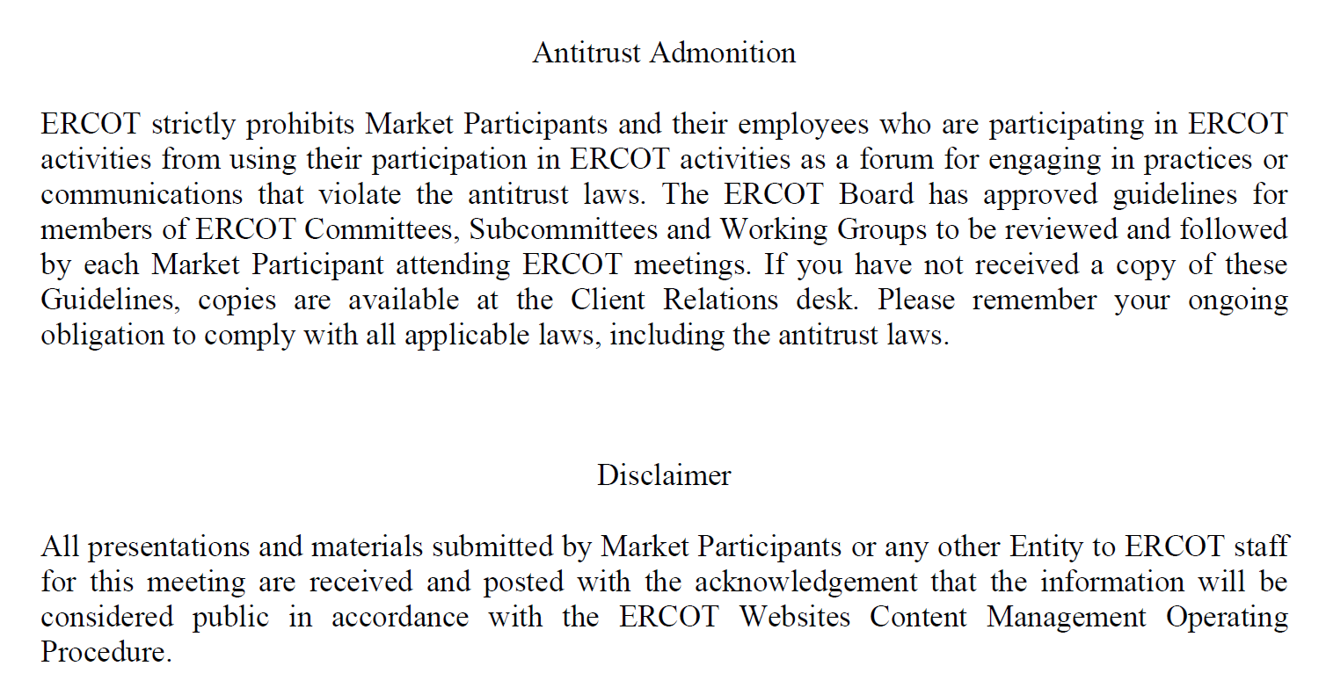
Antitrust Admonition

Slide 3
Topics
NPRR 1317 – Creation of Non-Settled Generator(NSG) and Clarification of the Types, Usage, and Registration of Distributed Generation
End Use Industry Classification Review
Model cleanup – temporary switch
Other Topics:
UDG Workshop
CIM 16 Training
Double Circuit Contingency Review
Manual Contingency Review

Slide 4
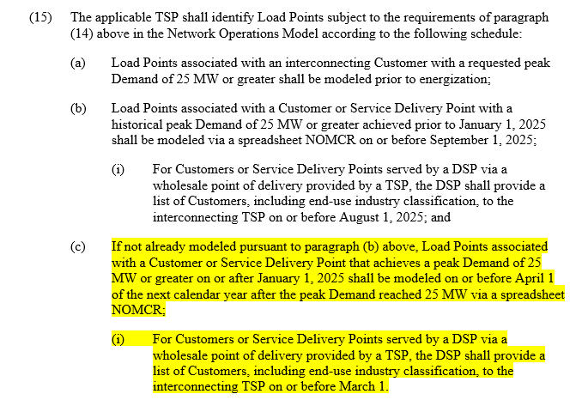
End Use Industry Classification Review
Nodal Protocols 3.10.7.2(15)

Slide 5
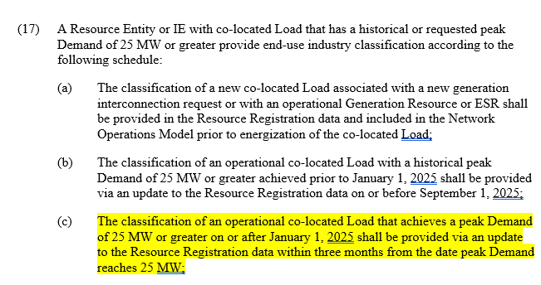
End Use Industry Classification Review
Nodal Protocols 3.10.7.2(17)

Slide 6
End Use Industry Classification Review
Load End-Use Classification Categories
Cryptocurrency Mining
Data Centers (non-crypto)
Government and Medical
Hydrogen and Electrofuel Production
Oil and Chemical Refining
Oil and Gas Production, Processing, and Transmission
Steel and Aluminum Manufacturing
Transportation
Other Industrial
Note: Residential is not added for this review

Slide 7
End Use Industry Classification Review
Market Notice and NDSWG email went out on February 12, 2026
For TSPs, Load Points that have achieved a peak demand of 25 MW or greater on or after January 1, 2025 shall be modeled on or before April 1 of the next calendar year
For Resource Entities associated with PUN or co-located Large Loads, an operational co-located Load that achieved a peak demand of 25 MW of greater on or after January 1, 2025 shall be updated in Registration data within three months from the date peak Demand reaches 25 MW

Slide 8
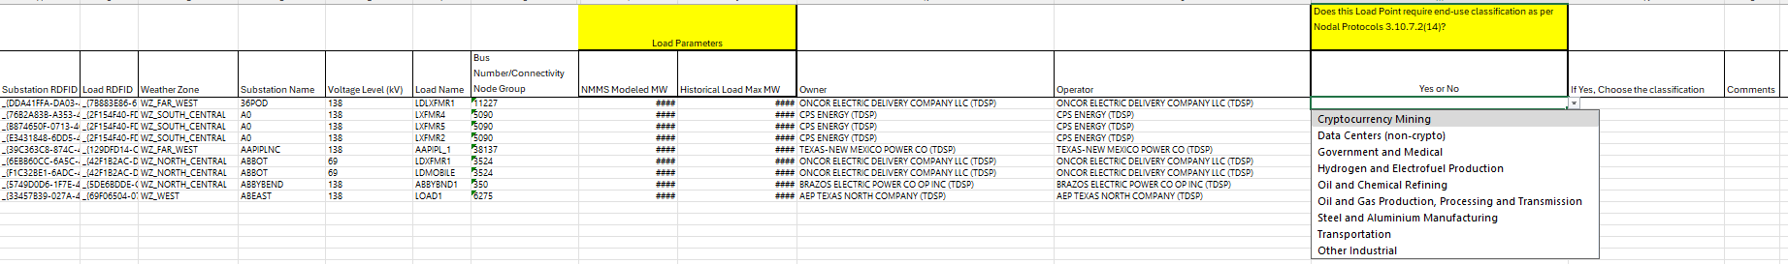
End Use Industry Classification Review - TSP
Spreadsheet is posted in NMMS Postings
TSPs to submit an ICR in NMMS on or before April 1 2026 with a Production Load Date of April 22 2026
Please include “Review of end-use industry classification for Load Points_TSP Name” on the description

Slide 9
End Use Industry Classification Review - RE
Private Use Networks or Co-located loads is available on ERCOT MIS ECEII Requested information folder for review
RE will submit a standard RSCR in RIOO RS with a description of “Review of end-use industry classification for Load Points”

Slide 10
Model cleanup – temporary switch
Goal: Keep the model accurate and aligned with field operations
Objective: Remove retired equipment and temporary modeling to maintain model integrity
Process:
ERCOT generated a list of equipment using the outage scheduler data (retirement or past planned dates)
Verified against the model
Bulk verification requests sent to TSP’s; Periodic clean up emails planned Items flagged on the attachment sent to the TSP’s requesting for their feedback: Comments, Manuals to be cleaned up, Obsolete lines, NOMCR numbers if clean up already submitted

Slide 11
Other Topics:
UDG Workshop – April 30, 2026
CIM16 Training – Q4 2026
Double Circuit Contingency Review
Kickoff email will be sent by beginning of March
Manual Contingency Review
Kickoff email will be sent by beginning of May

Slide 12
Other Topics
Open Discussion…

