Slide 1
ERCOT IBRWG: Other Industry Updates
Julia Matevosyan
Associate Director and Chief Engineer
ESIG
02/16/2026

Slide 2

DOE Forum for the Implementation of Reliability Standards for Transmission (i2X FIRST) – Season 2
May 27, 2025, 11 a.m. - 1 p.m. ET – Season 2 Kick-Off
June 24, 2025, 11 a.m.- 1 p.m. ET – NERC Milestone 3 Standards
July 22, 2025, 11 a.m.- 1 p.m. ET – IBR Plant Design Evaluation with Applicable Requirements I
August 26, 2025, 11 a.m.- 1 p.m. ET – IBR Plant Design Evaluation with Applicable Requirements II
September 23, 2025, 11 a.m.- 1 p.m. ET – IBR Plant Modeling Requirements and Best Practices
October 21, 2025, 11 a.m.- 1 p.m. ET – Challenges with IEEE2800-2022, Planned Revisions
November 25, 2025, 11 a.m.- 1 p.m. ET – Change of Management during IBR Plant Interconnection Process and Commissioning, How to Maintain Conformity
December 16, 2025, 11 a.m.- 1 p.m. ET – IBR Plant Commissioning Best Practices I
January 27, 2026, 11 a.m.- 1 p.m. ET – NERC PRC-029 Implementation, Experience, and Recommended Practices
February 24, 2026, 11 a.m. - 1 p.m. ET – IBR Standards – How to Make Sense of it All?
March 16, 2026, hybrid event during ESIG Spring Workshop: Grid Forming IBR Specifications, Testing Requirements, Lessons Learned
Sign up for all future i2X FIRST Season 2 Meetings here
Follow ESIG i2X FIRST website https://www.esig.energy/i2x-first-forum/ for meeting materials & recordings and for future meeting details & agendas

Slide 3
DOE i2x FIRST - NERC PRC-029 Implementation, Experience, and Recommended Practices (1/27/26)
280 attendees, the most attended i2x FIRST meetings
Agenda
Meeting Introduction: Julia Matevosyan, ESIG
Recap of NERC PRC-029-1 and FERC Order 909: JP Skeath, NERC
OEM Perspective and Recommended Practices: Yaw A. Akpaloo, Lucas Sales, GE Vernova
Recommended Practices for IBR Plant Ride-Through Evaluations: Amin Banaie, Elevate Energy Consulting
Q&A and Structured Discussion, led by Julia Matevosyan, ESIG
What is the best practice to identify legacy/inflight IBR plant’s limitations to comply with NERC PRC-029?
What are the best practices to streamline the assessment of legacy/inflight plants’ capability to comply with PRC-029?
Based on what method could NERC and RCs assess potential BPS reliability risks to inform decisions about limits to exemptions?

Slide 4
DOE i2x FIRST - NERC PRC-029 Implementation, Experience, and Recommended Practices (1/27/26)
Key Takeaways
Shift to Performance-Based Ride-Through: PRC-029-1 moves from relay settings to performance-based IBR ride-through requirements; October 2026 deadlines make early assessments essential.
Evolving Rules & Exemptions: Ongoing FERC-driven updates leave open questions on legacy assets, HVDC/choppers, exemptions, and documentation timing.
OEM- and Fleet-Specific Compliance Paths: Solutions vary by technology and vintage; software upgrades may help some legacy assets, while hardware limits must be assessed with OEMs.
As-Left Data Matters Most: Credible evaluations depend on verified site configurations, hidden protections, and OEM logic—often more critical than running extensive simulations
Model Fidelity Over Model Type: PRC-029-1 requires the best available model; EMT adds insight, but phasor models are often sufficient when limits are understood.
Early Coordination & Scalable Processes: Proactive owner-OEM-consultant alignment and repeatable methods are key to achieving compliance at scale.

Slide 5
DOE i2x FIRST– IBR Standards – How to Make Sense of it All? (2/24/26)
Agenda
Meeting Introduction: Julia Matevosyan, ESIG
IBR Standards - How to Make Sense of it All?: Jens Boemer, EPRI
Utility Perspective: Operational Readiness for Inverter-Based Resources: Scott Anderson, SRP
Raising the Bar Through the IBR Lifecycle: Ryan Quint, Elevate Energy Consulting
Coming up next:
Grid-Forming Inverter Workshop (hybrid)
i2x FIRST Season 3 (IEEE2800.2 adoption, NERC Milestone 4 FERC Order 901, PRC-029 implementation, new IEEE2800 series efforts, etc.)
Generation Interconnection Studies Forum
Technical Assistance Hours

Slide 6


DOE i2x FIRST –Grid-Forming Inverter Workshop (3/16/26)
Hybrid: In-person and Virtual, Tucson, AZ, March 16th
Agenda
Educational tutorial covering GFM fundamentals, including how GFM controls differ from grid-following (GFL) approaches, what capabilities they offer, and where current limitations remain.
Panel Discussion: Why and where grid-forming is being required by some ISOs and utilities, and why others have taken more cautious approaches (MISO, ISO-NE, SPP, SRP)
Emerging grid-forming requirements and standards, including regional implementations and ongoing joint IEEE/IEC efforts (UNIFI, VDE FNN Germany, and Electranix covering HECO/AEMO/MISO/ERCOT)
Real-world project experience from utilities, developers, OEMs, and planners implementing grid-forming inverters in the field (HECO, AEMO, Tesla, Fluence, Zenobe)
The workshop is intended for participants seeking a practical, systems-oriented view of grid-forming inverters, grounded in current experience and forward-looking collaboration.

Slide 7
UNIFI, V.3

Slide 8
UNIFI Specifications for Grid-forming Inverter-based Resources – Version 3
Published Jan 30, 2026: https://unificonsortium.org/resources/#toc_Specifications_v3
UNIFI specs team: researchers, IBR OEMs, system operators, plant operators
Content overview:
Defines four tiers of GFM capability
GFM requirements (qualitative)
Under normal operating conditions
Outside normal operating conditions
Modeling requirements (refers to IEEE 2800.2)
Time-domain tests with quantitative criteria (similar to ERCOT, AEMO, etc)
Frequency-domain tests with quantitative criteria (some new, some reference ESIG tests)
Currently serving as the starting point for IEEE P2800.1 (new recommended practice for GFM IBR equipment)

Slide 9
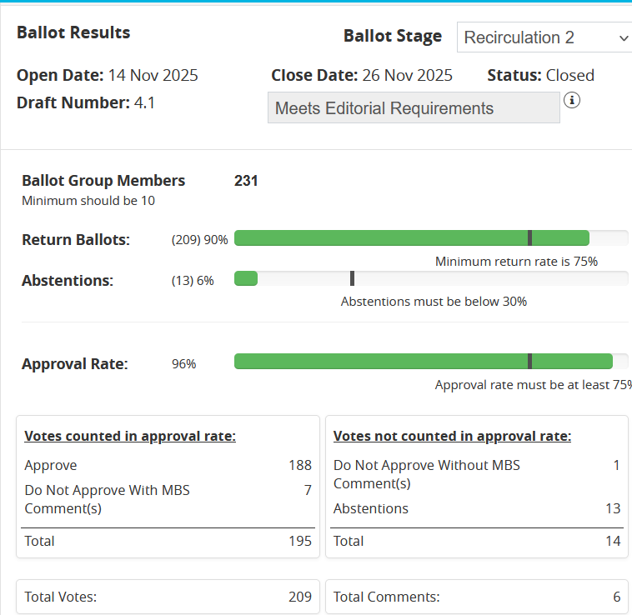
Status of IEEE P2800.2
Scope: Conformity assessment procedures for IEEE 2800-2022
IEEE-SA ballot completed November 2025
Final approval rate at 96%. Final response rate 90%. Abstentions 6%
Final ballot draft (D4.1) on IEEExplore
Approved by IEEE RevCom January 2026
Approved by IEEE-SA Standards Board February 2026
Currently undergoing final editing and formatting
IEEE 2800.2-2026 expected to be published around March/April
For more information on IEEE SA balloting for IEEE 2800.2 see “Other Industry Updates” from ERCOT IBRWG in Dec

Slide 10

ESIG Spring Technical Workshop
Sessions relevant to ERCOT IBRWG:
IBR Dominated Systems (Siemens, Fluence, AES, Tesla, AZZO)
EMT Modeling and Studies (ESIG, EnerNex, NYPA, NERC, EMTP)
System Strength Metrics and Impedance Scanning Methods (Monash University, Telos Energy, Electranix, MISO, RMS Energy)
Oscillation Detection and Analysis (Tesla, Imperial College, MISO/PowerTech, Reactive Technologies, NLR)

Slide 11
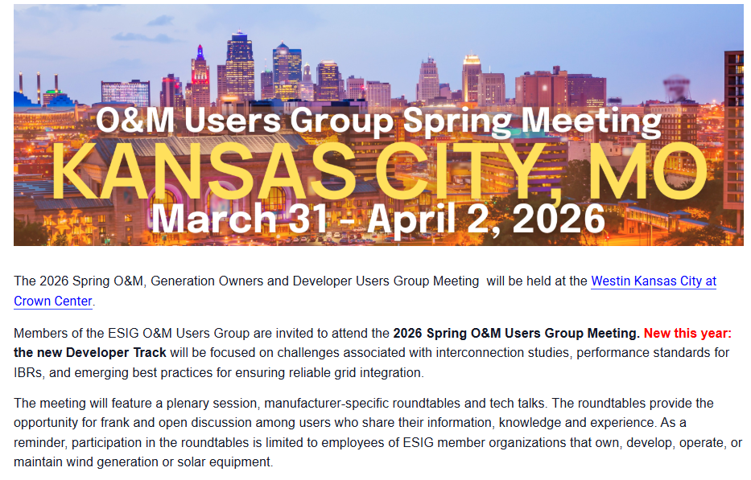
ESIG O&M UG Meeting – New IBR Developer Track
Introduction to Developer Track
Roundtable 1: IBR Unit Model Validation
Roundtable 2: IBR Plant Design Evaluation
Developer Track Tech Talk: IBR Plant Model Verification at Commissioning
Roundtable 3: Model Verification and Commissioning Testing
Roundtable 4: IBR Plant Modeling Throughout the Interconnection Process
Roundtable 5: NERC and Other Standards/Requirements
Roundtable 6: Post-Commissioning

Slide 12
Two ESIG Trainings – Nov and Dec 2025
ESIG Interconnection Studies Short Course WHEN: November 17-19, 2025 WHERE: Manatee Lagoon, 6000 N Flagler Dr, West Palm Beach, FL 33407 MORE DETAILS: This 3-day in-person training is intended to enhance the knowledge and ability of the current workforce through coursework focused on best practices for performing the study work necessary to interconnect inverter-based resources to the bulk power system reliably. Training participants will learn practical methods and best practices that can be leveraged into enhanced study practices across the industry. These training modules will focus on the expected day-to-day needs of engineers performing interconnection studies, model quality tests, or inverter-based resource model and simulation work as well as managing study practices within their organization.
ESIG Electromagnetic Transient Training WHEN: December 16 - 19, 2025 WHERE: Texas RE's Rio Grande Room, Austin, Texas MORE DETAILS: This 3-day in-person training is intended to enhance the knowledge and ability of the current workforce through coursework focused on performing EMT simulations in the current interconnection and planning paradigm. Training participants will learn practical methods and best practices that can be leveraged into enhanced study practices across the industry. These training modules will focus on the expected day-to-day needs of engineers performing EMT analysis as well as managing EMT study practices within their organization.
SLIDES AND RECORDINGS ARE POSTED HERE
SLIDES AND RECORDINGS ARE POSTED HERE
Thanks to NextEra and Texas Reliability Entity for hosting at their facilities!

Slide 13
Julia Matevosyan
julia@esig.energy

