Slide 1
Regulation Bias Analysis Post RTC
January 2026
ERCOT
Operations Planning
PDCWG | February 18th, 2026

Slide 2
Discussion Points
Current GTBD Parameters & References
Metric to measure Regulation bias and performance
Wind and Solar Ramp Rate MAE
Regulation Deployed Comparison (yearly/monthly)
Regulation bias for consecutive 5-min SCED intervals
Time Error and Accumulation
Profiles
Questions

Slide 3
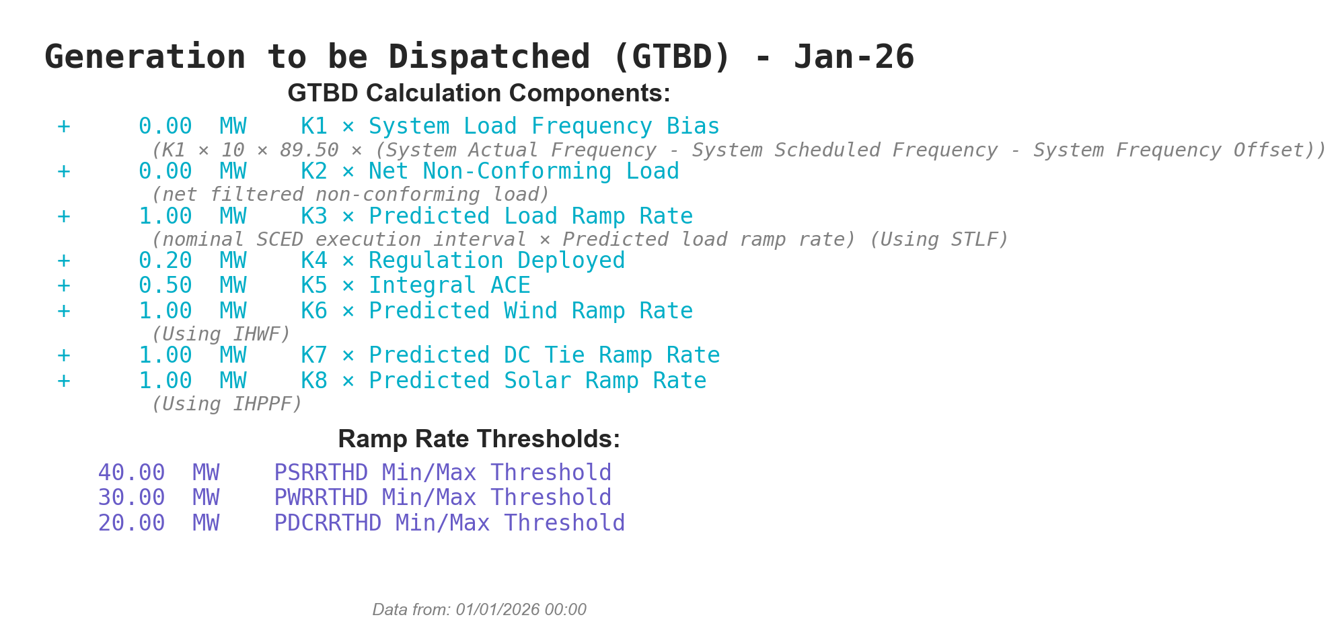
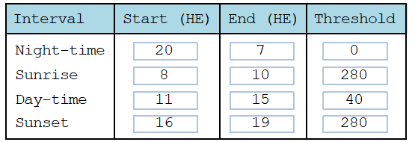
Current GTBD Parameters
PSRR Intervals
Notes:
3/12/18 – Integral ACE Time Constant Changed from 60 min to 45 min
5/17/18 – K4 Changed from 0.3 to 0.2 and K5 Changed from 0.4 to 0.5
12/4/18 – 10:05 AM – K6 Changed from 0 to 0.5
2/12/19 – 2:15 PM – K6 changed from 0.5 to 1.0
3/12/19 – 2:10 PM – PWRR Threshold from 10 to 15 MW/min
3/19/19 – 2:15 PM – PWRR Threshold from 15 to 20 MW/min
4/01/19 – 10:00 AM – K5 changed from 0.5 to 0.4 and Max. Integral ACE Feedback changed from 250 to 150
4/24/19 – 1:15 PM – Max. Integral ACE Feedback changed from 150 to 160. PWRR Threshold changed from 20 to 25.
5/22/19 – 1:10 PM – K5 changed from 0.4 to 0.5, Max Integral ACE feedback changed from 160 to 200, PWRR Threshold changed from 25 to 30
6/17/20 – 10 AM - PWRR Calculation method changed from Direct to Interpolated
9/1/20 – 11 AM - Max Integral ACE Feedback changed from 200 to 250
9/3/20 – 3 PM - Max Integral ACE Feedback changed from 250 to 300
9/4/20 – 3 PM - Max Integral ACE Feedback changed from 300 to 250
6/1/21 – 10:00 AM – K8 Changed from 0 to 0.5, PSRR Threshold changed to 10
6/2/21 – 10:00 AM – PSRR Threshold changed from 10 to 20
6/3/21 – 10:00 AM – K8 Changed from 0.5 to 0.75
6/4/21 – 10:00 AM – K8 Changed from 0.75 to 1
9/2/21 – 10:00 AM – PSRR Threshold changed to 30
6/7/22 – 10:30 AM – K7 Changed from 0 to 0.5, PDCTRR Min/Max Threshold changed to 10 MW/min
6/8/22 – 10:30 AM – PDCTRR Min/Max Threshold changed from 10 to 20 MW/min
6/9/22 – 10:30 AM – K7 Changed from 0.5 to 0.75
6/10/22 – 10:30 AM – K7 Changed from 0.07 to 1.0
7/21/22 – 10:00 AM–Max Integral ACE Feedback changed from 250 to 350
7/21/22 – 05:10 PM – K5 Changed from 0.5 to 1
7/22/22 – 09:40 PM – K5 Changed from 1 to 0.5
7/27/22 – 08:40 AM – PSRR Threshold changed to 40 MW/min
6/12/23 - PSRR dynamic threshold enabled. The Max PSSR started at 80 MW/min for sunrise and sunset hours
6/15/23 – The Max PSRR threshold increased to 100 MW/min for sunrise and sunset hours
10/26/23 – Max Integral ACE Feedback changed from 350 to 250
3/7/24 – PSRR threshold increased from 100 MW/Min to 120 MW/Min
05/30/24 – Max Integral ACE Feedback changed from 250 MW to 350 MW
8/28/24 – PSS Dynamic Threshold changed from 120 MW/Min – 180 MW/Min
10/31/24– K5 changed to 0.5 to 1 to correct the time error
11/1/24 - K5 changed from 1 to 0.75
11/5/24 – K5 changed from 0.75 to 0.5
11/18/24 – K5 changed from 0.5 to 0.75
11/22/24 – K5 changed from 0.75 to 0.5
3/5/25 – K5 changed from 0.5 to 0.75
3/6/25 – K5 changed from 0.75 to 1
3/7/25 – Max Ace Integral Feedback changed from 350 MW to 400 MW
3/7/25 – PSRR Dynamic Threshold for sunrise and sunset changed from 180 MW/Min to 225 MW/Min
3/11/25 – Max Ace Integral Feedback changed from 400 MW to 350 MW
3/12/25 – K5 changed from 1 to 0.5
6/6/25 – K5 changed from 0.5 to 0.75
6/13/25 – K5 changes from 0.75 to 0.5

Slide 4
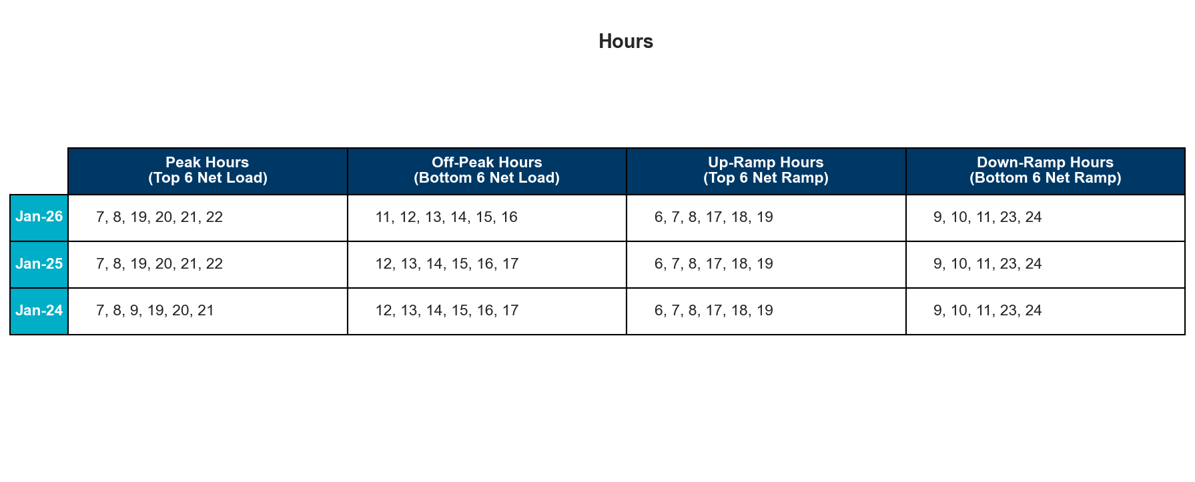
References
Notes:
Reference Hours

Slide 5
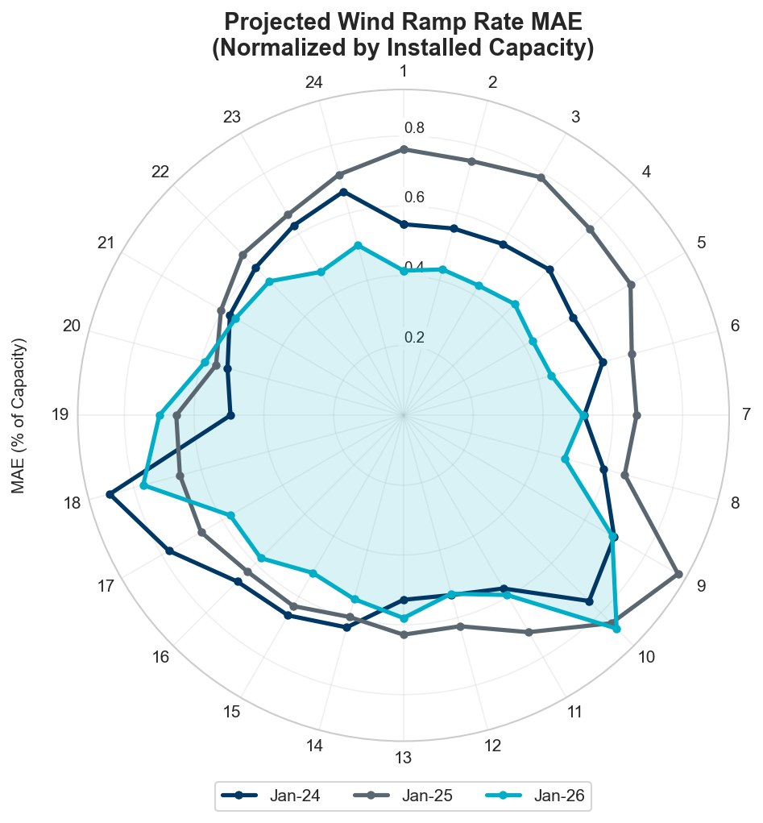
Projected Wind Ramp Rate MAE
Notes:
To better account for growth of wind and solar, we’ve normalized both of our Ramp Rate MAE charts based on installed capacities. This will let us better assess forecasting performance and other factors.

Slide 6
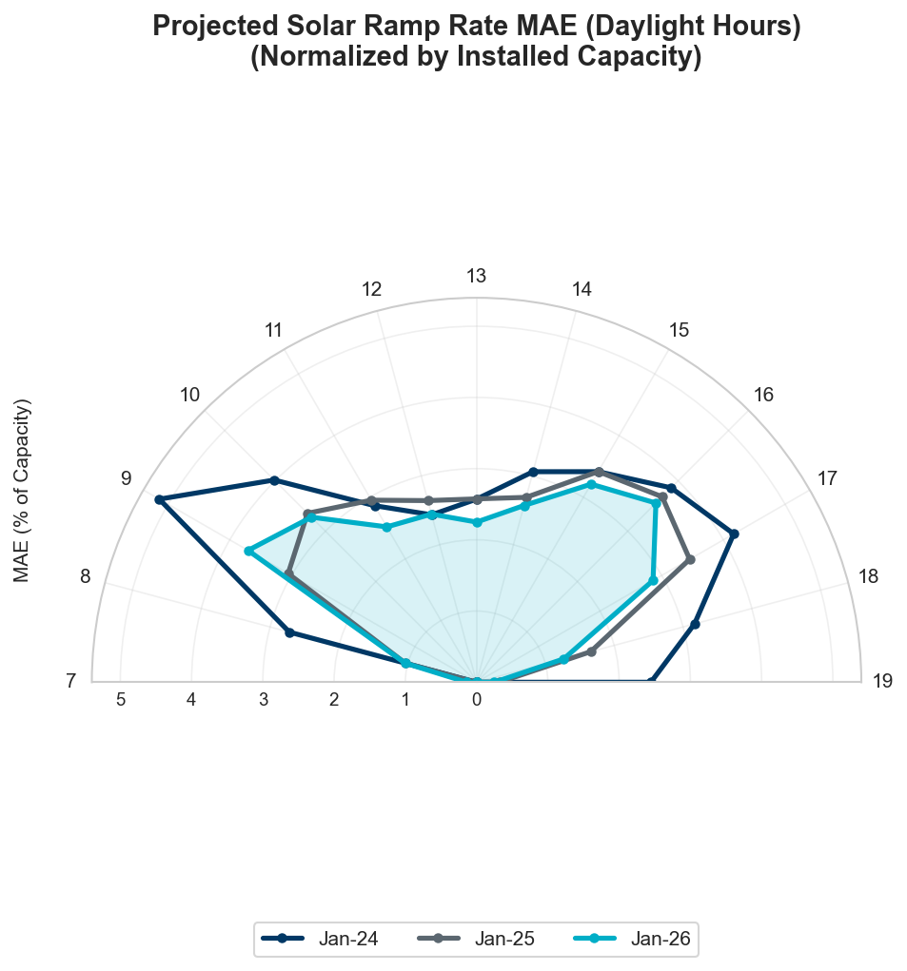
Projected Solar Ramp Rate MAE
Notes:
To better account for growth of wind and solar, we’ve normalized both of our Ramp Rate MAE charts based on installed capacities. This will let us better assess forecasting performance and other factors.

Slide 7
Total Regulation Deployed Comparisons

Slide 8
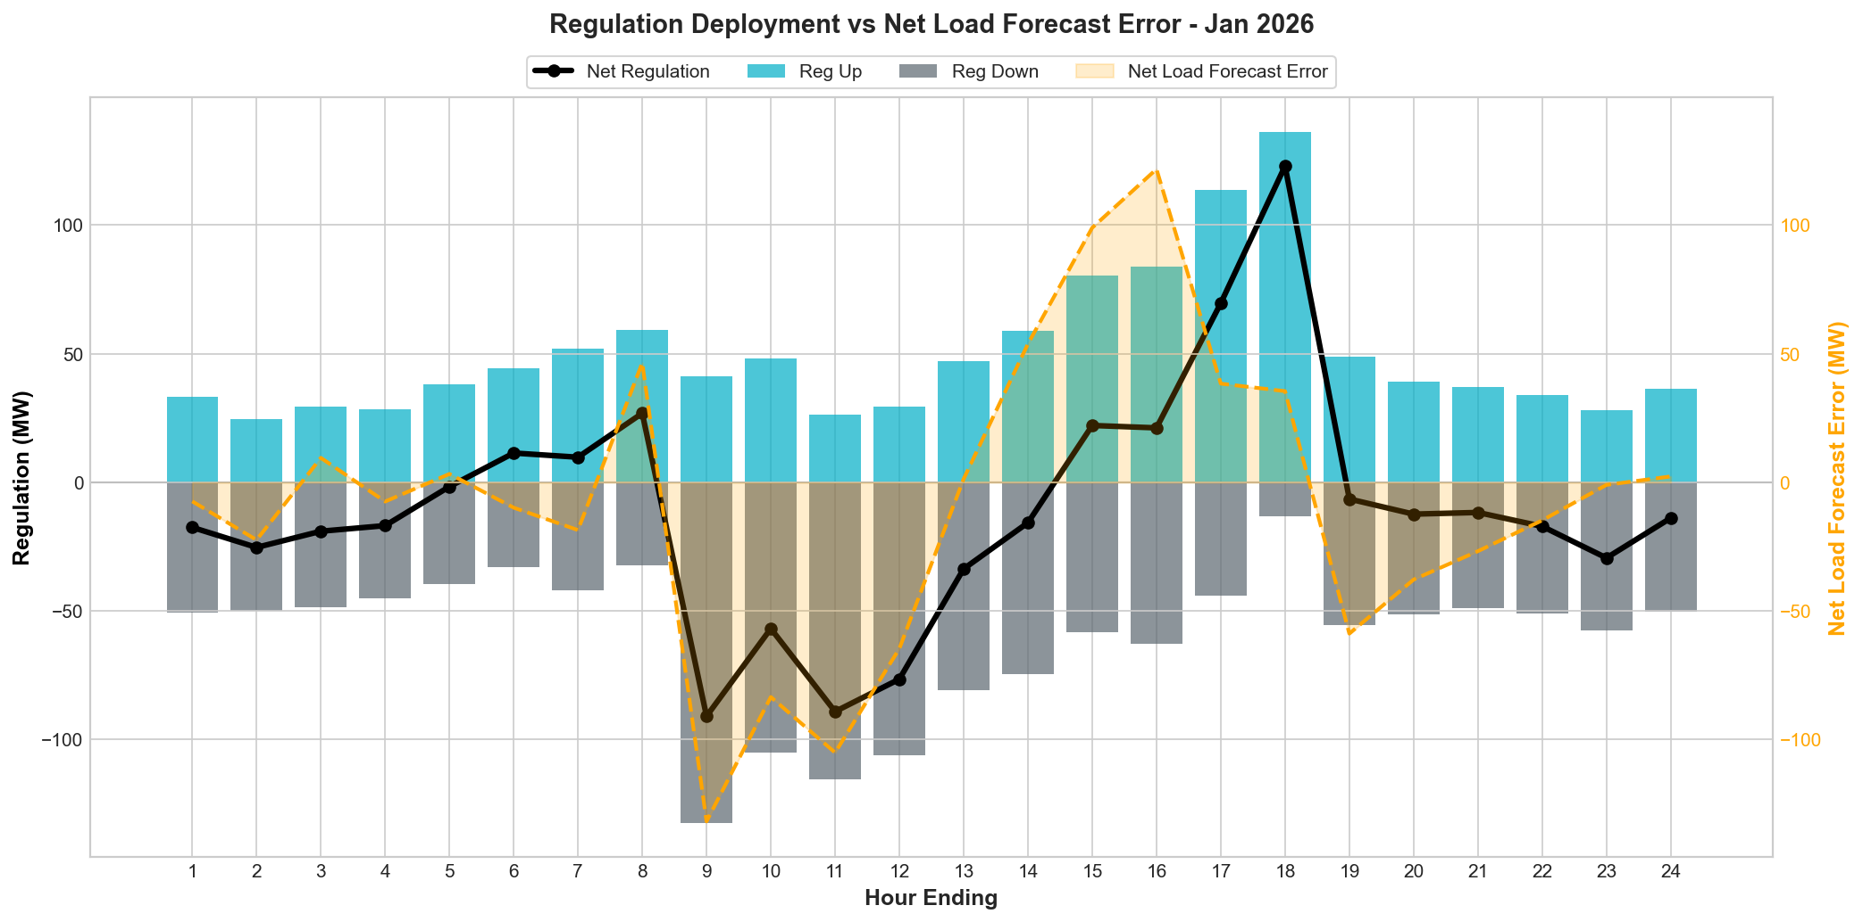
Total Regulation Deployed Comparison
Notes:
Regulation deployed for January: netload forecast error and regulation deployment trends track very closely.

Slide 9
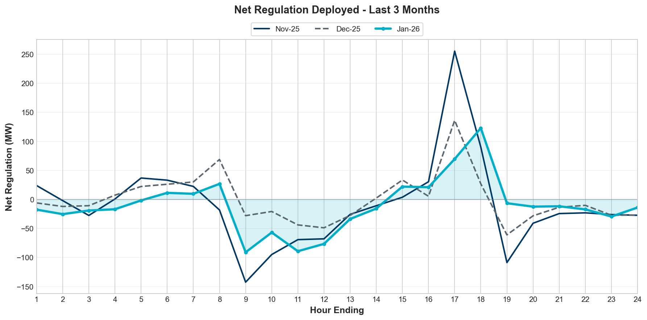
Regulation Deployed Comparison - Monthly
Notes:
Total regulation deployed compared with the previous two years.

Slide 10
REG Bias for Consecutive 5-min Intervals

Slide 11
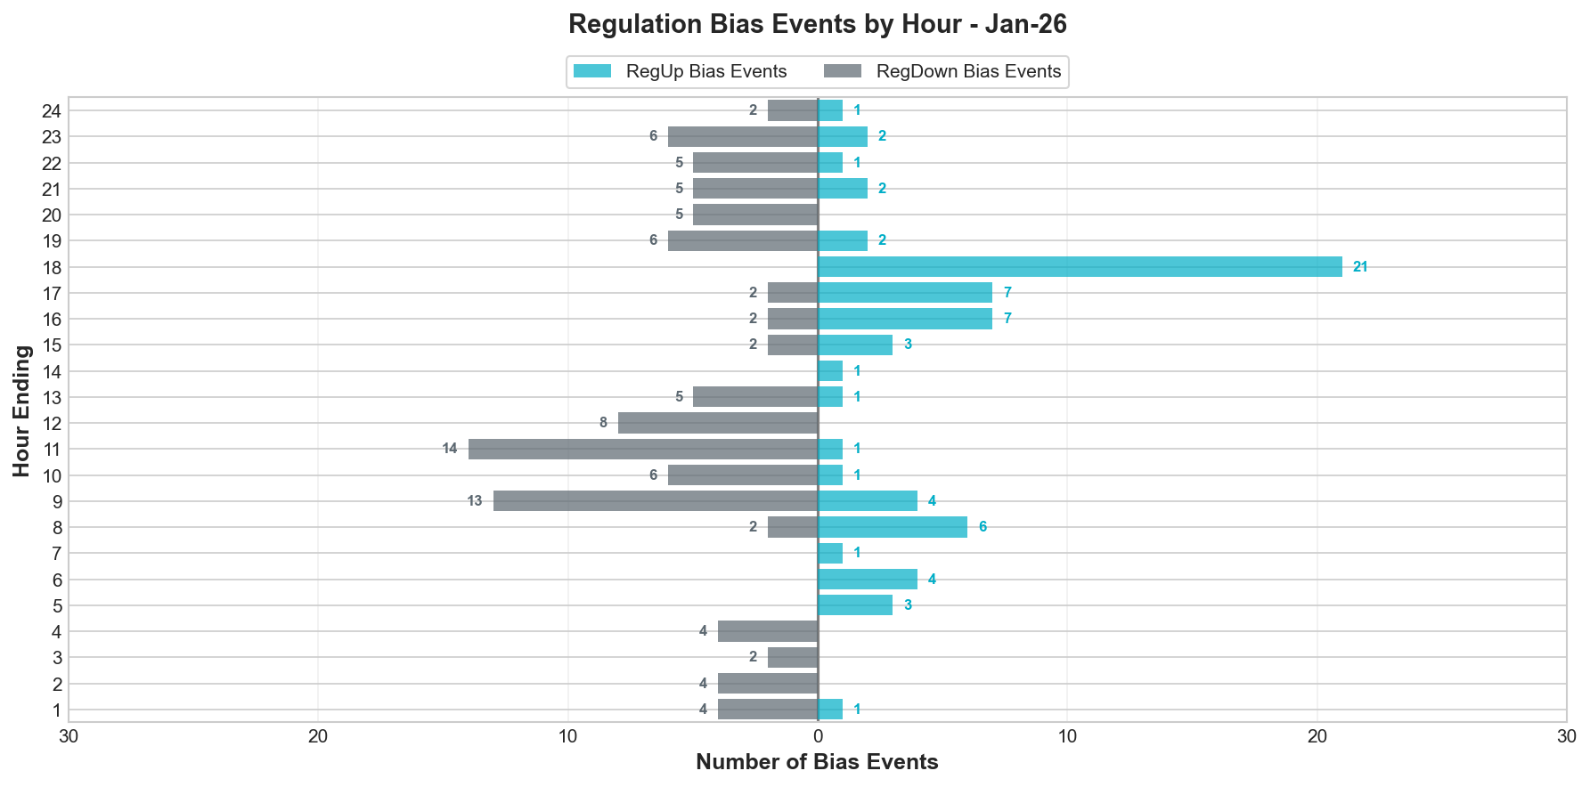

Regulation Bias for Consecutive SCED Intervals
Notes:
Regulation up bias occurrence for consecutive SCED intervals for all hours is 136 and peak hours is 48.

Slide 12
Time Error and Contributing Factors
Accumulated Time Error, Load, Wind Ramp, Solar Ramp, Start-Up/Shut-Down Hours, STLF Error and NSLL Ramping.

Slide 13
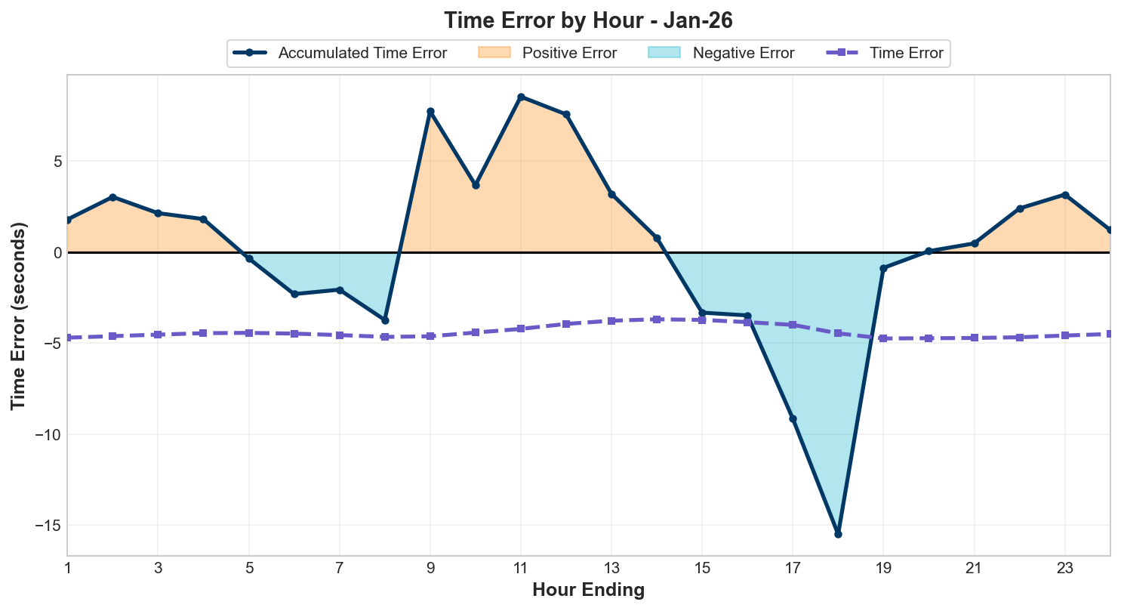
Time Error Accumulation

Slide 14
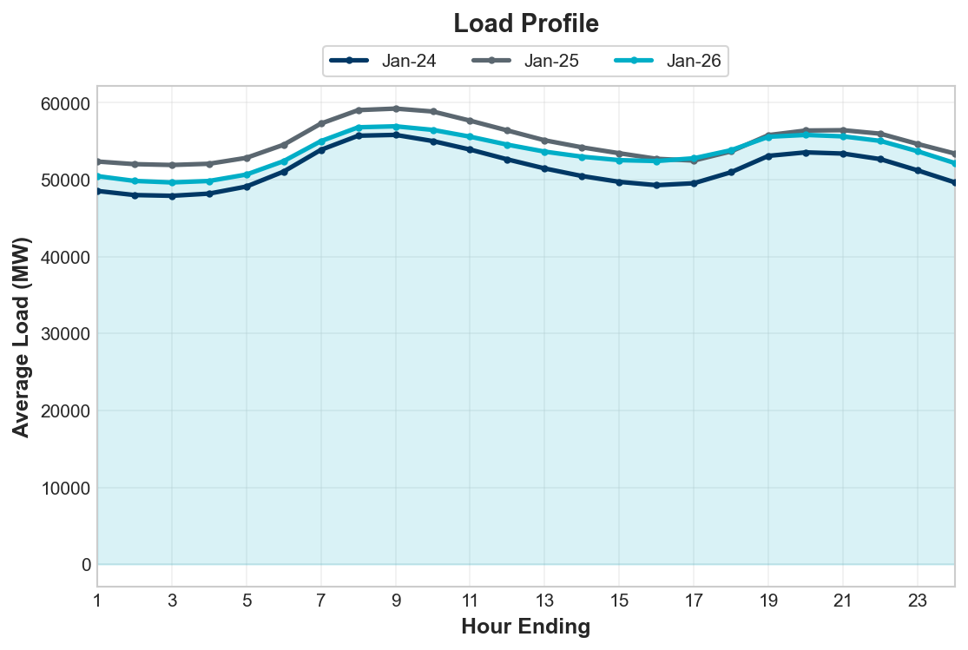
Load Profile
Notes:
Load is seeing an overall increase compared to the last two years.

Slide 15
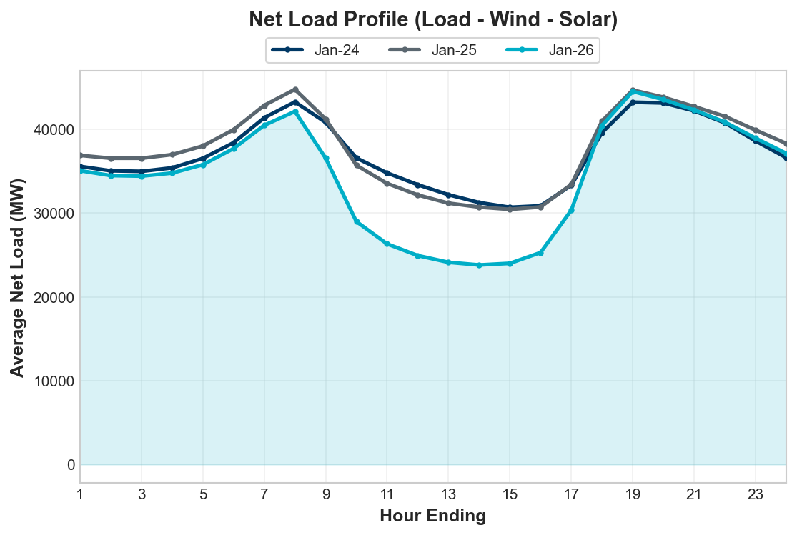
Net Load Profile
Notes:
The total load is more than the last year.
More Net Load during Up ramp hours.
Net Load: dashed line.

Slide 16
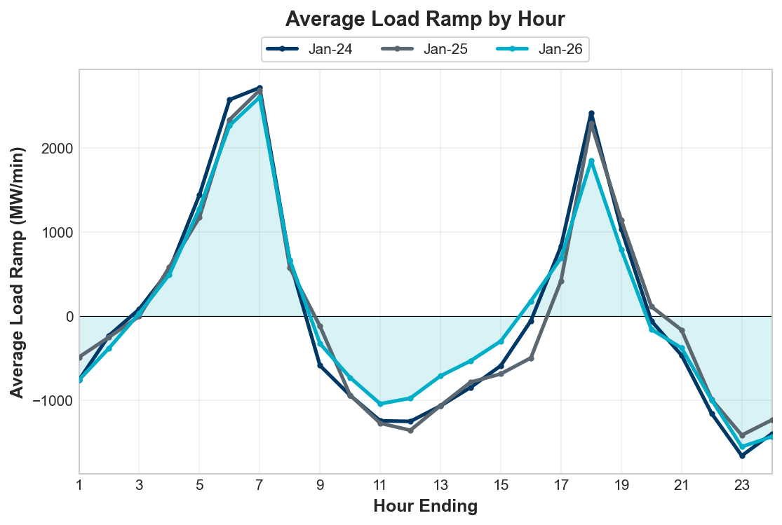
Load Ramp
Notes:
Overall hourly load ramp trend remained similar compared to the last couple of years.

Slide 17
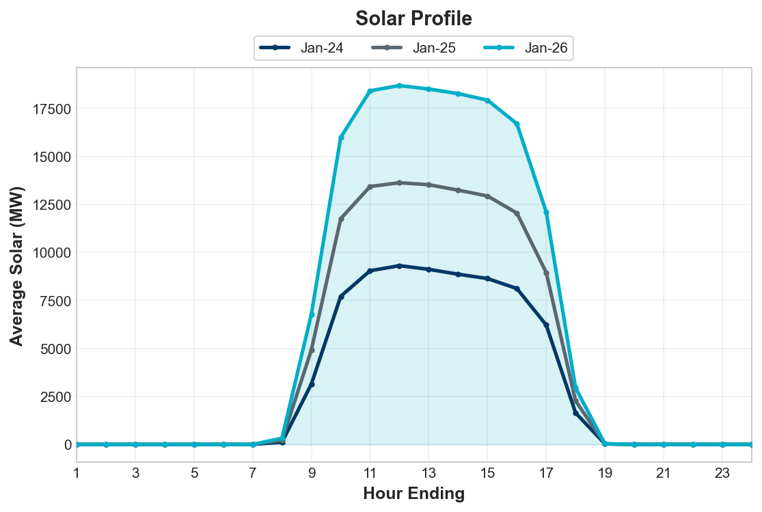
Solar Profile
Notes:
Wind generation is slightly lower than last year

Slide 18
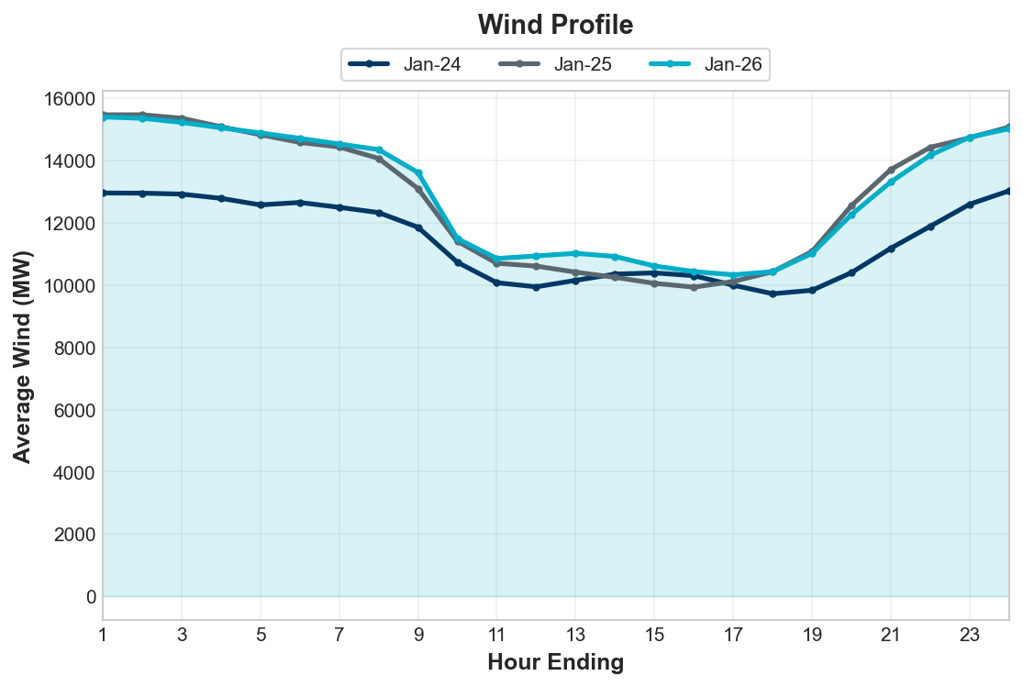
Wind Profile
Notes:
Wind generation is slightly lower than last year

Slide 19
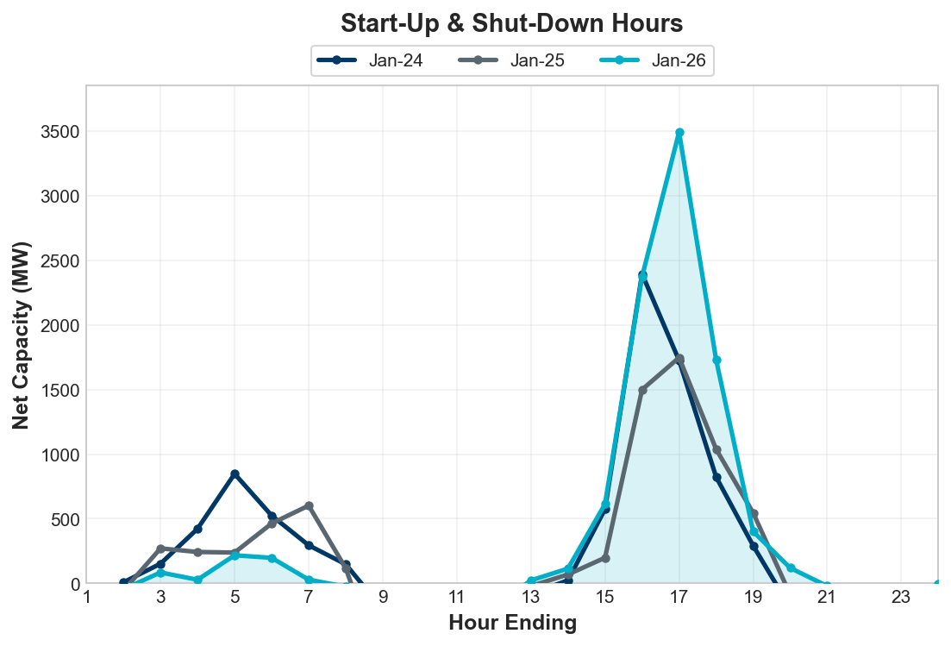
Start-Up & Shut-Down Hours
Notes:
Net Capacity on Start-Up/ShutDown are generally following the trends of the last two years. More capacity during sunset hours

Slide 20
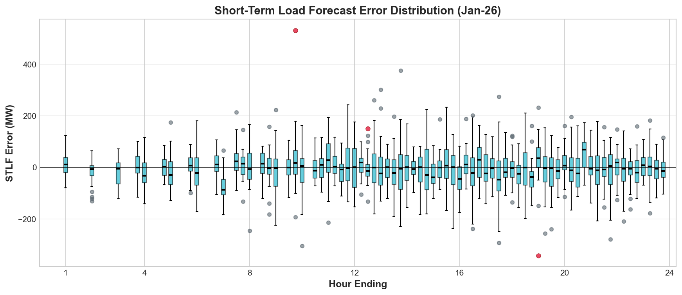
STLF Error Chart
Notes:
Error = Forecast – Actual
Min, Max, 10th, 90th percentile
15-minute intervals
Max Positive Forecast Error:
10/2025 HE10 -> 495 MW
Max Negative Forecast Error:
10/2025 HE9 -> -625 MW

Slide 21
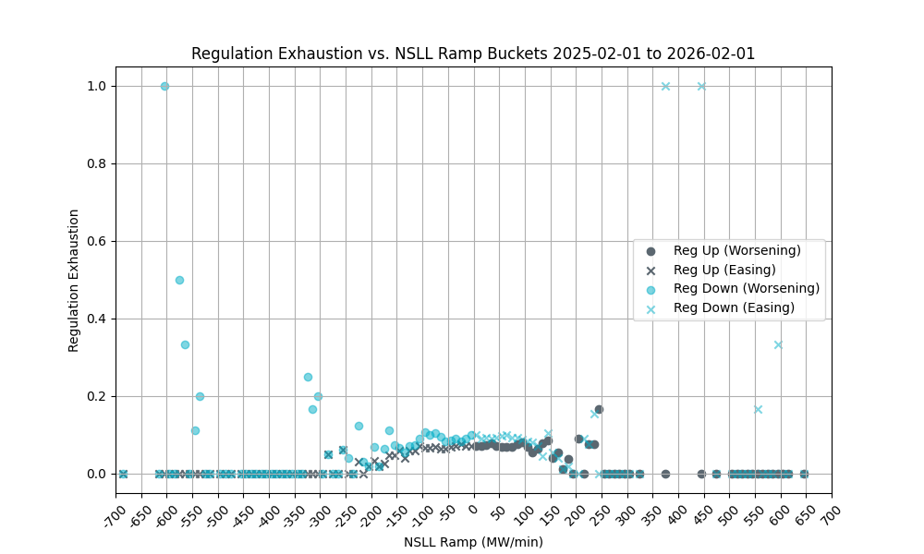
Non-SCED Qualified Large Load (NSLL) Ramping
Notes:
1-min NSLL ramp values were examined in bins of 10 MWs (as tracked on x-axis) and the average rate of intervals during which regulation was exhausted (i.e. remaining regulation was less than 5 MW) was computed (as tracked on y-axis).
NSLL includes Large Loads and Steel Mills that are not following SCED dispatch.
Trend is the same: we see low correlation between regulation exhaustion and NSLL ramp

Slide 22
Questions?
Thank you!

Slide 23
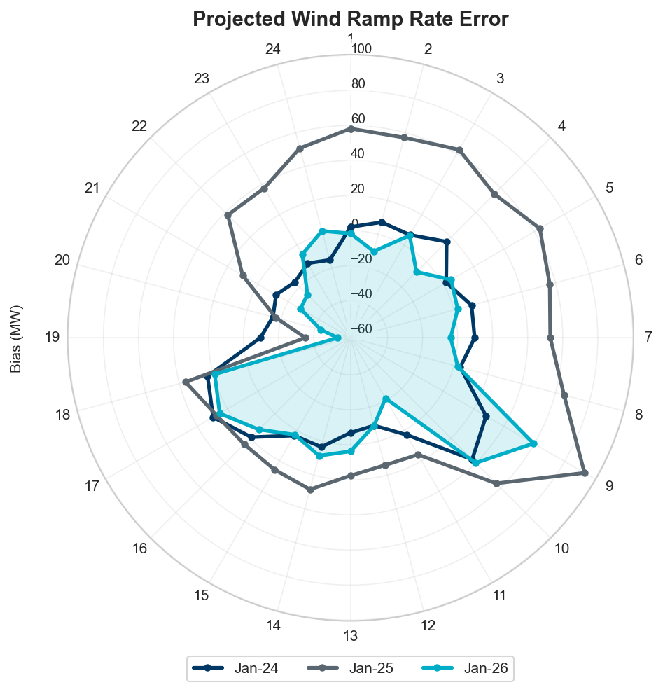
Projected Wind Ramp Rate Error
Notes:
Don’t Show: Still work in progress

Slide 24
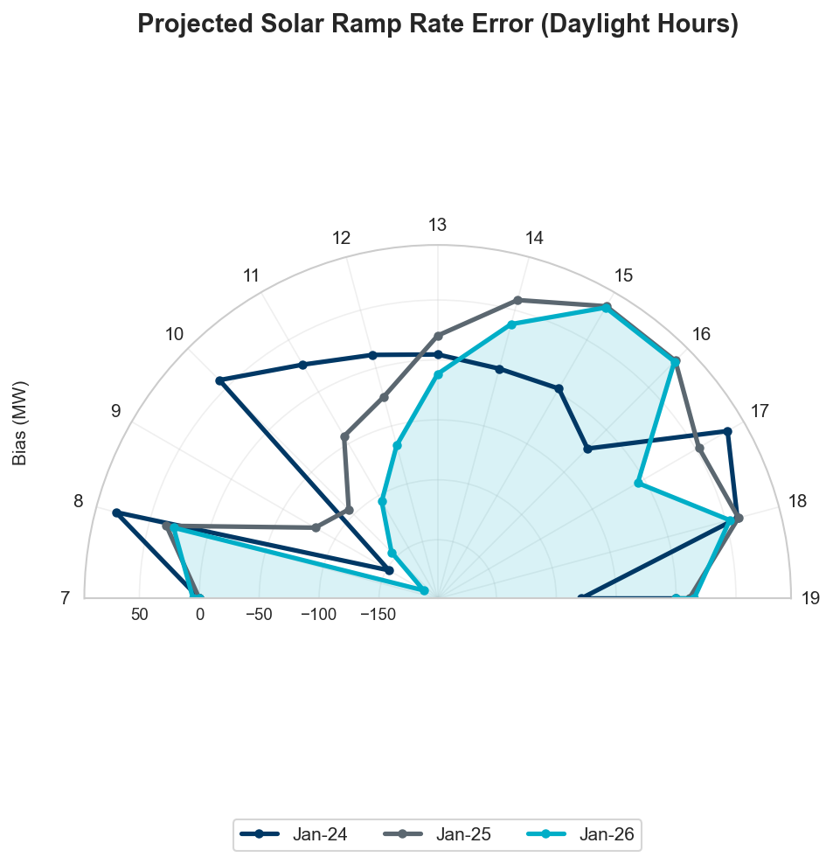
Projected Solar Ramp Rate Error
Notes:
Don’t Show: Still work in progress

Slide 25
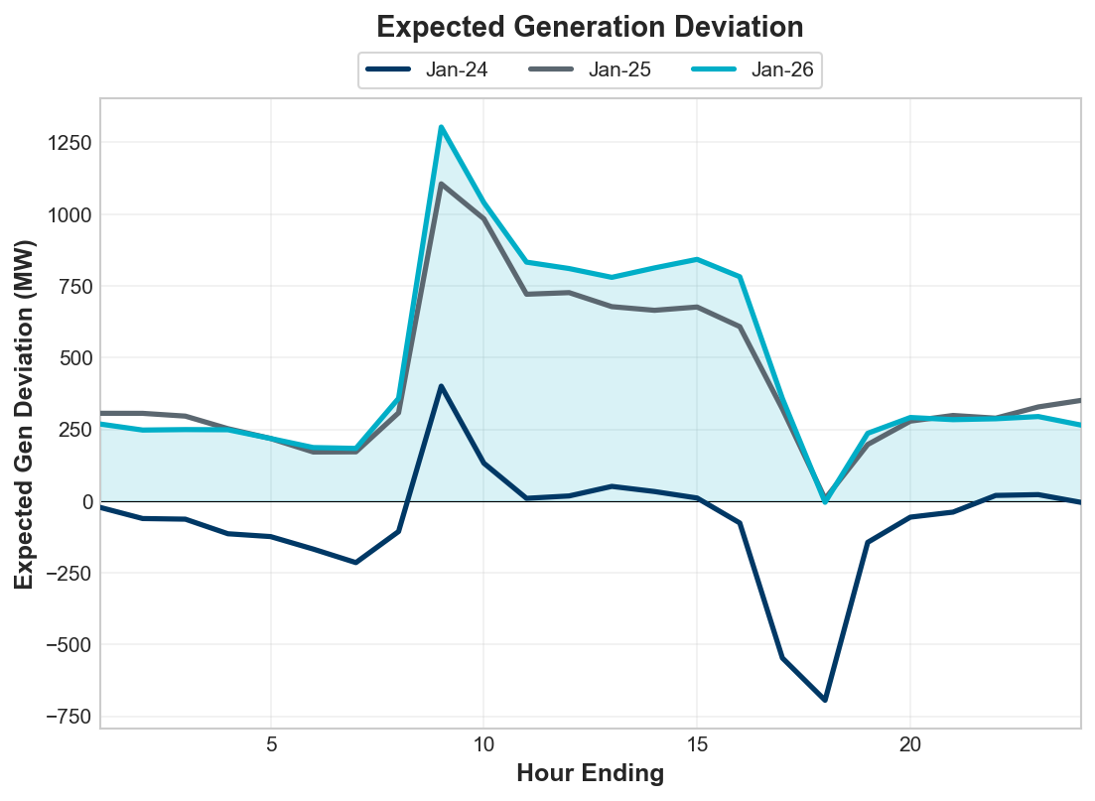
Expected Generation Deviation
Notes:
Largest expected generation deviation occurs during solar ramps. We see a positive average expected generation deviation in October.

