Slide 1
ERCOT Frequency Control Report
January 2026
ERCOT
Operations Planning
PDCWG | February 18th , 2026

Slide 2
Summary of January 2026
CPS1: 186.81%
Current CPS1 12-Month Rolling Average: 177.89%
0 BAAL Exceedance(s)
1 hourly CPS1 score below 100%
BAAL-003 Events have updated through 2024
2024 BAAL-003 FRM Performance: -1127.76
2026 RMS1 Statistics
Mean: 10.85 mHz
Min: 09.47 mHz
Max 14.75 mHz
Energy Statistics
Total Energy: 40,875,342 MWh
Wind Energy: 9,558,873 MWh
Percent Energy from Wind: 23.39%
Solar Energy: 3,315,884 MWh
Percent Energy from Solar: 8.11%
Minimum System Inertia
Mean: 245,600 MW*s
Max: 342,313 MW*s on January 21st
Min: 164,095 MW*s on January 30th

Slide 3
Frequency Control
CPS1, BAAL, & RMS1

Slide 4
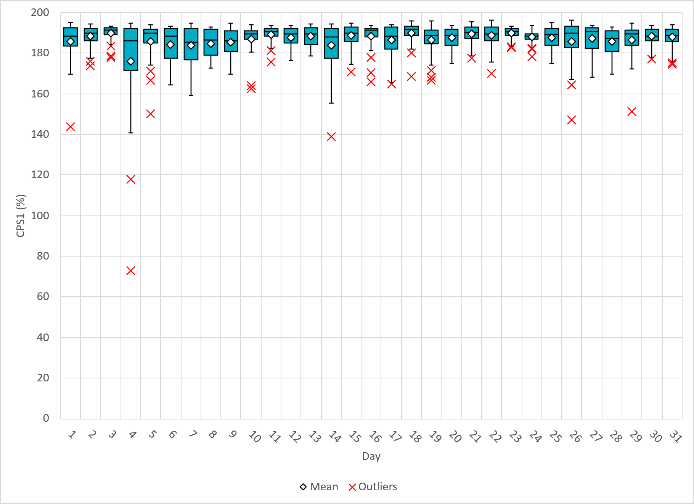
Hourly CPS1 by Day
Jan-26 CPS1 (%): 186.81
Notes:
CPS1 Score is 186.81%
Scores Below 100%: One instance below 100% occurred on Jan 4th 9AM --This score was 72.9% Mention this: The low score seen on the 4th has been analyzed and revealed telemetry issues from IRR units during curtailment, outreach is currently being done on these. (Luis will probably jump in and give some background here)

Slide 5
BAAL Exceedances & Violations
There were 0 BAAL exceedance(s) in January.

Slide 6
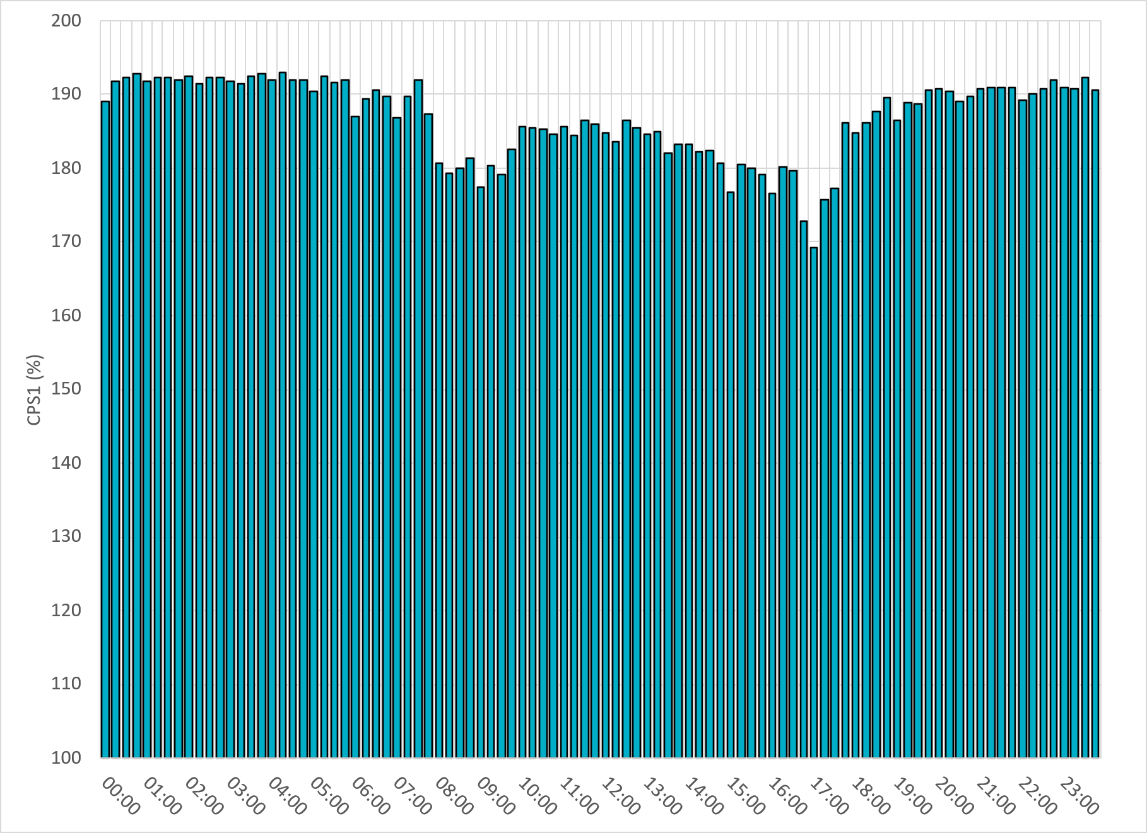
15-Minute Average CPS1%
Jan-26 CPS1 (%): 186.81
Notes:
CPS1 score is above 160% for all 15-minute intervals.

Slide 7
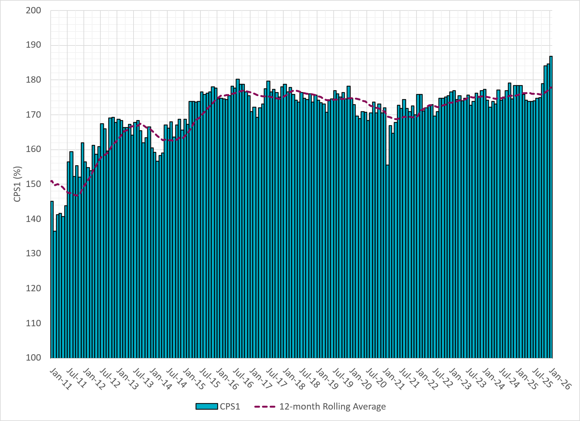
12-Month Rolling Average CPS1
Current 12-Month Rolling Average 177.89%
Notes:
12 month rolling average CPS1 score is 177.89 which is continuing the increasing trend of CPS1 scores.

Slide 8
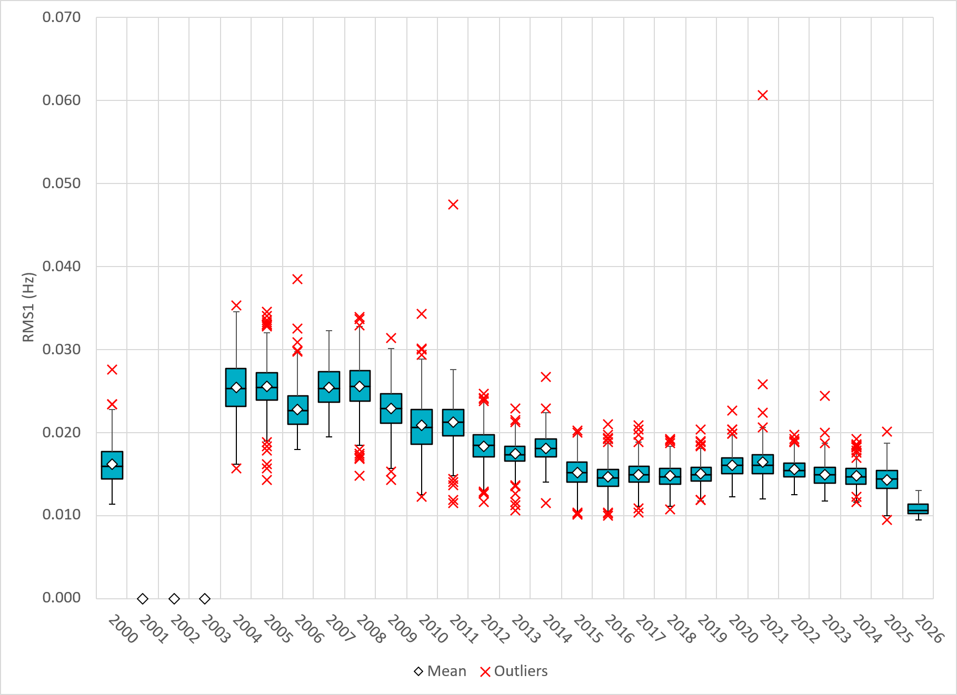
Daily RMS1 of ERCOT Frequency by Year
Notes:
Daily RMS1 frequency by year is similar compared to 2026.
2026 RMS1 Statistics
Mean: 10.85 mHz
Min: 09.47 mHz
Max 14.75 mHz

Slide 9
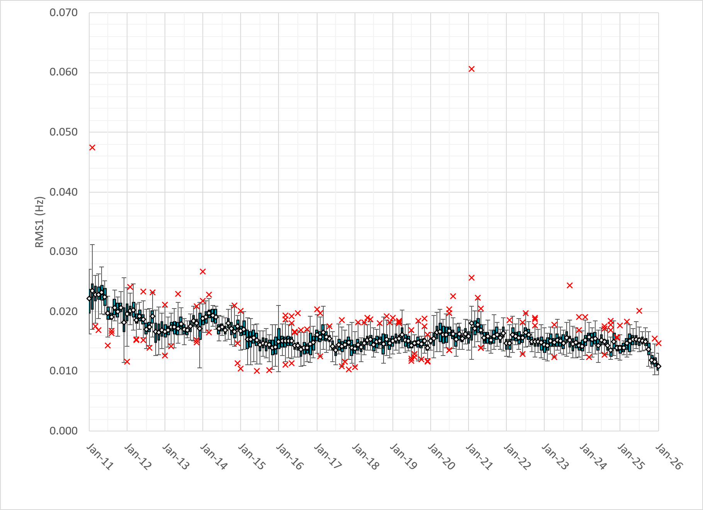
Daily RMS1 of ERCOT Frequency by Month
Notes:
A More granular look at last 15 years of RMS1 by month
10.85 mHz on avg for January 2025

Slide 10
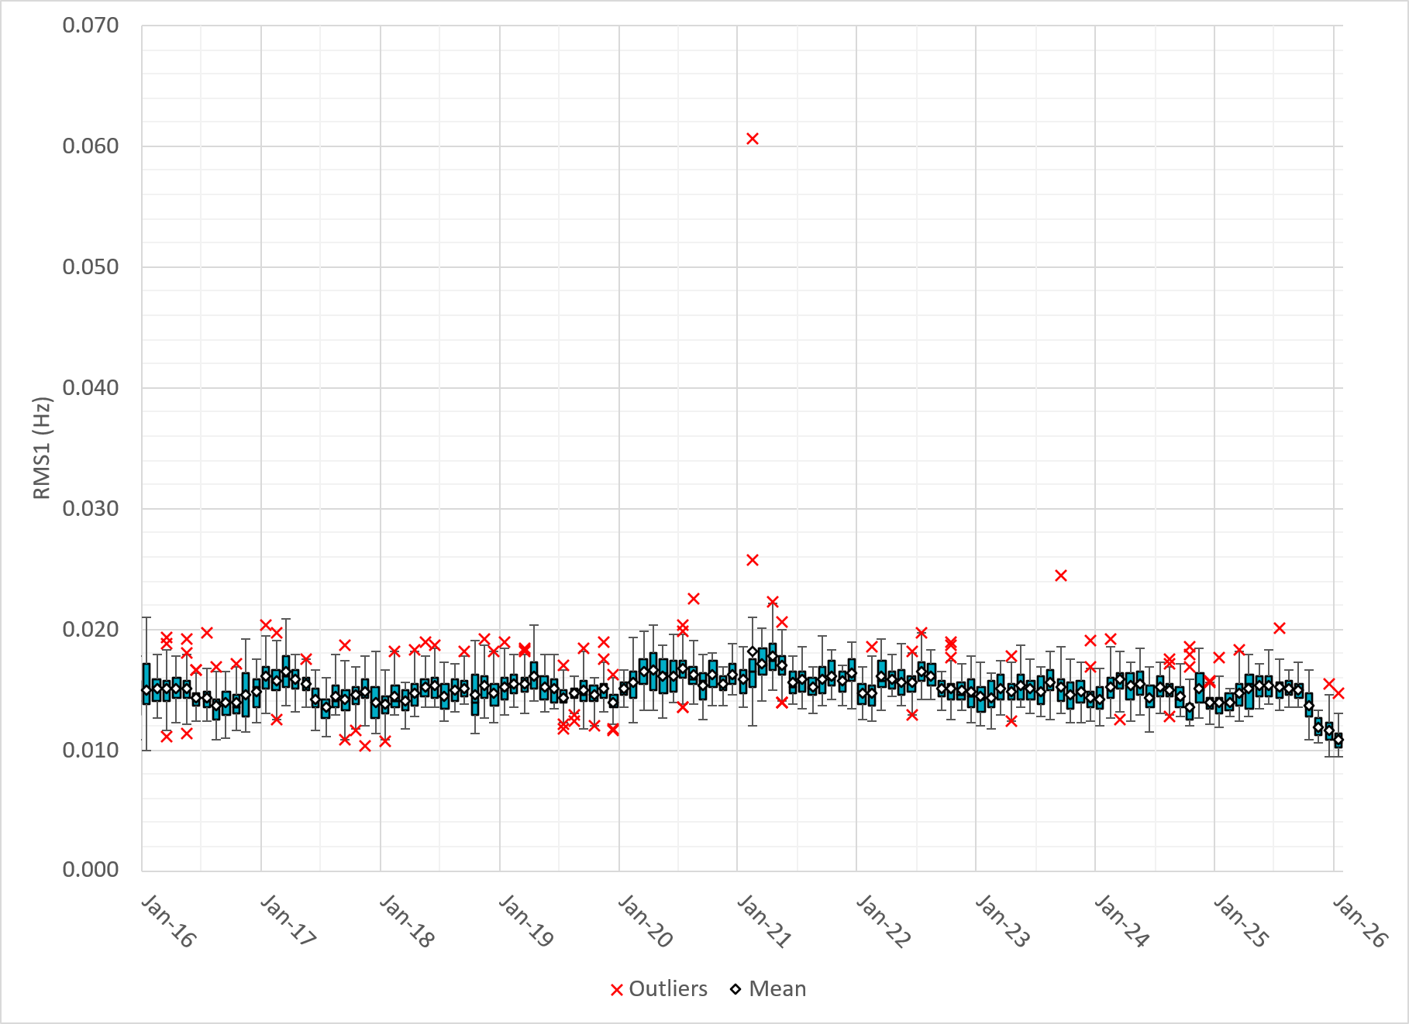
Daily RMS1 of ERCOT Frequency by Month
Notes:
Same data with 10 years shown instead of 15

Slide 11
Frequency Profile Comparison

Slide 12
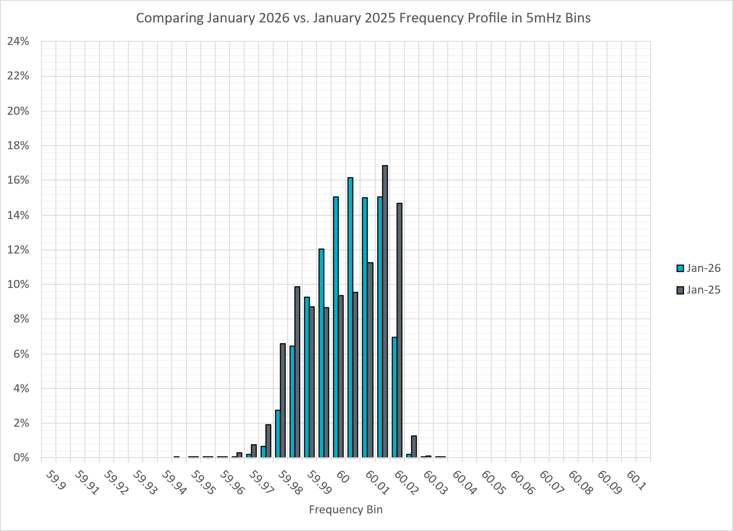
Frequency Profile Comparison
Notes:
Comparison of frequency profile between January 2025 and January 2026. Compared to last year, there are slightly less instances of frequency hovering around the dead bands.

Slide 13

Frequency Profile Comparison
Notes:
Comparison of frequency profile between January 2024 and January 2026. Similar to the previous slide, there are less instances of frequency hovering around the dead bands.

Slide 14
Time Error Correction

Slide 15
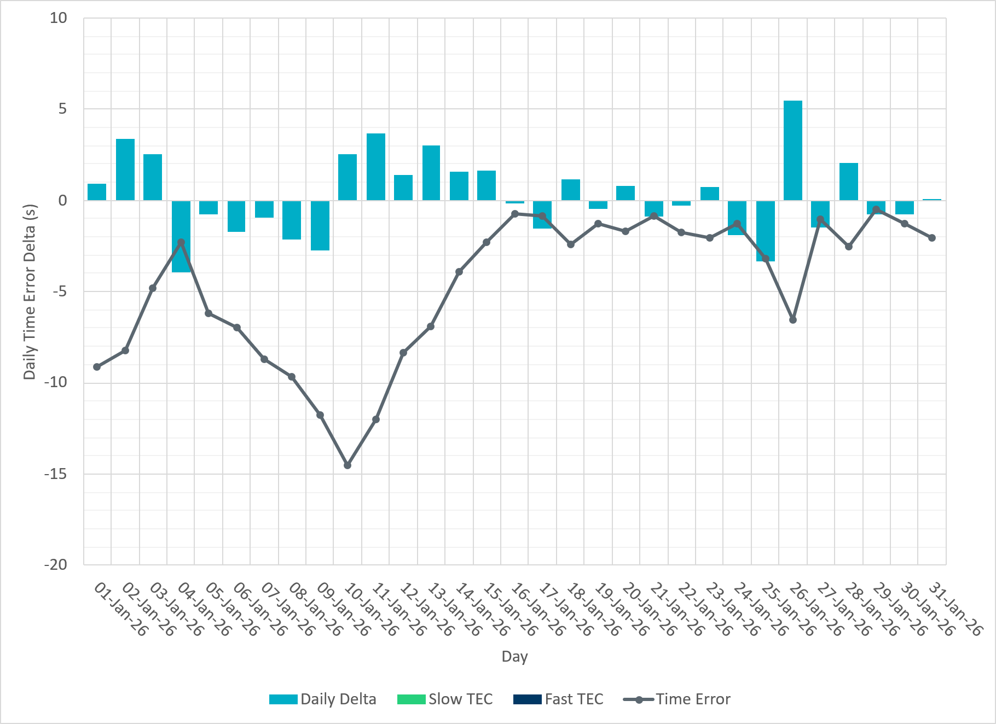
ERCOT Daily Time Error
Notes:
We see low time error accumulation throughout the month of January.

Slide 16
Time Error Corrections Log Summary
There have been no time error corrections since December 2016

Slide 17
BAL-003 Performance

Slide 18
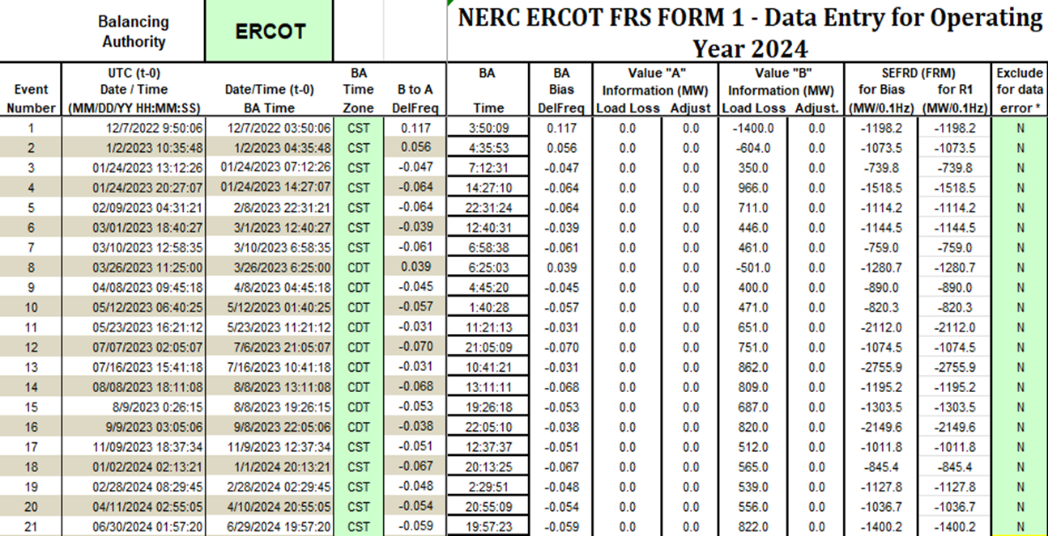
Op. Year 2024 BAL-003 Selected Events – Update
Notes:
BAL-003

Slide 19
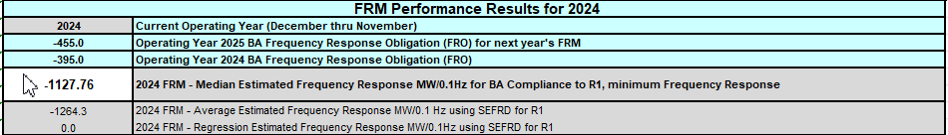
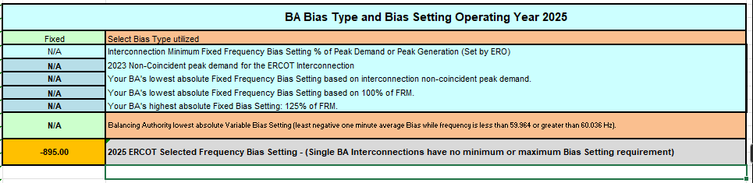
Op. Year 2024 BAL-003 FRM Performance - Update
Notes:
OP2018: FRO = -381.0, FRM_median = -843.17, FRM_average = -959.7
OP2019: FRO = -381.0, FRM_median = -811.14, FRM_average = -892.5
OP2020: FRO = -425.0, FRM median = -789.34, FRM average = -879.0
OP2021: FRO = -471.0, FRM median = -913.56, FRM average = -992.
OP2022: FRO = -412.0, FRM median = -1060.40, FRM average = -1153.4
OP2023: FRO = -463.0, FRM median = -1130.21, FRM average = -1302.7
OP2024: FRO = -395.0, FRM median = -1127.76, FRM average = -1264.3
OP2025: FRO = -455.0,

Slide 20
ERCOT Energy Statistics

Slide 21
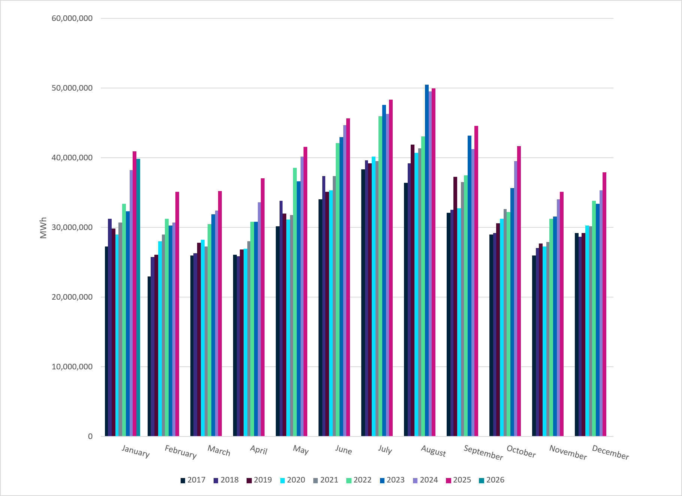
Total Energy
Notes:
39,818,889 MWh

Slide 22
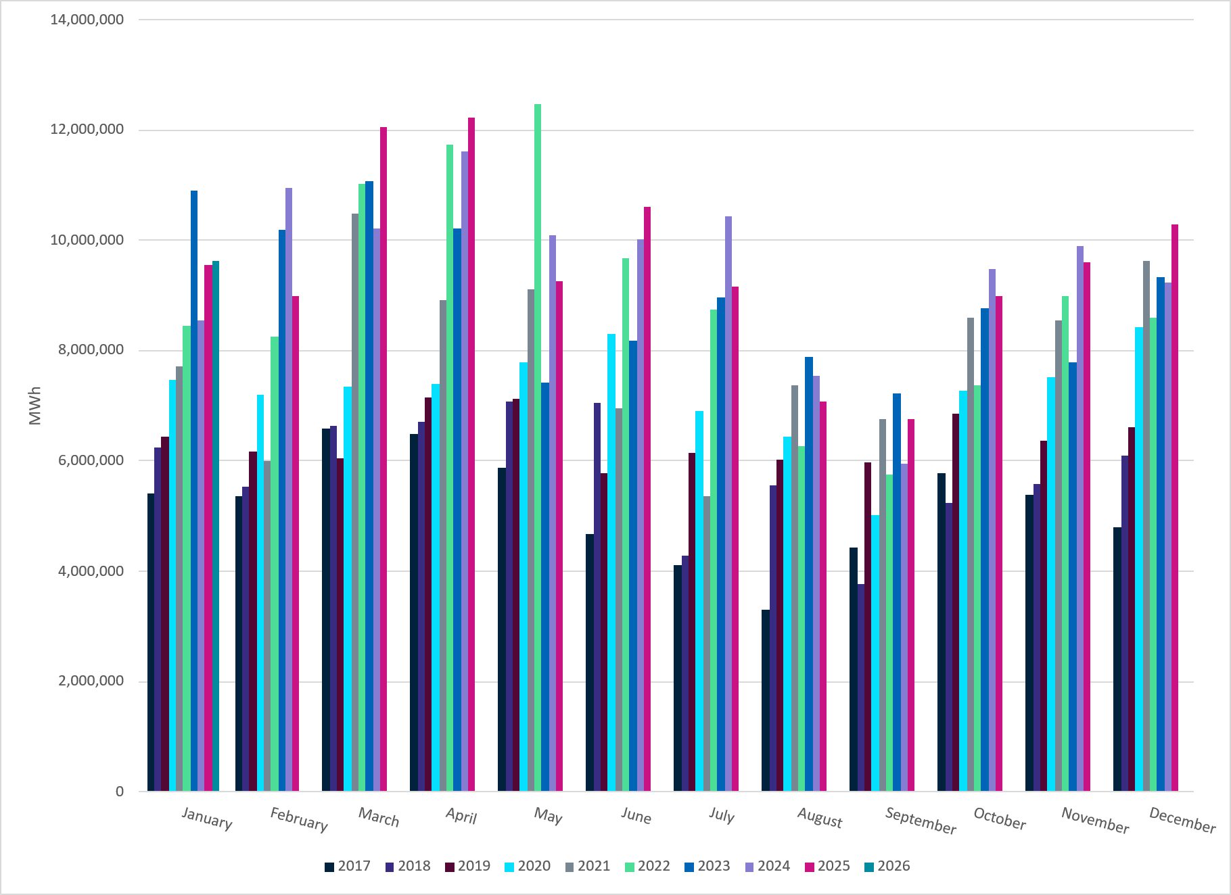
Total Energy from Wind Generation
Notes:
9,632,919 MWH

Slide 23
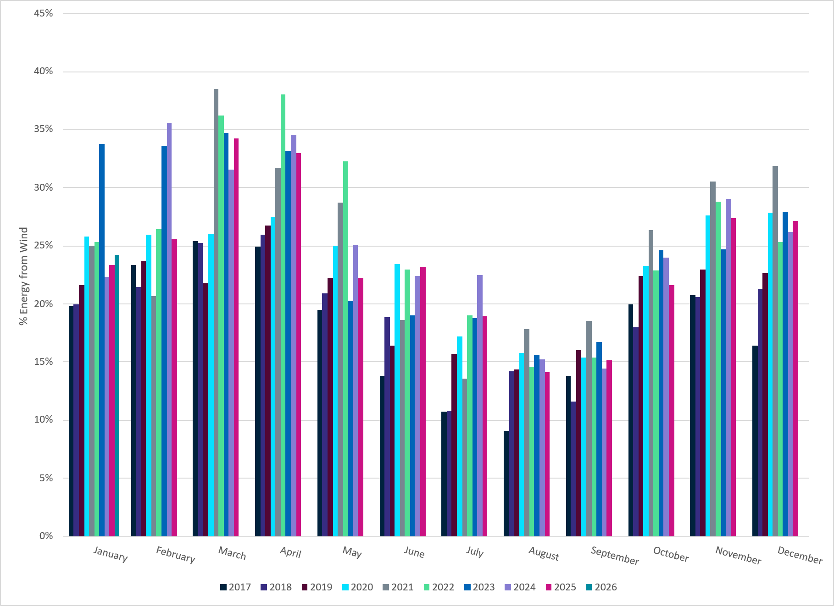
% Energy from Wind Generation
Notes:
24.19% of total energy was provided by wind generation

Slide 24
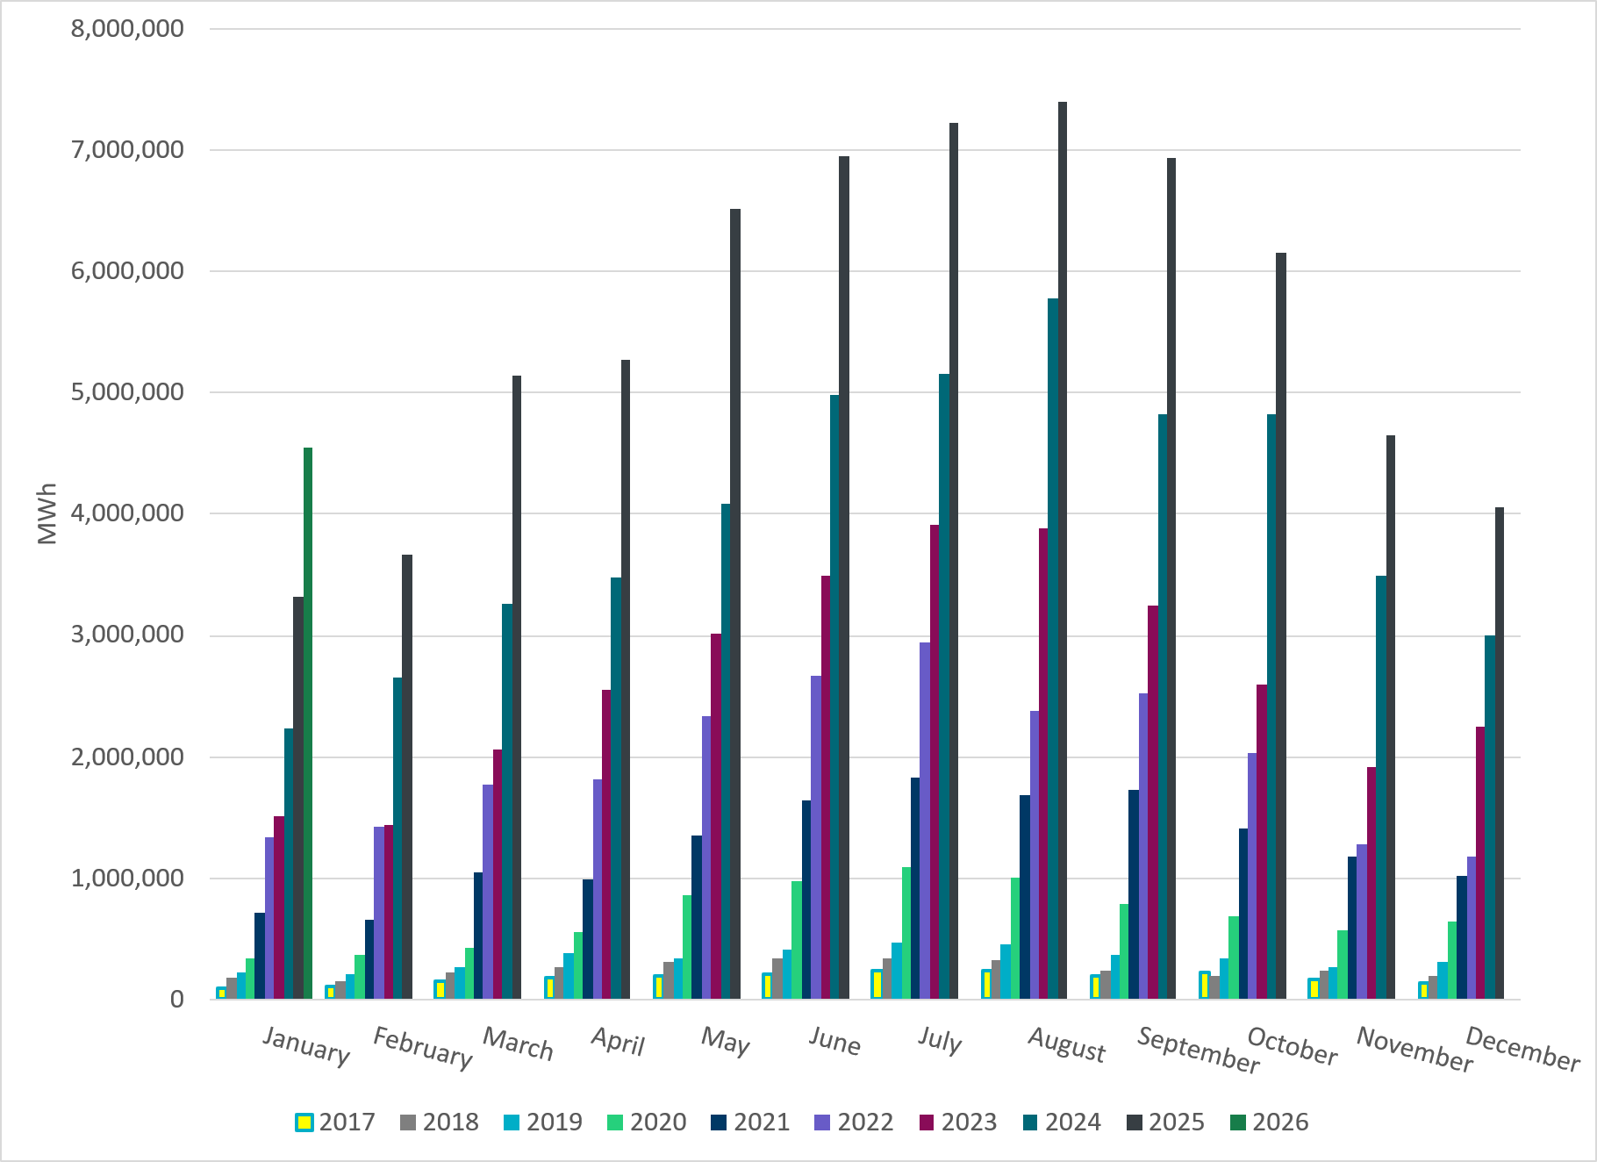
Total Energy From Solar Generation
Notes:
4,548,988 MWh

Slide 25
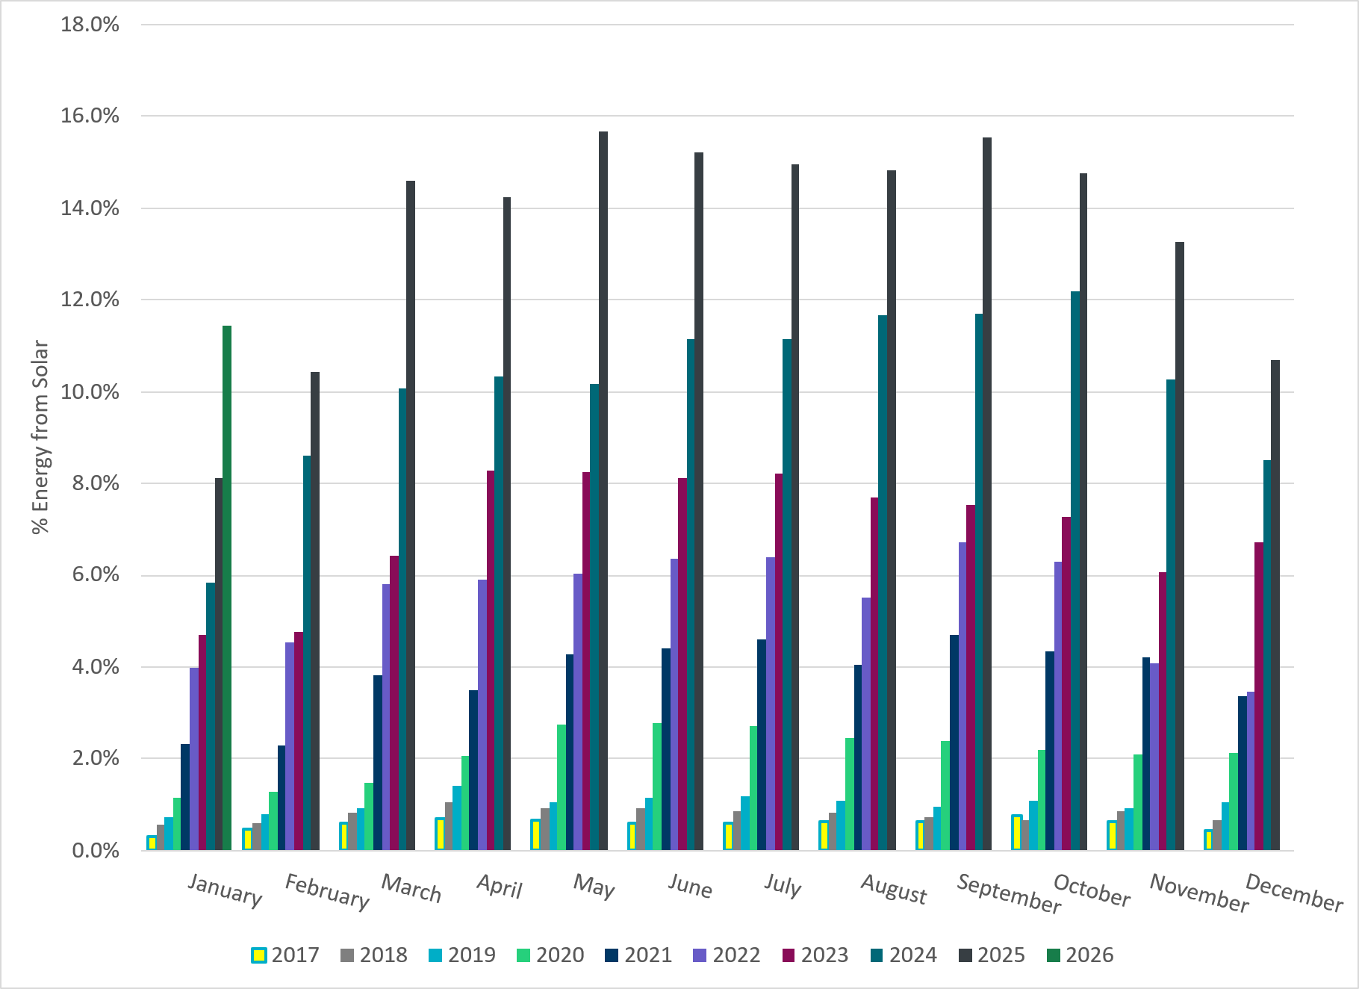
% Energy from Solar Generation
Notes:
11.42% of total energy was provided by solar generation

Slide 26
ERCOT System Inertia

Slide 27
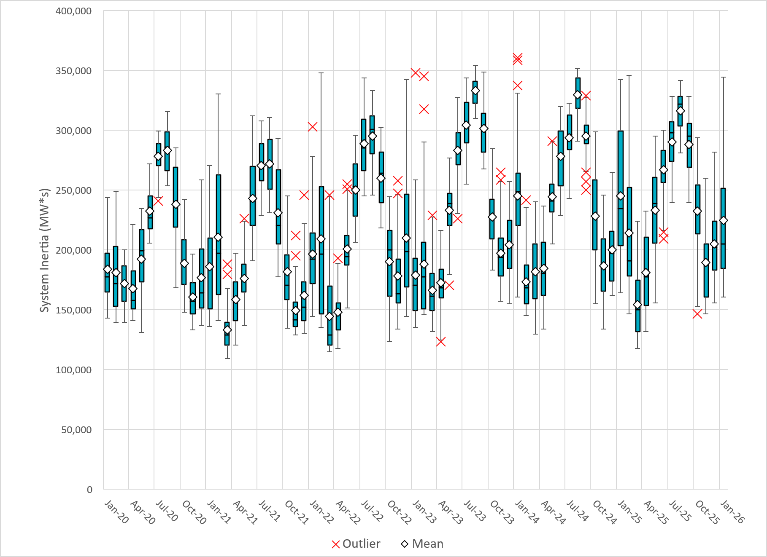
Daily Minimum System Inertia
Notes:
Minimum Inertia in January 2025 = 164,095 MW*s on January 30th
Historical Overall Minimum was 109,029 MW*s on 3/22/2021
January Data:
Mean: 245,600 MW*s
Max: 342,313 MW*s on January 21st
Min: 164,095 MW*s on January 30th

Slide 28
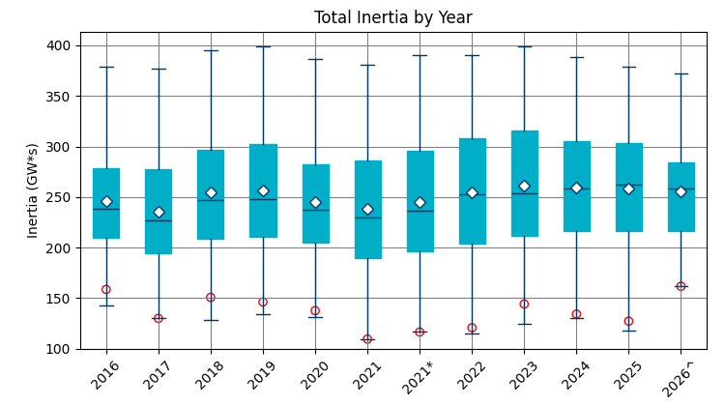
ERCOT Inertia 2016-2026
Date and Time | 2016 4/10 2:00 AM | 2017 10/27 4:00 AM | 2018 11/03 3:30 AM | 2019 3/27 1:00 AM | 2020 05/01 2:00 AM | 2021 03/22 00:00 AM | 2022 03/21 01:00 AM | 2023 04/18 02:00 AM | 2024 03/29 03:00 AM | 2024 03/29 03:00 AM | 2025 01/30 2:00 AM | 2026 01/16 11:00 AM
Min synch. Inertia (GW*s) | 143 | 130 | 128.8 | 134.5 | 131.1 | 109 | 115 | 124 | 130 | 130 | 164.1 | 164.6
System load at minimum synch. Inertia (MW) | 27,831 | 28,425 | 28,397 | 29,883 | 30,679 | 32,599 | 33,365 | 35,799 | 37,297 | 37,297 | 49,389 | 52,559
Non-synch. Gen. in % of System Load | 47 | 54 | 53 | 50 | 57 | 65 | 66 | 61 | 68 | 68 | 64 | 74
Notes:
Summary of ERCOT intertia for the previous 10 years. Lowest inertia this year was on January 16th.
For each box, the central mark (red line) is the median, the edges of the box (in blue) are the 25th and 75th percentiles, the whiskers correspond to +/- 2.7 sigma (i.e., represent 99.3% coverage, assuming the data are normally distributed. The corresponding lowest inertia in each year is given in the table.
The circle on each boxplot is showing inertia during time when highest portion of load was served by wind/solar generation in that year.

Slide 29
Questions?
Thank you!

