Slide 1
CRR Updates at CMWG
Samantha Findley
February 16, 2026

Slide 2
Agenda
LTAS transactions and solution times
CRR auction limits table –
Updates on CRR-related NPRRs and proposals

Slide 3
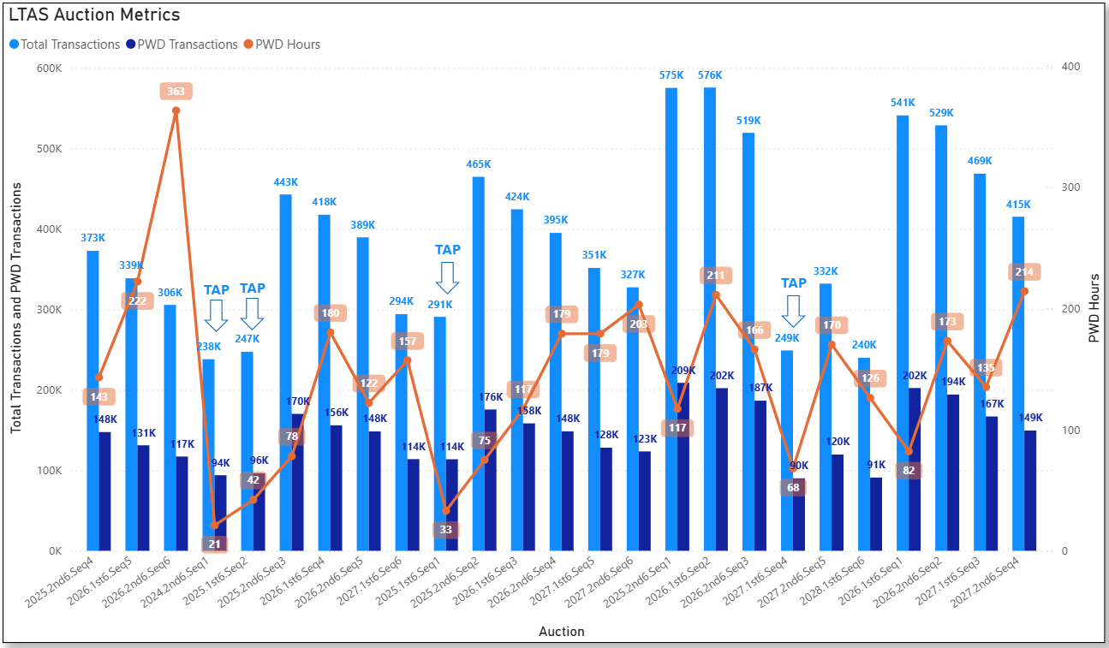
Historical LTAS transactions and solution times

Slide 4
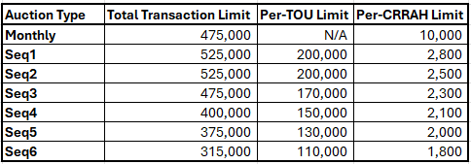
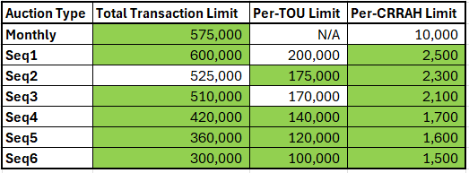
Update to CRR auction transaction limits
Previous limits:
Updated limits:

Slide 5
Updates on CRR NPRRs and proposals
A project for NPRRs 1288 and 936 has been initiated, targeting Q4 2026 implementation. With implementation, the bid limit will change to the Counter-Party level rather than the CRRAH level.
NPRR 1292: Vendor confirmed that it can be implemented such that Peak Weekday and Peak Weekend products can be preserved.
ERCOT will sponsor an NPRR to restructure the LTAS auctions as 6-monthly optimizations instead of the current 3-TOU structure. This would need to be implemented alongside NPRR 1292. Will bring NPRR draft to March CMWG.
ERCOT will not be submitting an NPRR for removing the budget constraint from the optimization at this time. We will re-evaluate after the changes above have been implemented.

