Slide 1
DAM PTP and PTPLO Submission Activity Update and NPRR Introduction
February 16, 2026
ERCOT Staff

Slide 2
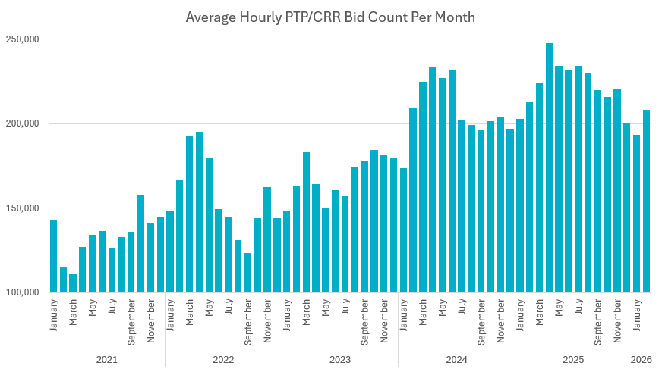
Historical PTP Counts - Update

Slide 3
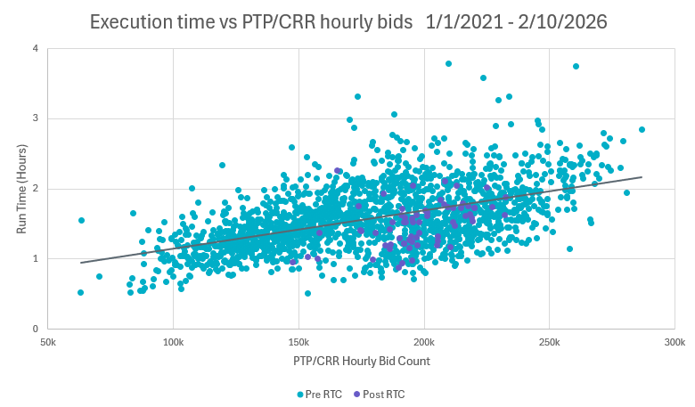
Historical PTP Counts - Update

Slide 4
Background
PTP and PTPLO interval records (hourly bids) have been identified as a particularly strenuous product for the DAM optimization engine to solve for. This is especially true for unawarded bids.
Further process and hardware improvements offer diminishing returns, as the underlying issue remains unresolved.
Without additional measures to manage PTP submission volume, we may be forced to lower the number of PTP interval submissions allowed per counterparty (currently set to 10,000). This is a hard cutoff and doesn’t necessarily assign appropriate value to PTP submissions.

Slide 5
NPRR Introduction
Therefore, we’re proposing NPRR language to implement an hourly-based fee for unawarded PTP bids (not PTPLO bids).
The fee rate will initially be $0.00 per unawarded hourly bid.
This establishes the mechanism for future fee implementation.
A non-zero fee should enable relaxation of the 10,000 hourly bid cutoff.

Slide 6
NPRR Formula and Example
Amount charged to QSE will be included in DAM congestion rent.
Charge to QSE = PTP Fee rate * PTP unawarded bid amount (count)
Example for QSE A (with example $0.50 fee rate)
In HE 1 QSE A has 100 unawarded hourly PTP bids
In HE 2 QSE A has 400 unawarded hourly PTP bids
HE 3-24 QSE A has 0 unawarded PTP bids
500 unawarded PTP bids
* $0.50 fee rate = $250.00 total charge to QSE A for that day

Slide 7
Discussion
Formal language in NPRR
Any questions or concerns?
Notes:
Note: when AS insufficiency occurs in DAM, two notices are sent. One is automated and one is manual.

