Slide 1
Credit Exposure Update
Credit Finance Sub Group
ERCOT Public
February 12, 2026

Slide 2
Monthly Highlights: Dember 2025 – January 2026
Market-wide average Total Potential Exposure (TPE) increased from $1.59 billion in December to $2.27 billion in January
Forward adjustment factors on average increased during the month
    Discretionary Collateral is defined as Secured Collateral in excess of TPE,CRR Locked ACL and DAM Exposure
  Average Discretionary Collateral increased from $3.93 billion in December compared to $5.66 billion in January
156 Collateral Calls issued in the amount of $209 Millions in January

Slide 3
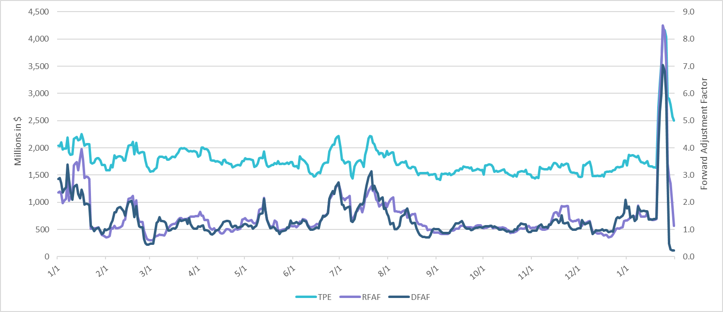
TPE and Forward Adjustment Factors: January 2025 – January 2026

Slide 4
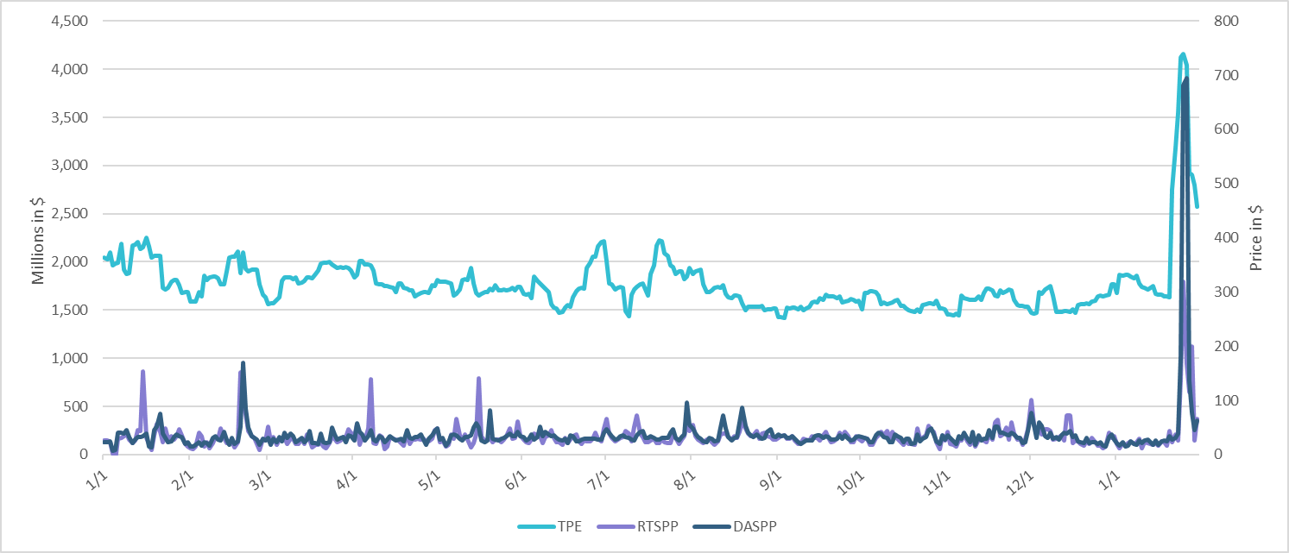
TPE/Real-Time & Day-Ahead Daily Average Settlement Point Prices for HB_NORT:H January 2025 – January 2026

Slide 5
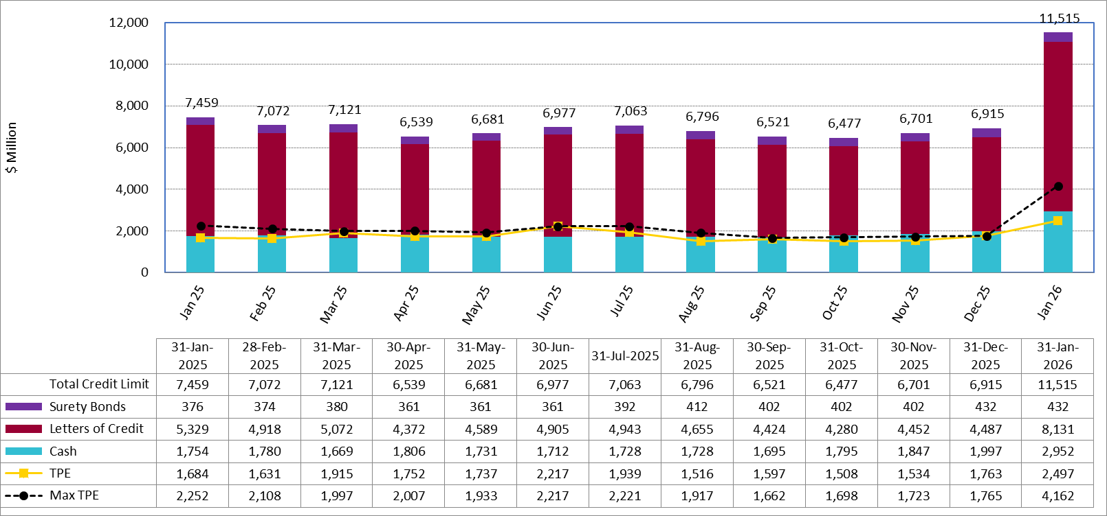
Available Credit by Type Compared to Total Potential Exposure (TPE):
January 2025 – January 2026
Numbers are as of month-end except for Max TPE
Max TPE is the highest TPE for the corresponding month

Slide 6
Issuer Credit Limits vs Total LC Amounts Per Issuer: January 2026
As of January 31, 2026
There are a total of 36 banks that have issued LCs.

Slide 7
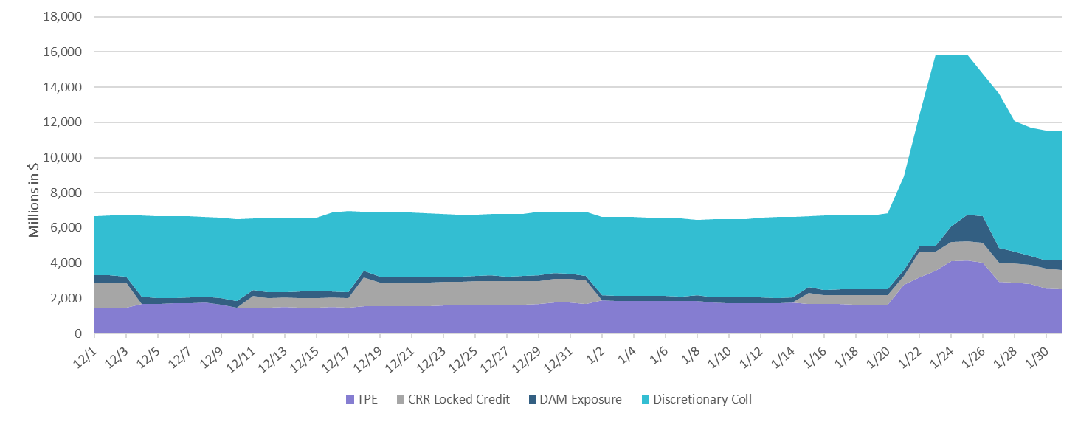
Discretionary Collateral December 2025 – January 2026

Slide 8
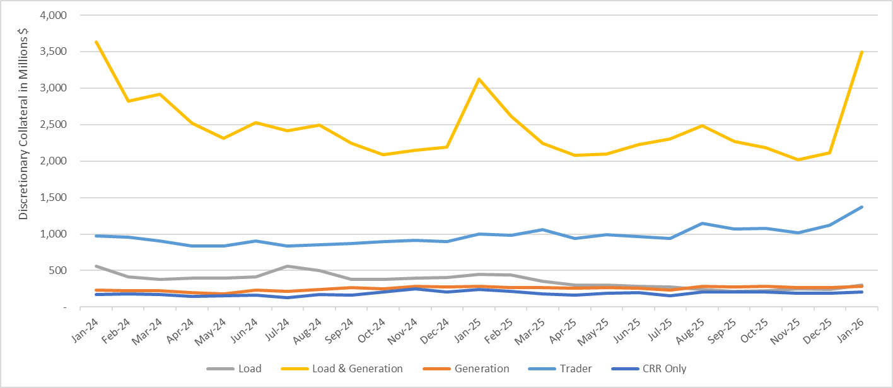
Discretionary Collateral by Market Segment January 2024 - January 2026

Slide 9
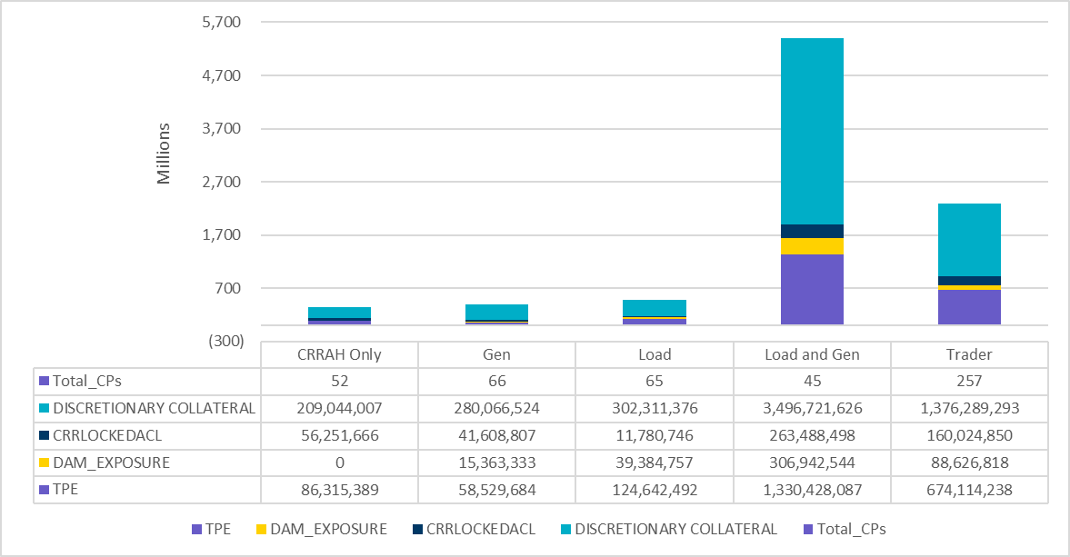
TPE and Discretionary Collateral by Market Segment - January 2026
Load and Generation entities accounted for the largest portion of discretionary collateral

Slide 10
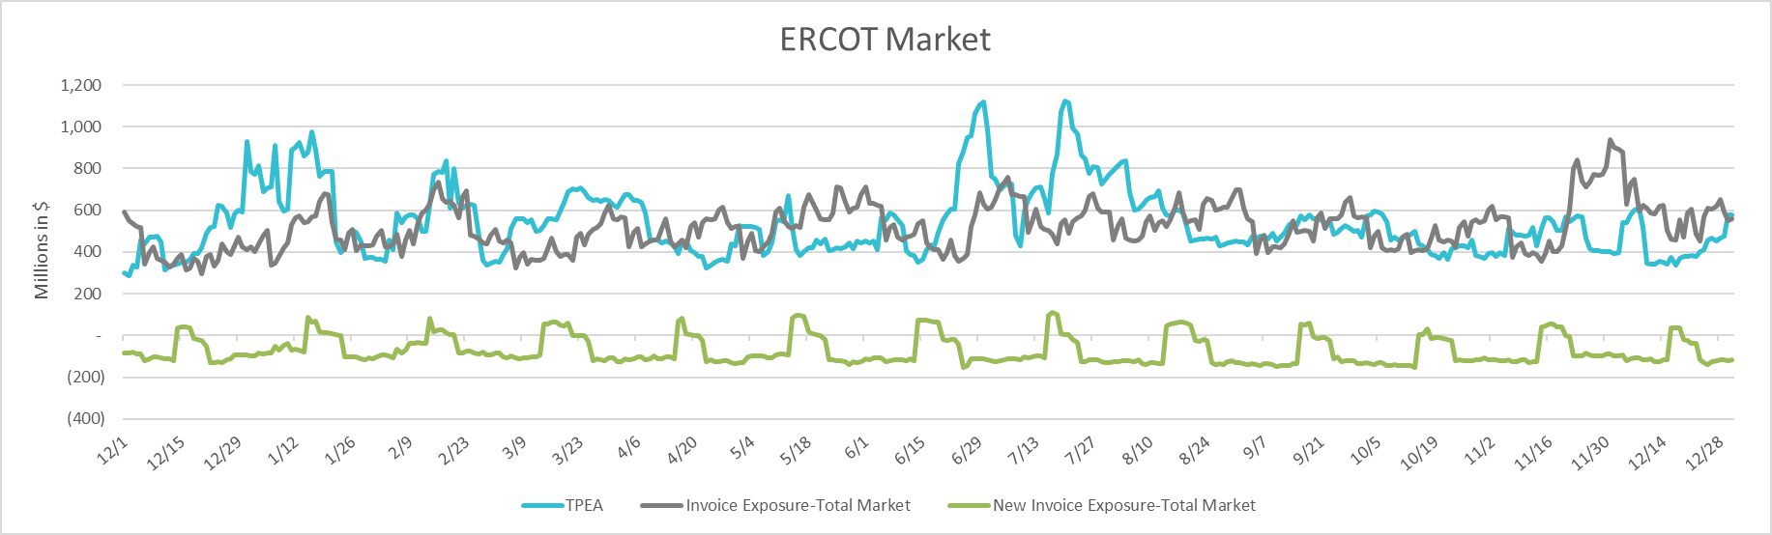
TPEA Coverage of Settlements December 2024 - December 2025
Invoice Exposure | Historical | Future
Existing Invoice Exposure | RTLCNS + UDAA | M1 Days (including current day) Forward Charge Invoice Amounts
New Invoice Exposure | 7 Days Back Net Invoice Amounts (Charges & Credits) | M1 Days (including current day) Forward Net Invoice Amounts (Charges & Credits); Excluding: 1) Securitization Invoices; 2) CRR Auction Invoices; and 3) Subchapter N Funds Distribution Invoice

Slide 11
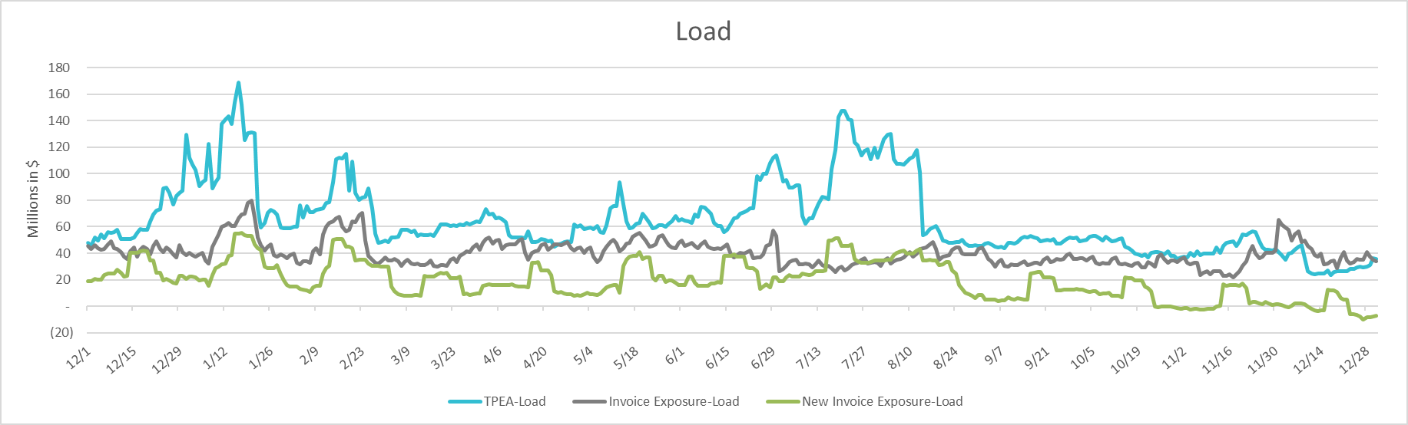
TPEA Coverage of Settlements December 2024 - December 2025
Invoice Exposure | Historical | Future
Existing Invoice Exposure | RTLCNS + UDAA | M1 Days (including current day) Forward Charge Invoice Amounts
New Invoice Exposure | 7 Days Back Net Invoice Amounts (Charges & Credits) | M1 Days (including current day) Forward Net Invoice Amounts (Charges & Credits); Excluding: 1) Securitization Invoices; 2) CRR Auction Invoices; 3) Subchapter N Funds Distribution Invoice

Slide 12
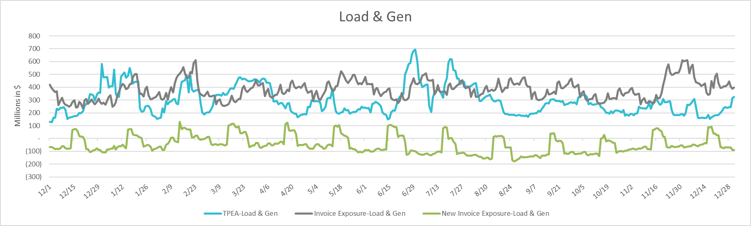
TPEA Coverage of Settlements December 2024 - December 2025
Invoice Exposure | Historical | Future
Existing Invoice Exposure | RTLCNS + UDAA | M1 Days (including current day) Forward Charge Invoice Amounts
New Invoice Exposure | 7 Days Back Net Invoice Amounts (Charges & Credits) | M1 Days (including current day) Forward Net Invoice Amounts (Charges & Credits); Excluding: 1) Securitization Invoices; 2) CRR Auction Invoices; 3) Subchapter N Funds Distribution Invoice

Slide 13
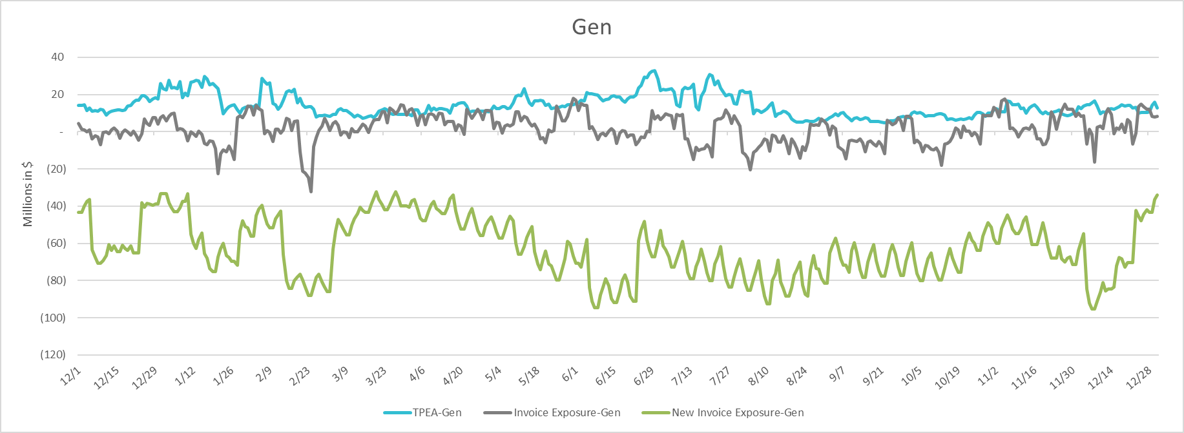
TPEA Coverage of Settlements December 2024 - December 2025
Invoice Exposure | Historical | Future
Existing Invoice Exposure | RTLCNS + UDAA | M1 Days (including current day) Forward Charge Invoice Amounts
New Invoice Exposure | 7 Days Back Net Invoice Amounts (Charges & Credits) | M1 Days (including current day) Forward Net Invoice Amounts (Charges & Credits); Excluding: 1) Securitization Invoices; 2) CRR Auction Invoices; 3) Subchapter N Funds Distribution Invoice

Slide 14
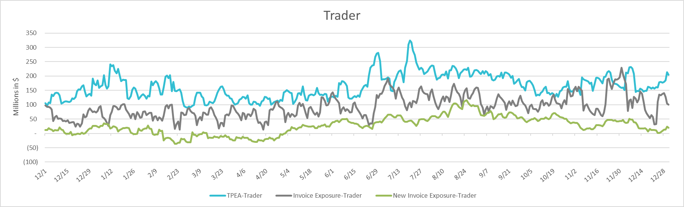
TPEA Coverage of Settlements December 2024 - December 2025
Invoice Exposure | Historical | Future
Existing Invoice Exposure | RTLCNS + UDAA | M1 Days (including current day) Forward Charge Invoice Amounts
New Invoice Exposure | 7 Days Back Net Invoice Amounts (Charges & Credits) | M1 Days (including current day) Forward Net Invoice Amounts (Charges & Credits); Excluding: 1) Securitization Invoices; 2) CRR Auction Invoices; 3) Subchapter N Funds Distribution Invoice

Slide 15
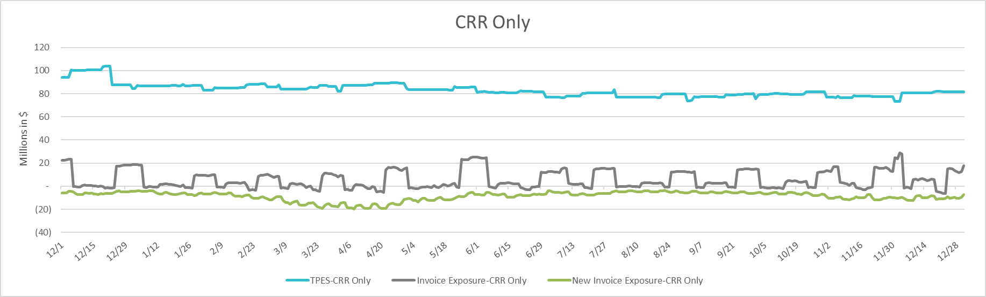
TPEA Coverage of Settlements December 2024 - December 2025
Invoice Exposure | Historical | Future
Existing Invoice Exposure | RTLCNS + UDAA | M1 Days (including current day) Forward Charge Invoice Amounts
New Invoice Exposure | 7 Days Back Net Invoice Amounts (Charges & Credits) | M1 Days (including current day) Forward Net Invoice Amounts (Charges & Credits); Excluding: 1) Securitization Invoices; 2) CRR Auction Invoices; 3) Subchapter N Funds Distribution Invoice

Slide 16
Questions

