Slide 1
Project Update
February 11, 2026
Troy Anderson
ERCOT Portfolio Management

Slide 2
Project Update Agenda
Recent / Upcoming Project Highlights
2026 Release Targets
Other Project Updates
Priority/Rank Recommendations for Revision Requests with Impacts
No new items to prioritize
Technology Working Group (TWG)
Next meeting is 2/19/2026
Prioritization Update
Aging Revision Request Project History
2026 Project Planning
Reports at Upcoming PRS Meetings
March
Impact Analysis Accuracy Report
FTE Impacts of Revision Requests Report
April
Aging Revision Request Prioritization
Location of Revision Request Project Information: http://www.ercot.com/services/projects

Slide 3
Recent / Upcoming Project Highlights
2026 January Off-Cycle Release – 1/1/2026 Complete
NPRR1283 – Modification of SSR Mitigation Timeline
2026 January Release – R1 – 1/29/2026 Complete
NPRR1234 – Interconnection Requirements for Large Loads and Modeling Standards for Loads 25 MW or Greater
End-Use Industry Classifications to Loads
PGRR131 – Requirements for Interconnection Cost Reporting for Transmission- Connected Generators
2026 February Off-Cycle Release – 2/1/2026 Complete
NPRR1285 – Improve Self-Commitment within RUC Opt Out Window
2026 February Release – R2 – 2/26/2026 In Flight
NPRR1299 – Clarifications to Emergency Response Service (ERS)
2026 February Off-Cycle Release – 3/2/2026 In Flight
NPRR1277 – Revisions to EAL Formula
Note: Projected Go-Live dates are subject to change. Please watch for market notices as the effective dates approach.
3

Slide 4
2026 Release Targets – Approved NPRRs / SCRs / xGRRs
R1
R3
R5
January 1/28-1/29 | February 2/25-2/26 | March 3/25-3/26 | April 4/29-4/30 | May 5/27-5/28 | June 6/24-6/25
NPRR1234(c) PGRR131 NPRR1283 NPRR1285 NPRR1299 | NPRR1277 |  |  |  | SCR820
R2
R4
R6
ü
ü
ü
ü
ü
E
E
1/1
SCR820 TO/QSE Testing
2/1
3/2
RTC+B Stabilization
July 7/29-7/30 | August 8/26-8/27 | September 9/30-10/1 | October 10/28-10/29 | December 12/16-12/17
 |  |  | NPRR1281
R7
R8
R9
R10
R11
NS
Numerous projects are initiating in 2026 and will eventually have go-live targets
Go-live dates can differ from Protocol effective dates – Please refer to market notices for more details
APPENDIX
Red Text: New additions and target release changes
Strike-Through Text: Previous target release
(a), (b), etc.: Multiple phase release
Project Status Codes
NS = Not Started
I = Initiation
P = Planning
E = Execution
H = On Hold
NPRR1234(c) – RIOO changes for End-Use
Industry Classification to Loads
Release targets are subject to change

Slide 5
Other Project Updates
NPRR1290 Phase 2 – Gap Resolutions and Clarifications for RTC+B
The team was ready to kick this off as part of RTC+B stabilization
Discovered an issue with the language – ERCOT will file an urgent NPRR to resolve
Path forward is now TBD – may require a stand-alone project
NPRR1198 – Congestion Mitigation Using Topology Reconfigurations
Targeting April 2026 start – expecting late Q3 / early Q4 go-live
This is one of the “high priority” items identified in last year’s prioritization workshop
NPRR1201 – Limitations on Resettlement Timeline & Default Uplift Exposure Adjustments
Targeting July 2026 start with go-live in late 2026
NPRR1238 – Voluntary Registration of Loads with Curtailable Load Capabilities
Part of Large Load Curtailment Manager project (Initiated in February 2026)
Targeting partial implementation by summer 2026 with full scope delivered by end of 2026
ERCOT expecting to file an NPRR to codify SB6-related curtailments in the Protocols
Targeting April 2026 for the next prioritization discussion at PRS
Plans for 2026 will largely be in place (and in motion) by that time
5

Slide 6
Priority / Rank Recommendations for Revision Requests with Impacts
Recommendations for…
Revision Request | Description | Priority | Rank | Comments
None
PPL Rank Information
Next 2025 Rank in Business Strategy = 4580 Next 2028 Rank in Business Strategy = 5110
Next 2026 Rank in Business Strategy = 4820 Next 2029 Rank in Business Strategy = 5300
Next 2027 Rank in Business Strategy = 4910 Next Rank in Regulatory = 430

Slide 7
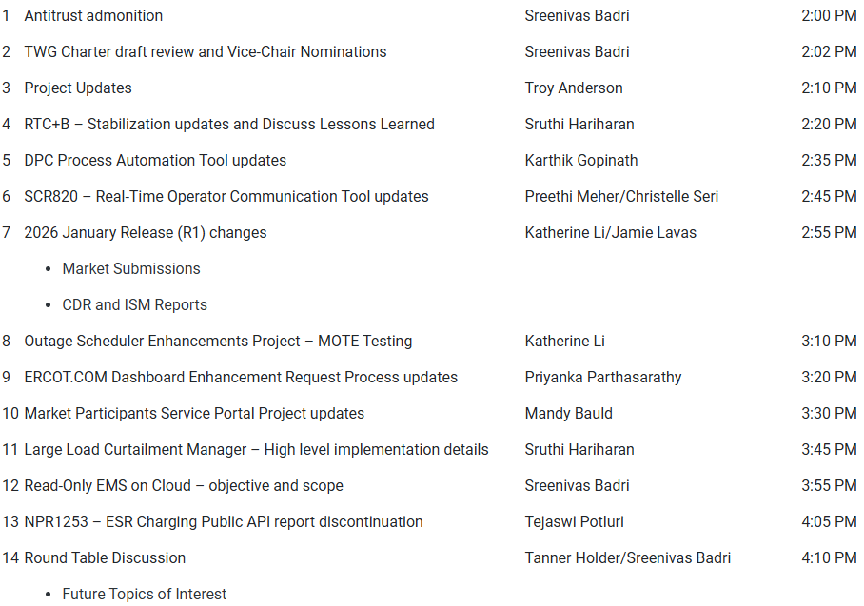
Technology Working Group (TWG)
Agenda for TWG meeting held on 1/22/2026:
Next TWG scheduled for 2/19/2026

Slide 8
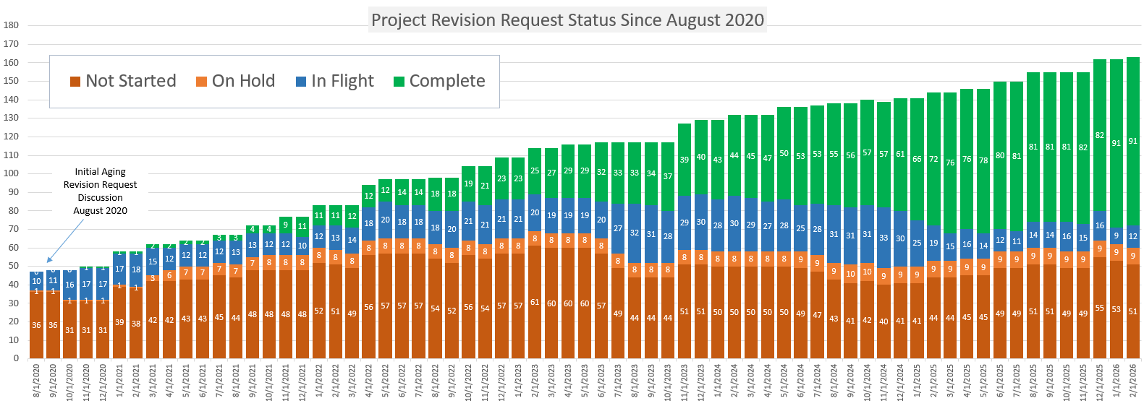
Aging Revision Request Project History
Population: Aging Revision Requests as of 8/2020 plus any new approved RRs with related projects since 8/2020
Key Takeaway: Aging backlog has remained relatively steady since 2021

Slide 9
2026 Project Planning
ERCOT understands that Market Participants need lead time to implement changes in their systems for many Revision Requests
Approved Revision Request Project Starts
NPRR936 – CRR Account Holder Limits
NPRR1188 – Implement Nodal Dispatch and Energy Settlement for Controllable Load Resources
NPRR1238 – Voluntary Registration of Loads with Curtailable Load Capabilities
NPRR1244 – Clarification of CLR Primary Frequency Response Responsibilities
NPRR1277 – Revisions to EAL Formula
NPRR1281 – Improvements to Alternate FFSS Resource Designation
NPRR1288 – Remove Multiple Month Transactions in CRR Auctions
NPRR1290 Phase 2 – Gap Resolutions and Clarifications for RTC+B
Revision Request Projects with Potential for 2026 Implementation
NPRR1198 – Congestion Mitigation Using Topology Reconfigurations
NPRR1201 – Limitations on Resettlement Timeline & Default Uplift Exposure Adj
SCR818 Phase 2 – Changes to Incorporate GIC Modeling Data into Existing Modeling Applications
SCR829 – API for the NDCRC Application
SCR831 – Short Circuit Model Integration
Other priority Review Request projects may start in 2026 with a future year Go-Live
DRRS (NPRR1309, NPRR1310), Residential Demand (NPRR1296), Firming
Green Text: Deemed “High Priority” at 2025 Prioritization Workshop

