Slide 1
SSWG Report to ROS
February 5, 2026
Chair: Zach Walker (Zachary.Walker2@oncor.com)
Vice Chair: Chris Ramirez (cramirez@wettllc.com)

Slide 2
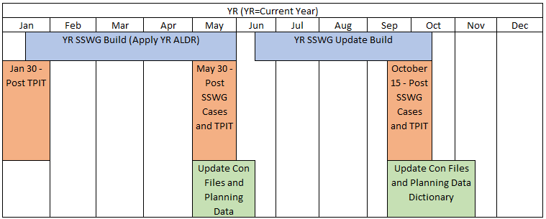
SSWG Report
Key Updates
26SSWG TPIT Update #1
  Transmission Project & Information Tracking (TPIT)
  Updated report published Jan 29th
  https://www.ercot.com/gridinfo/planning
26SSWG Case Build #1
  Currently Ongoing
  In-Person Post-Dispatch Tuning Meeting
    April 27th – 29th
  Target Posting: May 22nd
  2026 SSWG Leadership Nominations
  Chair: Chris Ramirez (WETT)
  Vice-Chair: Weiwei Hu (AEN)
SSWG Report to ROS External

