Slide 1
NPRR 1317 Creation of Non-Settled Generator (NSG) and Clarification of the Types, Usage, and Registration of Distributed Generation
Thinesh Devadhas Mohanadhas / Douglas Fohn
ERCOT

Slide 2
NPRR 1317 Creation of Non-Settled Generator (NSG) and Clarification of the Types, Usage, and Registration of Distributed Generation
This NPRR incorporates the Resource Definition Task Force’s (RTF’s) RTF-5 defined terms “Non-Settled Generation” (NSG) to clarify the appropriate use of Distributed Generation (DG) or subtype of DG throughout the Protocols and meets the RTF’s objectives to “identify problematic terms” in the Protocols and “improv[e] the current structure and terms where practical.”
An NSG is not a Market Participant (MP). An NSG is a generator, including an Energy Storage System, with a nameplate capacity that is greater than 1 MW that is not registered with ERCOT as a different registrant type (i.e. Generation Resource, Settlement Only Generator, Energy Storage Resource, or Settlement Only Energy Storage System). Any NSG exports are NOT entitled to Settlement and will not be used for Settlement purposes.
NSG enables ERCOT to gain visibility into distributed and transmission generators that are not registered as any MP type by collecting basic registration details (>1 MW) and telemetry data (>10 MW).
NSG does not apply to generators that are:
  Registered with ERCOT as an MP; or
  That are not capable of being connected in parallel operation to the ERCOT System.
Notes:
https://www.ercot.com/calendar/04162020-RTF-Meeting-by-WebEx

Slide 3
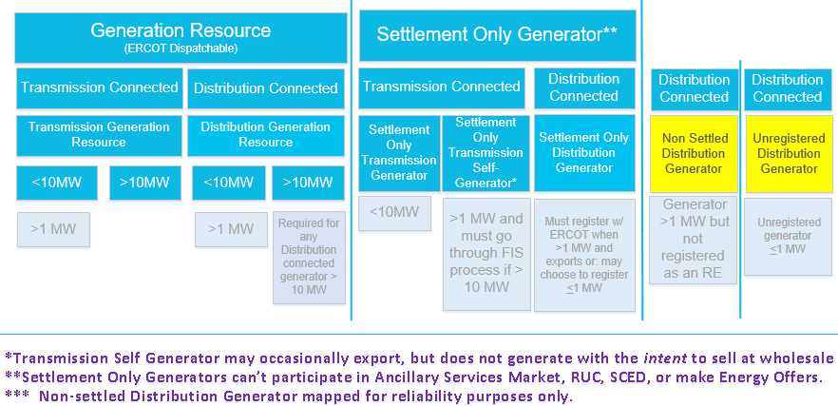
RTF-5 Generation Framework
***
Notes:
https://view.officeapps.live.com/op/view.aspx?src=https%3A%2F%2Fwww.ercot.com%2Ffiles%2Fdocs%2F2020%2F04%2F16%2FRTF5_Proposed_Revisions_to_Generation_Framework_v4.pptx&wdOrigin=BROWSELINK

Slide 4
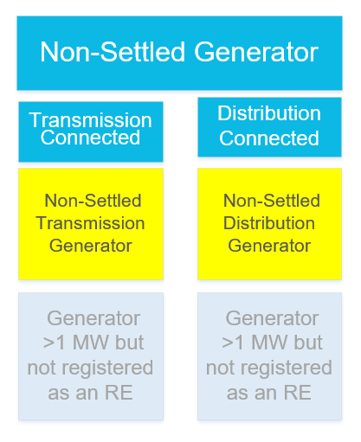
NSG Definitions
Non-Settled Generator (NSG)
A generator, including an Energy Storage System (ESS), with a nameplate capacity greater than one MW that is not registered with ERCOT as a Generation Resource, Settlement Only Generator (SOG), Energy Storage Resource (ESR), or Settlement Only Energy Storage System (SOESS). NSG exports to the ERCOT System are not entitled to Settlement and will not be used for Settlement purposes.
Non-Settled Distribution Generator (NSDG)
An NSG that is a Distributed Generator (DG).
Non-Settled Transmission Generator (NSTG)
An NSG that is either (i) directly or (ii) indirectly connected to the ERCOT Transmission Grid and that may be connected in parallel operation to the ERCOT System.

Slide 5





Distributed Generation (DG)
NPRR 1317
Non-Settled Distribution Generator (NSDG)
Typically >1 MW
Unregistered Distribution Generator (UDG)*
Typically ≤1 MW
Settlement- Only Distributed
Generator (SODG)
Typically <10 MW
Distribution Generation Resources (DGR)
Typically <10 MW
Compensated for energy
Compensated for energy and Ancillary Services
Batteries
Rooftop solar
Utility-scale solar
Utility-scale solar
Batteries
Fossil-fuel units (Natural gas-fired and diesel)
Commercial solar
Commercial solar
Fossil-fuel units (Natural gas-fired)
Small commercial solar
Fossil-fuel units (Natural gas-fired and diesel)
Fossil-fuel units (Natural gas-fired and diesel)
Other technologies
*NPRR 1265 Unregistered Distributed Generator

Slide 6
    Douglas.Fohn@ercot.com
    Thinesh.DevadhasMohanadhas@ercot.com
    Thank You

