Slide 1

WMWG update to wms
February 4, 2026
Amanda Frazier, WMWG Chair

Slide 2
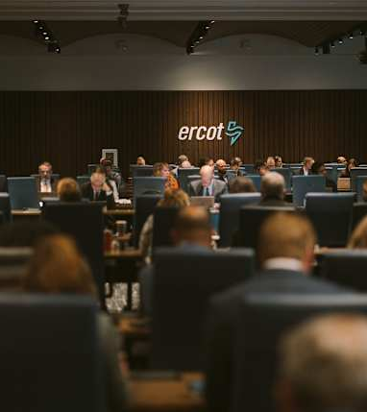
AGENDA
NPRRS ready for WMS vote:
  None
NPRRs Still with WMWG
  NPRR1278 - Establishing Advanced Grid Support Service as an Ancillary Service
  NPRR1307- Revised Definition of Mitigation Plan
Other Business
  Joint WMWG/DSWG Emergency Response Service (ERS) Discussion
  TAC Assignment on EPA Regulations
  WMWG Leadership

Slide 3
Discussion of NPRRs
  NPRR1278 - Establishing Advanced Grid Support Service as an Ancillary Service Discussion on hold pending development of DRRS
  NPRR1307- Revised Definition of Mitigation Plan – Tabled for additional discussion
  ERCOT-sponsored language updates the definition of “Mitigation Plan” to include pre-contingency actions to mitigate system cascading, uncontrolled separation, angular instability, and voltage instability. Also specifies that Load shedding may be necessary to support pre-contingency actions (outside of EEA3 events).
  Vistra 12/4/2025 Comments request that pre-contingency load shed be included in within the Reliability Deployment Price Adder (RDPA) calculations to minimize price-suppressive impacts of non-EEA3 load shed.
    Load shed to mitigate local contingencies is not currently included within RDPA calculations. A new project will be required to make system changes to accommodate ERCOT-directed pre-contingency load sheds within RDPA calculations.
    ERCOT has clarified that it is not technically feasible to incorporate TO-directed pre-contingency load shed into RDPA calculations.

Slide 4
Other Business
  Joint WMWG/DSWG Discussion on Emergency Response Service (ERS) – Tabled for additional discussion
  ERCOT reviewed its WMS presentation on the availability and performance of price-sensitive ERS Resources in support of potential program reforms to maximize the reliability benefit of ERS.
    A majority of stakeholders agreed that any qualified ERS Resource meeting the performance and availability requirements should be able to compete for ERS awards – changes to the program should focus on performance / availability and not Resource-type.
    Enchanted Rock / Generate Capital reiterated their WMS recommendation to bifurcate the ERS program to create an “ERS-Gen” product in recognition of the distinct reliability value of dispatchable generation on the distribution grid.
    Stakeholders discussed the potential reliability impacts of ERS “pre-deployments” from price-responsive loads and the historic performance of ERS Resources as measured by deployments and annual testing requirements.
  ERCOT has committed to bring back additional data on stakeholder questions, including proposals to improve the reliability of the ERS program by tightening availability / performance requirements.

Slide 5
Other Business
  TAC Assignment on EPA Regulations
  Review impacts of existing and proposed EPA regulations on the ERCOT market, the reliability of the ERCOT grid, and the future Resource mix.
  WMWG hosted a discussion with Susana Hildebrand (Vistra) during January 30, 2025, meeting.
    No requests from stakeholders to renew discussions in 2026 – WMWG has concluded this assignment.
  WMWG Leadership
  Amanda Frazier (Chair) and Trevor Safko (Vice-Chair) are willing to continue to serve as WMWG leadership for 2026. No other nominations were received.

Slide 6

THANK YOU

