Slide 1
Settlement Stability
2025 Q4 Update to WMS
Settlements Group
ERCOT
02/04/2026

Slide 2
8.2(2)(c)(i) Track number of price changes
Reporting Period: 2025 Q4
Operating Day | # of Corrected Prices |  |  |  |  |  | # of Intervals Affected |  |  |  |  |  | Market Notice
 | DASPP | MCPC | RTSPP | RTRMPR | ORDC Adders | RTESOGPR | DASPP | MCPC | RTSPP | RTRMPR | ORDC Adders | RTESOGPR
06/27/2025 | 18607 | 22 | - | - | - | - | 24 | 10 | - | - | - | - | M-B092525-02
10/14/2025 | - | - | 6386 | 7394 | 6 | 2646 | - | - | 6 | 6 | 6 | 6 | M-B121725-01
Notes:
The price changes reported on this slide display the price corrections that have been done after the Settlement Statement has posted for the Operating Day.

Slide 3
8.2(2)(c)(iv) Track number of resettlements due to non-price errors
Reporting Period: 2025 Q4
Operating Day(s) Resettled | Reason for Resettlement | Affected Charge Types | Market Notice Number
03/16/2025 | Granted Dispute: Recalculation of Reliability Unit Commitment (RUC) Guarantee amounts reassessing the value of the actual fuel burned during RUC events | LARTRNAMT, RTEIAMT, RUCCSAMT, RUCMWAMT | M-C103125-01
03/21/2025
03/26/2025
03/27/2025

Slide 4
8.2(2)(c)(ii) Track number and types of disputes submitted
8.2(2)(c)(iii) Compliance with timeliness of response to disputes
YEAR | 2025 |  | 100% of dispute resolutions were timely.
CALENDAR QUARTER REPORTED | Q1-Q4
Disputed Charge Sub-Type | Submitted | Resolved | Denied | Granted | Granted with Exceptions
Ancillary Services-DAM | 3 | 1 | 1 | 0 | 0
Ancillary Services-RTM | 5 | 7 | 7 | 0 | 0
Congestion Revenue Rights-DAM | 7 | 0 | 0 | 0 | 0
DA/RT Invoice | 4 | 2 | 2 | 0 | 0
Emergency Operations | 4 | 0 | 0 | 0 | 0
ENERGY-DAM | 1 | 0 | 0 | 0 | 0
Energy-RTM | 40 | 28 | 12 | 16 | 0
Firm Fuel Supply Service | 4 | 3 | 3 | 0 | 0
Gene. Res. Base Pt Deviation | 6 | 5 | 4 | 1 | 0
Reliability Unit Commitment | 108 | 109 | 5 | 104 | 0
TOTAL | 182 | 155 | 34 | 121 | 0
Submitted but not resolved disputes may be:
Not started
Open
Rejected
Withdrawn

Slide 5
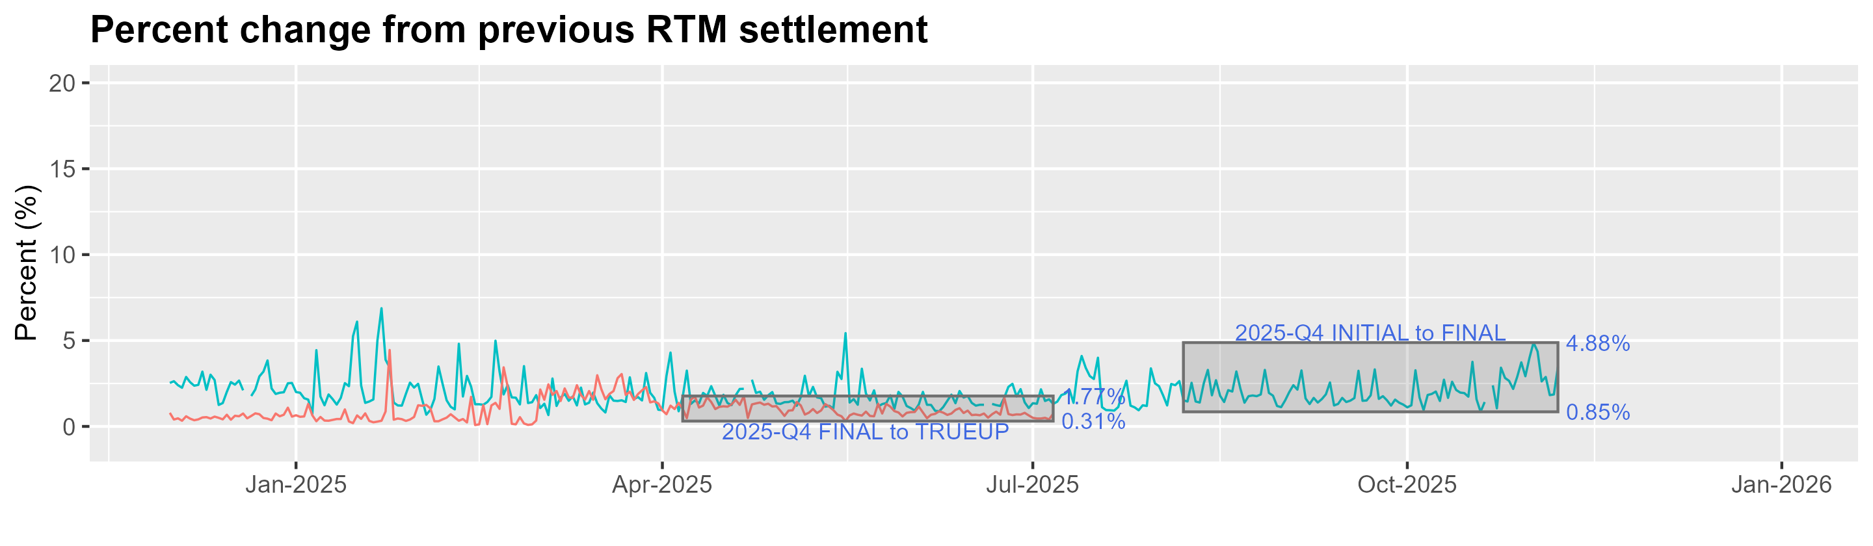
8.2(2)(c)(v) Other Settlement metrics
NOTE: ERS Final settlement OD data is not represented in graph.
Average percent change
 | 2016 | 2017 | 2018 | 2019 | 2020 | 2021 | 2022 | 2023 | 2024 | 2025
FINAL | 2.57 | 3.01 | 2.93 | 2.66 | 3.09 | 3.53 | 3.36 | 2.90 | 2.32 | 1.95
TRUEUP | 0.28 | 0.27 | 0.26 | 0.20 | 0.26 | 0.46 | 0.99 | 0.83 | 0.41 | 1.02

Slide 6
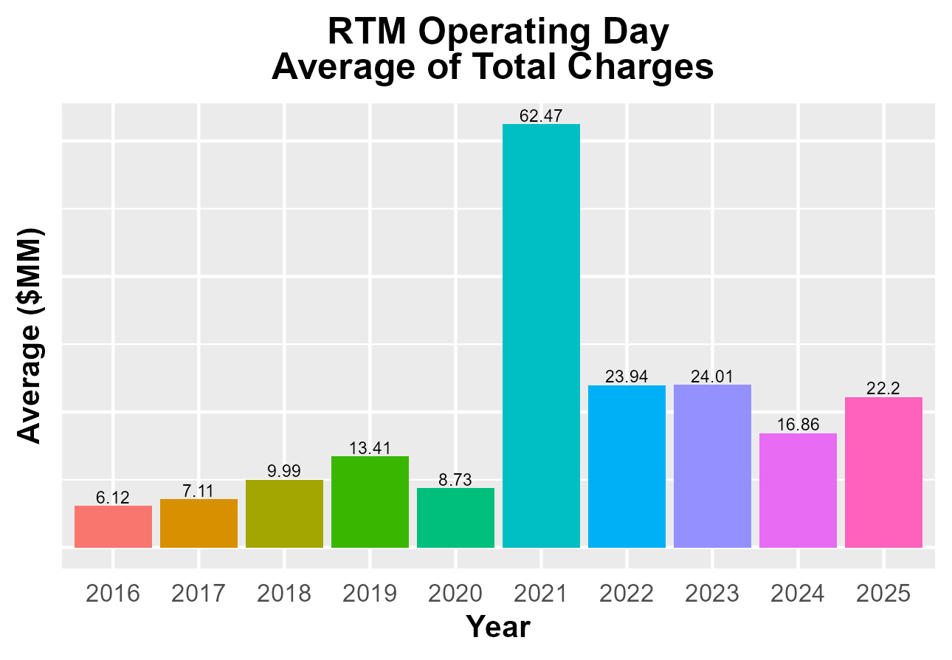
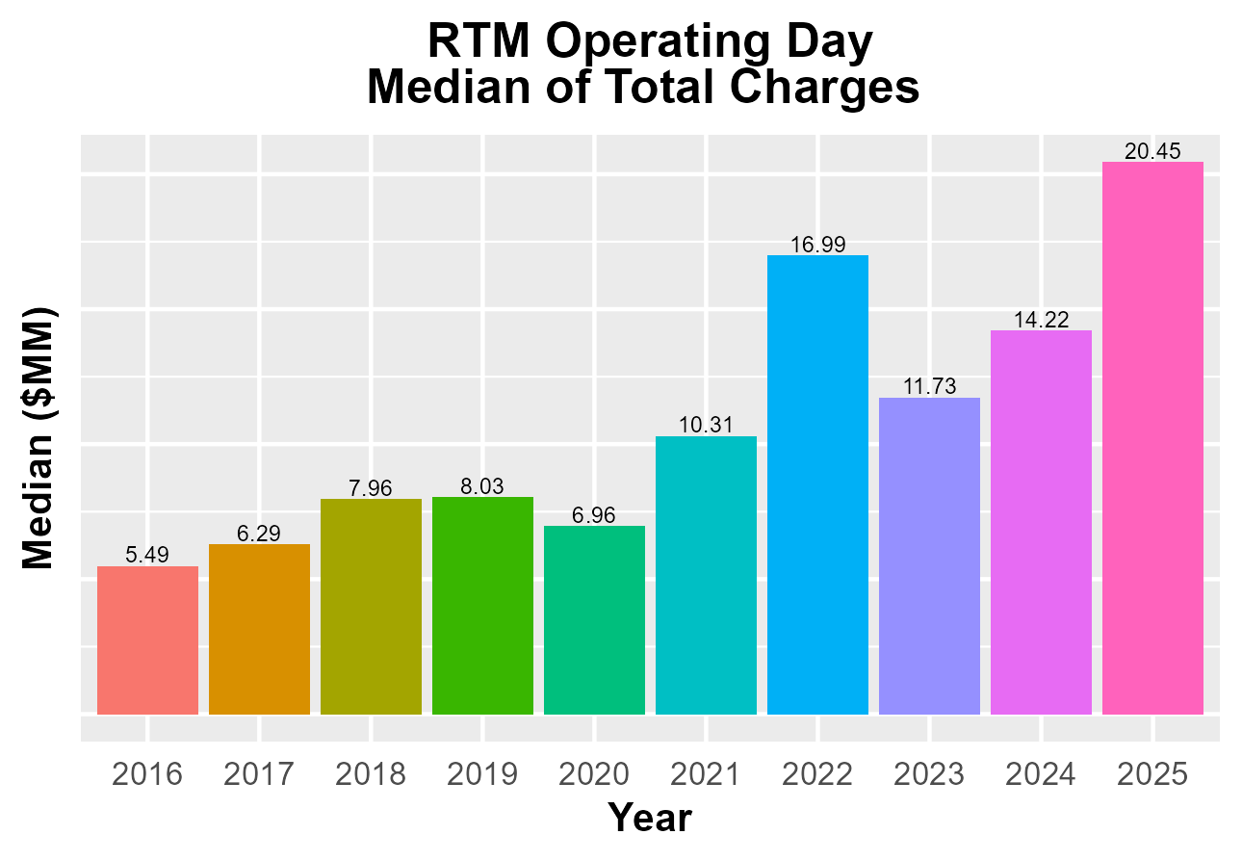
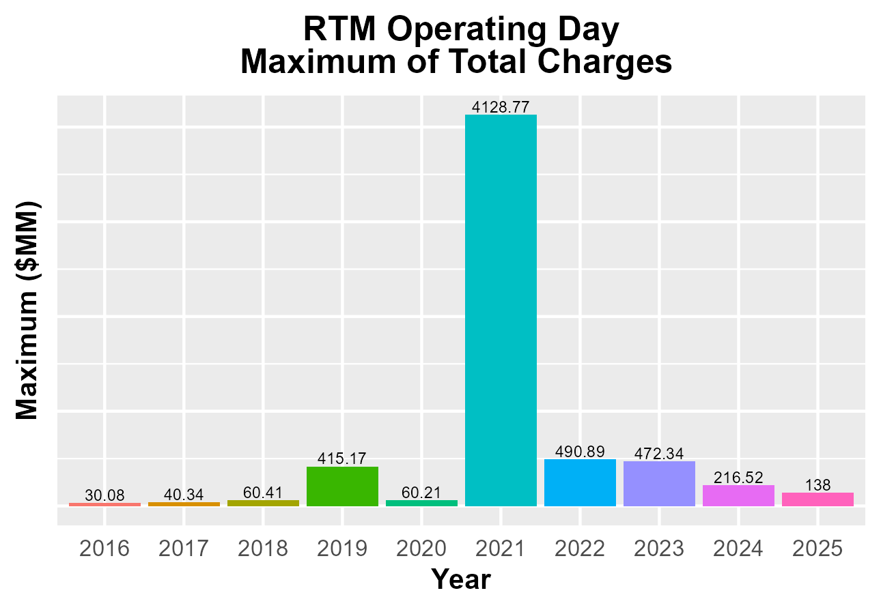
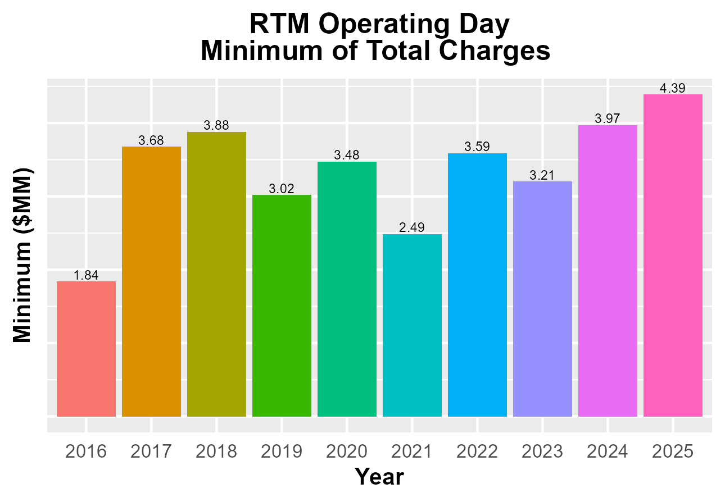
8.2(2)(c)(v) Other Settlement metrics

Slide 7
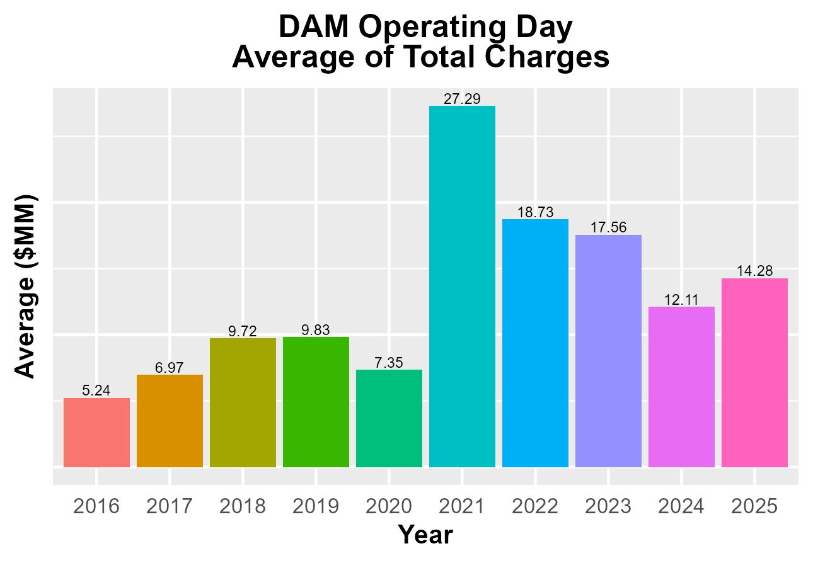
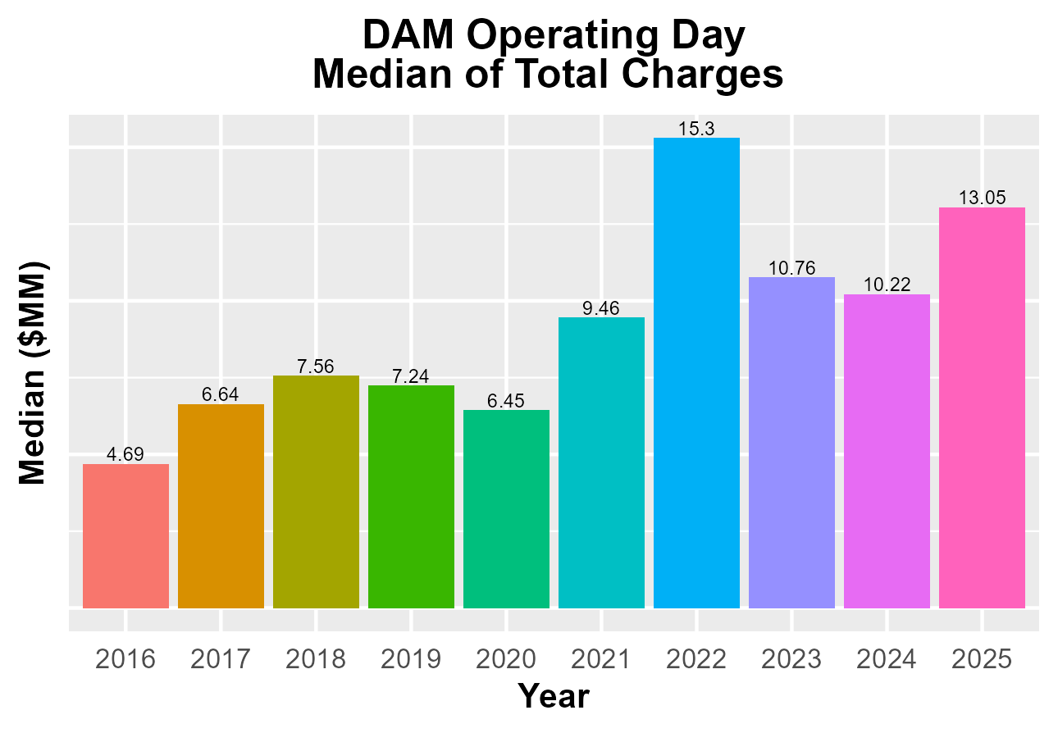
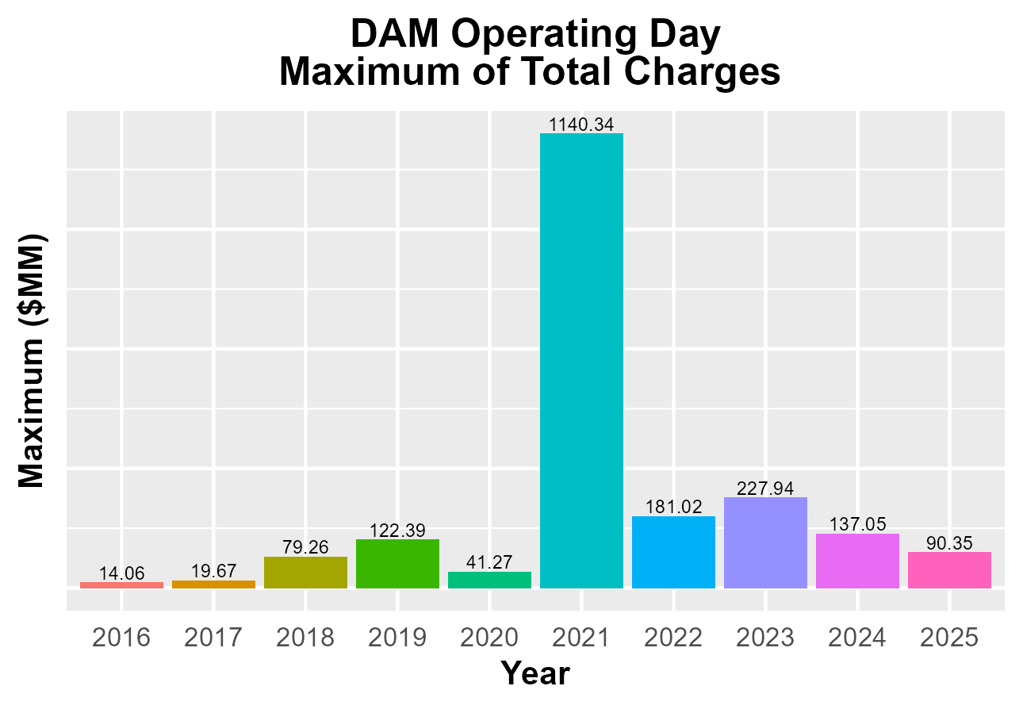
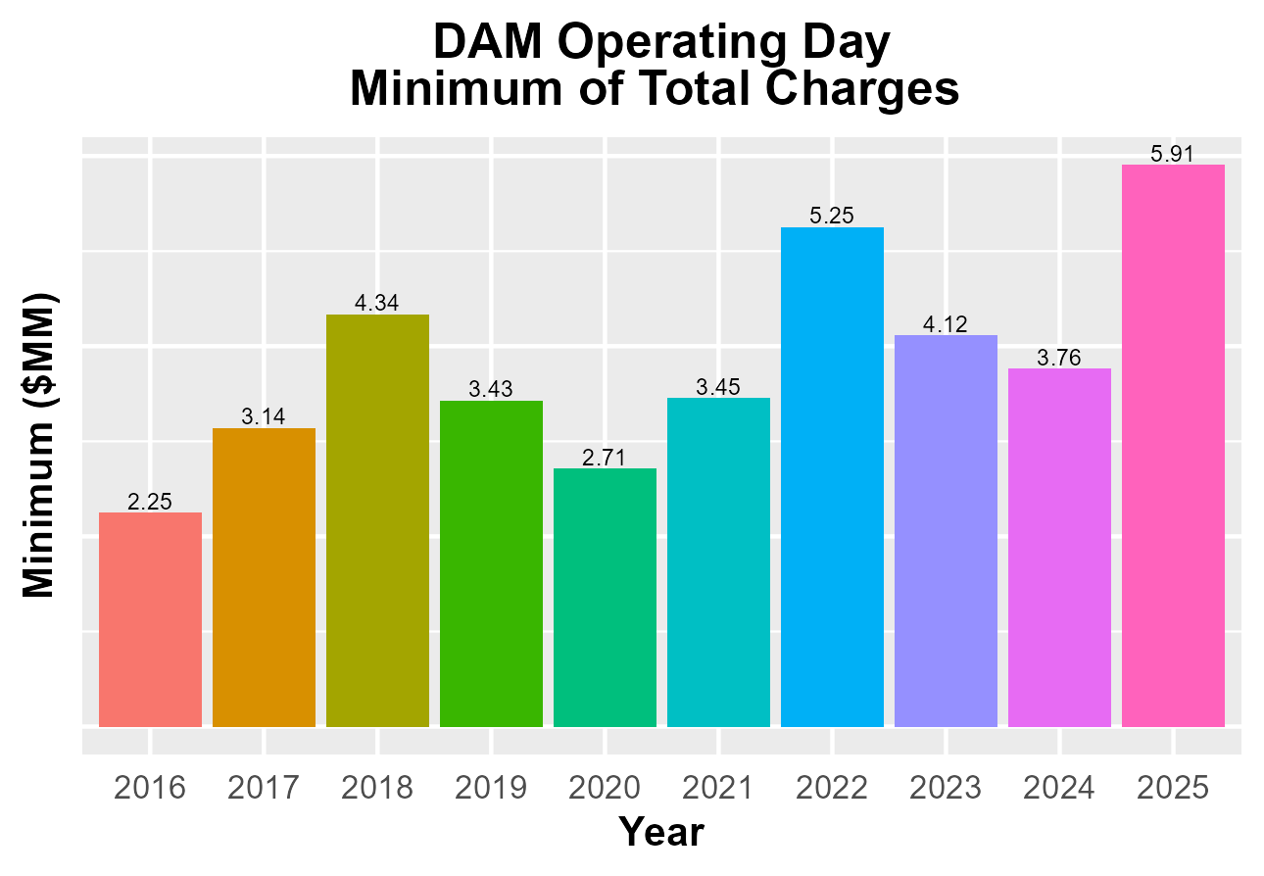
8.2(2)(c)(v) Other Settlement metrics

Slide 8
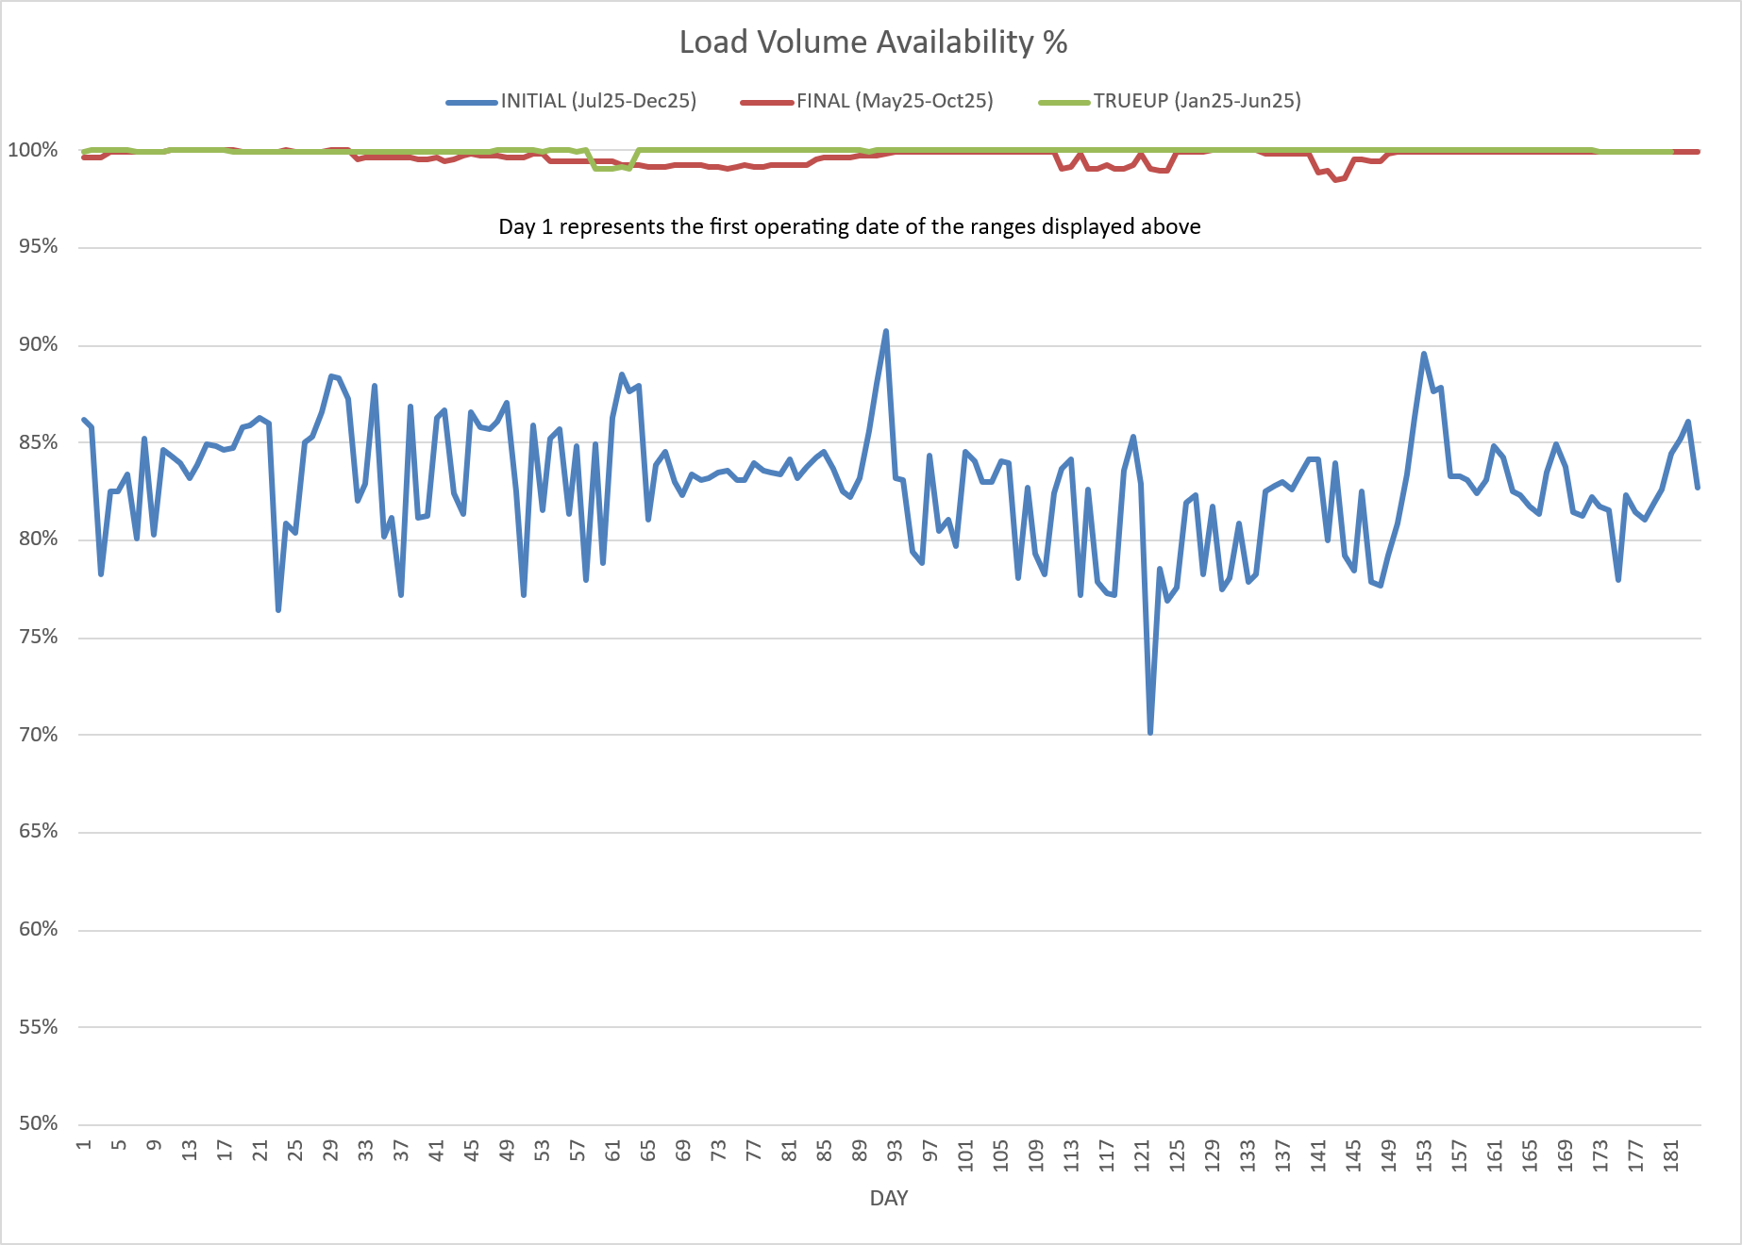
8.2(2)(c)(vi) Availability of ESIID consumption data

Slide 9
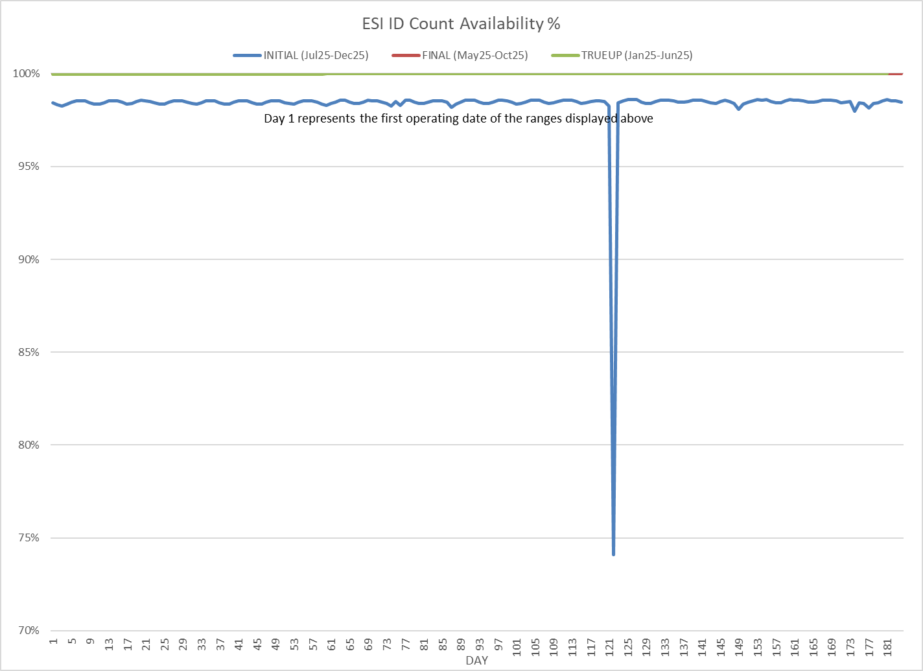
8.2(2)(c)(vi) Availability of ESIID consumption data

Slide 10
8.2(2)(g) Net Allocation to Load - Totals and $/MWh
NET ALLOCATION TO LOAD ($M)
 | Dec 2024 | Jan 2025 | Feb 2025 | Mar 2025 | Apr 2025 | May 2025 | Jun 2025 | Jul 2025 | Aug 2025 | Sep 2025 | Oct 2025 | Nov 2025 | Dec 2025
Balancing Account Payout to Load | -13.4 | -40.9 | -32.1 | -7.5 | -18.4 | -37.0 | -34.7 | -30.5 | -32.4 | -25.2 | -0.3 | -17.2 | -16.4
Base/Set Point Deviation Payments | -0.7 | -0.9 | -0.6 | -0.7 | -0.8 | -0.6 | -0.7 | -0.6 | -0.7 | -0.6 | -0.8 | -0.6 | -1.0
Black Start Service Settlement | 0.7 | 0.7 | 0.6 | 0.7 | 0.6 | 0.6 | 0.6 | 0.6 | 0.6 | 0.6 | 0.6 | 0.6 | 0.6
Block Load Transfer Settlement | 0.0 | 0.0 | 0.0 | 0.0 | 0.0 | 0.0 | 0.0 | 0.0 | 0.0 | 0.0 | 0.0 | 0.0 | 0.0
DAM Ancillary Service Settlement | 7.9 | 9.6 | 14.5 | 14.1 | 15.0 | 49.0 | 14.8 | 10.5 | 10.5 | 6.2 | 10.9 | 15.0 | 21.4
Emergency Energy Charges | 0.0 | 0.0 | 0.1 | 0.1 | 0.0 | 0.0 | 0.0 | 0.0 | 0.0 | 0.0 | 0.1 | 0.0 | 0.1
ERCOT Admin Fee Settlement | 22.0 | 25.6 | 21.9 | 21.9 | 23.0 | 26.0 | 28.5 | 30.2 | 31.2 | 27.7 | 25.9 | 22.5 | 23.8
ERO Pass-Through Fee⁵ | 2.3 | 2.5 | 2.5 | 2.5 | 2.5 | 2.5 | 2.5 | 2.5 | 2.5 | 2.5 | 2.5 | 2.5 | 2.5
ERS Settlement¹ | 8.5 | 8.5 | 8.5 | 8.5 | 1.1 | 1.1 | 7.9 | 7.9 | 7.9 | 7.9 | 0.0 | 0.0 | 0.0
Firm Fuel Service Settlement | 10.2 | 10.3 | 10.8 | 6.2 | 0.0 | 0.0 | 0.0 | 0.0 | 0.0 | 0.0 | 0.0 | 6.9 | 12.8
High Dispatch Limit Override | 0.0 | 0.0 | 0.0 | 0.0 | 0.0 | 0.0 | 0.0 | 0.0 | 0.0 | 0.0 | 0.0 | 0.0 | 0.0
Misc Settlements⁶ | 0.0 | 0.0 | 0.4 | 0.0 | 0.0 | 0.0 | 0.0 | 0.0 | 0.0 | 0.0 | 0.0 | 0.0 | 0.0
Non-Zonal Auction Distribution | -41.3 | -27.7 | -29.1 | -48.6 | -50.7 | -45.6 | -42.9 | -21.9 | -26.6 | -23.7 | -31.4 | -27.1 | -24.9
ORDC Settlement | 1.5 | 3.8 | 7.7 | 3.7 | 1.3 | 1.1 | 1.4 | 1.0 | 1.1 | 2.2 | 1.5 | 1.4 | 0.7
Real-Time Ancillary Service Revenue Neutrality | 0.0 | 0.0 | 0.0 | 0.0 | 0.0 | 0.0 | 0.0 | 0.0 | 0.0 | 0.0 | 0.0 | 0.0 | 0.2
Real-Time Derated Ancillary Service | 0.0 | 0.0 | 0.0 | 0.0 | 0.0 | 0.0 | 0.0 | 0.0 | 0.0 | 0.0 | 0.0 | 0.0 | 0.0
Revenue Neutrality Total | 17.7 | 23.1 | 21.9 | 14.6 | 12.0 | 13.4 | 13.5 | 12.0 | 10.5 | 9.9 | 7.5 | 7.5 | 5.9
RMR Settlement | 0.0 | 0.0 | 0.0 | 11.0 | 9.1 | 6.3 | 10.7 | 7.7 | 5.3 | 3.1 | 3.2 | 3.1 | 3.1
RUC Settlement | -0.1 | -0.7 | -1.1 | -0.4 | -1.0 | -0.3 | -0.2 | -0.2 | 0.0 | -0.1 | -0.1 | -0.1 | -0.2
Voltage Services Settlement | 0.0 | 0.0 | 0.0 | 0.0 | 0.0 | 0.0 | 0.0 | 0.0 | 0.0 | 0.0 | 0.0 | 0.0 | 0.0
Zonal Auction Distribution² | -96.5 | -109.8 | -100.8 | -117.7 | -108.5 | -116.2 | -126.8 | -138.2 | -138.8 | -110.1 | -124.5 | -110.6 | -107.7
Total Allocation to Load | -81.2 | -95.9 | -74.8 | -91.6 | -114.8 | -99.7 | -125.4 | -119.0 | -128.9 | -99.6 | -104.9 | -96.1 | -79.1
Adjusted Metered Load (TWh) | 34.9 | 40.6 | 34.8 | 34.8 | 36.6 | 41.3 | 45.2 | 47.9 | 49.5 | 44.0 | 41.1 | 35.7 | 37.8
$/MWh³ | -2.3 | -2.4 | -2.1 | -2.6 | -3.1 | -2.4 | -2.8 | -2.5 | -2.6 | -2.3 | -2.6 | -2.7 | -2.1
Note: The Net Allocation to Load amounts provided in this presentation are for informational purposes only and cannot be relied upon for accurate measurements or forecasts of individual QSE charges and payments.
¹The total ERS charges have been evenly allocated across the contract period.
²Zonal Auction Distribution by 2003 Congestion Management Zone, shown below.
³The $/MWh value as calculated per PR 8.2 (2) g
⁴The $/MWh value by 2003 Congestion Management Zone, as calculated per PR 8.2(2) g
⁵Allocated to load from two years prior per the Electric Reliability Organization Fee Assessment and Collection Guide
⁶ Non-Statement amounts impacting Net Allocation to Load

Slide 11
8.2(2)(g) Net Allocation to Load - Totals and $/MWh
ZONAL AUCTION DISTRIBUTION PER CONGESTION MANAGEMENT ZONE ($M)
 | Dec 2024 | Jan 2025 | Feb 2025 | Mar 2025 | Apr 2025 | May 2025 | Jun 2025 | Jul 2025 | Aug 2025 | Sep 2025 | Oct 2025 | Nov 2025 | Dec 2025
HOUSTON | -6.9 | -10.1 | -8.4 | -10.1 | -12.0 | -12.8 | -11.6 | -12.4 | -10.9 | -8.6 | -10.6 | -7.9 | -7.9
NORTH | -15.8 | -21.0 | -18.8 | -16.6 | -15.5 | -19.8 | -26.3 | -28.3 | -29.9 | -21.3 | -19.4 | -14.6 | -18.2
SOUTH | -29.6 | -33.2 | -29.3 | -33.8 | -33.2 | -33.7 | -38.6 | -44.0 | -44.9 | -32.2 | -31.4 | -27.4 | -28.9
WEST | -44.2 | -45.5 | -44.3 | -57.1 | -47.7 | -50.0 | -50.4 | -53.5 | -53.1 | -48.0 | -63.1 | -60.7 | -52.8
TOTAL | -96.5 | -109.8 | -100.8 | -117.7 | -108.5 | -116.2 | -126.8 | -138.2 | -138.8 | -110.1 | -124.5 | -110.6 | -107.7
REAL-TIME ADJUSTED METERED LOAD BY CONGESTION MANAGEMENT ZONE (TWh)
 | Dec 2024 | Jan 2025 | Feb 2025 | Mar 2025 | Apr 2025 | May 2025 | Jun 2025 | Jul 2025 | Aug 2025 | Sep 2025 | Oct 2025 | Nov 2025 | Dec 2025
HOUSTON | 8.3 | 9.1 | 8.1 | 8.8 | 9.5 | 10.8 | 11.6 | 12.2 | 12.3 | 11.2 | 10.3 | 8.7 | 8.9
NORTH | 10.9 | 13.7 | 11.3 | 10.3 | 10.7 | 12.1 | 14.4 | 15.7 | 15.9 | 13.6 | 12.3 | 10.6 | 12.0
SOUTH | 8.7 | 10.6 | 9.0 | 8.9 | 9.6 | 11.3 | 11.9 | 12.3 | 13.2 | 11.7 | 10.9 | 9.1 | 9.5
WEST | 7.0 | 7.2 | 6.3 | 6.8 | 6.7 | 7.2 | 7.3 | 7.8 | 8.0 | 7.6 | 7.5 | 7.2 | 7.5
TOTAL | 34.9 | 40.6 | 34.8 | 34.8 | 36.6 | 41.3 | 45.2 | 47.9 | 49.5 | 44.0 | 41.1 | 35.7 | 37.8
ZONAL AUCTION REVENUE PER CONGESTION MANAGEMENT ZONE ($/MWh)
 | Dec 2024 | Jan 2025 | Feb 2025 | Mar 2025 | Apr 2025 | May 2025 | Jun 2025 | Jul 2025 | Aug 2025 | Sep 2025 | Oct 2025 | Nov 2025 | Dec 2025
HOUSTON | -0.8 | -1.1 | -1.0 | -1.1 | -1.3 | -1.2 | -1.0 | -1.0 | -0.9 | -0.8 | -1.0 | -0.9 | -0.9
NORTH | -1.4 | -1.5 | -1.7 | -1.6 | -1.4 | -1.6 | -1.8 | -1.8 | -1.9 | -1.6 | -1.6 | -1.4 | -1.5
SOUTH | -3.4 | -3.1 | -3.3 | -3.8 | -3.5 | -3.0 | -3.2 | -3.6 | -3.4 | -2.8 | -2.9 | -3.0 | -3.0
WEST | -6.3 | -6.3 | -7.0 | -8.4 | -7.1 | -6.9 | -6.9 | -6.9 | -6.6 | -6.3 | -8.4 | -8.4 | -7.0
TOTAL | -2.8 | -2.7 | -2.9 | -3.4 | -3.0 | -2.8 | -2.8 | -2.9 | -2.8 | -2.5 | -3.0 | -3.1 | -2.8
NET ALLOCATION TO LOAD PER CONGESTION MANAGEMENT ZONE ($/MWh)⁴
 | Dec 2024 | Jan 2025 | Feb 2025 | Mar 2025 | Apr 2025 | May 2025 | Jun 2025 | Jul 2025 | Aug 2025 | Sep 2025 | Oct 2025 | Nov 2025 | Dec 2025
HOUSTON | -0.4 | -0.8 | -0.3 | -0.3 | -1.5 | -0.8 | -1.0 | -0.6 | -0.7 | -0.6 | -0.5 | -0.5 | -0.1
NORTH | -1.0 | -1.2 | -1.0 | -0.8 | -1.6 | -1.2 | -1.8 | -1.4 | -1.7 | -1.4 | -1.1 | -1.0 | -0.7
SOUTH | -3.0 | -2.8 | -2.6 | -3.0 | -3.7 | -2.6 | -3.2 | -3.2 | -3.2 | -2.6 | -2.4 | -2.6 | -2.2
WEST | -5.9 | -6.0 | -6.3 | -7.6 | -7.3 | -6.5 | -6.9 | -6.5 | -6.4 | -6.1 | -7.9 | -8.0 | -6.2
TOTAL | -2.3 | -2.4 | -2.1 | -2.6 | -3.1 | -2.4 | -2.8 | -2.5 | -2.6 | -2.3 | -2.6 | -2.7 | -2.1

Slide 12
26.2 Securitization Default Charge
27.3 Securitization Uplift Charge
Subchapter M Invoice Month | Reference Month (RTM_FINAL data) | Monthly Uplift ($) (TSDCMA) | SDCMMATOT (MWh)
Dec-24 | Sep-24 | 2,234,826 | 254,909,036
Jan-25 | Oct-24 | 2,234,826 | 267,243,422
Feb-25 | Nov-24 | 2,234,826 | 259,296,832
Mar-25 | Dec-24 | 2,234,826 | 271,342,237
Apr-25 | Jan-25 | 2,234,826 | 269,652,704
May-25 | Feb-25 | 2,393,201 | 245,496,350
Jun-25 | Mar-25 | 2,393,201 | 266,900,167
Jul-25 | Apr-25 | 2,393,201 | 270,472,809
Aug-25 | May-25 | 2,393,201 | 268,649,078
Sep-25 | Jun-25 | 2,226,786 | 266,278,515
Oct-25 | Jul-25 | 2,226,786 | 290,092,789
Nov-25 | Aug-25 | 2,226,786 | 293,689,057
Dec-25 | Sep-25 | 2,226,786 | 300,611,656
Subchapter N¹ Invoice Month | Monthly Uplift ($) (MTSUCDA) | Non-Optout RTAML (MWh) | $/MWh
Dec-24 | 13,134,200 | 21,319,230 | 0.62
Jan-25 | 11,975,300 | 22,872,340 | 0.52
Feb-25 | 10,965,136 | 19,724,836 | 0.56
Mar-25 | 12,139,972 | 19,105,310 | 0.64
Apr-25 | 11,748,360 | 20,201,438 | 0.58
May-25 | 11,780,760 | 22,722,460 | 0.52
Jun-25 | 12,173,452 | 26,566,583 | 0.46
Jul-25 | 12,173,452 | 28,029,759 | 0.43
Aug-25 | 11,180,138 | 27,693,031 | 0.4
Sep-25 | 12,336,704 | 28,156,252 | 0.44
Oct-25 | 11,951,182 | 24,456,665 | 0.49
Nov-25 | 9,872,694 | 17,714,312 | 0.56
Dec-25 | 13,290,165 | 23,671,066 | 0.56
¹The data provided is grouped by the month the amount was invoiced.

