Slide 1
Reliability Assessment – Trial Results
Jan 23, 2026

Slide 2
Agenda
Heat Maps
Reliability Standards Trial Assessment Results
1
2
3
4
Zonal Reliability Modeling
Weather Weighting
4
5

Slide 3
Reliability Standards Trial Assessment Results
ERCOT SAWG Jan 2026

Slide 4
Reliability Standard 2026 Trial Assessment Results
PowerGEM incorporated modeling updates base on the 2025 methodology enhancement studies to produce the final trial results (“Final Study”)
The table below shows the incremental reliability standard criteria impacts of the methodology enhancements.
  PowerGEM has estimated 15 GW of perfect capacity to bring the Final Study in compliance with the three reliability criteria
Cumulative Assumption Changes | LOLE (events / year) | 1% Exceedance Duration | 1% Exceedance Depth
Reliability Standard (Benchmark) | 0.1 | 12 hours | 14 GW
2026 Base Case | 0.146 | 12 hours | 15 GW
Event Duration Update + January Reliability Risk Shift | 0.156 | 12 hours | 15 GW
Reduced Weatherization Benefit | 0.382 | 16 hours | 29 GW
FINAL - Weather Years Reweighted | 0.308 | 16 hours | 30 GW
FINAL Compliant Portfolio (+15 GW) | 0.1 | 11 hours | 11.5 GW
Notes:
Include thresholds (standards)

Slide 5
Heat Maps
ERCOT SAWG Jan 2026

Slide 6
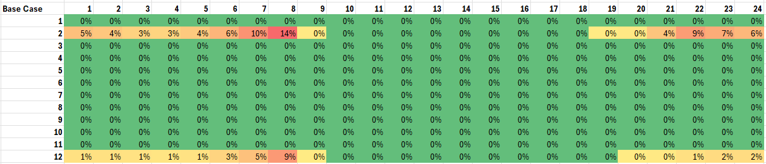
EUE Heat Maps – Base Case by Month
Notes:
Base Case includes standard ERCOT model prior to the Reliability Assessment Trial

Slide 7
EUE Heat Maps – Base Case by Weather Year
Base Case | 1 | 2 | 3 | 4 | 5 | 6 | 7 | 8 | 9 | 10 | 11 | 12 | 13 | 14 | 15 | 16 | 17 | 18 | 19 | 20 | 21 | 22 | 23 | 24
1983 | 0% | 0% | 0% | 0% | 0% | 0% | 1% | 2% | 0% | 0% | 0% | 0% | 0% | 0% | 0% | 0% | 0% | 0% | 0% | 0% | 0% | 0% | 0% | 0%
1984 | 0% | 0% | 0% | 0% | 0% | 0% | 0% | 0% | 0% | 0% | 0% | 0% | 0% | 0% | 0% | 0% | 0% | 0% | 0% | 0% | 0% | 0% | 0% | 0%
1985 | 0% | 0% | 0% | 0% | 0% | 0% | 2% | 3% | 0% | 0% | 0% | 0% | 0% | 0% | 0% | 0% | 0% | 0% | 0% | 0% | 1% | 1% | 0% | 0%
1989 | 1% | 1% | 1% | 1% | 1% | 2% | 3% | 6% | 0% | 0% | 0% | 0% | 0% | 0% | 0% | 0% | 0% | 0% | 0% | 0% | 0% | 1% | 1% | 1%
2013 | 0% | 0% | 0% | 0% | 0% | 0% | 0% | 0% | 0% | 0% | 0% | 0% | 0% | 0% | 0% | 0% | 0% | 0% | 0% | 0% | 0% | 0% | 0% | 0%
2021 | 4% | 4% | 3% | 2% | 3% | 5% | 7% | 10% | 0% | 0% | 0% | 0% | 0% | 0% | 0% | 0% | 0% | 0% | 0% | 0% | 3% | 7% | 6% | 5%
Notes:
Base Case includes standard ERCOT model prior to the Reliability Assessment Trial
Weather years without EUE removed from results

Slide 8
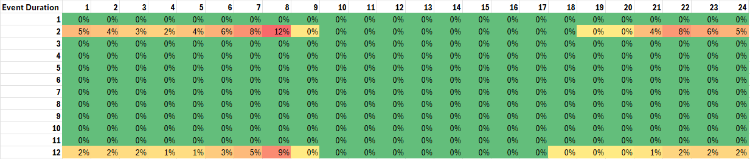
EUE Heat Maps – Updated Event Duration By Month
Notes:
Event Duration Case includes updated weather outage analysis performed by PowerGEM
Notes:
Add in summary of input change

Slide 9
EUE Heat Maps – Updated Event Duration by Weather Year
Base Case | 1 | 2 | 3 | 4 | 5 | 6 | 7 | 8 | 9 | 10 | 11 | 12 | 13 | 14 | 15 | 16 | 17 | 18 | 19 | 20 | 21 | 22 | 23 | 24
1983 | 0% | 0% | 0% | 0% | 0% | 1% | 1% | 3% | 0% | 0% | 0% | 0% | 0% | 0% | 0% | 0% | 0% | 0% | 0% | 0% | 0% | 1% | 1% | 0%
1984 | 0% | 0% | 0% | 0% | 0% | 0% | 0% | 0% | 0% | 0% | 0% | 0% | 0% | 0% | 0% | 0% | 0% | 0% | 0% | 0% | 0% | 0% | 0% | 0%
1985 | 0% | 0% | 0% | 0% | 0% | 0% | 1% | 3% | 0% | 0% | 0% | 0% | 0% | 0% | 0% | 0% | 0% | 0% | 0% | 0% | 1% | 1% | 0% | 0%
1989 | 1% | 1% | 1% | 1% | 1% | 2% | 3% | 6% | 0% | 0% | 0% | 0% | 0% | 0% | 0% | 0% | 0% | 0% | 0% | 0% | 0% | 1% | 1% | 1%
2013 | 0% | 0% | 0% | 0% | 0% | 0% | 0% | 0% | 0% | 0% | 0% | 0% | 0% | 0% | 0% | 0% | 0% | 0% | 0% | 0% | 0% | 0% | 0% | 0%
2021 | 4% | 4% | 3% | 2% | 3% | 5% | 7% | 9% | 0% | 0% | 0% | 0% | 0% | 0% | 0% | 0% | 0% | 0% | 0% | 0% | 3% | 6% | 6% | 5%
Notes:
Event Duration Case includes updated weather outage analysis performed by PowerGEM
Weather years without EUE removed from results

Slide 10
EUE Heat Maps – All Changes by Month
Notes:
All Changes includes Event Duration, January Reliability Risk, and updated weatherization curves.

Slide 11
EUE Heat Maps – All Changes by Weather Year
Notes:
All Changes includes Event Duration, January Reliability Risk, and updated weatherization curves.
1898_up10 and 2021_back21 are day-shifted versions of their respective years, used to reallocate risk across the three winter months.
Weather years without EUE removed from results

Slide 12
Weather Weighting
ERCOT SAWG Jan 2026

Slide 13
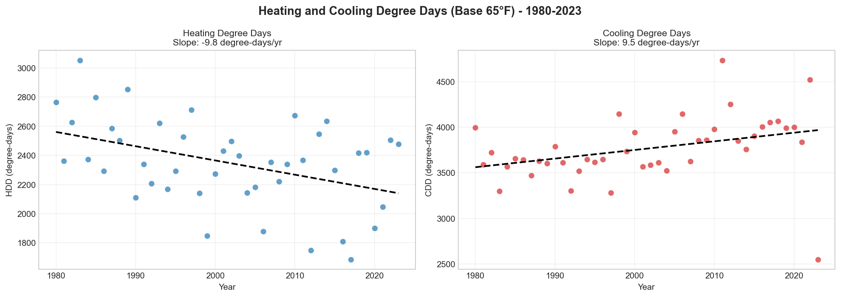
Weather Year Weighting

Slide 14
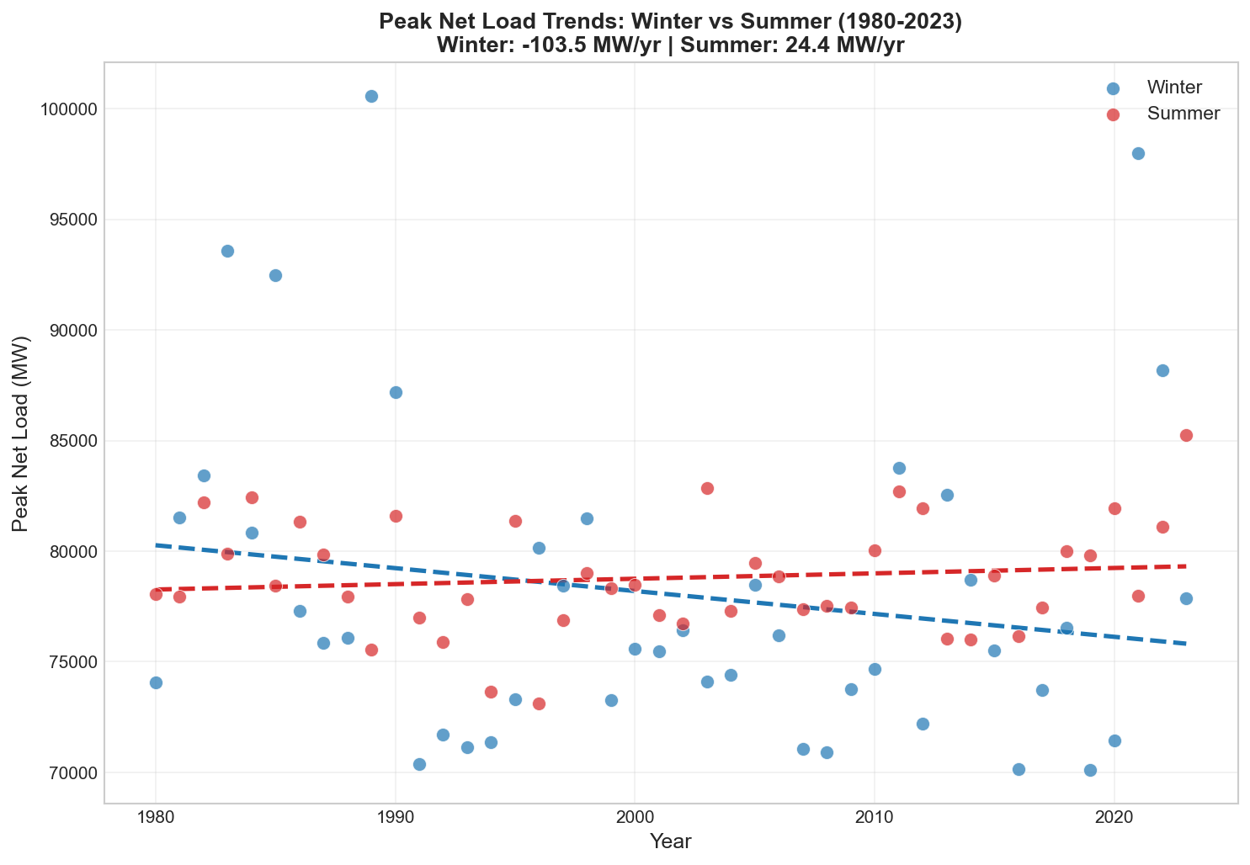
Weather Weighting - Net Load
Net load regression shows similar trend to the temperature plots: peak winter net load is trending down as peak summer net load is trending up.
PowerGEM has linearly reweighted the weather years to detrend the frequency of extreme cold and hot temperatures.

Slide 15
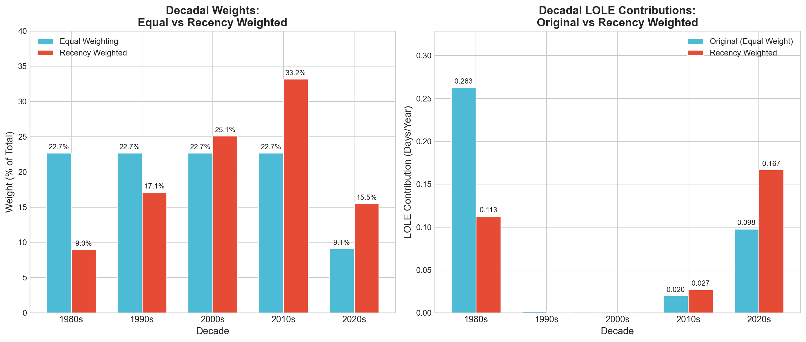
Weather Weighting

Slide 16
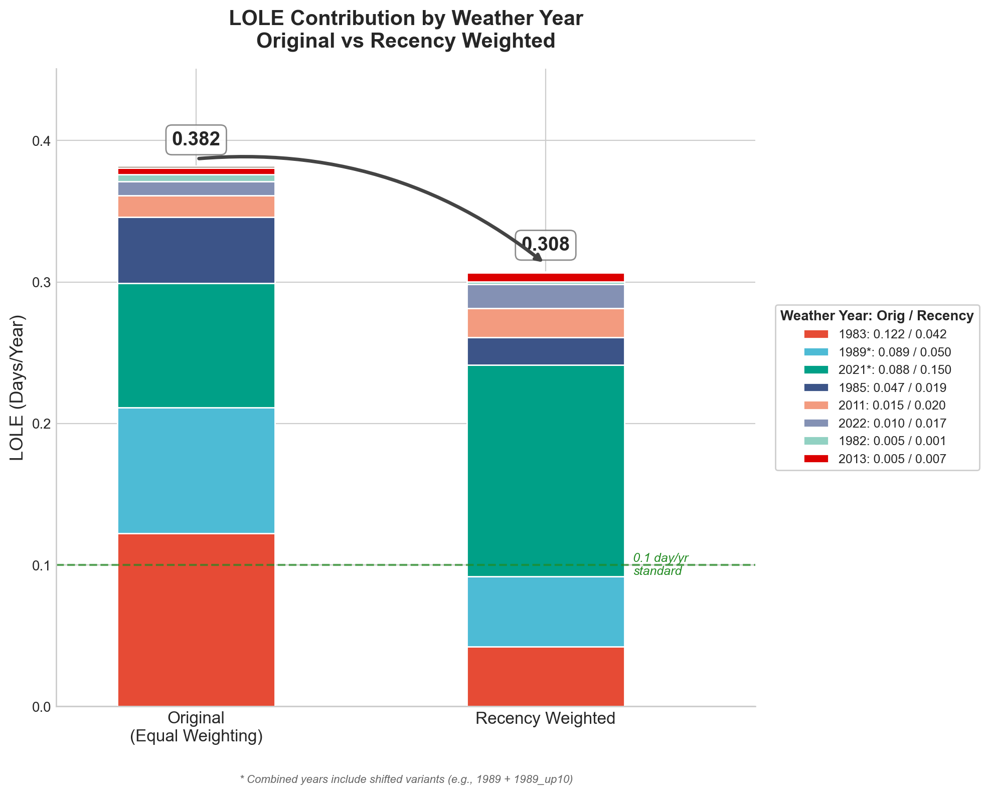
Weather Weighting
Applying recency weighting to weather years reduces overall system-wide LOLE by down-weighting major winter events from the 1980s.
This reduction is partially offset by increased weighting on higher-LOLE years such as 2011, 2013, 2021, and 2023.

Slide 17
Reweighted EUE Heat Map – By Month
Notes:
Note the reweighting adjusts the monthly risk balance as December outages
This might require redoing the Jan Reliability Risk analysis.

Slide 18
Reweighted EUE Heat Map – By Weather Year

Slide 19
Zonal Reliability Model
ERCOT SAWG Jan 2026

Slide 20
Zonal Reliability Study Objectives
Perform clustering analysis using PowerGEM’s TARA model to identify clusters with similar effects on flow-gates
Perform transfer limit analysis using TARA to identify zone-to-zone constraints and simultaneous import and export constraints
Run SERVM simulations to analyze the change in reliability for 2026 when moving from single zone representation of ERCOT to the clustered representation.

Slide 21
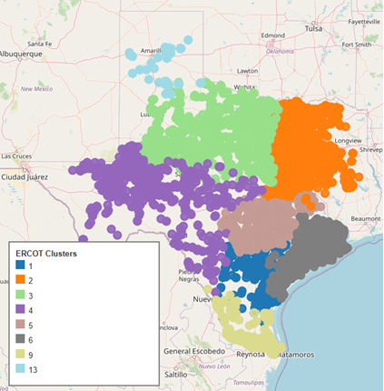
Clustering Results
13 clusters were initially identified by PowerGEM
PowerGEM worked with ERCOT and ultimately consolidated several zones
Final clustering includes 8 zones

Slide 22
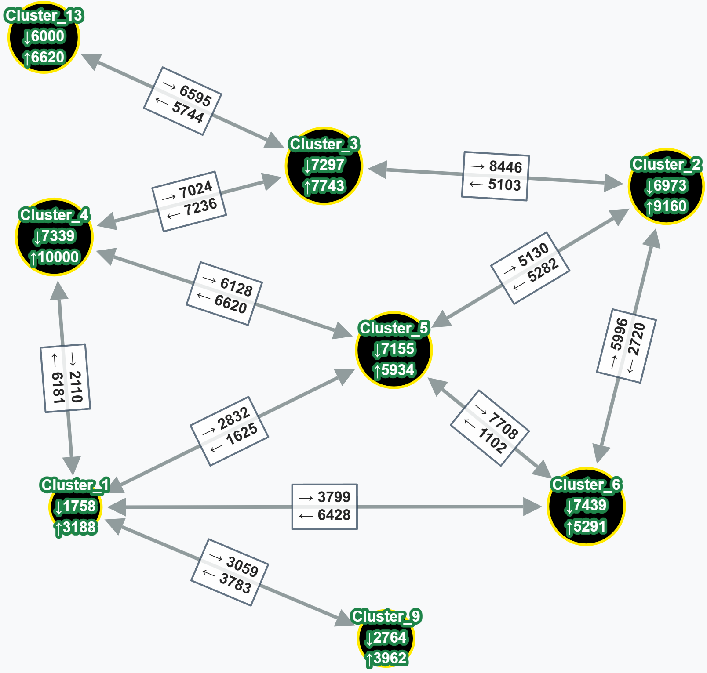
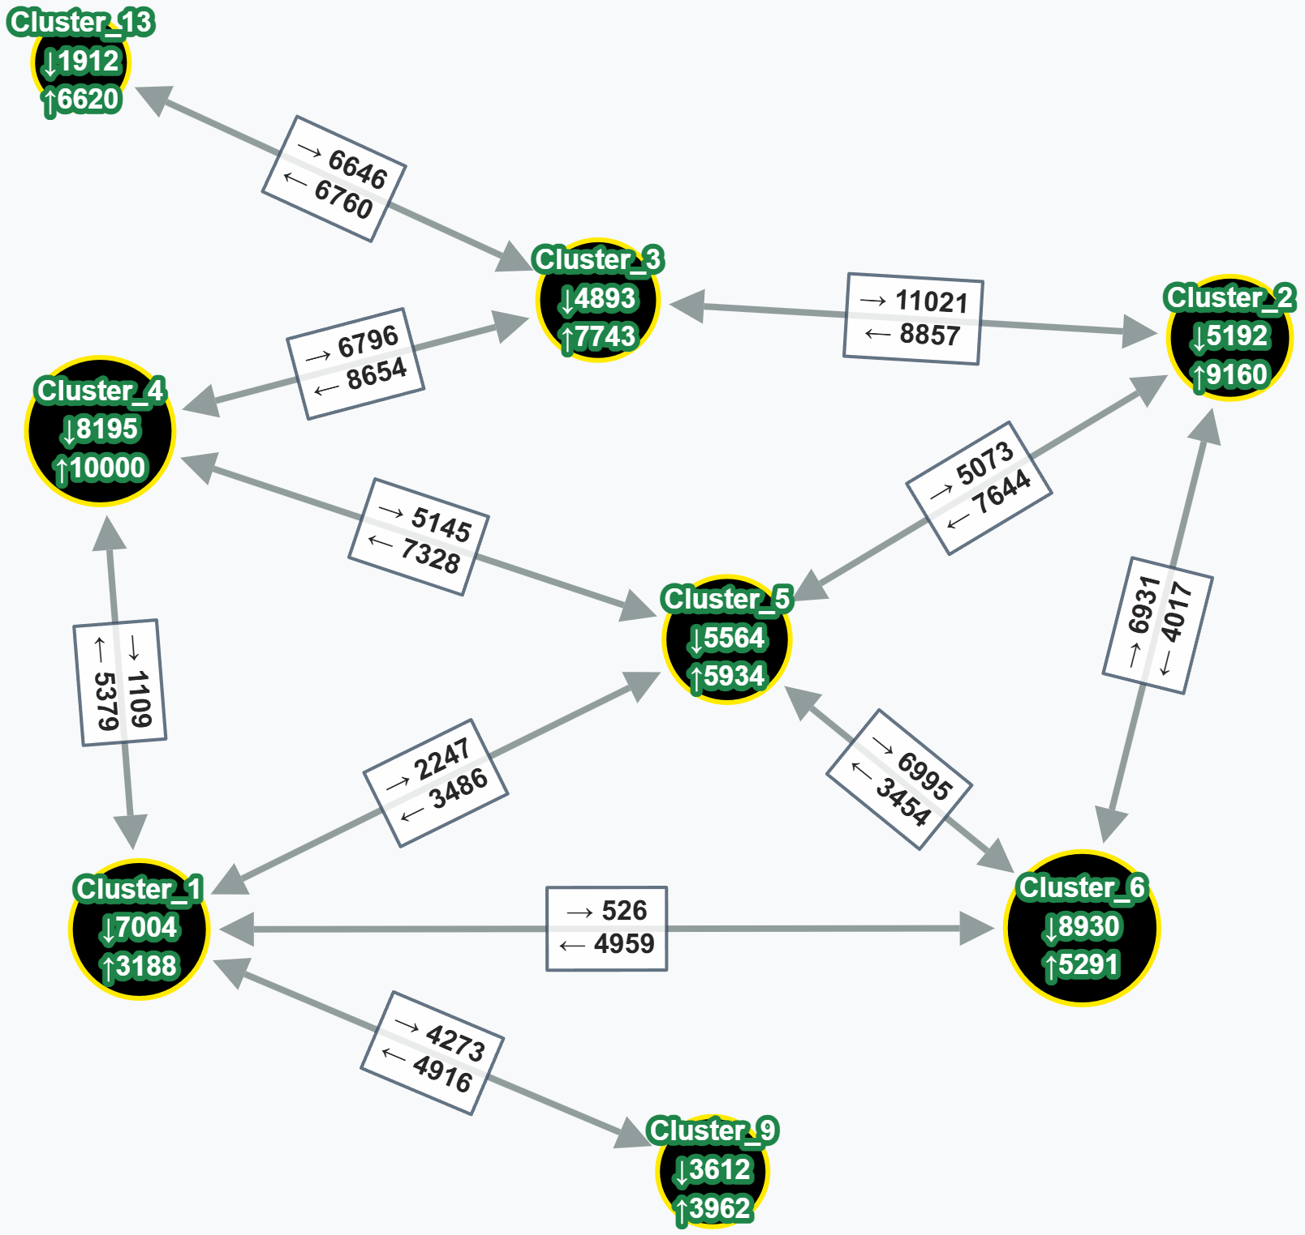
Seasonal Transfer Limits
Summer Transfer Limits
Winter Transfer Limits

Slide 23
Zonal Model Results
Copper Sheet scenario was from an intermediate study (does not match any of the studies previously discussed)
Aggregated constraints do not reflect emergency mitigation opportunities that would be available to operations

