Slide 1
NDSWG Meeting
January 2026

Slide 2
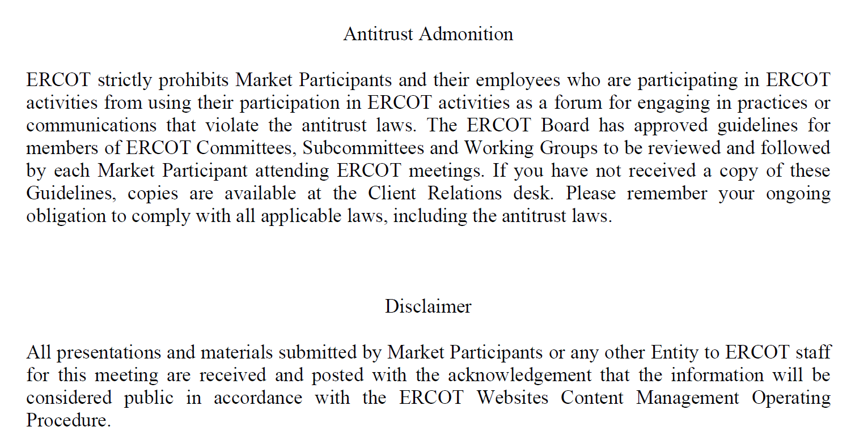
Antitrust Admonition

Slide 3
Topics
MOD33 – 33 Modeling Data Verification Request
NDSWG Vice Chair Nomination
Annual Review
End Use Industry Classification
Double Circuit Contingency
Manual Contingency
Other Topics:
On Site Meeting
UDG Workshop

Slide 4
Topics
MOD33 – 33 Modeling Data Verification Request
NDSWG Vice Chair Nomination
Annual Review
End Use Industry Classification
Double Circuit Contingency
Manual Contingency
Other Topics:
On Site Meeting
UDG Workshop

Slide 5
Topics
MOD33 – 33 Modeling Data Verification Request
NDSWG Vice Chair Nomination
Annual Review
End Use Industry Classification
Double Circuit Contingency
Manual Contingency
Other Topics:
On Site Meeting
UDG Workshop

Slide 6
Topics
MOD33 – 33 Modeling Data Verification Request
NDSWG Vice Chair Nomination
Annual Review
End Use Industry Classification
Double Circuit Contingency
Manual Contingency
Other Topics:
On Site Meeting
UDG Workshop

Slide 7
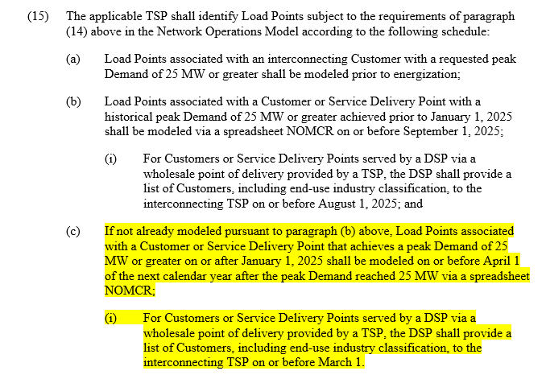
Annual Review - Load End Use Industry Classification
Nodal Protocols 3.10.7.2(15)

Slide 8
Annual Review - Load End Use Industry Classification
Load End-Use Classification Categories
Cryptocurrency Mining
Data Centers (non-crypto)
Government and Medical
Hydrogen and Electrofuel Production
Oil and Chemical Refining
Oil and Gas Production, Processing, and Transmission
Steel and Aluminum Manufacturing
Transportation
Other Industrial

Slide 9
Annual Review - Load End Use Industry Classification
Load Points that have achieved a peak demand of 25 MW or greater on or after January 1, 2025 shall be modeled on or before April 1 of the next calendar year
Market Notice will be sent on first week of February
Private Use Networks or Co-located loads will be available on ERCOT MIS ECEII Requested information folder
RE will submit an attachment only RSCR in RIOO RS on or before April 1 2026 with a description of “Load End Use Industry Classification Annual Review”

Slide 10
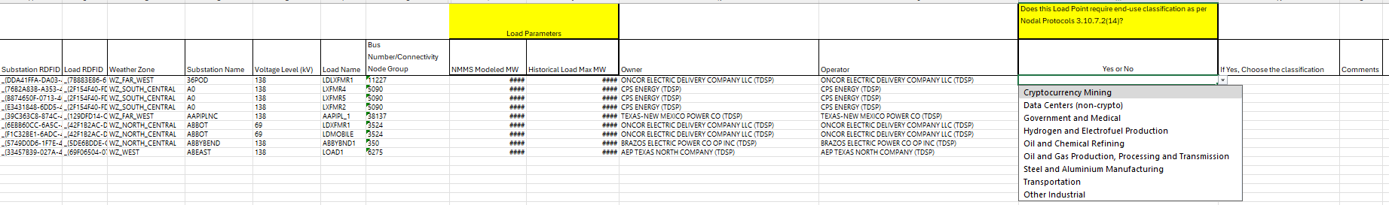
Annual Review - Load End Use Industry Classification
Spreadsheet will be posted in NMMS Postings by the end of January
TSPs will submit an ICR in NMMS on or before April 1 2026 with a Production Load Date of April 22 2026
Please include “Load End Use Industry Classification Annual Review” on the description

Slide 11
Annual Review:
Double Circuit Contingency Review
Kickoff email will be sent by beginning of March
Manual Contingency Review
Kickoff email will be sent by beginning of May

Slide 12
Topics
MOD33 – 33 Modeling Data Verification Request
NDSWG Vice Chair Nomination
Annual Review
End Use Industry Classification
Double Circuit Contingency
Manual Contingency
Other Topics:
On Site Meeting
UDG Workshop

Slide 13
Other Topics:
On Site Meeting / Training
Training is scheduled for Q4 2026
UDG Workshop
Tentative schedule is Q2 2026

Slide 14
Other Topics
Open Discussion…

