Slide 1
Market Participant Service Portal with new Identity Provider ERCOT Staff Technology Working Group 1/22/2026
Agenda
Overview of 2026 implementation focus
February TWG topics
Key Takeaway(s)
2026 focus is on the new MP Service Portal (MPSP) using a new identify management provider (IdP)
Market engagement occurring Q1 through Q3
Plans beyond the October release are TBD

Slide 2
Strategic Direction shared at October PRS
CURRENT STATE
Email and phone-call based exchange of forms and information between ERCOT & Stakeholders
Various access methods
FUTURE STATE
Portal-based, centralized, auditable, & streamlined forms and information exchange between ERCOT & Stakeholders
Use of modern and streamlined access methods for security & efficiency

Slide 3
High Points
2026 Focus is on the Market Participant Service Portal (MPSP) with the new identity management provider (IdP).*
Automation of Client Services Workflows
Digitization of Legal Forms
Merging Weatherization Portal into MPSP
Oct 2026 is the MPSP target release - this is the next available release window.
Plans continue to evolve thru Q1; technical details firm up in Q2; readiness focus in Q3.
Plans for subsequent releases will develop throughout 2026.
Communication at TWG or a TWG-sponsored workshops.
* Scope list in Appendix

Slide 4
What to Expect in 2026
Q1
Ongoing development and ERCOT testing for the MPSP
Q2
Begin implementation of new IdP & integrate into ERCOT MPSP test environment
Q3
Stakeholder data collection - new data in alignment with MPSP and NPRRs, in support of testing and go-live readiness (July)
Target Release in October (earliest opportunity for MPSP Go-Live; next is April 2027, due to blackout period for Weatherization Inspections)
Stakeholder education - training on MPSP with new IdP (multiple opportunities, July-September)
Target for Board of Directors approval of related NPRR1302, NPRR1303, NPRR1306 (June)
Q4
Stakeholder sandbox testing (August-September)
Ongoing stabilization support & additional education, as needed
Ongoing MPSP development and ERCOT testing
Review & Feedback (February/March TWG): MPSP scope and objectives & NPRR relationship to digitization of forms & new IdP
Share initial 2027 wave plan to digitize the remaining 60+ forms in scope
Share targeted implementation timelines for MPSP (March TWG)
Confirm and refine implementation timelines for MPSP
IAM Modernization – onboard implementation vendor & select IdP
Review & Feedback: approach for MPSP education and sandbox testing, implementation timelines and MP impact details (June TWG)
Share initial plan to digitize forms in the MPSP, with priority focus on forms targeted in Oct 2026 (June TWG)
Share initial 2027/2028 plan for integrating the new IdP into other external-facing applications
Checkpoint on path to MPSP October go-live (end of Q2)
Review & Feedback: Approach and timeline to digitize remaining ~60 forms in scope
Review & Feedback: Approach and timelines for integrating the new IdP into other external-facing applications

Slide 5
Topics for February TWG
Review & Feedback
MPSP scope, objectives, usability considerations, and expected impacts to MPs
NPRR relationship to digitization of forms in MPSP & new IdP

Slide 6
Appendix
Scope, NPRR References, Outcomes

Slide 7
MPSP October Release Scope
MP Service Portal with new IdP for Market Participant identify management
Notice of Change of Information (NCI) – Legal (New Item)
LSIPA (Section 23 Form S) – Legal (Existing Item on Public Portal)
Annual Membership Request – Legal (Existing Item on Public Portal)
Contact Client Services – Client Services (New Item)
Public Information Request – Client Services (Existing Item on Public Portal)
MIS Report Request – Client Services (Existing Item on Public Portal)
RE : Summer Appendix A – Weatherization (Existing Item on Weatherization Portal)
RE : Summer Attachment K – Weatherization (Existing Item on Weatherization Portal)
RE : Summer Notarized Attestation – Weatherization (Existing Item on Weatherization Portal)
RE : Winter Appendix A – Weatherization (Existing Item on Weatherization Portal)
RE : Winter Notarized Attestation – Weatherization (Existing Item on Weatherization Portal)
TSP : Summer Appendix A – Weatherization (Existing Item on Weatherization Portal)
TSP : Summer Notarized Attestation – Weatherization (Existing Item on Weatherization Portal)
TSP : Winter Appendix A – Weatherization (Existing Item on Weatherization Portal)
TSP : Winter Notarized Attestation – Weatherization (Existing Item on Weatherization Portal)
PUC Request for Information – Weatherization (Existing Item on Weatherization Portal)
Weatherization Support – Weatherization (Existing Item on Weatherization Portal)
*Additional forms are under consideration for digitization in the MPSP October release; feasibility to be determined in Q2
*Existing MP identify management solution remains in place for all other external-facing applications; detailed planning for these applications will not start until later this year

Slide 8
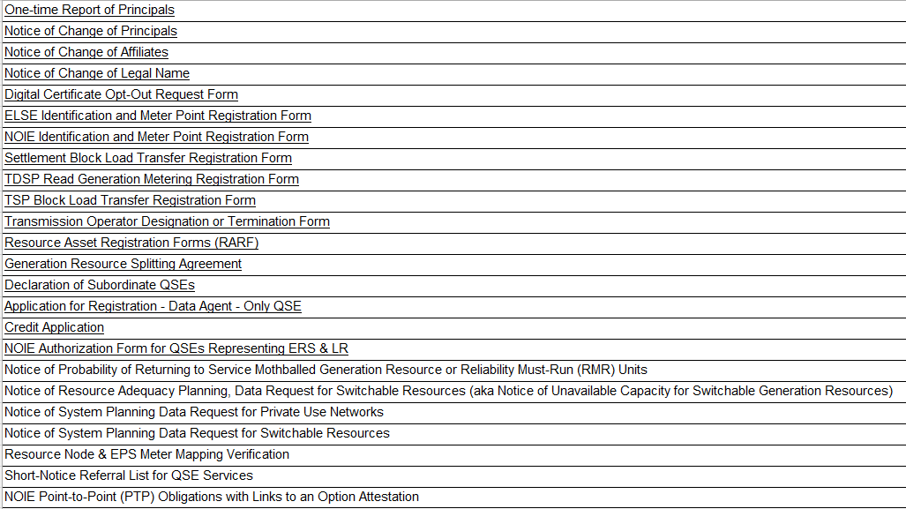
Form Digitization Scope for TBD later releases
Protocol Section 22 Forms A-E, G-N
Protocol Section 23 Forms A-S
Other Forms:

Slide 9
Additional IdP Integration Timing is TBD
Integration of the new IdP into additional market-facing web applications is currently TBD.
Plans will be shared later this year, and current expectation is that changes to additional applications are not likely to occur prior to 2027.

Slide 10
Related Revision Requests
MP Service Portal | Status
NPRR1302, Addition of a Market Participant Service Portal within the MIS Certified Area and Revision of Forms | Tabled at PRS
NPRR1303, Modernize Submission of Declarations of Natural Gas Pipeline Coordination | Approved
NPRR1306, Removal of Digital Certificate References for Market Participants with ERCOT MIS Access | Tabled at PRS
RMGRR184 | Tabled at RMS

Slide 11
MP Service Portal Outcomes
Desired Outcomes:
Reduce MP email and phone interactions with ERCOT staff.
Enable MPs:
Contact Client Services and submit IT issues through the portal.
Submit applications, forms and requests directly in the portal (reducing email-based submissions).
Track submission status in real time via a dashboard.
Implement secure access with Username/Password & MFA for access and authentication.
Digitize Protocol Sections 22 and 23 forms and workflows, including:
Submission of Protocol Section 23, Form E: Notice of Change of Information (NCI).
Submission of Protocol Section 23, Form S: Reporting and Attestation Regarding Purchase of Critical Electric Grid Equipment (CEGE) and Critical Electric Grid Services (CEGS) from a Lone Star Infrastructure Protection Act (LSIPA) Designated Company or LSIPA Designated Country (LSIPA Attestation).
Provide automated features:
Perform initial validation for completeness (e.g., checking required fields or uploaded documents).
Confirm receipt of submissions.
Routing of approved submissions to relevant departments and updating the system directly, minimizing data entry.
Enable in-portal messaging or notifications to replace email communication, reducing confusion and enhancing response times.
Deliver a user-friendly, self-service experience and MPs can check their submission status & correct deficiencies.
Reduce administrative workload, allowing the process to scale more easily as the volume of submissions increases.
Maintain a centralized log for all submissions, updates, and communications for audits and compliance.
11

