Slide 1
2026 Reliability Assessment Activities
Supply Analysis Working Group
Pete Warnken
Resource Adequacy Department
January 23, 2026

Slide 2
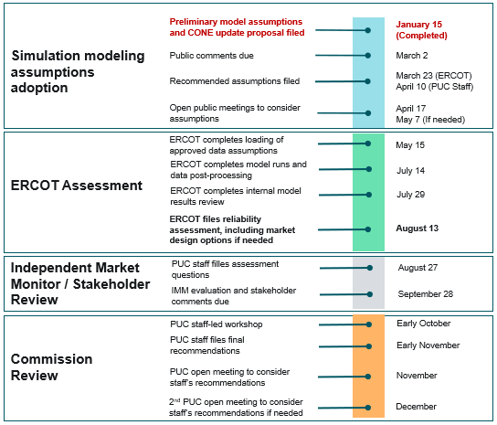
Reliability Assessment Roadmap
Key PUC pending policy decisions impacting the roadmap and assessment outcome:
    Consideration of using a new load forecast based on the upcoming large load forecasting compliance plan in lieu of the current “ERCOT-Adjusted Load Forecast”
    Adoption of a new planning CONE (or CONEs) for assessing the system cost of market design options if needed for reliability standard compliance

Slide 3
Preliminary Proposed Modeling Input Assumptions
  List of input assumptions, with associated high-level modeling background and references, filed with the Commission on January 15, 2025: https://interchange.puc.texas.gov/search/documents/?controlNumber=58777&itemNumber=6
  Must include:
    the number of historic weather years that will be included in the modeling;
    (ii) the amount of new resources and retirements, in megawatts, listed by
    resource type;
    (iii) the weatherization effectiveness; and
    (iv) any other assumptions that would impact the modeling results, along with an explanation of the possible impact of the additional assumptions.

Slide 4
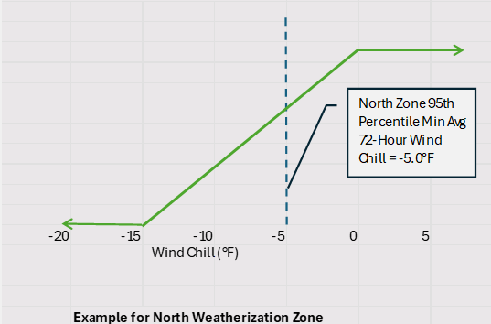
Preliminary Proposed Modeling Input Assumptions
  Key assumptions documented:
    Number of historical weather years: 44 (1980 through 2023, inclusive)
    Resources and retirements: December 2025 Capacity, Demand and Reserves (CDR) report
    Weatherization effectiveness: Adopts a piece-wise approach for weather-related unplanned thermal outages by weatherization zone
      85% reduction when wind chill temp is at or above the 95th percentile criterion temp values
      Linearly declining effectiveness percentage for a temp range of 5° above to 10° below the criterion temp values
      0% effectiveness for lower temps

Slide 5
Preliminary Proposed Modeling Input Assumptions
  Other key proposed assumptions:
    Load forecast: Use the 2025 ERCOT-Adjusted Forecast or a 2026 Regional Transmission Plan (RTP) compliant forecast based on Transmission and/or Distribution Service Providers (TDSP’s) large load forecast data
    Dispatchable Reliability Reserve Service (DRRS): Model as similar to non-spin Ancillary Service for 2029 with qualification criteria and other attributes outlined in NPRR1309
    Weather Year Weighting: Change from uniform annual weights (“probabilities”) to linearly increasing weights such that the trend in the frequency of extreme temperatures (both low and high) is flat across the entire historical window. This approach decreases the impact of older loss-of-load events while placing greater weight on events in more recent years.
    Transmission representation: Base simulation to reflect a single ERCOT zone with DC tie transfers; indicative zonal Loss of Load Expectation (LOLE) sensitivities can be performed if desired
    Reliability Standard “Magnitude” criterion: 13,988 MW for 2026, 14,509 MW for 2029

Slide 6
Cost of New Entry (CONE) Update Proposal
  Filed concurrently with the modeling input assumptions
    https://interchange.puc.texas.gov/Documents/58777_5_1575180.PDF
  Proposed tasks for the Brattle/Sargent & Lundy Team
    Task 1: Identify candidate reference technologies for 2029
    Task 2: Conduct expedited bottom-up cost analyses for the candidate reference technologies
      Leverage the Brattle Team’s PJM study
    Task 3: Translate costs into ERCOT-specific CONE values, updating the CONE model prepared for the 2024 CONE study
    Task 4: Equipment availability assessment to inform scenarios for potential market design options and capacity expansion modeling
    Tasks 5-7: Vetting process support and CONE report development
  CONE value(s) to be ready in time for possible market design option evaluation

