Slide 1
Public Dashboard Enhancement Request Process Update
Priyanka Parthasarathy
January 2026

Slide 2



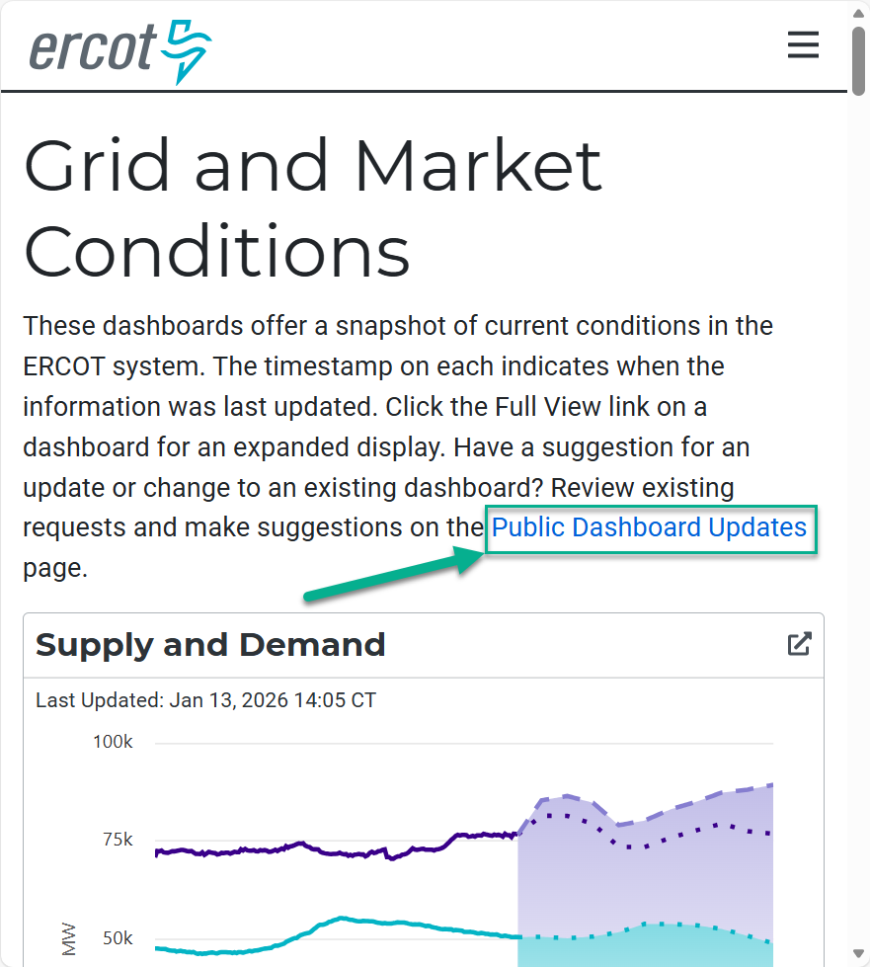
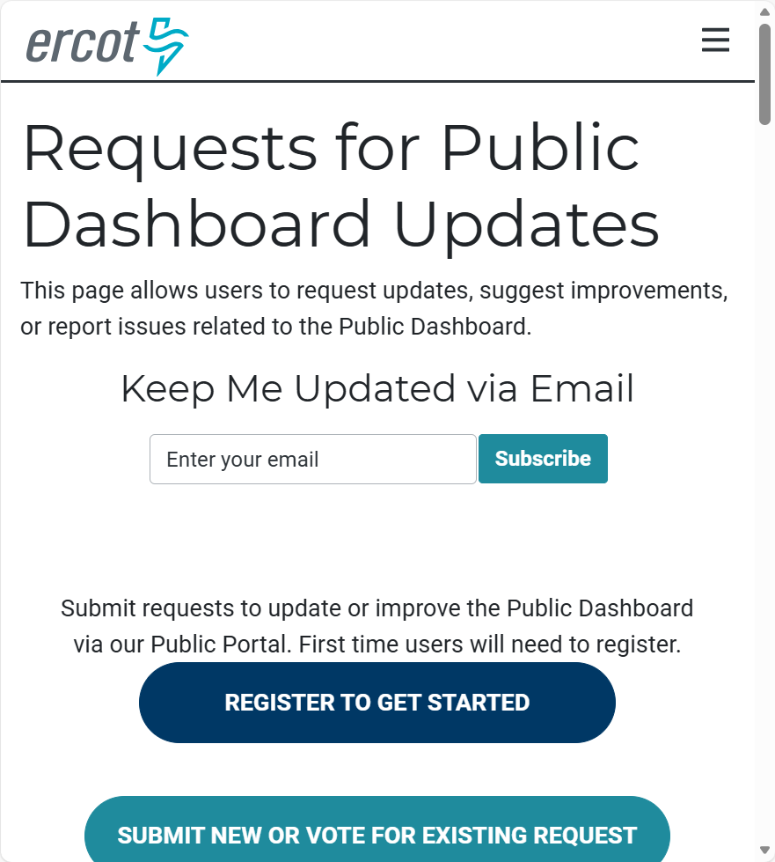
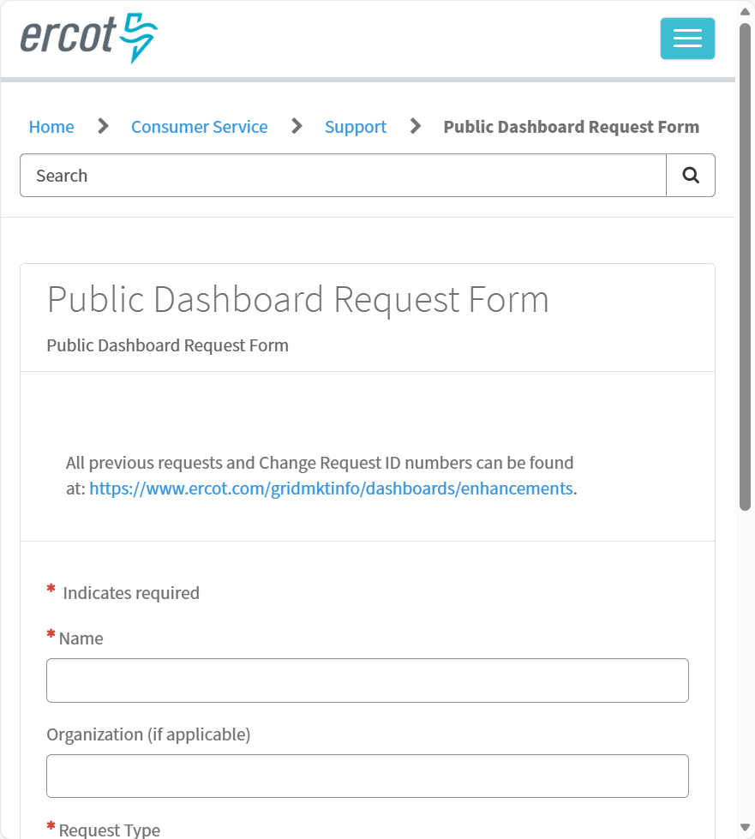
Steps to Submit & View Requests
Access the page from Grid or Market Conditions - > Requests for Public Dashboard Updates page.
Request updates, review existing requests, or subscribe to notifications.
Submit a new change request or add your vote to an existing request.

Slide 3


Dashboards & Displays Process Flow
1
2
3
4
5
ERCOT Schedules Implementation of Dashboard/Display Changes
Dashboard Requests
Complete Dashboard
ERCOT Impact Analysis Review
Project Review
ERCOT Consideration
4
Rejected
Roadmap & Status Updates
& Display Request Form
& Prioritization

Slide 4
Questions & Contact Info
ERCOT will consider all requests but does not make any assurance that requests will be adopted. If ERCOT determines in its sole discretion that the request should be granted, it will be worked on according to ERCOT's timeline for dashboard enhancements and requests.
Contact us: webmaster@ercot.com
Feedback is also received via ERCOT committees and groups.

