Slide 1



Powering the AI Revolution Without Breaking the Grid
ERCOT LLWG Meeting
Relyion Energy Inc.
Jan 22nd 2026
Notes:
Hi, I am Surinder Singh, CEO and founder of Relyion Energy, where we have built a smarter battery brain for a renewable energy future with foundations in AI-based battery management systems.

Slide 2
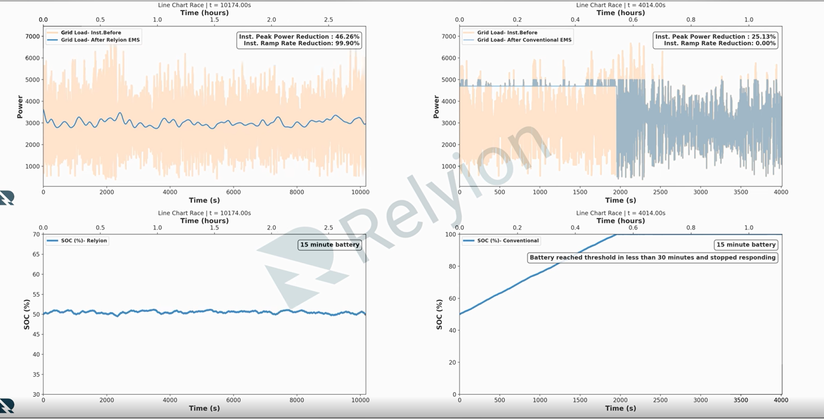
AI-Powered Flexible Datacenter Power Management
• Peak grid power reduced by 50%
• Ramp rates reduced by 99.5%+
• Transients eliminated, not deferred
• Sustained operation without SOC drift
Convert peak-to-trough power demand to a lower, more stable “base load,” enabling faster access to power with lower capital requirements
Enables Data Center Mission Critical Operations and Grid Resiliency

Slide 3
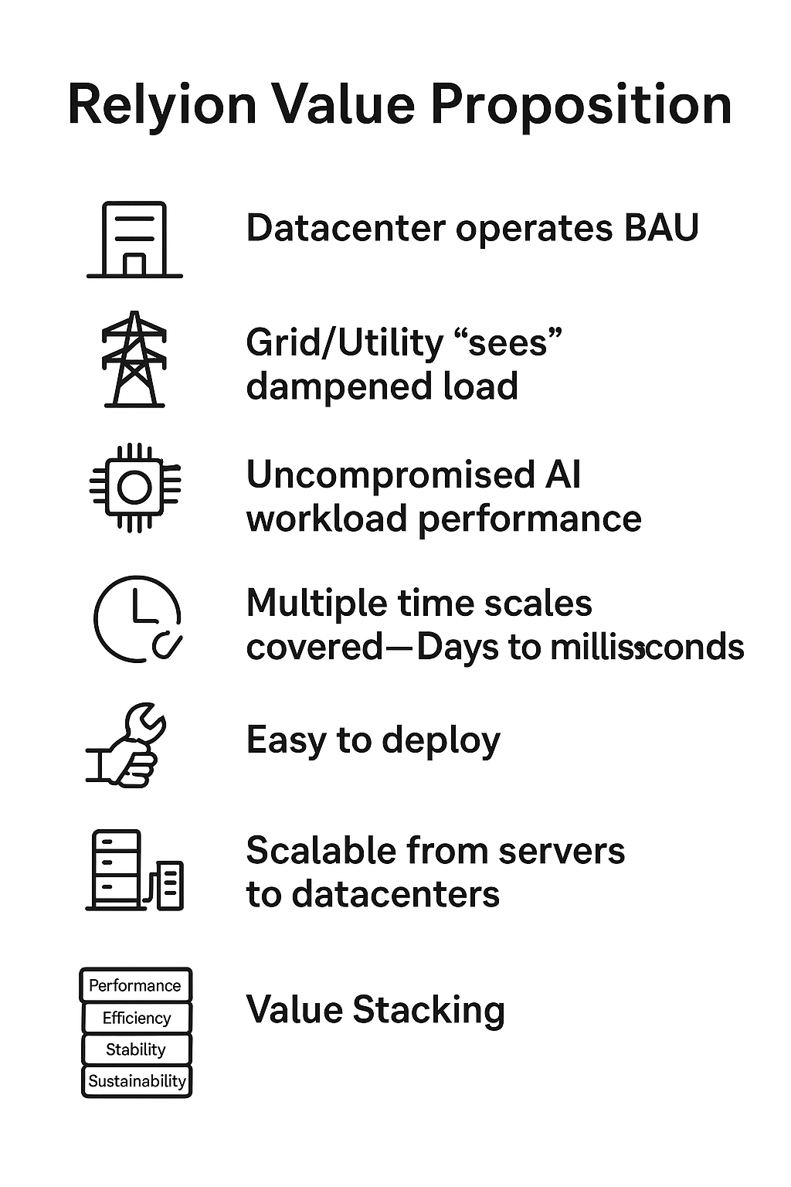
Relyion Value Proposition
Proprietary and Confidential
3
Datacenter operates Business As Usual
Grid/Utility “sees” dampened load
Uncompromised AI workload performance
Multiple time scales covered- Days to milliseconds
Software solution is easy to deploy
Scalable from servers to datacenters
Value Stacking
Exponential Revenue Generation Partner for Customer

Slide 4






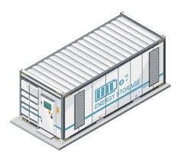


Technology Building Blocks
AI WORKLOAD
TOTAL DEMAND
FORECASTING
COOLING POWER
BATTERY ENERGY STORAGE
OPTIMZATION

Slide 5
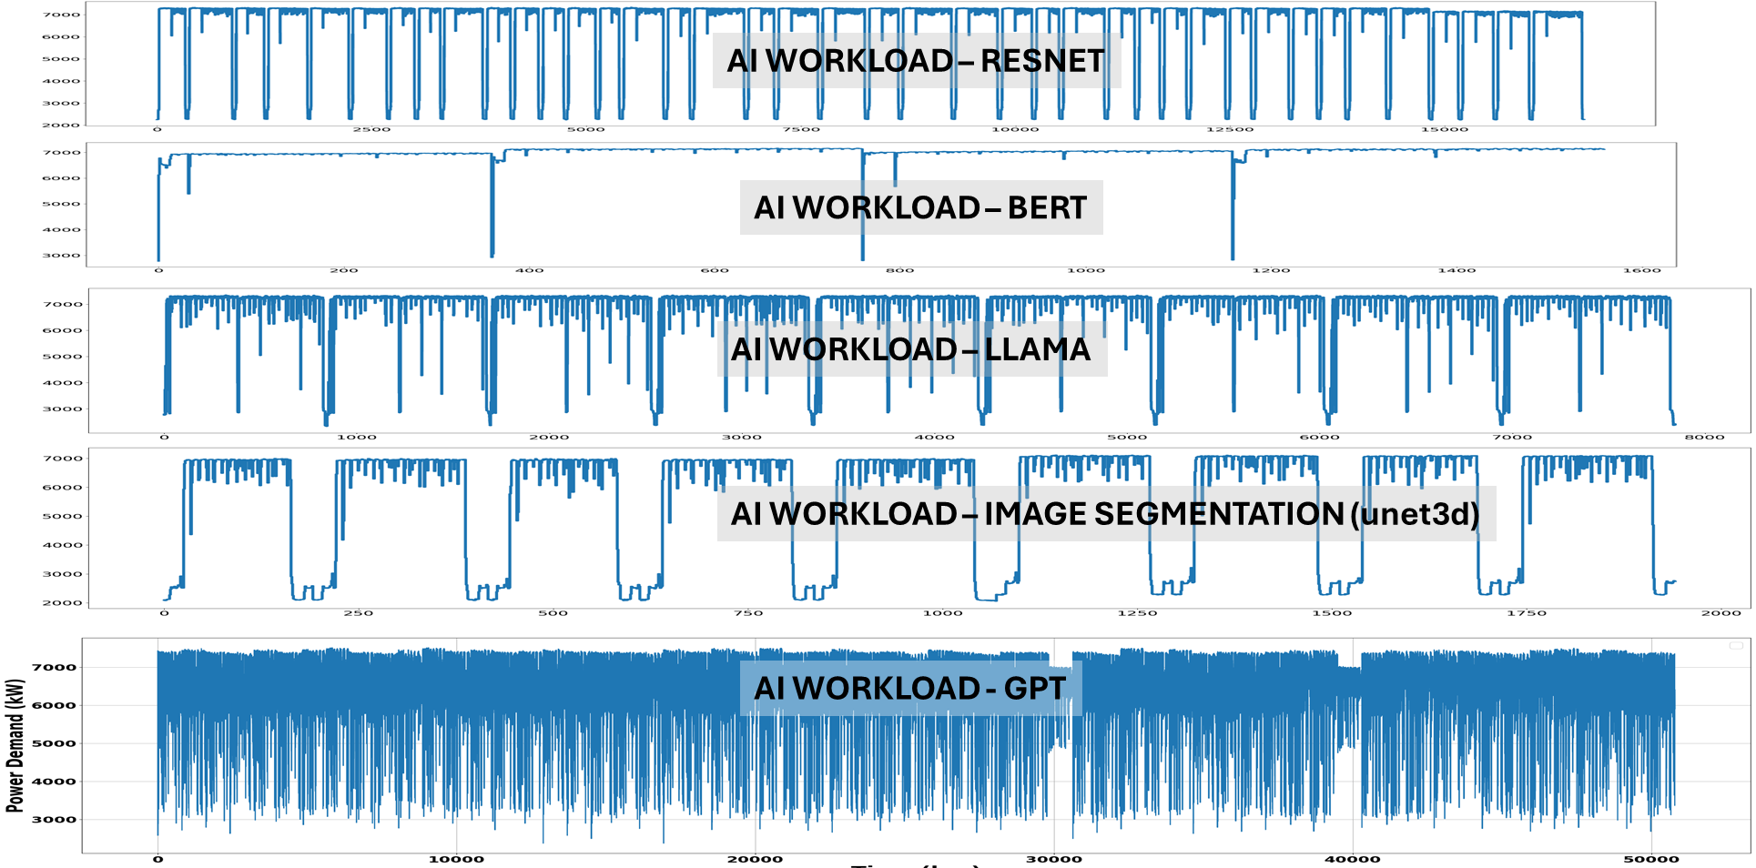
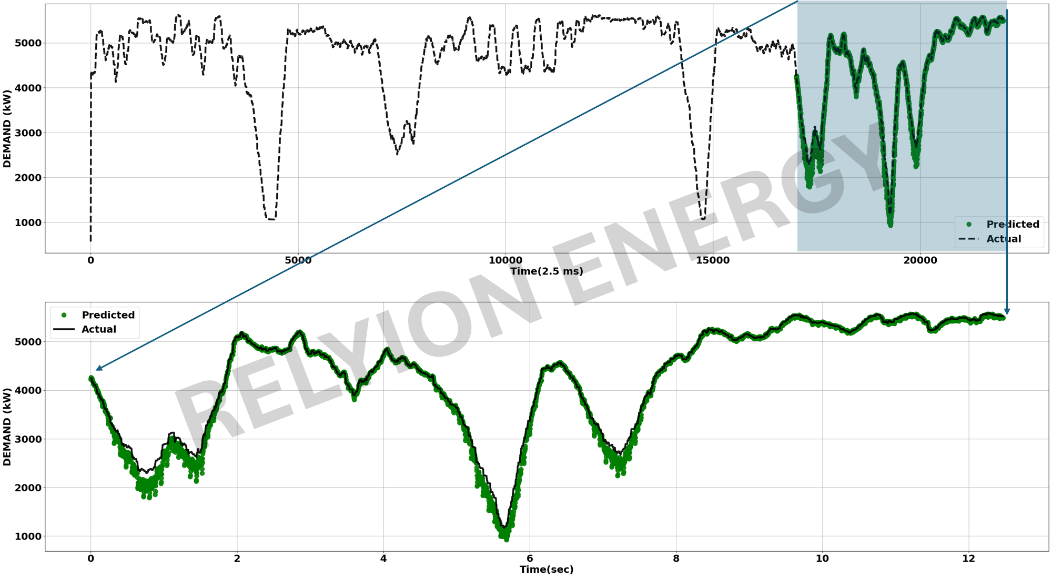
Forecasting
Transformer based AI model
Recognize patterns
Recognize interdependencies
Recognize context across sequences
Asymmetric Loss function with custom weights
Datacenter constraints (Workload characterization)

Slide 6

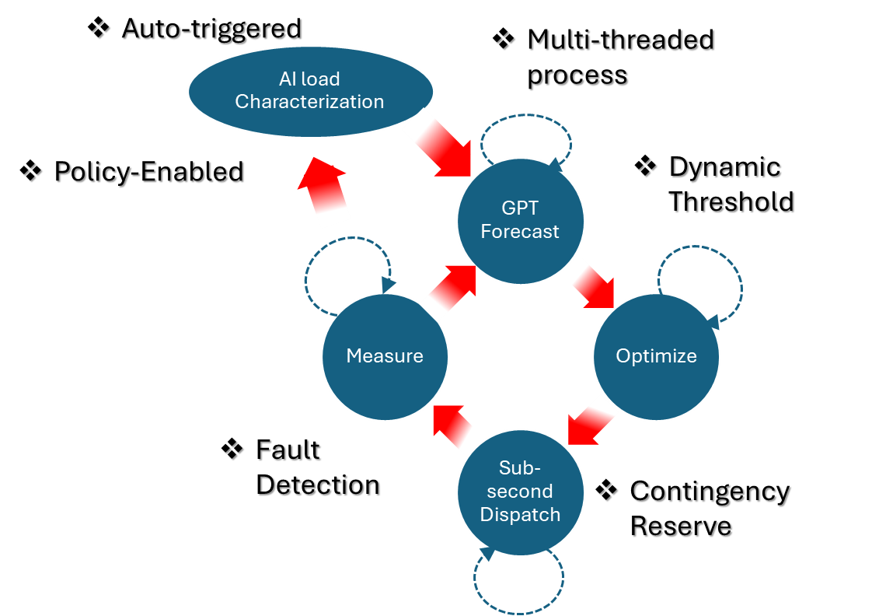
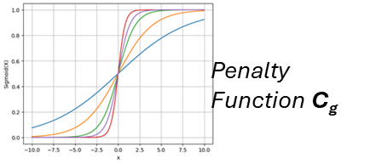
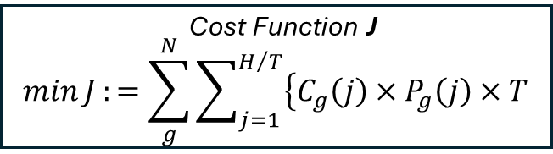
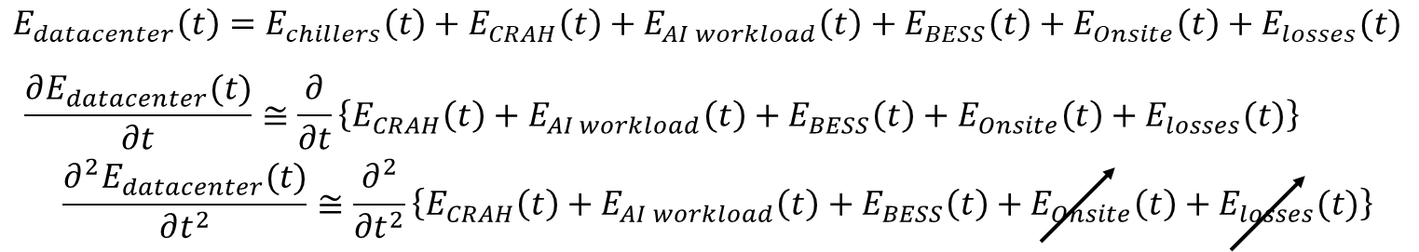
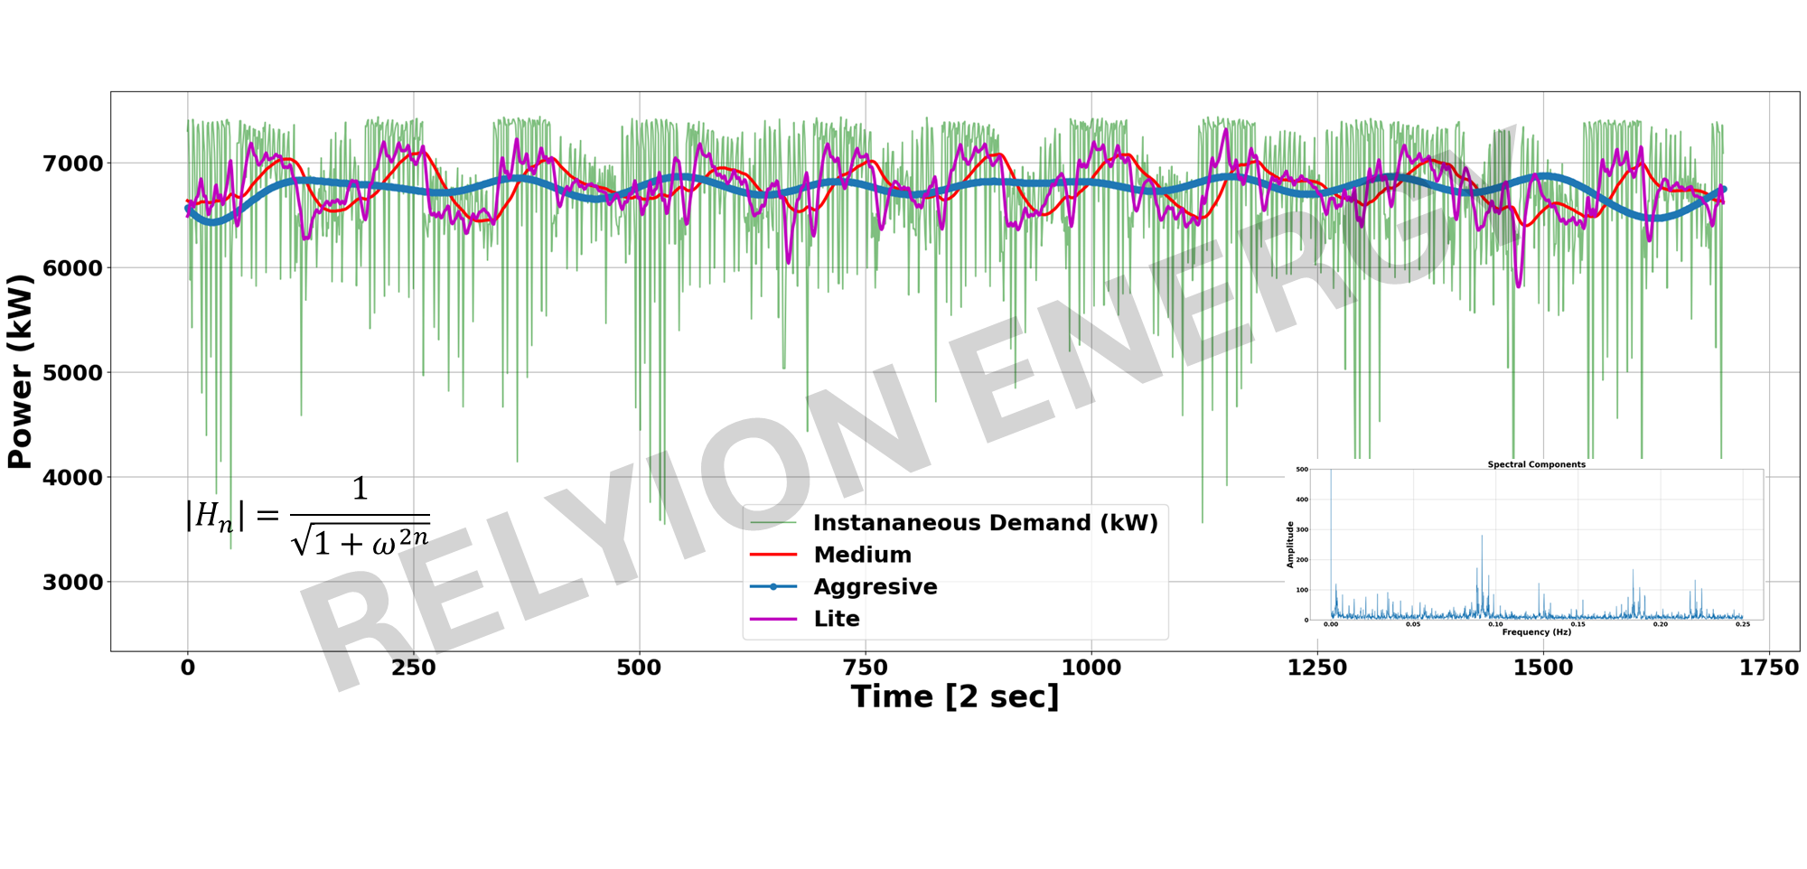
Nonlinear Optimization of BESS Operation
Optimization workflow
Model Predictive Control

Slide 7
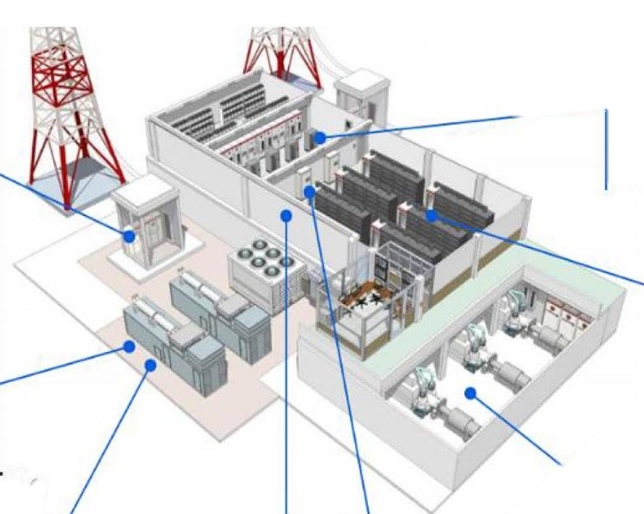
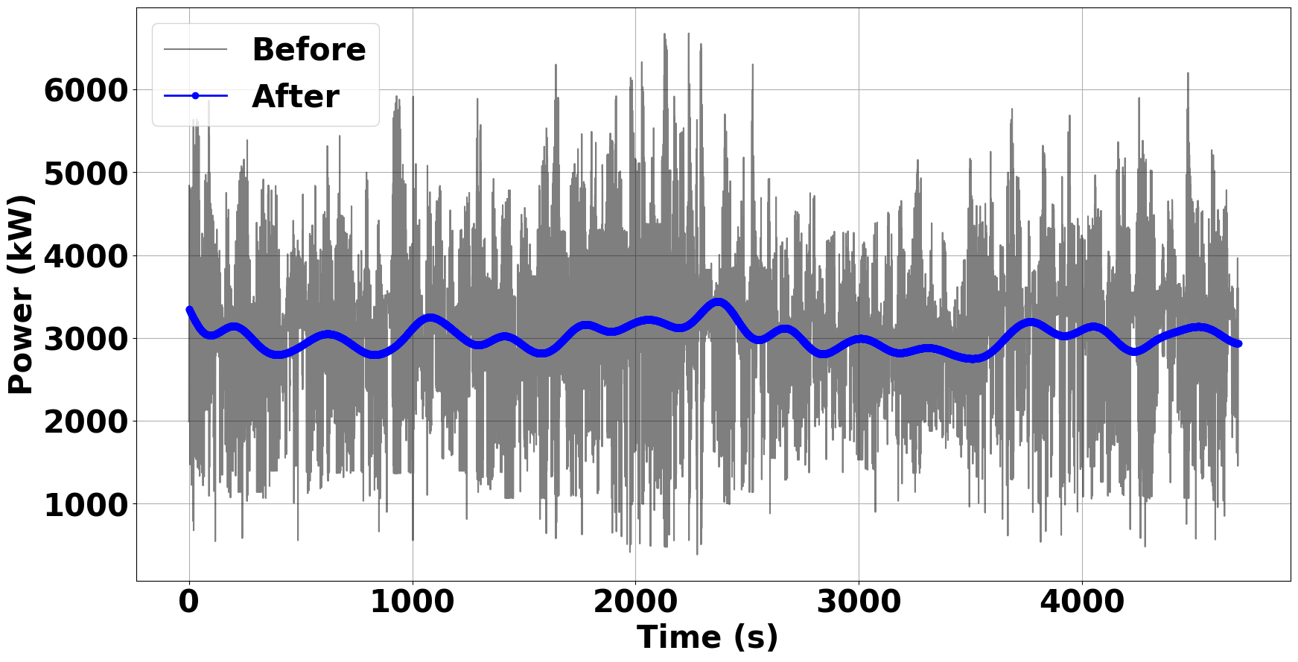
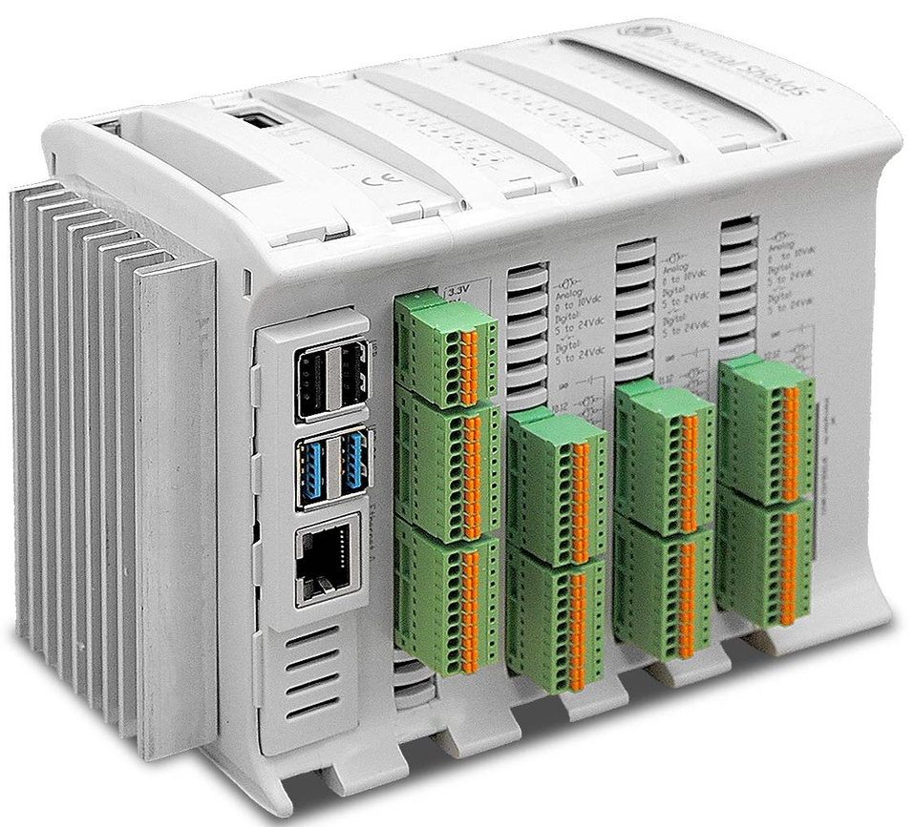
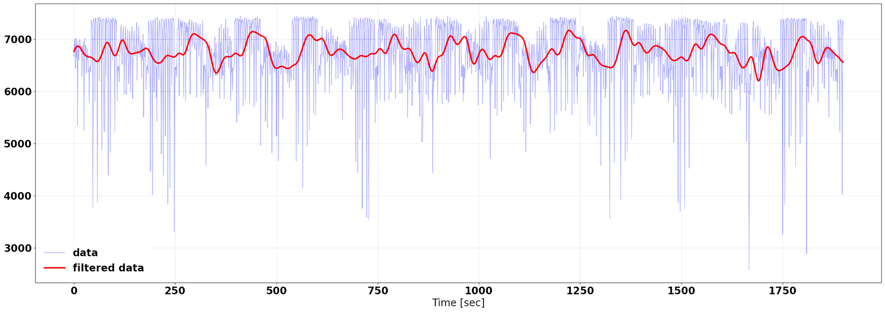

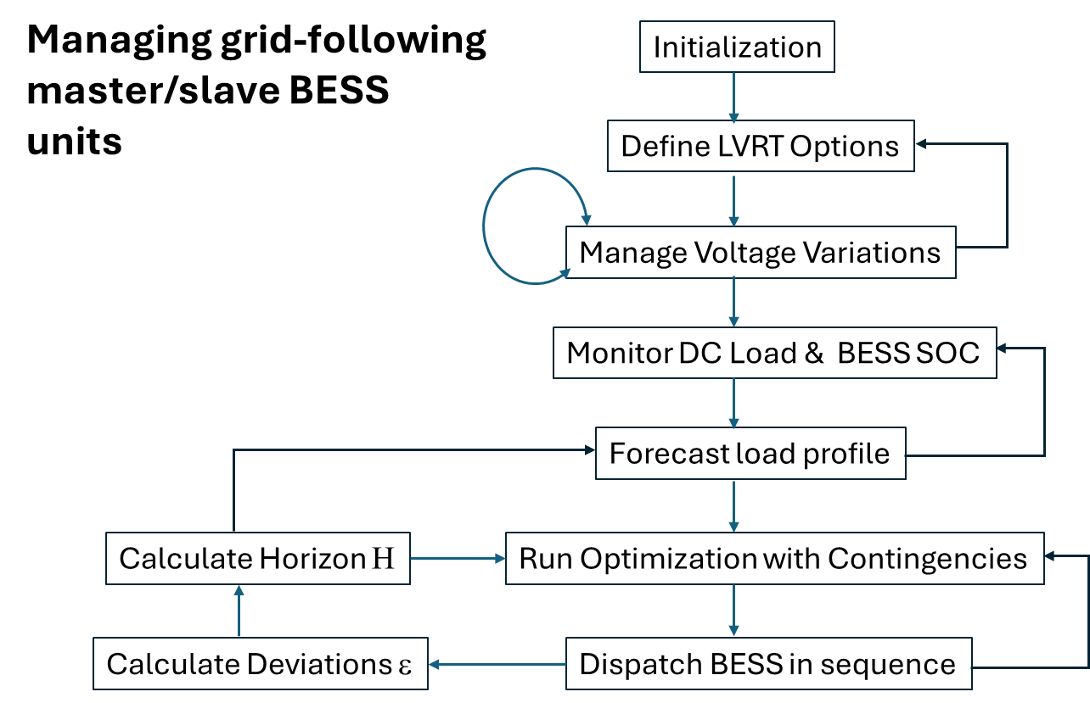
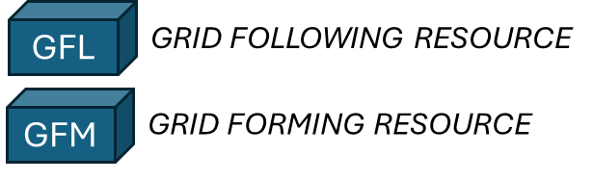
Realtime Orchestration
Power
GFM
GFL
GFL
GFM
GFL
GFL
GFM
GFL
GFL
PLC
GFL
GFL
GFL
Network
GFL
GFL
GFL
GFM

Slide 8
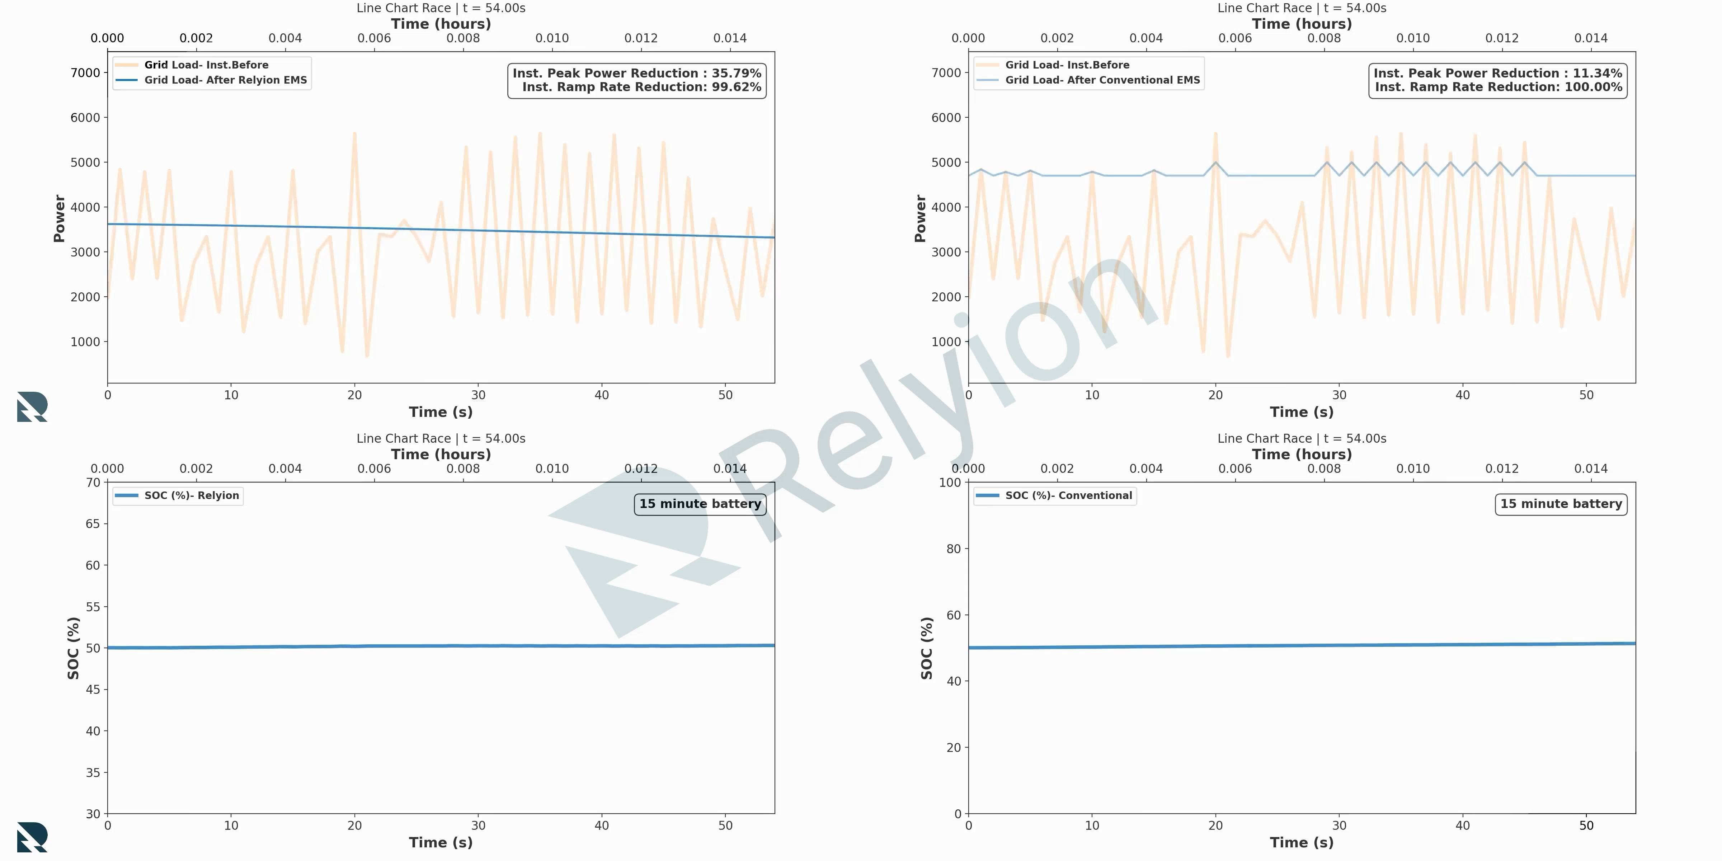
AI Solution Relyion
Conventional Solution

Slide 9
Summary
Consistent BESS Operation for stable load at POI
Easily Integrable with any other ancillary processes
Compute load management
Cooling load management
Preventive Maintenance
Easily Integrable with other operation policies/objectives
Dynamic Enable/Disable without interruption/downtime
Minimal Capacity degradation of BESS
Scalable from racks to datacenter wide deployment

Slide 10
Thank you

Slide 11
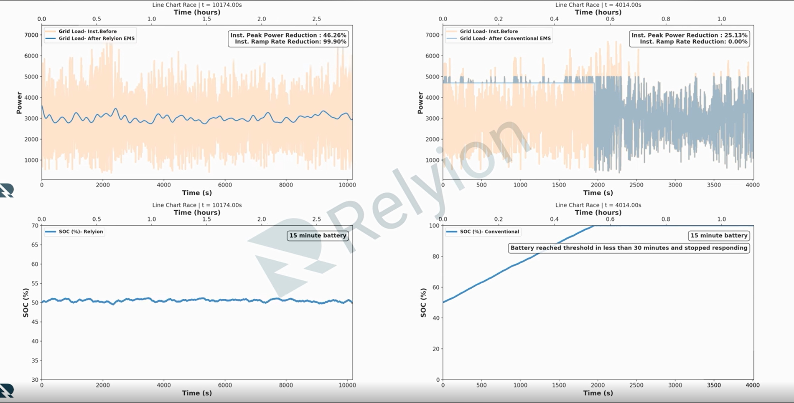
AI-Powered Flexible Datacenter Power Management
• Peak grid power reduced by 50%
• Ramp rates reduced by 99.5%+
• Transients eliminated, not deferred
• Only a small duration battery is effective
• Sustained operation without SOC drift
• Conventional BESS becomes ineffective in approximately 30 minutes
These results translate into clear, system-level benefits
across the ecosystem:
• Faster interconnection timelines by materially lowering peak power requests
• Higher compute uptime and revenue certainty by stabilizing power delivery at the source rather than reacting after instability occurs
• Lower capex for datacenter operators by avoiding oversized batteries and infrastructure built solely to manage transients
• Reduced capital requirements for utilities, easing transmission and distribution upgrades and lowering long-term cost pressure on ratepayers
• Improved grid stability through the elimination of continuous load-induced transients and oscillations
Convert peak-to-trough power demand to a lower, more stable “base load,” enabling faster access to power with lower capital requirements

