Slide 1
ERCOT Frequency Control Report
November 2025
ERCOT
Operations Planning
PDCWG | January 21st , 2026

Slide 2
Summary of November 2025
CPS1: 184.08%
Current CPS1 12-Month Rolling Average: 176.63%
0 BAAL Exceedance(s)
0 hourly CPS1 score below 100%
BAAL-003 Events have updated through 2024
2024 BAAL-003 FRM Performance: -1127.76
2025 RMS1 Statistics
Mean: 14.49 mHz
Min: 10.55 mHz
Max 20.14 mHz
Energy Statistics
Total Energy: 35,121,541 MWh
Wind Energy: 9,609,890 MWh
Percent Energy from Wind: 27.36%
Solar Energy: 4,656,344 MWh
Percent Energy from Solar: 13.26%
Minimum System Inertia
Mean: 189,849 MW*s
Max: 260,206 MW*s on Nov. 19th
Min: 146,852 MW*s on Nov. 4th

Slide 3
Frequency Control
CPS1, BAAL, & RMS1

Slide 4
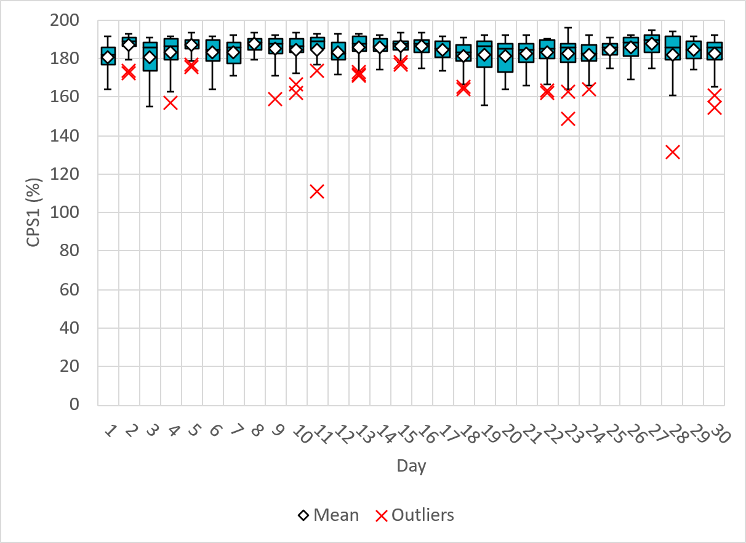
Hourly CPS1 by Day
Nov-25 CPS1 (%): 184.08
Notes:
CPS1 Score is 174.97%
Zero outliers over 180%:

Slide 5
BAAL Exceedances & Violations
There were 0 BAAL exceedance(s) in November.

Slide 6
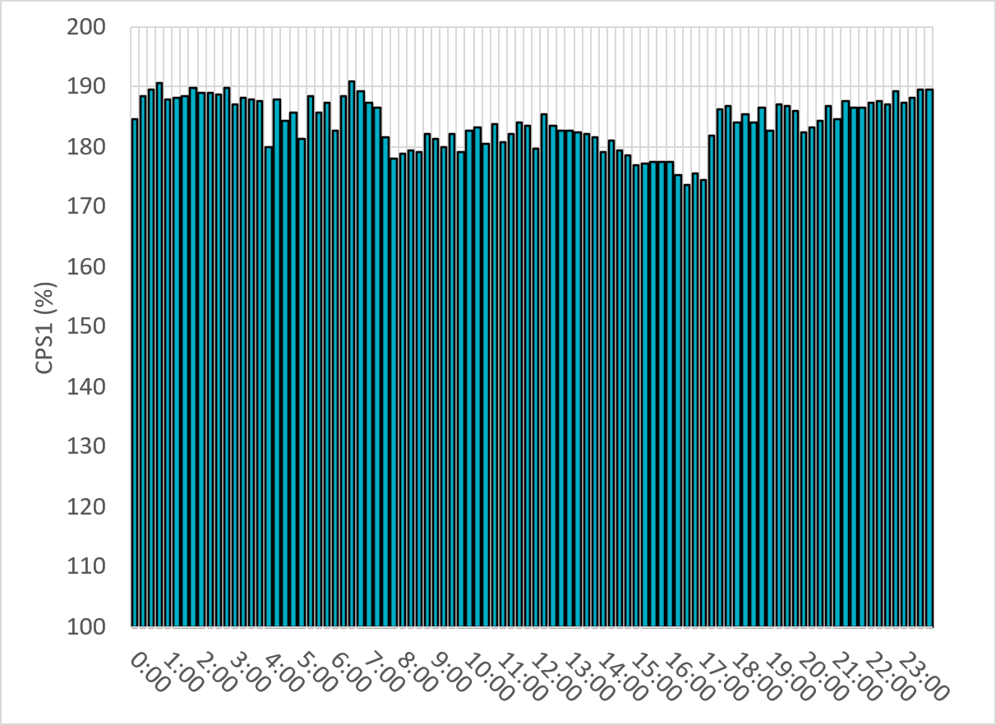
15-Minute Average CPS1%
Nov-25 CPS1 (%): 184.08
Notes:
CPS1 score is above 160% for all 15-minute intervals.

Slide 7
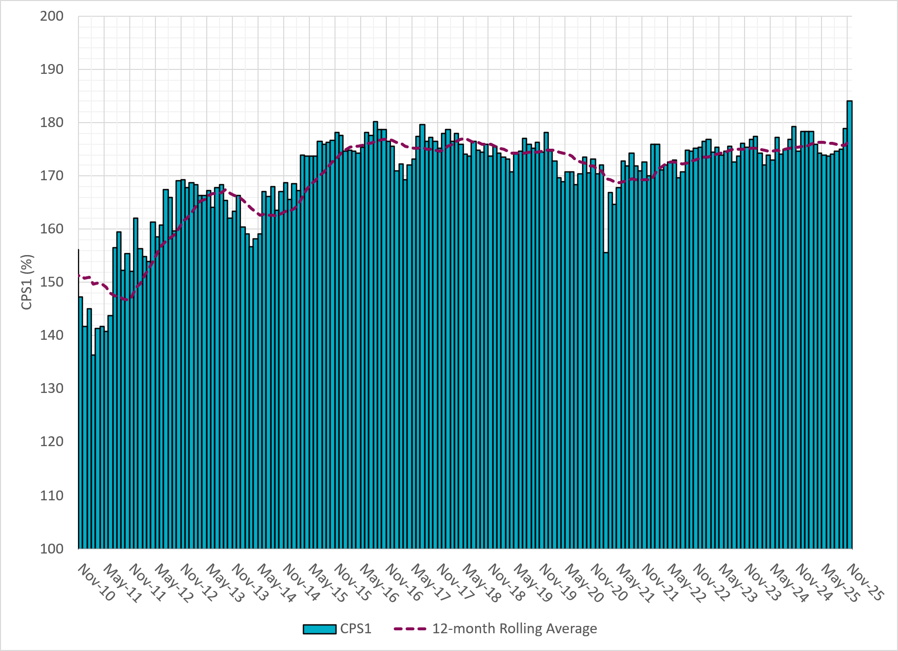
12-Month Rolling Average CPS1
Current 12-Month Rolling Average: 176.63%
Notes:
12 month rolling average CPS1 score is 176.63% which is in line with expectations

Slide 8
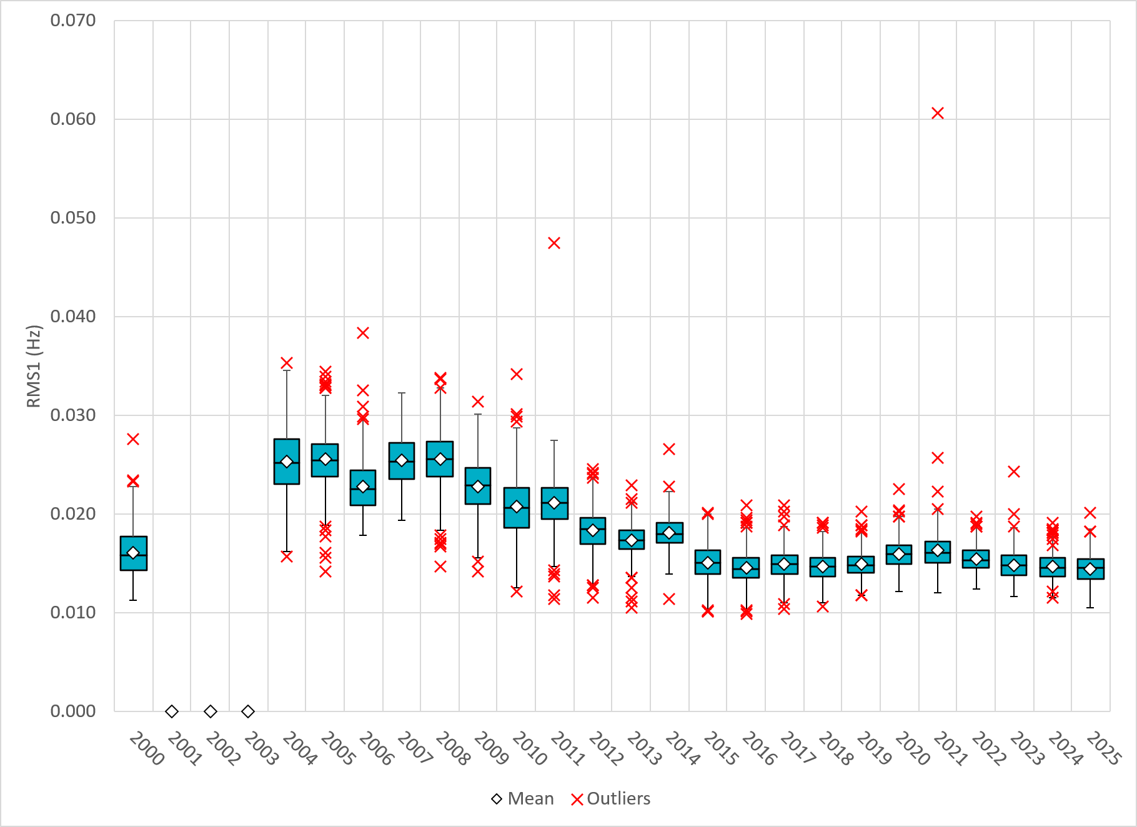
Daily RMS1 of ERCOT Frequency by Year
Notes:
Daily RMS1 frequency by year is lower compared to 2024.
2025 Stats:
Mean: 14.49 mHz
Min: 10.55 mHz
Max 20.14 mHz

Slide 9
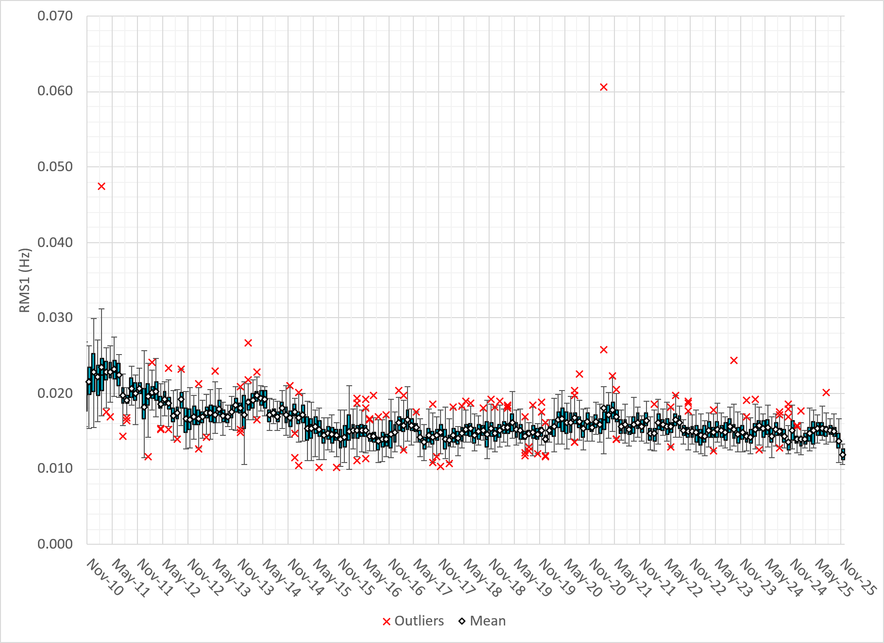
Daily RMS1 of ERCOT Frequency by Month
Notes:
A More granular look at last 15 years of RMS1 by Month
11.93 mHz on avg for November 2025

Slide 10
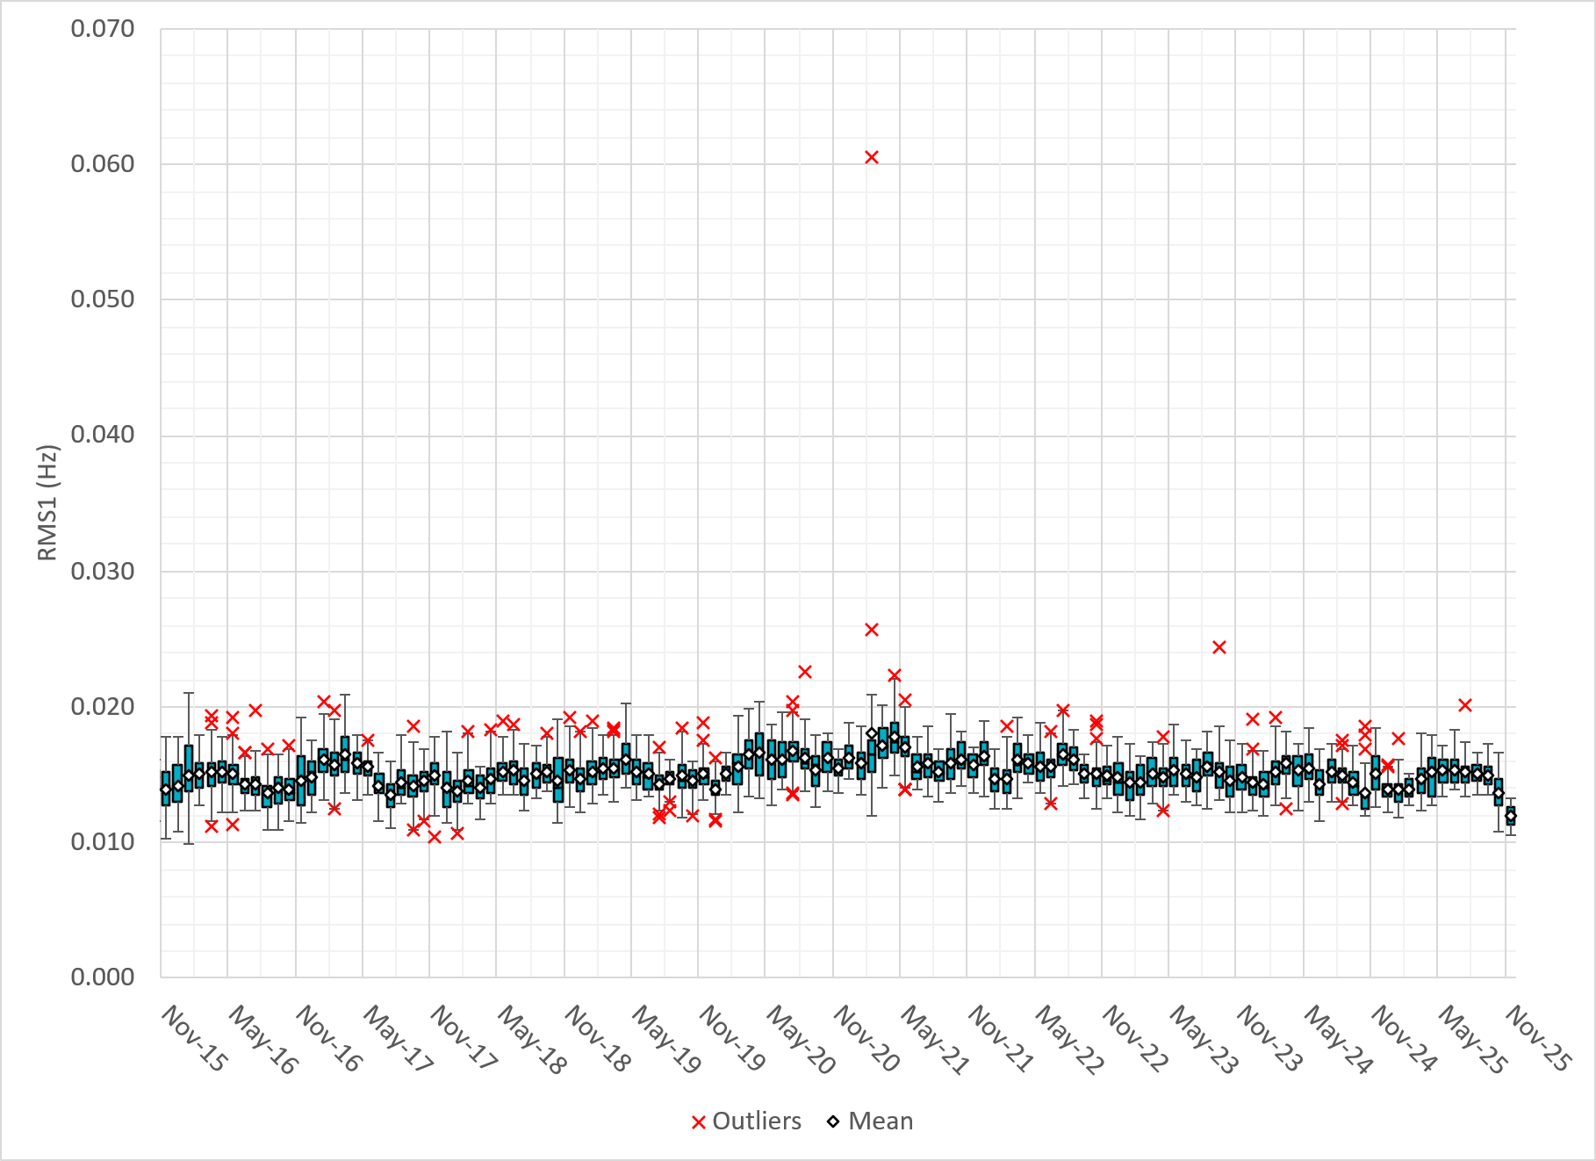
Daily RMS1 of ERCOT Frequency by Month
Notes:
Same data with 10 years shown instead of 15

Slide 11
Frequency Profile Comparison

Slide 12
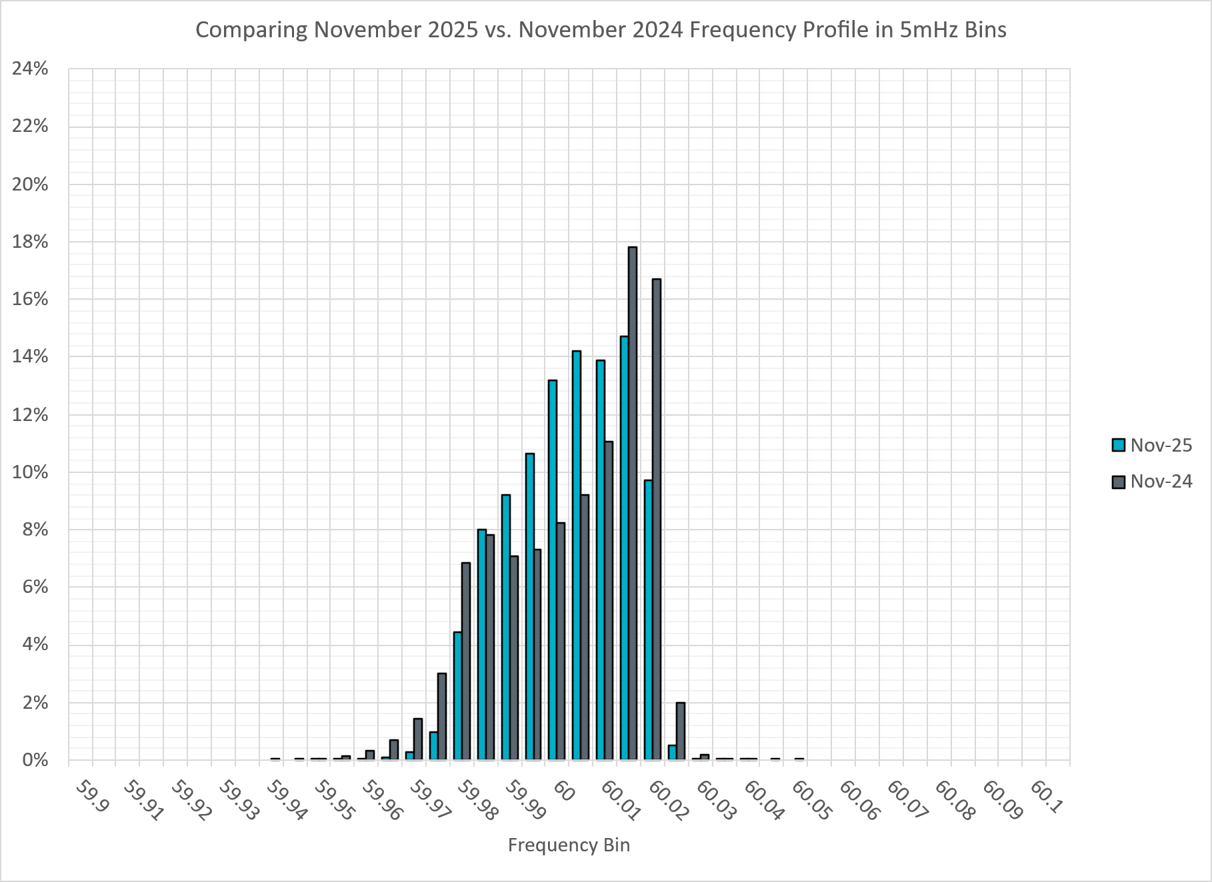
Frequency Profile Comparison
Notes:
Comparison of frequency profile between November 2024 and November 2025. Compared to last year, there are less instances of frequency hovering around the lower and higher deadbands.

Slide 13
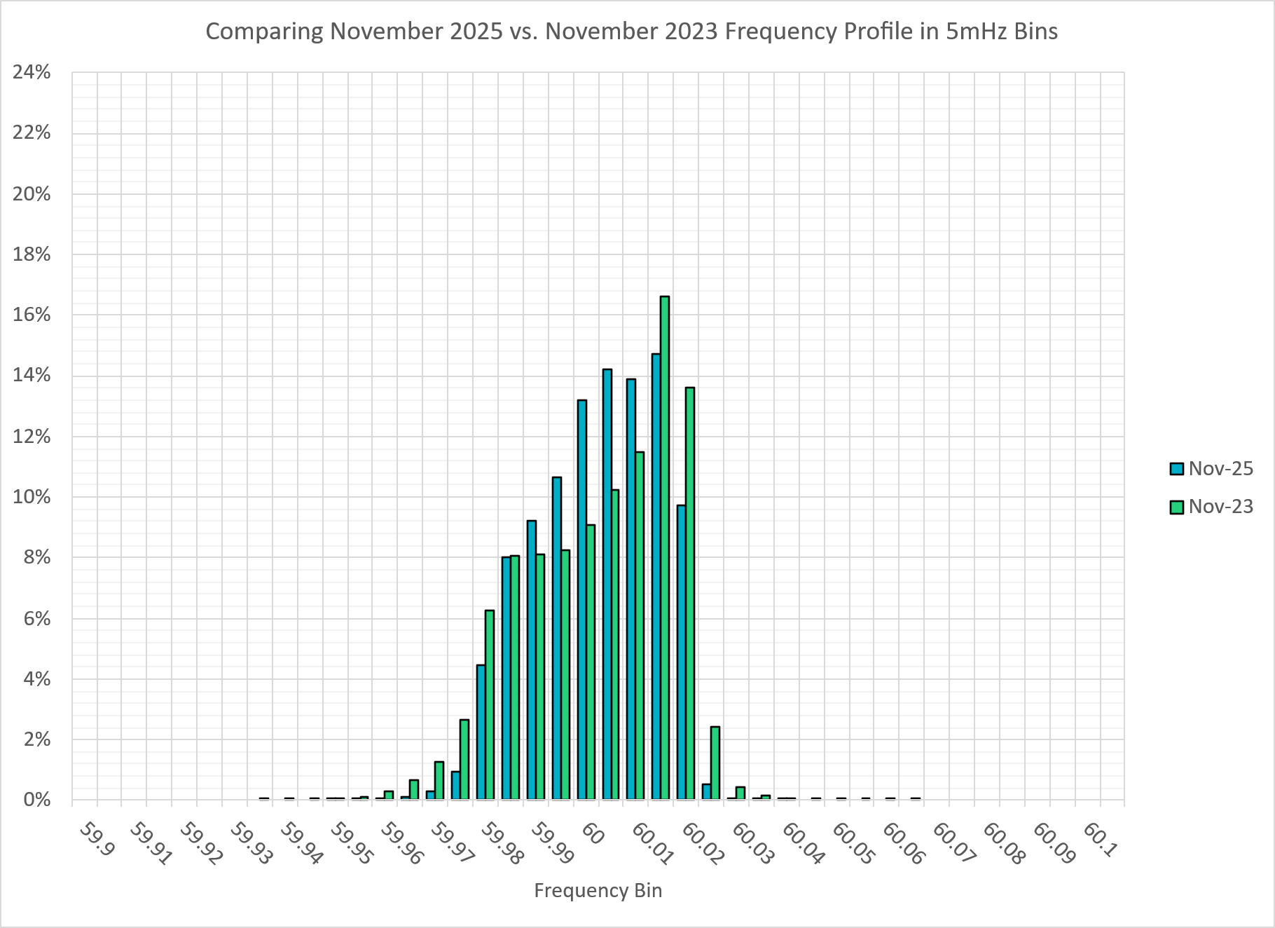
Frequency Profile Comparison
Notes:
Comparison of frequency profile between November 2023 and November 2025. Like the previous slide, compared to 2023, there are less instances of frequency around the deadbands.

Slide 14
Time Error Correction

Slide 15
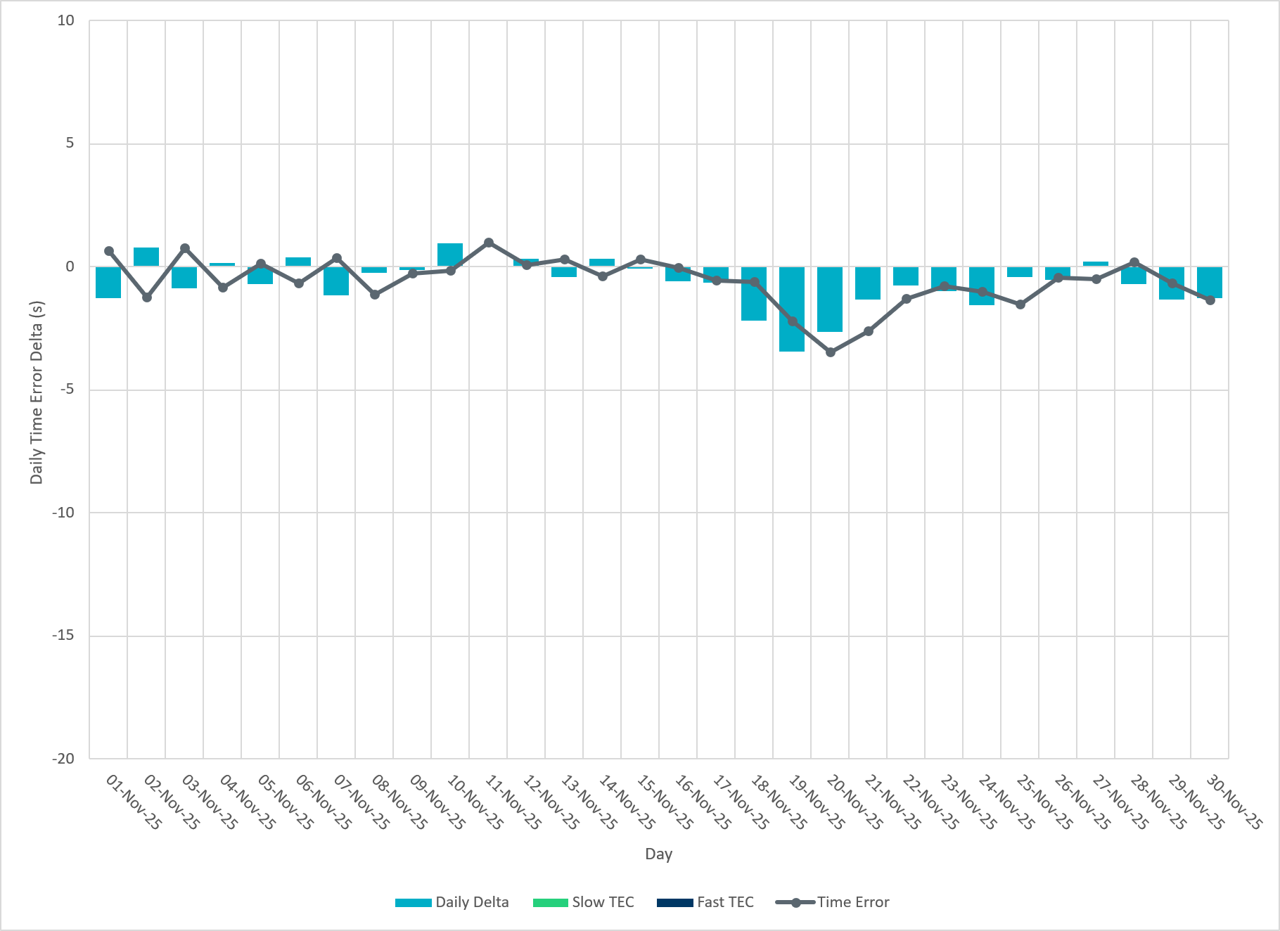
ERCOT Daily Time Error
Notes:
We did not make time error corrections in the month of November.

Slide 16
Time Error Corrections Log Summary
There have been no time error corrections since December 2016

Slide 17
BAL-003 Performance

Slide 18
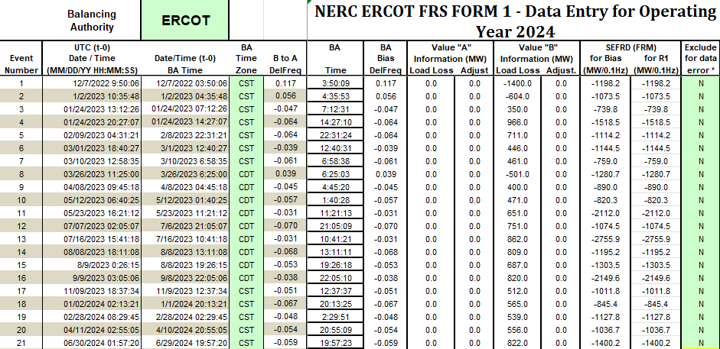
Op. Year 2024 BAL-003 Selected Events – Update
Notes:
BAL-003

Slide 19
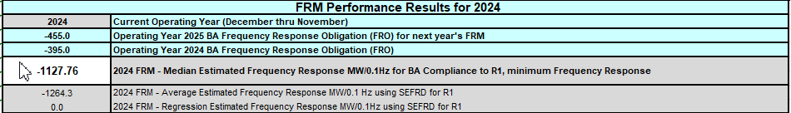
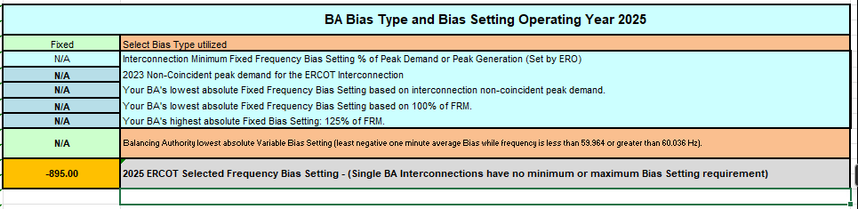
Op. Year 2024 BAL-003 FRM Performance - Update
Notes:
OP2018: FRO = -381.0, FRM_median = -843.17, FRM_average = -959.7
OP2019: FRO = -381.0, FRM_median = -811.14, FRM_average = -892.5
OP2020: FRO = -425.0, FRM median = -789.34, FRM average = -879.0
OP2021: FRO = -471.0, FRM median = -913.56, FRM average = -992.
OP2022: FRO = -412.0, FRM median = -1060.40, FRM average = -1153.4
OP2023: FRO = -463.0, FRM median = -1130.21, FRM average = -1302.7
OP2024: FRO = -395.0, FRM median = -1127.76, FRM average = -1264.3
OP2025: FRO = -455.0,

Slide 20
ERCOT Energy Statistics

Slide 21
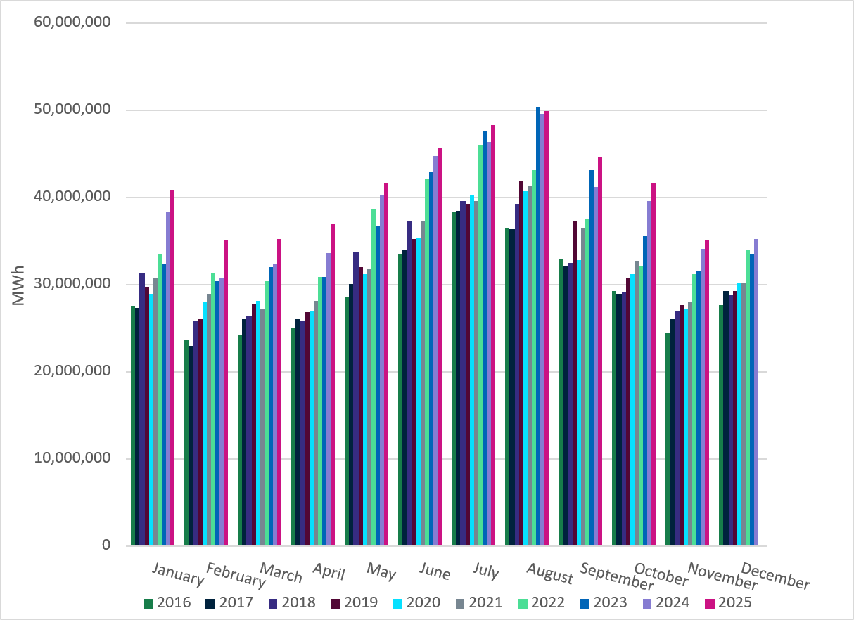
Total Energy
Notes:
Total Energy: 35,121,541 MWh – Decrease in total energy compared to last month

Slide 22
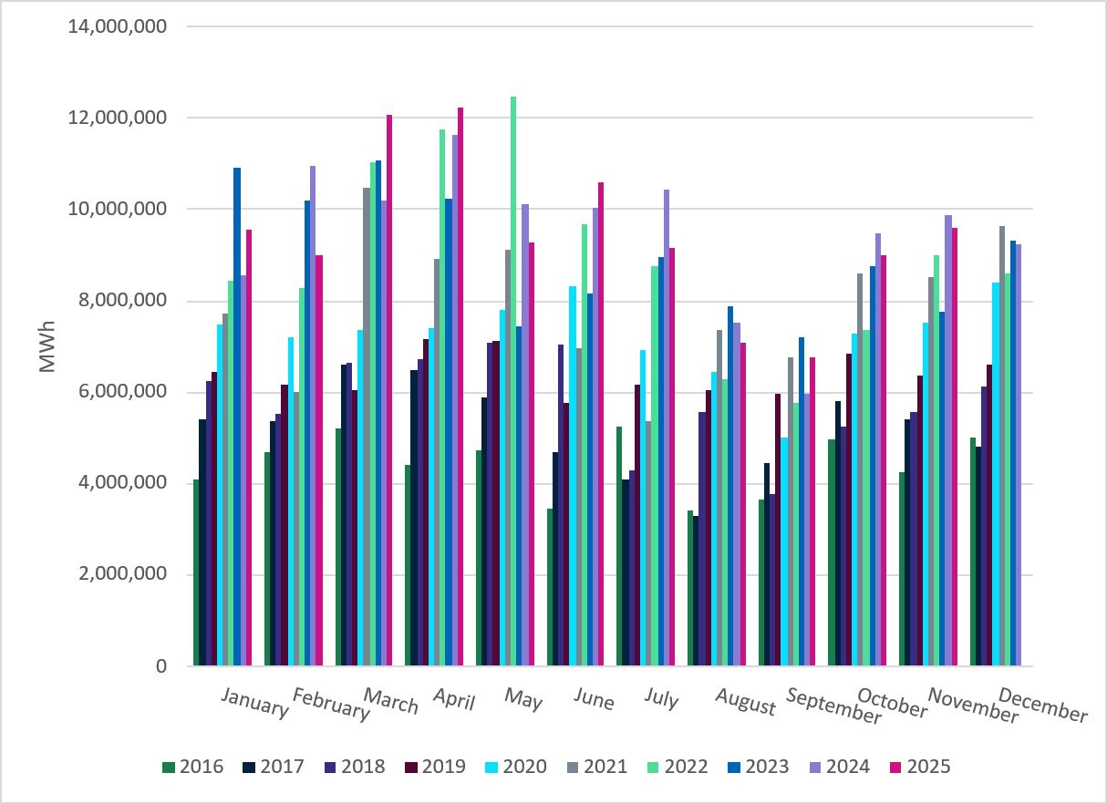
Total Energy from Wind Generation
Notes:
Wind Energy: 9,609,890 MWH – Increase in total energy from wind compared to last month

Slide 23
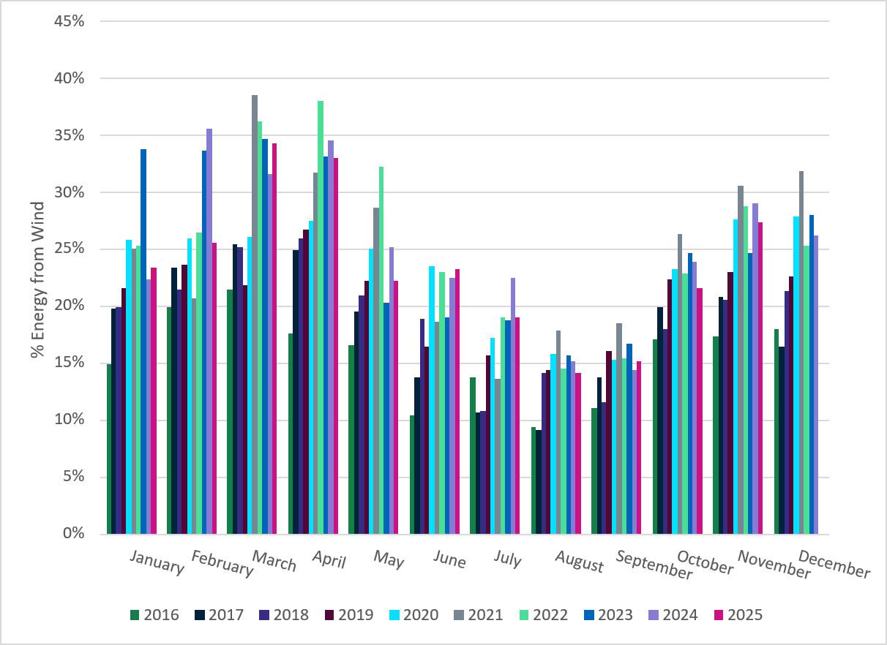
% Energy from Wind Generation
Notes:
Percent Energy from Wind: 27.36% of total energy was provided by wind generation

Slide 24
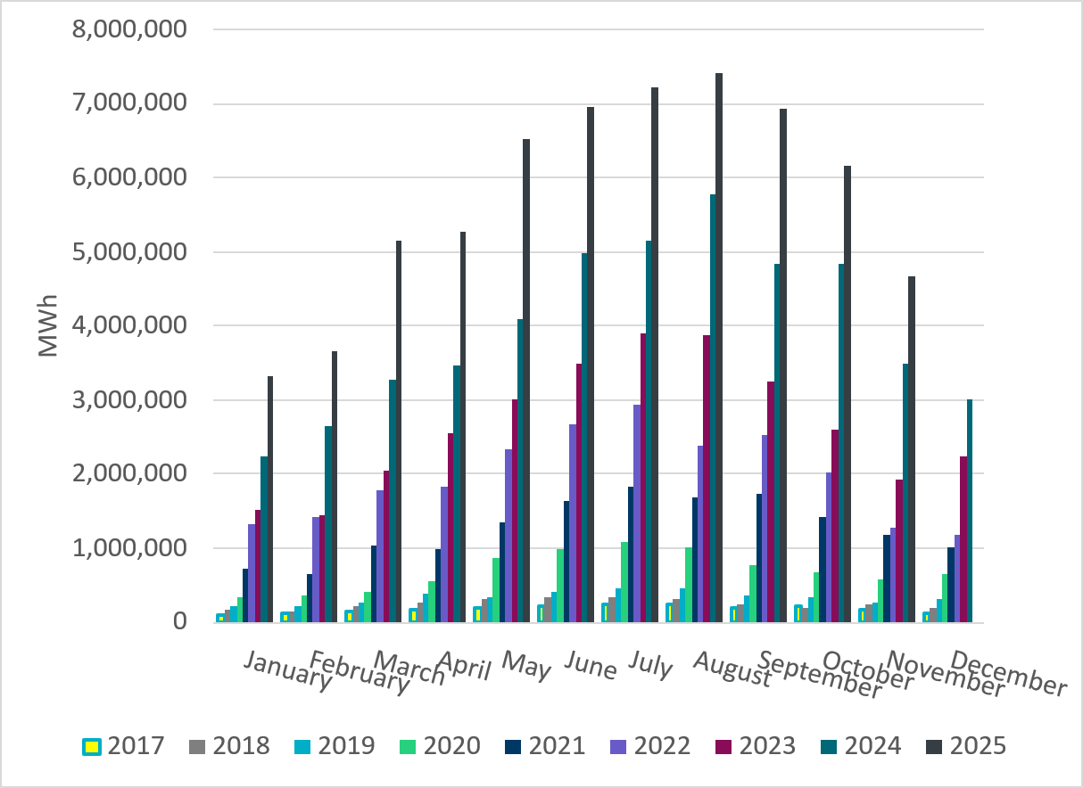
Total Energy From Solar Generation
Notes:
Solar Energy: 4,656,344 MWh – Decrease in total energy from Solar

Slide 25
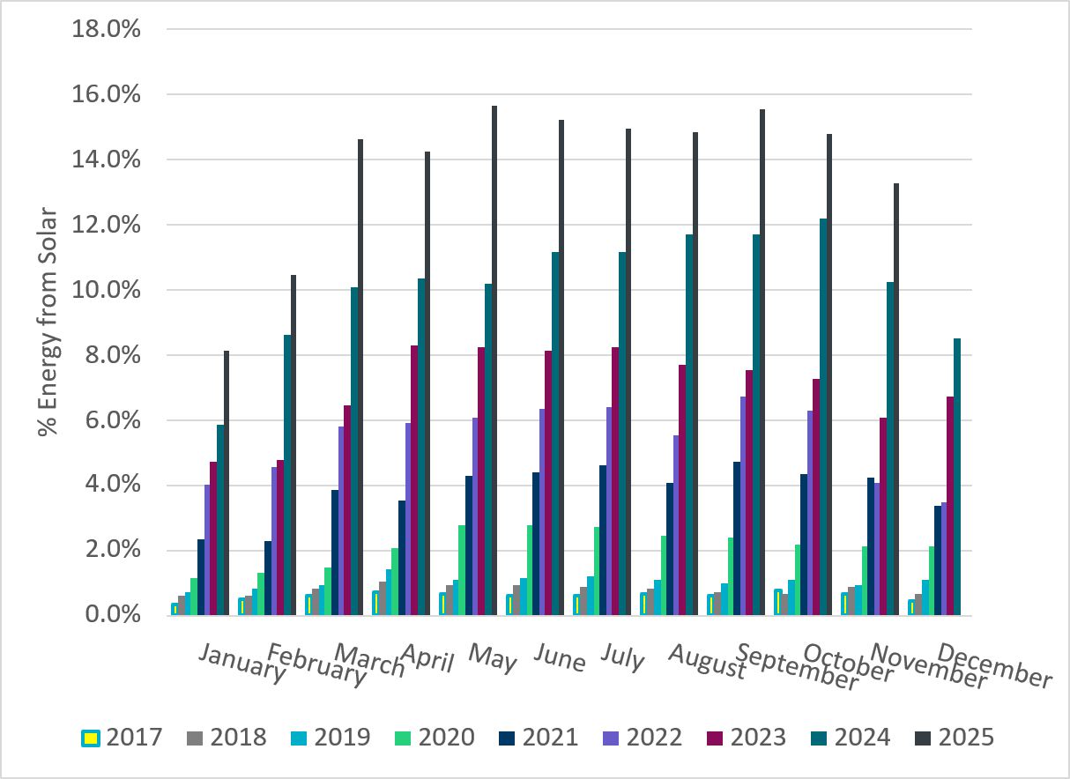
% Energy from Solar Generation
Notes:
Percent Energy from Solar: 13.26% of total energy was provided by solar generation

Slide 26
ERCOT System Inertia

Slide 27
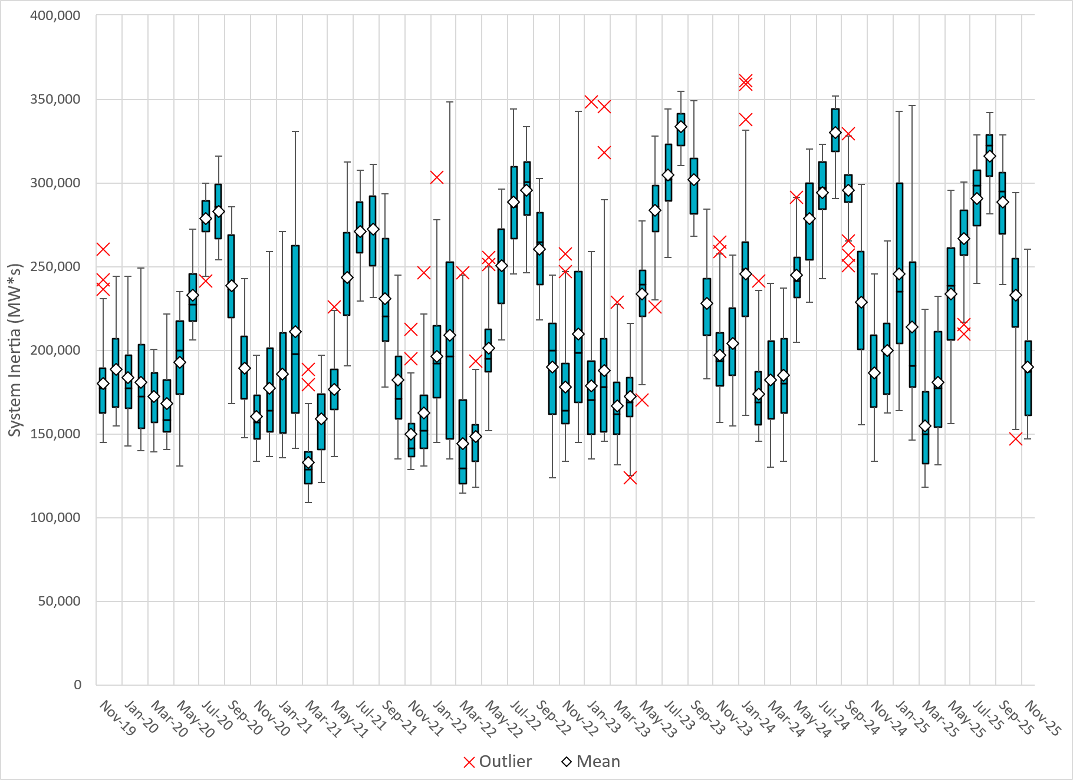
Daily Minimum System Inertia
Notes:
Minimum Inertia in November 2025 = 146,852 MW*s on Nov. 4th
Historical Overall Minimum was 109,029 MW*s on 3/22/2021
November Data:
Mean: 189,849 MW*s
Max: 260,206 MW*s on Nov. 19th
Min: 146,852 MW*s on Nov. 4th

Slide 28
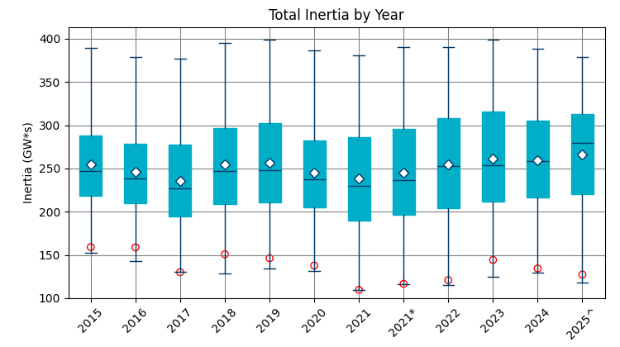
ERCOT Inertia 2015-2025
Date and Time | 2015 11/25 2:00 AM | 2016 4/10 2:00 AM | 2017 10/27 4:00 AM | 2018 11/03 3:30 AM | 2019 3/27 1:00 AM | 2020 05/01 2:00 AM | 2021 03/22 00:00 AM | 2022 03/21 01:00 AM | 2023 04/18 02:00 AM | 2024 03/29 03:00 AM | 2024 03/29 03:00 AM | 2025 03/18 12:00 AM
Min synch. Inertia (GW*s) | 152 | 143 | 130 | 128.8 | 134.5 | 131.1 | 109 | 115 | 124 | 130 | 130 | 118.3
System load at minimum synch. Inertia (MW) | 27,190 | 27,831 | 28,425 | 28,397 | 29,883 | 30,679 | 32,599 | 33,365 | 35,799 | 37,297 | 37,297 | 48,973
Non-synch. Gen. in % of System Load | 42 | 47 | 54 | 53 | 50 | 57 | 65 | 66 | 61 | 68 | 68 | 74
Notes:
Summary of ERCOT inertia for the previous 10 years. Lowest inertia this year was on March 18th.
For each box, the central mark (red line) is the median, the edges of the box (in blue) are the 25th and 75th percentiles, the whiskers correspond to +/- 2.7 sigma (i.e., represent 99.3% coverage, assuming the data are normally distributed. The corresponding lowest inertia in each year is given in the table.
The circle on each boxplot is showing inertia during time when highest portion of load was served by wind/solar generation in that year.
(add ffr)

Slide 29
Questions?
Thank you!

