Slide 1
SCR820 – Real-Time Operator Communication System (RTOC)
Preethi Meher & Christelle Seri
January 22, 2026

Slide 2
SCR820
Agenda
  Status updates
  Project timeline overview
  MPIM Access
  Demo

Slide 3
Status Updates
Project updates
  ERCOT internal operator logging feature went live in Dec 2025
  Messaging feature deployed and under testing in staging
  MIS proxy setup to enable external user access
  Development updates
  EMS data interface development is in progress to provide:
    SOL Exceedance data
    EEA related alarms
  Communication template creation screens under development
  Admin screens for internal use in progress

Slide 4
SCR820 – Project Timelines
Project Timeline
Phase | Milestone | Target Date
Planning | Requirements & Design Finalized | Complete
Development | Development & Internal ERCOT Testing | By Feb 2026
Testing | TOs/QSEs Testing | Mar 2026 – Apr 2026
Parallel Ops | Dual Operation Phase | May 2026
Go Live | Full Launch | June 2026

Slide 5
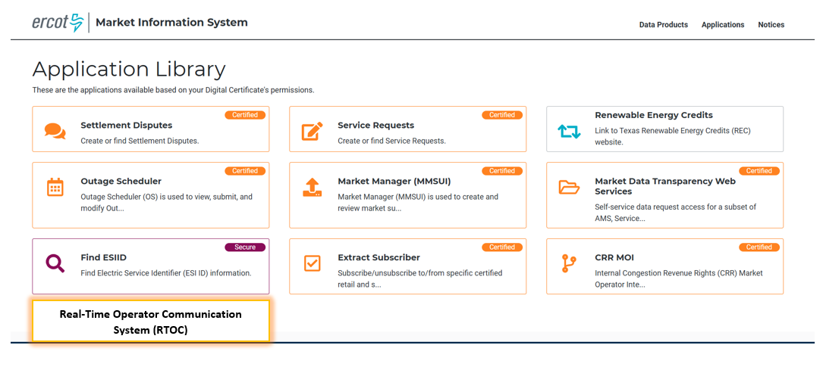
Tool Access
Access control
  Application access will be granted via digital certificates
  New roles must be added to the certificate for authorization
    Operator (RTOC_M_OPERATOR)
    ReadOnly (RTOC_M_VIEW)
  Link will be available on mis.ercot.com application library
Available to request

Slide 6
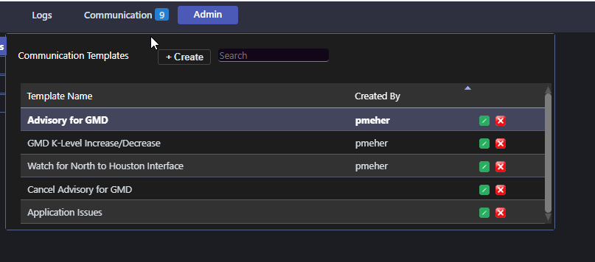
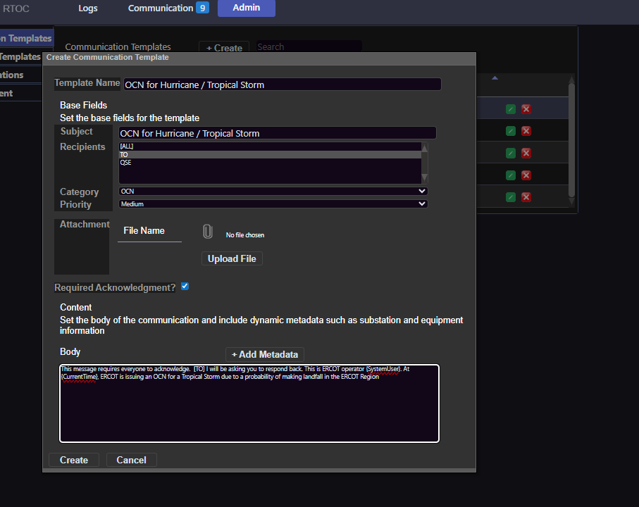
Template Creation
Communication template

Slide 7
SCR820
Thank you

