Slide 1
ERCOT Technology Working Group (TWG)
January 22, 2026

Slide 2
ERCOT TWG
WELCOME

Slide 3
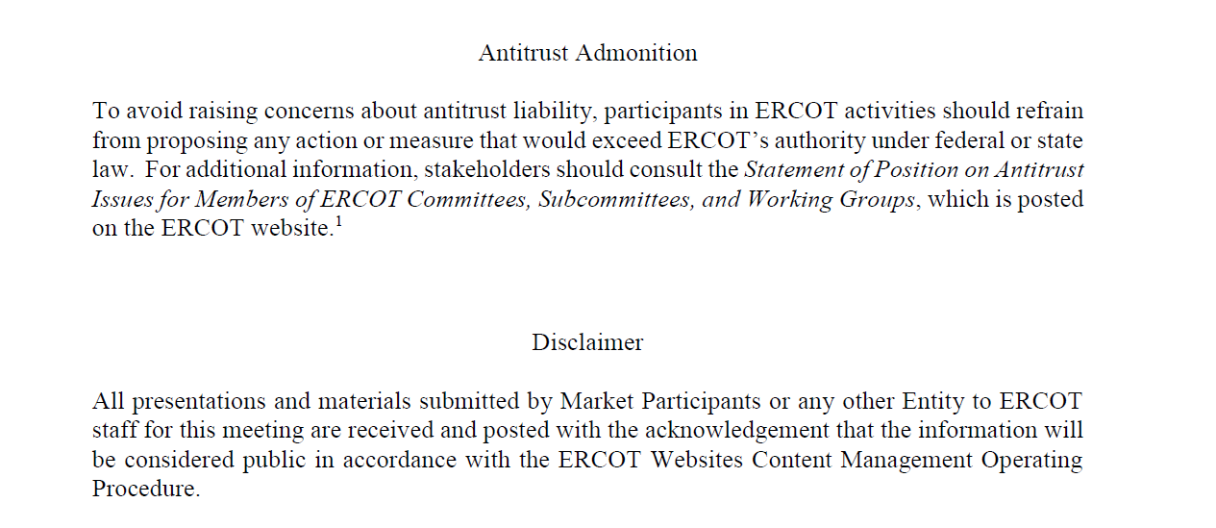
ERCOT TWG

Slide 4
ERCOT TWG Agenda
Item # | Item Description | Presenter | Start Time
1 | Antitrust admonition | Sreenivas Badri | 2:00 PM
2 | TWG Charter review Vice-Chair Nominations | Sreenivas Badri | 2:02 PM
3 | Project Updates | Troy Anderson | 2:10 PM
4 | RTC+B – Stabilization updates and Discuss Lessons Learned | Sruthi Hariharan | 2:20 PM
5 | DPC Process Automation Tool updates | Yugendher Karedla | 2:35 PM
6 | SCR820 – Real-Time Operator Communication Tool updates | Preethi Meher/Christelle Seri | 2:45 PM
7 | 2026 January Release (R1) changes Market Submissions CDR and ISM Reports | Katherine Li/Jamie Lavas | 2:55 PM
8 | Outage Scheduler Enhancements Project – MOTE Testing | Katherine Li | 3:10 PM
9 | ERCOT.COM Dashboard Enhancement Request Process updates | Priyanka Parthasarathy | 3:20 PM
10 | Market Participants Service Portal Project updates | Mandy Bauld | 3:30 PM
11 | Large Load Curtailment Manager – High level implementation details | Sruthi Hariharan | 3:45 PM
12 | Read-Only EMS on Cloud – objective and scope | Sreenivas Badri | 3:55 PM
13 | NPR1253 – ESR Charging Public API report discontinuation | Tejaswi Potluri | 4:05 PM
14 | Round Table Discussion Future Topics of Interest | Tanner Holder | 4:10 PM
15 | Adjourn | Tanner Holder | 4:20 PM

Slide 5
TWG
  TWG Charter Review – Sreenivas Badri/TWG
  Vice-Chair Nominations – Sreenivas Badri

Slide 6
RTC+B – Stabilization updates
  RTC+B – Stabilization updates and Discuss Lessons Learned
  – Sruthi Hariharan

Slide 7
DPC Process Automation
DPC Process Automation Tool updates – Yugendher Karedla

Slide 8
SCR820 – Real-Time Operator Communication Tool updates
SCR820 – Real-Time Operator Communication Tool updates
– Preethi Meher/Christelle Seri

Slide 9
2026 January (R1) Release changes
      Market Submissions – Katherine Li
      CDR and ISM Reports – Jamie Lavas

Slide 10
Outage Scheduler (OS) Enhancements Project – MOTE Testing
Outage Scheduler (OS) Enhancements Project – MOTE Testing
– Katherine Li

Slide 11
ERCOT.COM Dashboard Enhancement Request Process updates
ERCOT.COM Dashboard Enhancement Request Process updates
– Priyanka Parthasarathy

Slide 12
Market Participants Service Portal Project updates
Market Participants Service Portal Project updates
– Mandy Bauld

Slide 13
Large Load Curtailment Manager – High level implementation details
Large Load Curtailment Manager – High level implementation details
– Sruthi Hariharan

Slide 14
Read-Only EMS – Objective and Scope
Read-Only EMS on Cloud – objective and scope
– Sreenivas Badri

Slide 15
NPR1253 – ESR Charging Public API report discontinuation
NPR1253 – ESR Charging Public API report discontinuation
– Tejaswi Potluri

Slide 16
ERCOT TWG – Round Table Discussion
ERCOT TWG – Round Table Discussion
  Future Topics of Interest
  Topics and presentations from TWG members
  Vice-Chair Nominations

Slide 17
ERCOT TWG
Thank You
You can reach Sreenivas at
Sreenivas.Badri@ercot.com and Tanner at tholder@tnsk.com

