Slide 1
Down Stream Production Changes (DPC) – Process Automation
Yugendher Karedla/Karthik Gopinath
January 22, 2026

Slide 2
Down Stream Production Changes (DPC) – Process Automation
Objectives of Today’s Discussion
  Refresher on DPC Automation concept
  Review of Mockups
    Interface for submitting Temporary DPCs
    Dashboard Visualization and functionality
  Implementation Timelines
This effort provides new tool to Market Participants to facilitate DPC submission process for Temporary DPCs.

Slide 3
Down Stream Production Changes (DPC)
Downstream Production Change (DPC) is a standard process that makes changes to the Network Model in production in between the weekly model loads without having to load a new model (database load).
This process is managed by the multiple teams at ERCOT (Network Modeling, GMS, Shift Engineers, Operations etc.).
DPC process helps update the network model in both Energy and Market Management systems (EMS and MMS) incorporating the changes submitted by the transmission operators that are critical to maintaining the reliability of the system.
The DPC process allows ERCOT to make specific data modifications in real-time including:
  Static Line / Transformers Ratings
  Dynamic Line Ratings
  Line / Transformer Impedance
  Contingency Definition updates
  Enabling and Disabling of Contingencies
  GTC updates
  RAP and RAS changes
GTC and RAP/RAS definition updates related DPCs are submitted by ERCOT Operations team.

Slide 4
Down Stream Production Changes (DPC)
DPC process is intended to make model changes in production between weekly model loads as necessary, not for model changes that can follow normal NOCMR timelines.
Current High level DPC Process
MP
(Submits Model changes for DPC)
NMMS
Review Model and Create DPC
Jira Process
1. Review and Approve by Operations team
2. Track DPC implementation in EMS/MMS systems across multiple models
EMS/MMS
DPC process demands significant collaboration efforts between several departments within ERCOT and market participants. It requires significant amount of manual effort to create, validate, track and implement DPCs in multiple environments across multiple weekly model loads.
The manual nature of DPC tasks often leads to inefficiencies, delays, and increased resource loading across several departments within ERCOT. This multifaceted process demands extensive time and resources to ensure accuracy and efficiency.

Slide 5
Summary of feedback received from TOs
  TSP initiates new DPC submission
    when an operational line or transformer ratings / Impedances that gets published from their engineering team, is different from ERCOT Model ratings / Impedances.
    Based on rating comparisons done every month at TSP side & if they see discrepancy with ERCOT Model ratings.
  Current DPC NOMCR submission process involves
    Submitting DPC NOMCRs into ERCOT modeling system
    Send out email to notify ERCOT network modeling group
    Attach a DPC request form and reason for DPC with NOMCR
    After DPC is processed into ERCOT system, update TSPs EMS model to reflect the change.
  Current DPC CAMR submission process involves
    For equipment outages / reclosures, submit a DPC CAMR to enable Manual contingencies within 3 business days of effective date.
    If a new CTG is needed to reflect new configuration, attach an excel sheet with proposed CTG definition in CAMR.
    Submit a separate DPC CAMR within 3 business days of configuration returning to Normal.
    When active CTGs are found to be incorrect, CAMR DPC submitted to disable or edit incorrect CTGs.

Slide 6
Distinction between Permanent and Temporary DPC type updates
  Permanent DPC types
    DPC updates that will be done in Production , but they also will need to go into Network Model
    These DPC updates will continue to be applied in Production for few more model loads, before they are included within NMMS CIM XML file.
    All DPC types are eligible for Permanent DPCs.
    Continue to follow the current process of submitting Permanent DPC NOMCRs into ERCOT modeling system.
  Temporary DPC types
    DPC updates that does not need to go into Network Model.
    DPC updates that requests ERCOT control room to make a temporary update to model data due to a field outage / field work, that can last for up to 2 weeks.
    Below are the 2 major Temporary DPC types that ERCOT receives from MPs
      Static Line / Transformers Ratings
      Enabling and Disabling of Contingencies
    New DPC UI Tool is developed to provide ability for MPs to quickly submit temporary DPCs, with effective dates to ERCOT production system.
  A new DPC Dashboard will be developed that provides full list of DPCs (both permanent and temporary DPCs) with their status (planned / Implemented) with a historian for past DPCs implemented.

Slide 7
New DPC Tool – High Level Implementation Details
  New displays and dash boards will be added in current Outage Scheduler UI (OS UI) to allow Market Participants to submit Temporary DPCs with start and end times.
  Currently QSEs with resources and TOs have the access to OS UI through ERCOT MIS website
  A new role will be created to TOs to access these displays using OS UI.
  ERCOT Operations will review and approve Temporary DPCs.
  Upon approval, Temporary DPCs get implemented in ERCOT real-time systems (EMS/MMS) automatically and provides status back to DPC tool.
  Thereafter, DPCs get implemented automatically in EMS/MMS systems during every week model load until end time of DPCs.
  This new DPC tool will provide visibility to Market Participants on DPC implementation status in ERCOT EMS/MMS systems. Dashboards will be developed to meet this requirement along with ability to sorting and filtering capabilities

Slide 8
New DPC Tool – High Level Implementation Details
  If a Temporary DPC submitted through DPC UI, is not yet implemented, TOs will have an option to Withdraw the DPC from their DPC Dashboard, using “Withdraw” status option.
  Once a Temporary DPC is approved at ERCOT and is Implemented in EMS / MMS Applications, TOs will not be able to “Withdraw” their submitted DPC. If this scenario arises, TOs can submit another new Temporary DPC to revert the implemented DPC.
  ERCOT is pursuing an option to provide ability for TOs to associate Temporary DPC to an Outage. This will be an optional attribute (not mandatory), which allows more visibility to ERCOT, as we see several instances of Contingency status update DPCs tied to an Outage condition.
  TOs DPC dashboard will continue to show status updates on the submitted DPCs (both Permanent and Temporary DPCs), as ERCOT goes through DPC implementation and confirmation steps.

Slide 9
New DPC Tool – High Level Implementation Details
  DPC Tool support following DPC Types
    Update Static Line / Transformers Ratings
    Enabling and Disabling of Contingencies
  DPC Tool Data Flows:
NMMS Mage
(Network Model)
Permanent DPCs
DPC
Importer
OS UI
MPs
DPC Tool
ERCOT Review & Approval (DPC Dashboard)
EMS/MMS
Temporary DPCs
MPs DPC dashboard (All DPCs)

Slide 10
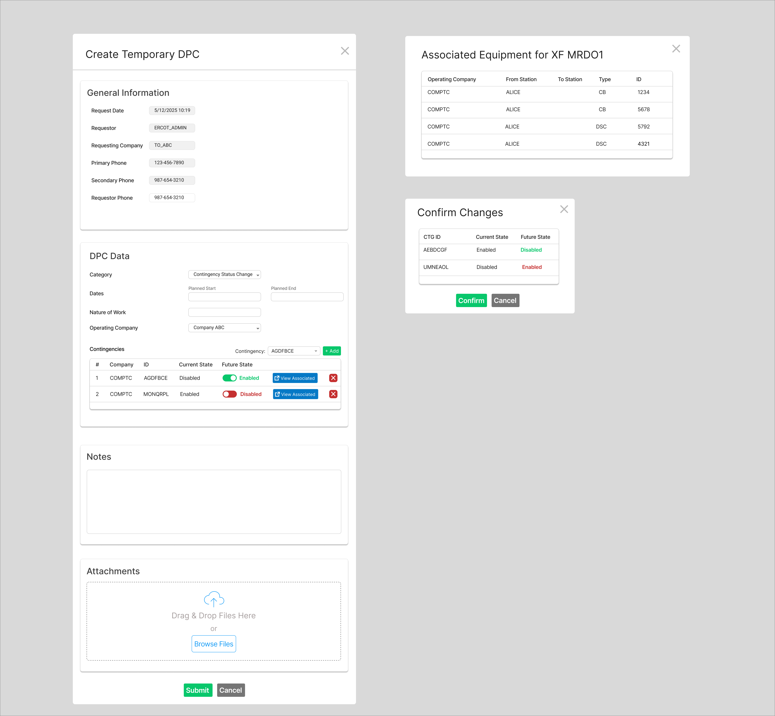
Submitting Temporary DPCs – Contingency Status Changes
For Contingency Status Change DPCs this includes:
  Planned start/end, nature of work, operating company
  Notes, attachments
  Individual contingencies and future state
    Associated equipment for each contingency can also be viewed
  On submit, a summary of the changes will be presented along with a prompt to confirm

Slide 11
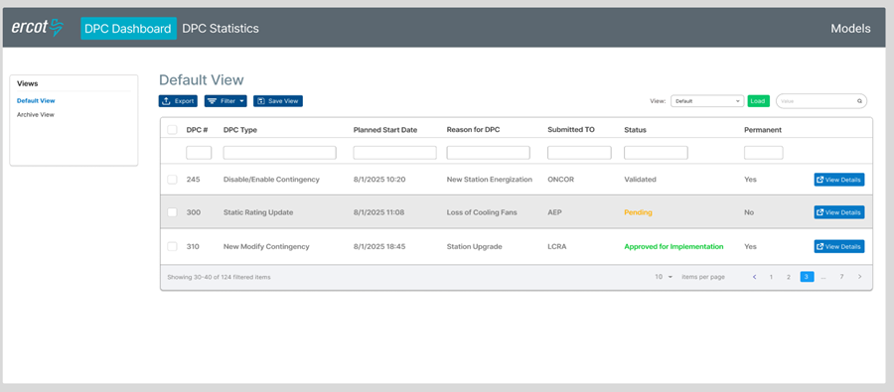
DPC Dashboard- Default View
Displays DPCs pending approval or implementation with general info and link to view full details
Users can apply filters and personalize the view then save and reload it
Other views include the Archive (completed or rejected DPCs).

Slide 12
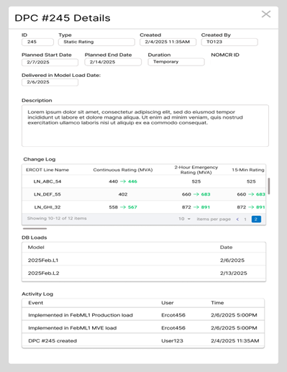
DPC Details Popup
A DPC’s details can be viewed in the DPC Details popup
  This includes:
    General Information: description, type, creation date, duration, etc.
    Change Log: the list of all changes applied in this DPC
    DB Loads: the DB Loads the DPC is applied in
    Activity Log: key dates and events relating to the DPC (created on, implemented on, etc.)

Slide 13
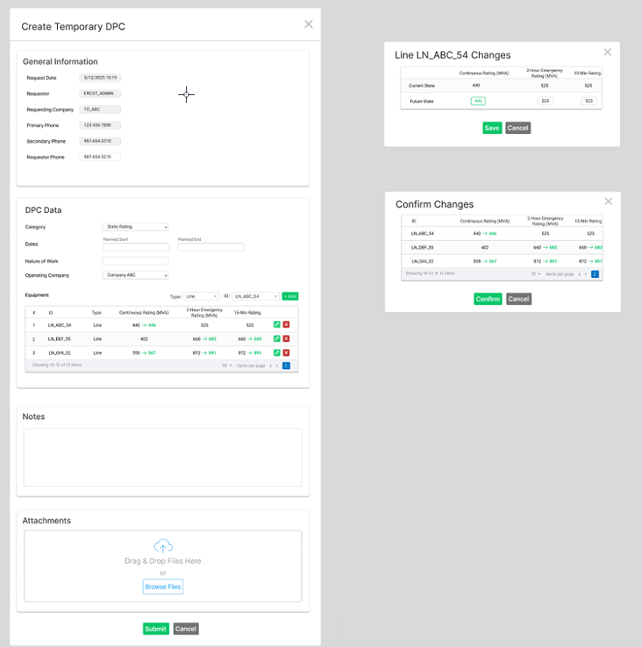
Submitting Temporary DPCs- Static Rating - Updates
Static Rating update DPCs form includes:
  Planned start/end, nature of work, operating company
  Notes, attachments
  Can review each specific device ratings and update.
  On submit, a summary of the changes will be presented along with a prompt to confirm

Slide 14
Handling schedule changes for temporary DPCs- Updates
Withdrawal Option
  TOs can withdraw a DPC while it is “Submitted” Status , but NOT after it gets to “Approved for Implementation” status.
  Use case for Withdraw option is when TOs like to edit start/end dates or content of DPC, before it is approved for implementation at ERCOT.
End Date Modification- Applicable to implemented DPC.
  On Completed status, TOs can modify the planned end date:
    Earlier end date: Ends the DPC sooner.
    Later end date: Extends the DPC duration.
  Note- End date needs to be greater than current date/time and cannot be 30 days from date of submission for Temporary DPCs.
After DPC is implemented in production (Completed Status), if TOs want to change the DPC again then a new DPC needs to be submitted for the same equipment.
Closed Status
  Once the planned end date is reached, the DPC automatically transitions to Closed status.
  Transition to Closed status - It would trigger EMS/Market applications to revert back to pre-DPC state in production.
  After DPC transitions to closed status, no further changes are allowed, and it will be archived for historical reference.

Slide 15
Implementation Timelines
Development and Testing Timelines
  12/09/2025 - Project got into Execution phase (Design Complete)
  DPC Tool changes Development and Testing– Q1 and Q2 of 2026
  TOs Testing – April – June 2026
  Tentative Go Live – July 2026
Next Steps.
  New DPC Tool development and testing.
  Provide periodic updates on implementation progress through TWG and NDSWG.
  DPC Tool Demo – Feb/Mar 2026.
  Tuning implementation approach and details based on Market Participant feedback

