Slide 1
Monthly Review of Reliability Unit Commitment Market Impacts – October 2025
Wholesale Market Working Group
ERCOT Market Analysis

Slide 2
RUC Resource-Hours
* The difference between “Instructed” and “Effective” values is a result of Resources starting up, shutting down, receiving partial hour instructions, or otherwise not being dispatchable by SCED.

Slide 3
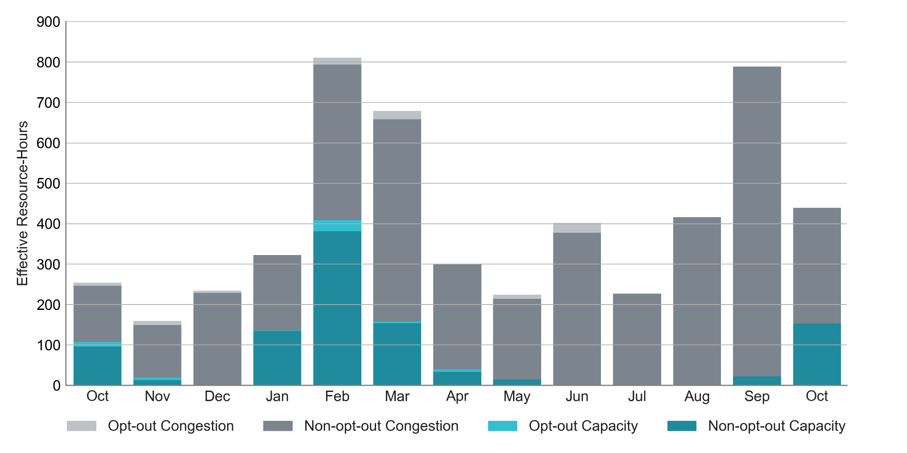
RUC Instruction Reasons: Last 13 Months
65% of RUC effective hours in October 2025 were nominally attributed to congestion.

Slide 4
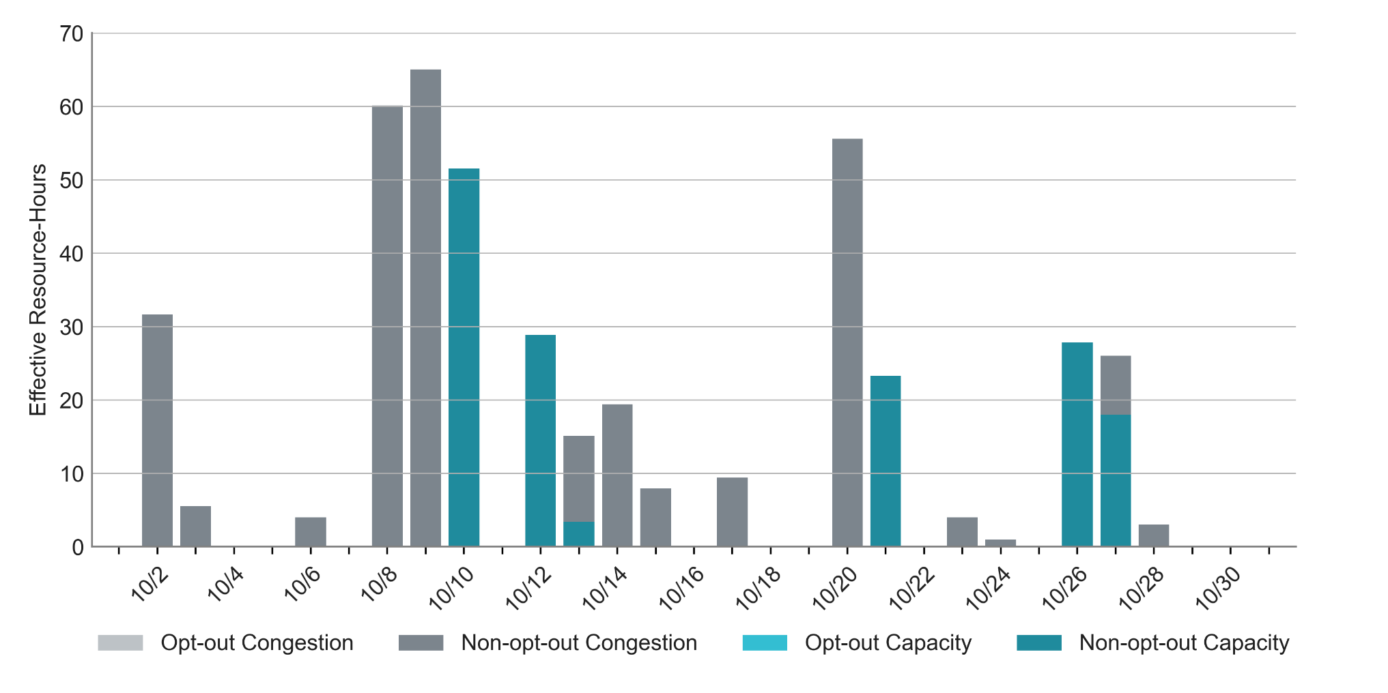
RUC Instruction Reasons in October 2025
439.1 RUC effective Resource-hours:
  286.2 hours (65%) for congestion

Slide 5
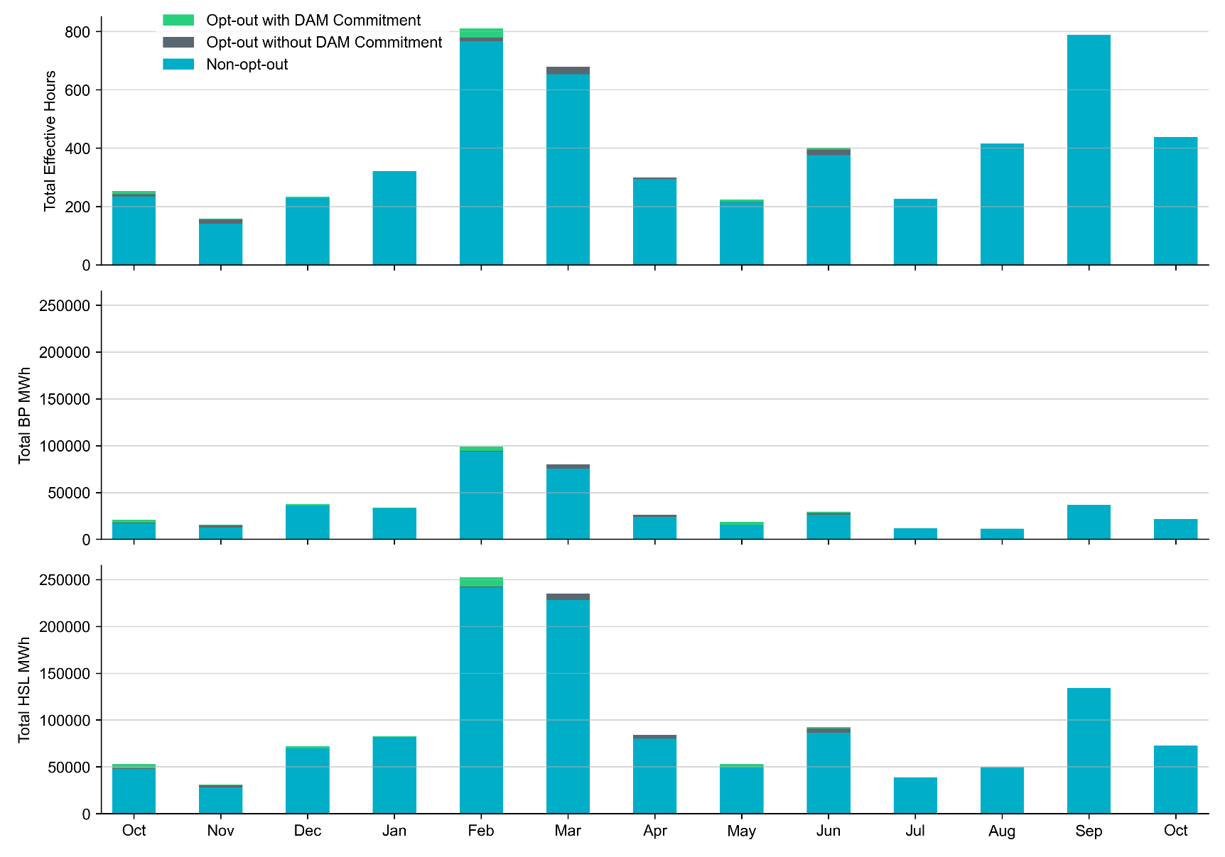
Non-opt-out and Opt-out Totals: Last 13 Months
October 2025 had a total of 439.1 non-opt-out effective Resource-hours (100%) and 0 opt-out effective Resource-hours (0%).

Slide 6
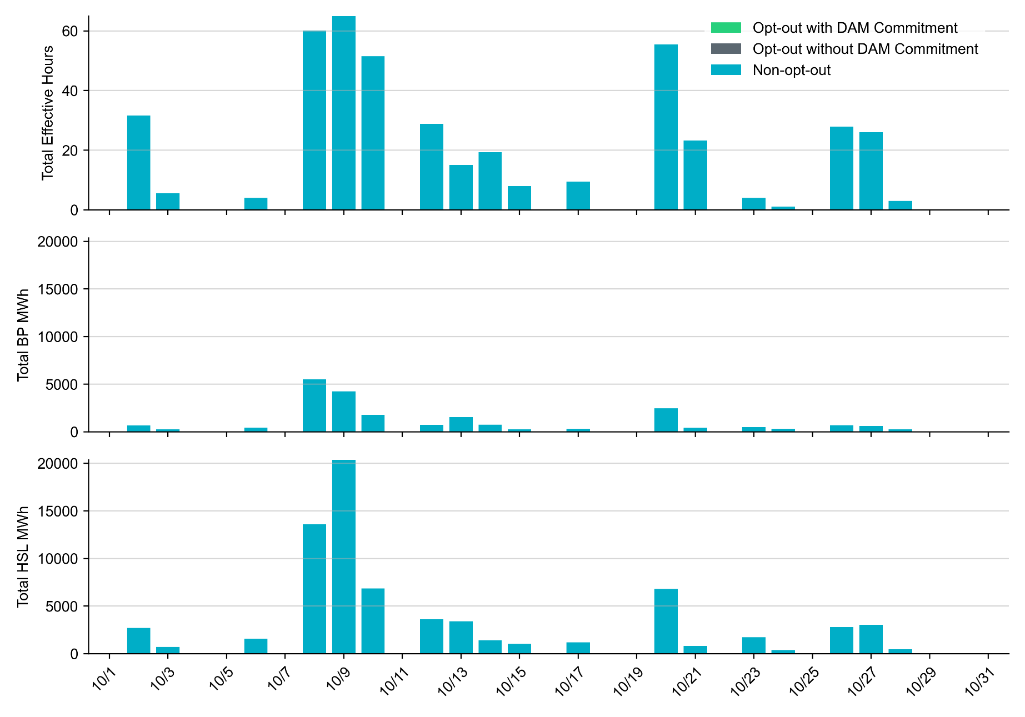
Non-opt-out and Opt-out Totals: October 2025

Slide 7
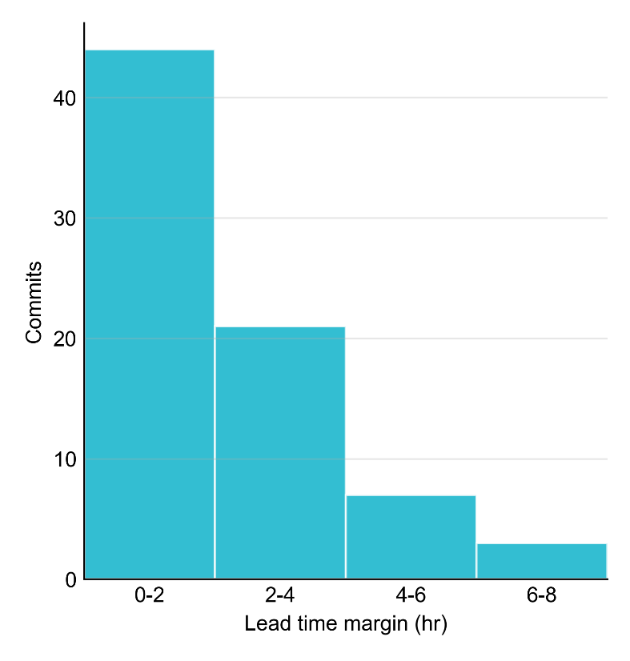
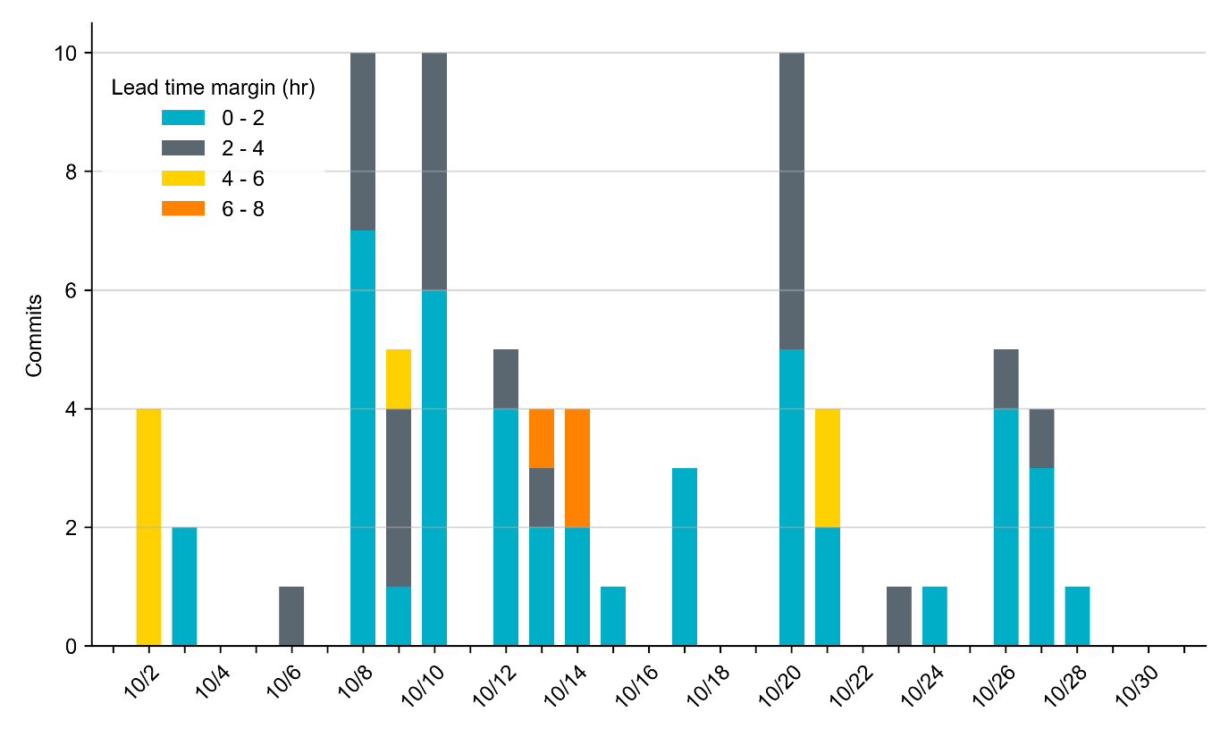
RUC Lead Time Margin: October 2025
Most RUC commitment windows (59%) had a lead time margin of 2 hours or less.
Lead time refers to the length of time between a RUC instruction and the start of the commitment window.
Lead time margin is the difference between lead time and the Resource’s startup time.
  In cases where a Resource is committed for multiple back-to-back time blocks, lead time margin is calculated from the first instruction.

Slide 8
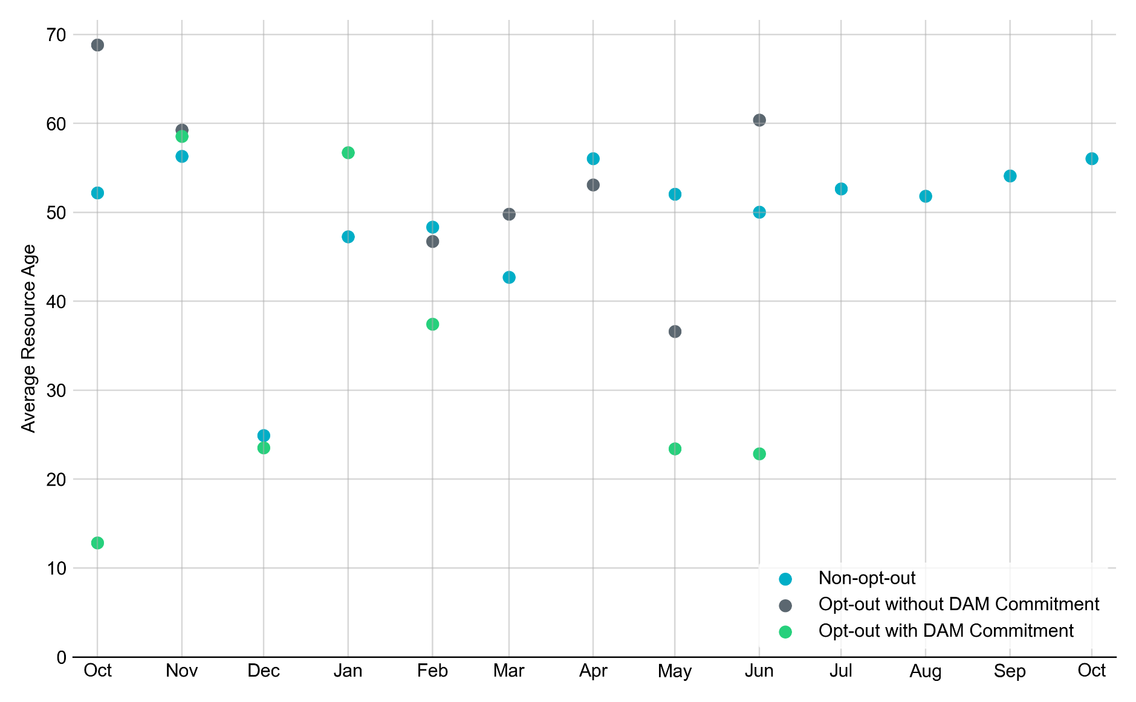
Average Resource Age: Last 13 Months
In October 2025, the average age of RUC-committed Resources was 56.0 years for Non-opt-out Resource-hours.
Note: For Resource configurations with multiple physical generators, the age of the oldest generator is used.

Slide 9
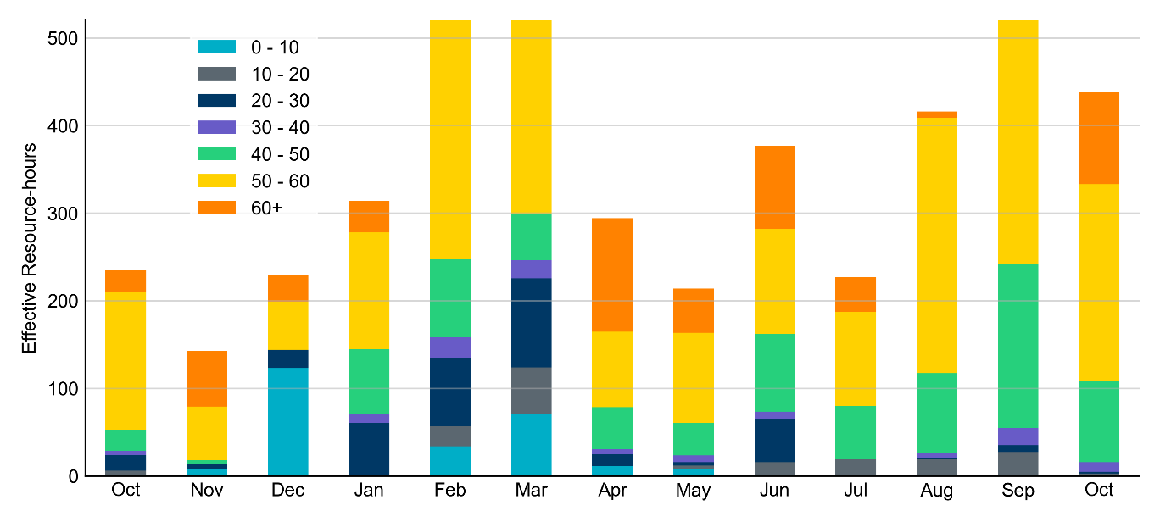
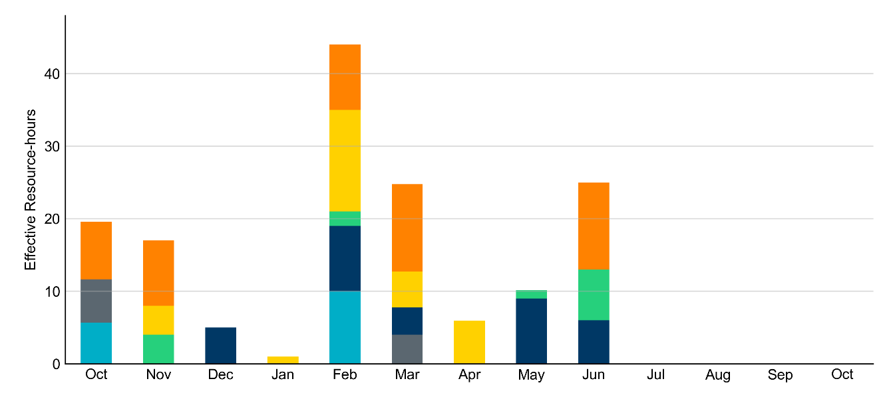
Age Category: Last 13 Months
In October 2025, most RUC Effective Resource-Hours (75%) were provided by resources that were at least 50 years old.
Non-opt-out
Opt-out

Slide 10
RUC-Instructed Resource Dispatch above Low Dispatch Limit (LDL) in Non-Opt-Out Hours
Out of all 439.1 non-opt-out Effective Resource-hours, RUC-instructed Resources were dispatched above their LDL for 27.2 Resource-hours.
  In 3.7 of these Resource-hours, the Locational Marginal Price (LMP) for the RUC-instructed Resource exceeded the RUC offer floor.
  In 23.4 of these Resource-hours, the LMP for the RUC-instructed Resource fell below the RUC offer floor.
    All 23.4 Resource-hours saw the RUC-instructed Resource being mitigated.
There were no Exceptional Fuel Cost submissions for any Resources committed by RUC.

Slide 11
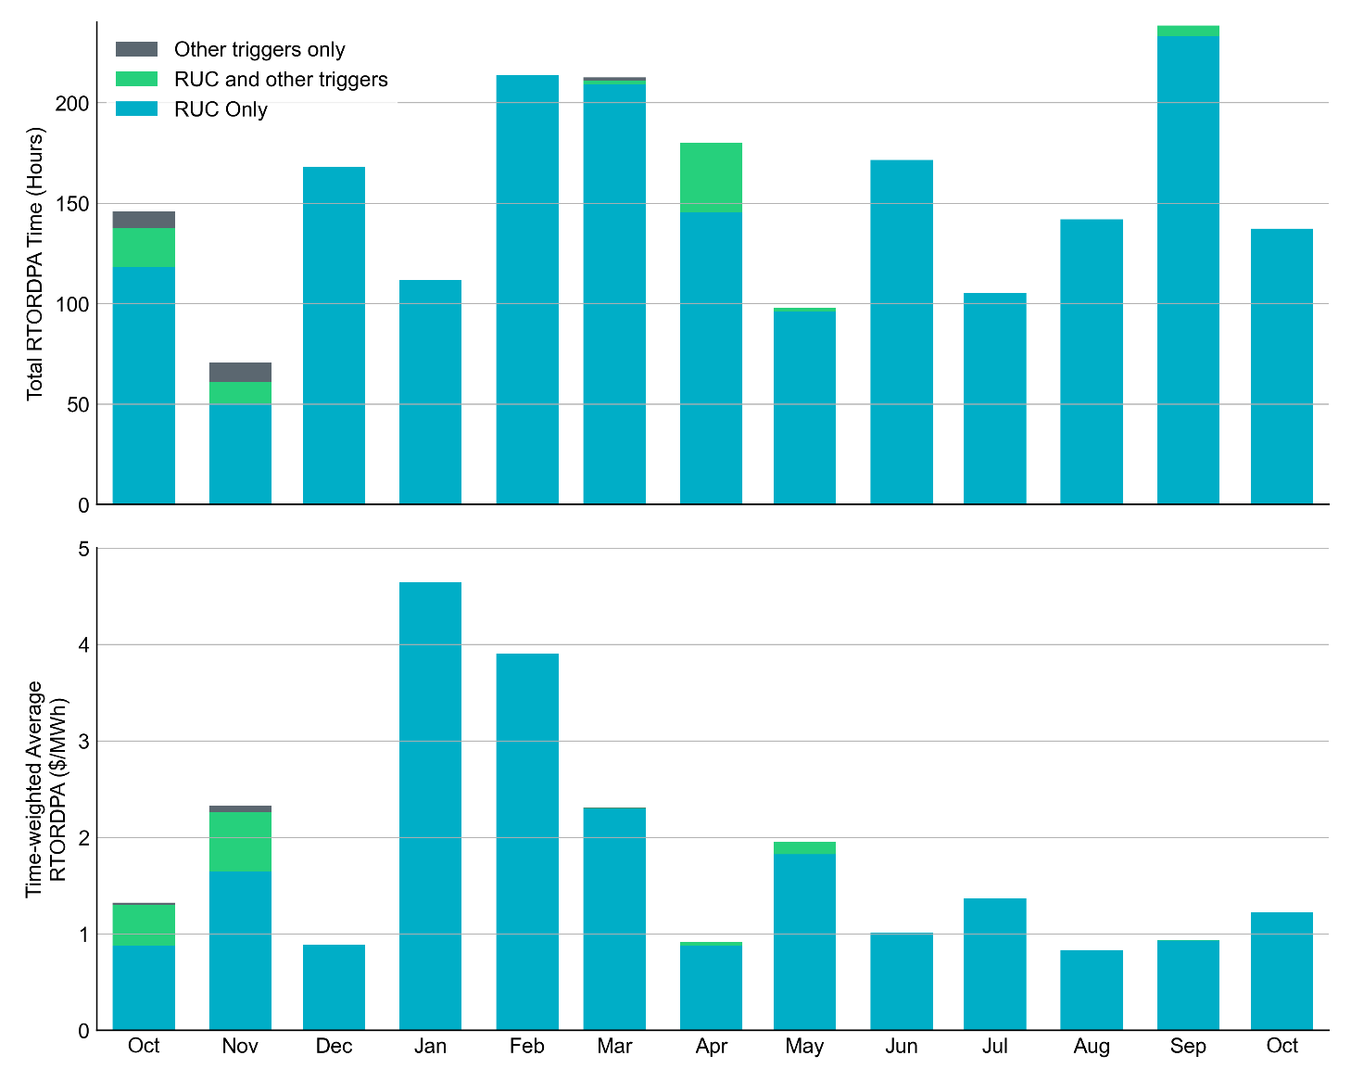
Reliability Deployment Price Adder: Last 13 Months
October 2025 had a total of 137.3 RTORDPA hours with a time-weighted average value of $1.22/MWh.
These graphs show RTORDPA instances by reliability action: 'RUC Only' for instances triggered solely by Reliability Unit Commitment, 'RUC and other triggers' for instances with RUC and additional triggers, and 'Other triggers only' for instances with non-RUC triggers. The daily average RTORDPA is calculated using the total duration across all categories. See ERCOT protocol section 6.5.7.3.1 for details.

Slide 12
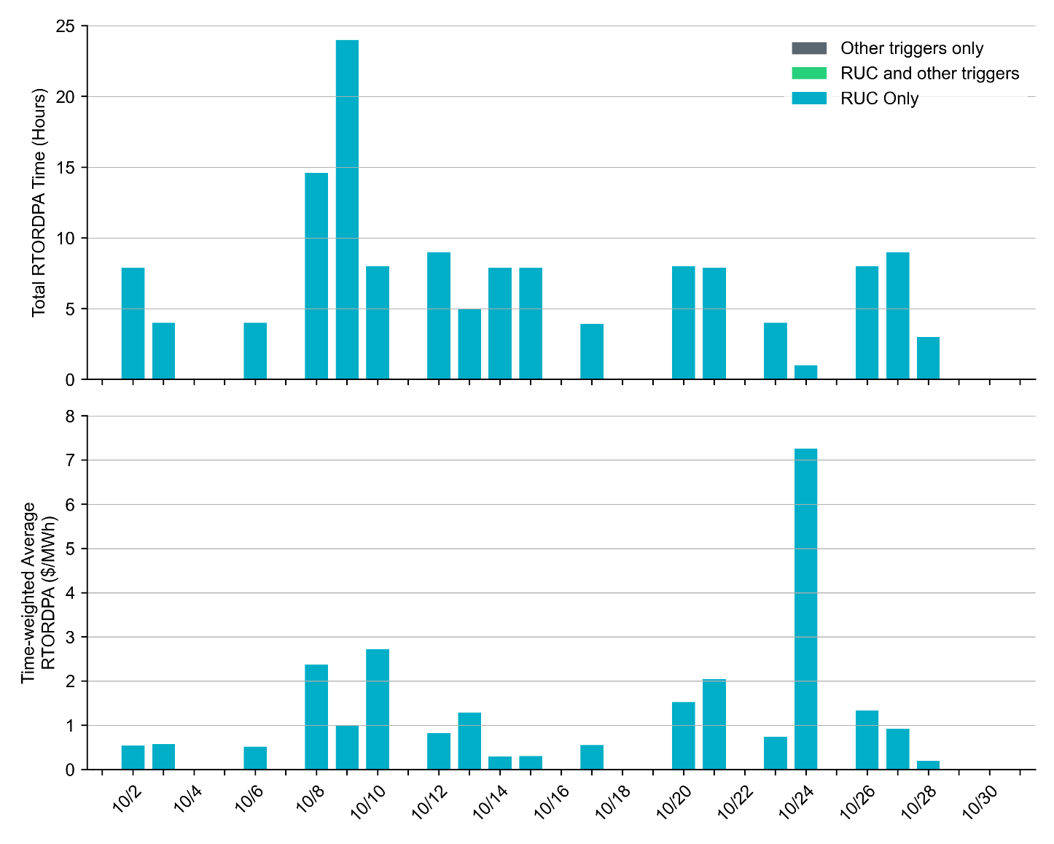
Reliability Deployment Price Adder: October 2025
OD 10/24 had the highest daily time-weighted average RTORDPA of $7.26/MWh.
These graphs show RTORDPA instances by reliability action: 'RUC Only' for instances triggered solely by Reliability Unit Commitment, 'RUC and other triggers' for instances with RUC and additional triggers, and 'Other triggers only' for instances with non-RUC triggers. The daily average RTORDPA is calculated using the total duration across all categories. See ERCOT protocol section 6.5.7.3.1 for more details.

Slide 13
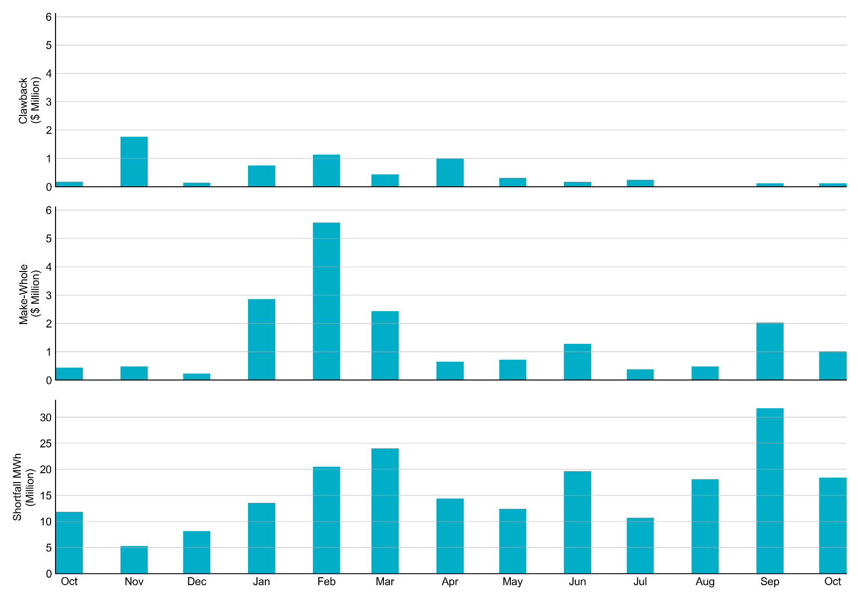
RUC Clawback, Make-Whole, and Shortfall
For October 2025, the total Clawback Charge was $128,343. The total Make-Whole Payment was $1,016,193.
Of the $1,016,193 in Make-Whole Payments made in October 2025, $5.40 was uplifted to load due to rounding.
The remaining amount was collected through Capacity-Short Charges.
Data as of October 7th, 2025

Slide 14
RUC Clawback by Settlement Type
Month | Initial Settlement ($) | Final Settlement Change ($) | True-up Settlement Change ($) | Net as of November 10, 2025 ($)
Oct ‘24 | 179,331 | 0 | 0 | 179,331
Nov ‘24 | 2,022,874 | 0 | -259,986 | 1,762,888
Dec ‘24 | 147,389 | -3 | 0 | 147,386
Jan ‘25 | 1,037,717 | 0 | -294,094 | 743,623
Feb ‘25 | 3,272,312 | 0 | -2,138,639 | 1,133,673
Mar ‘25 | 545,642 | 0 | -87,084 | 458,558
Apr ‘25 | 993,341 | 119 | -418,816 | 574,643
May ‘25 | 574,643 | 0 | - | -
Jun ‘25 | 173,176 | 0 | - | -
Jul ‘25 | 246,345 | 134 | - | -
Aug ‘25 | 12,319 | 0 | - | -
Sep ‘25 | 122,634 | - | - | -
Oct ‘25 | 128,343 | - | - | -
Negative dollars represent a payment from ERCOT to a market participant
“-” indicates settlement has yet to be completed.
Net figures may differ slightly due to rounding.

Slide 15
RUC Make-Whole by Settlement Type
Month | Initial Settlement ($) | Final Settlement Change ($) | True-up Settlement Change ($) | Net as of November 10, 2025 ($)
Oct ‘24 | -364,395 | 0 | -72,381 | -436,776
Nov ‘24 | -164,191 | 0 | -317,703 | -481,894
Dec ‘24 | -179,587 | 0 | -53,342 | -232,929
Jan ‘25 | -834,867 | -80,530 | -1,947,157 | -2,862,554
Feb ‘25 | -1,198,579 | -17,762 | -4,344,131 | -5,560,472
Mar ‘25 | -1,701,707 | 0 | -111,462 | -1,813,169
Apr ‘25 | -594,864 | -3,693 | 104,830 | -493,728
May ‘25 | -493,728 | 0 | - | -
Jun ‘25 | -1,285,661 | 0 | - | -
Jul ‘25 | -382,594 | -294 | - | -
Aug ‘25 | -487,773 | 0 | - | -
Sep ‘25 | -2,035,251 | - | - | -
Oct ‘25 | -1,016,193 | - | - | -
Negative dollars represent a payment from ERCOT to a market participant
“-” indicates settlement has yet to be completed.
Net figures may differ slightly due to rounding.

