Slide 1
Monthly Review of Reliability Unit Commitment Market Impacts – December 2025
Wholesale Market Working Group
ERCOT Market Analysis

Slide 2
RUC Resource-Hours
* The difference between “Instructed” and “Effective” values is a result of Resources starting up, shutting down, receiving partial hour instructions, or otherwise not being dispatchable by SCED.

Slide 3
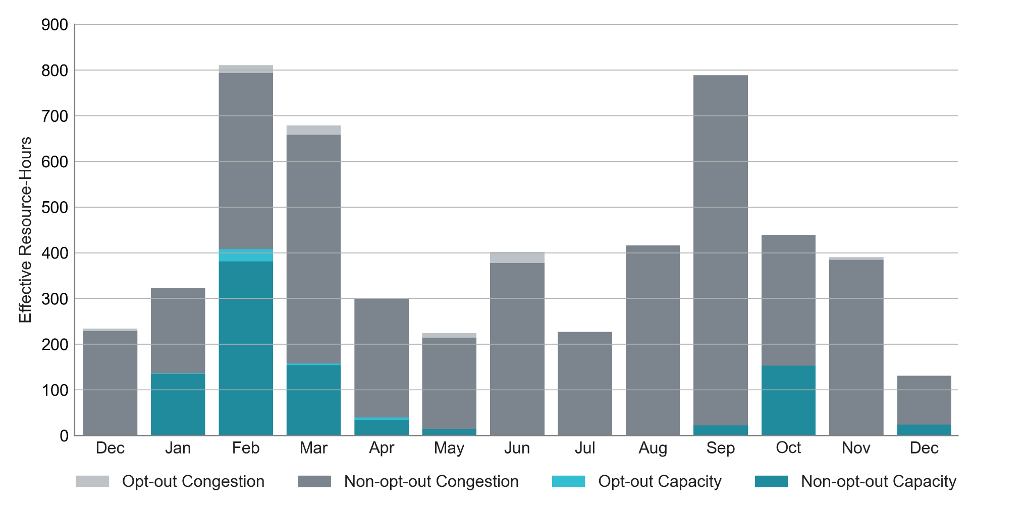
RUC Instruction Reasons: Last 13 Months RUC effective hours in December 2025 were lower than in previous months.
89 out of 131 Effective Resource-Hours in December 2025 occurred before the implementation of Real-Time Co-Optimization Plus Batteries (RTC+B)

Slide 4
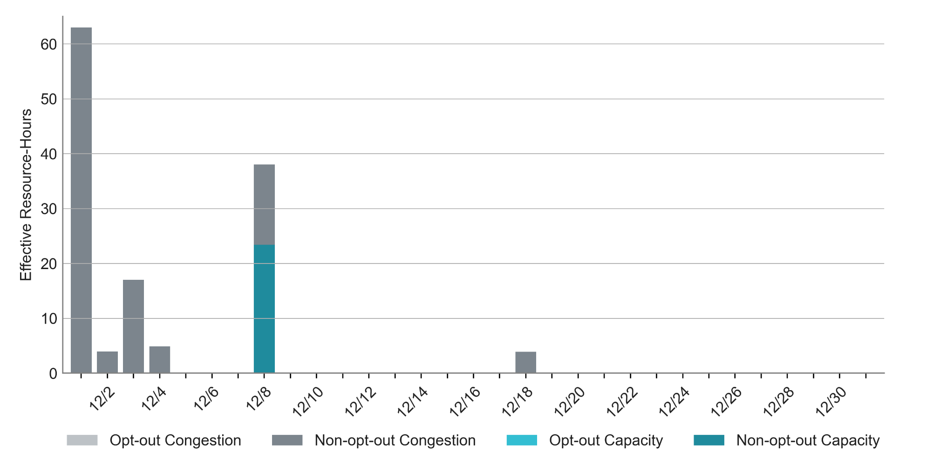
RUC Instruction Reasons in December 2025 82% of RUC effective hours in December 2025 were nominally attributed to congestion.
129.9 RUC effective Resource-hours:
106.7 hours (82%) for congestion

Slide 5
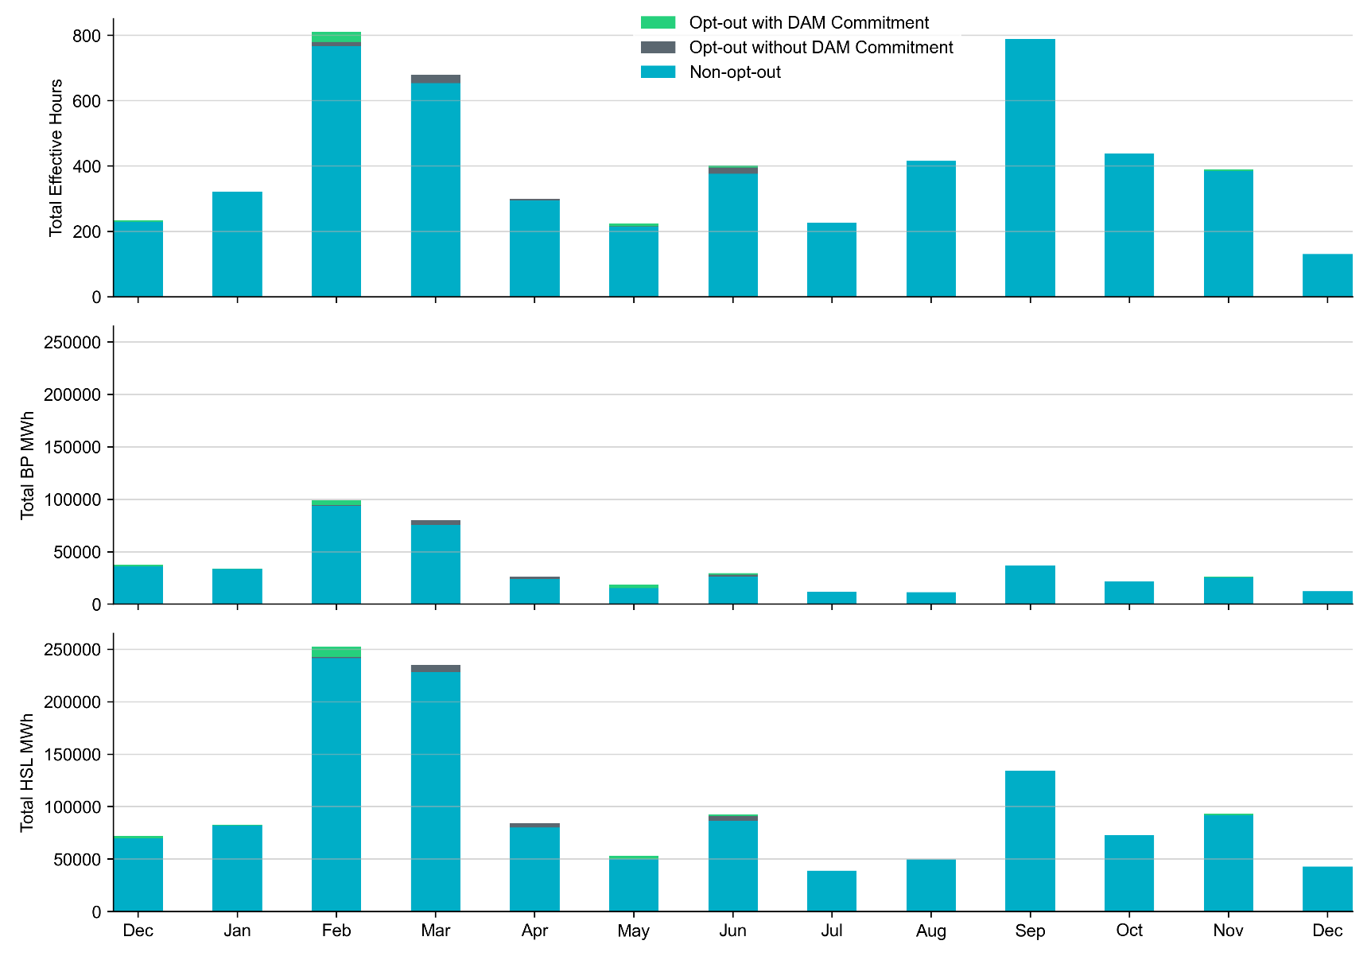
Non-opt-out and Opt-out Totals: Last 13 Months December 2025 had a total of 129.9 non-opt-out effective resource-hours (100%) and no opt-out effective Resource-hours, following a similar pattern to previous months.

Slide 6
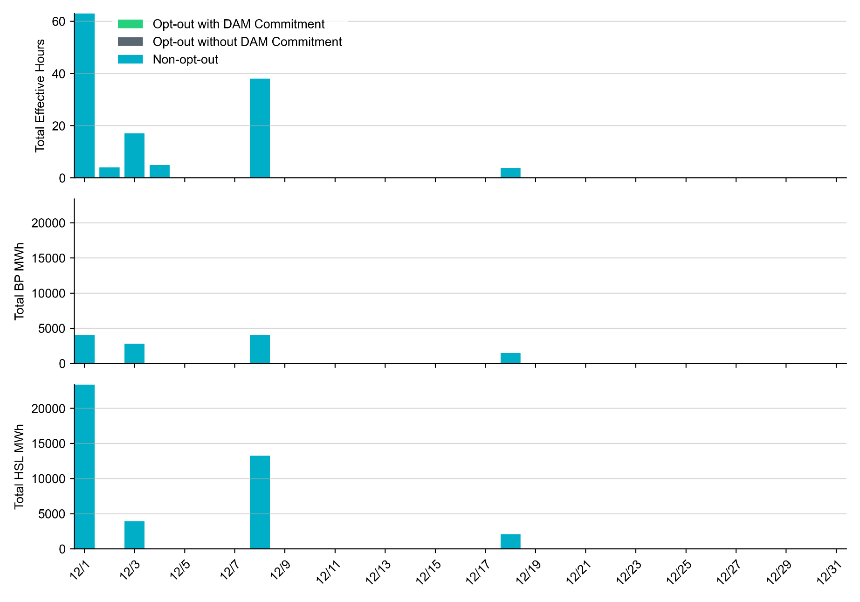
Non-opt-out and Opt-out Totals: December 2025 December 2025 had a total of 129.9 non-opt-out effective resource-hours (100%) and no opt-out effective Resource-hours.

Slide 7
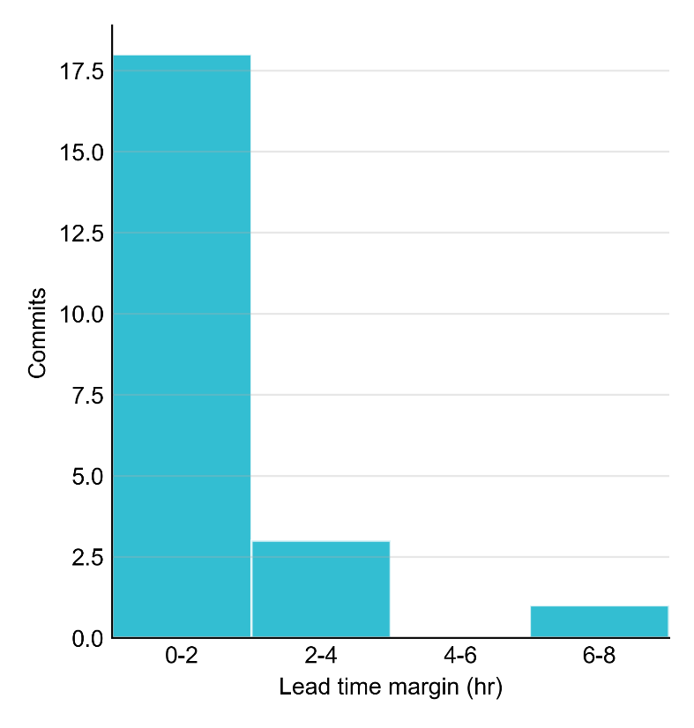
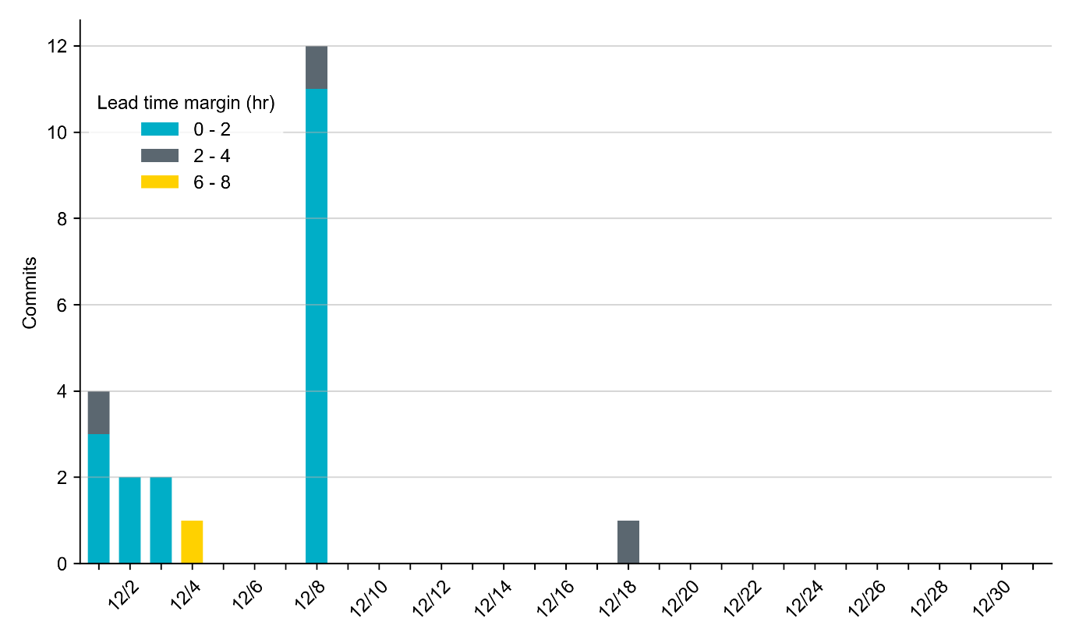
RUC Lead Time Margin: December 2025 Most RUC commitment windows (82%) had a lead time margin of 2 hours or less.
Lead time refers to the length of time between a RUC instruction and the start of the commitment window.
Lead time margin is the difference between lead time and the Resource’s startup time.
In cases where a Resource is committed for multiple back-to-back time blocks, lead time margin is calculated from the first instruction.

Slide 8
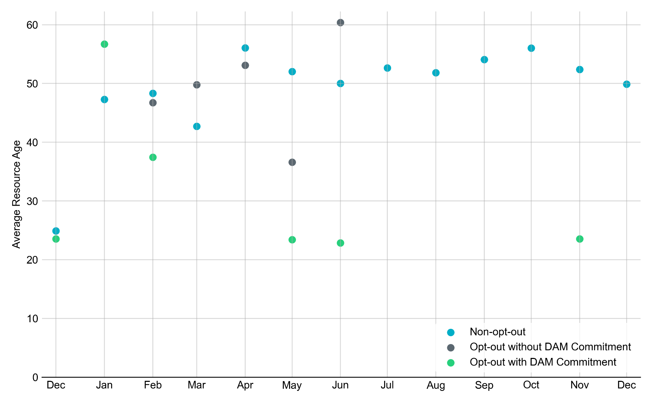
Average Resource Age: Last 13 Months In December 2025, the average age of RUC-committed Resources was 49.9 years for Non-opt-out Resource-hours.
Note: For Resource configurations with multiple physical generators, the age of the oldest generator is used.

Slide 9
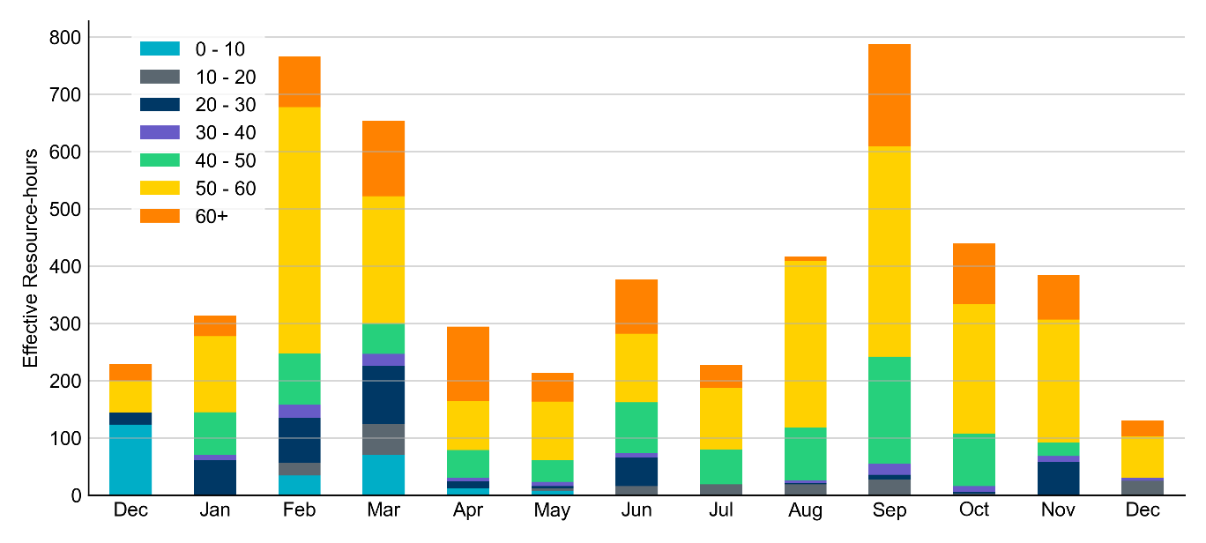
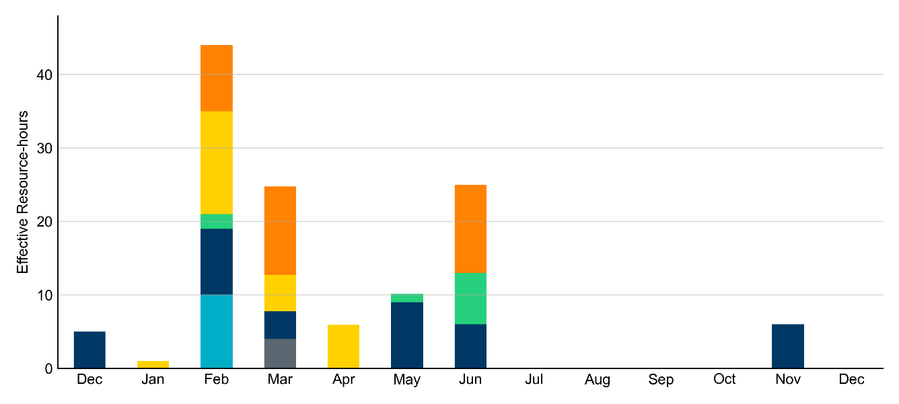
Age Category: Last 13 Months In December 2025, most RUC Effective Resource-Hours (80%) were provided by resources that were at least 50 years old.
Non-opt-out
Opt-out

Slide 10
RUC-Instructed Resource Dispatch above Low Dispatch Limit (LDL) in Non-Opt-Out Hours
Out of all 129.9 non-opt-out Effective Resource-hours, RUC-instructed Resources were dispatched above their LDL for 1.8 Resource-hours.
In 1.4 of these Resource-hours, the Locational Marginal Price (LMP) for the RUC-instructed Resource exceeded the RUC offer floor.
In 0.3 of these Resource-hours, the LMP for the RUC-instructed Resource fell below the RUC offer floor.
All 0.3 Resource-hours saw the RUC-instructed Resource being mitigated.
There were no Exceptional Fuel Cost submissions for any Resources committed by RUC.

Slide 11
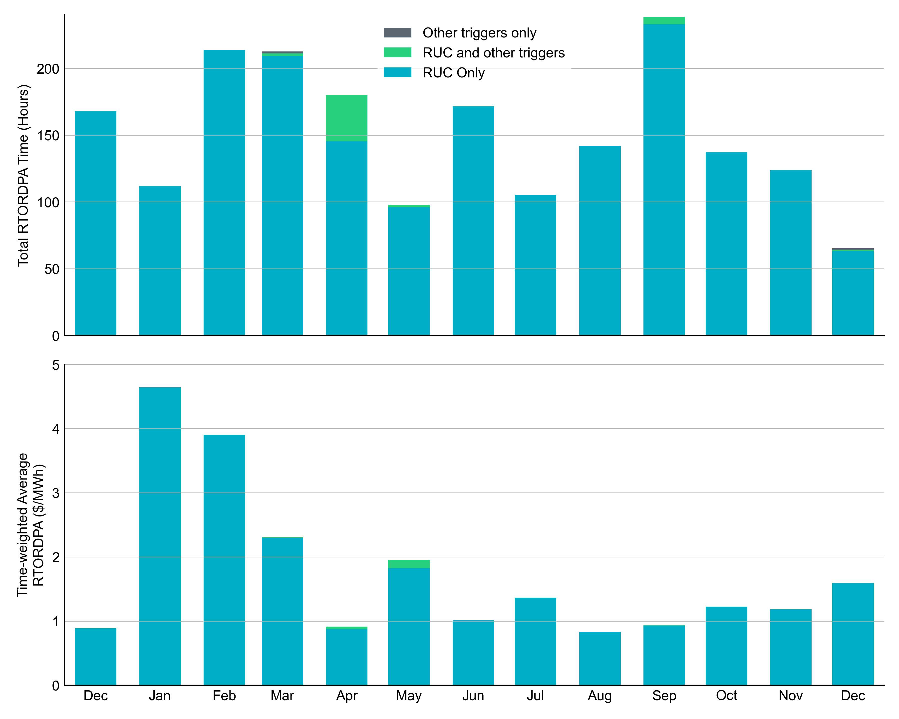
Reliability Deployment Price Adder: Last 13 Months December 2025 had a total of 65.2 RTORDPA hours with a time-weighted average value of $1.59/MWh.
These graphs show RTORDPA instances by reliability action: 'RUC Only' for instances triggered solely by Reliability Unit Commitment, 'RUC and other triggers' for instances with RUC and additional triggers, and 'Other triggers only' for instances with non-RUC triggers. The daily average RTORDPA is calculated using the total duration across all categories. See ERCOT protocol section 6.5.7.3.1 for details.

Slide 12
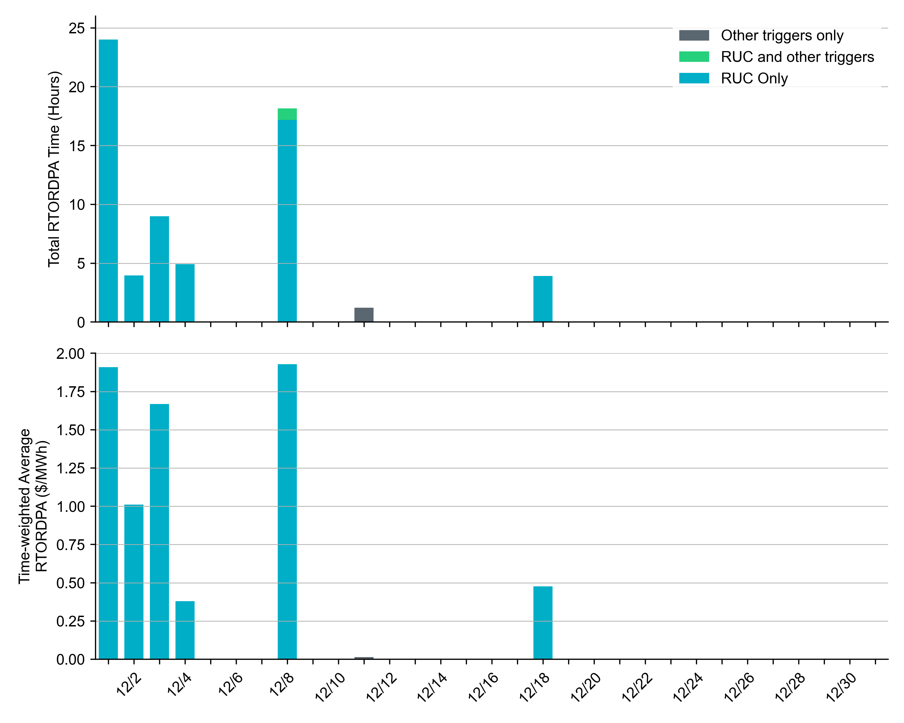
Reliability Deployment Price Adder for Energy: December 2025 OD 12/8 had the highest daily time-weighted average RTORDPA of $1.93/MWh.
These graphs show RTORDPA instances by reliability action: 'RUC Only' for instances triggered solely by Reliability Unit Commitment, 'RUC and other triggers' for instances with RUC and additional triggers, and 'Other triggers only' for instances with non-RUC triggers. The daily average RTORDPA is calculated using the total duration across all categories. See ERCOT protocol section 6.5.7.3.1 for more details.

Slide 13
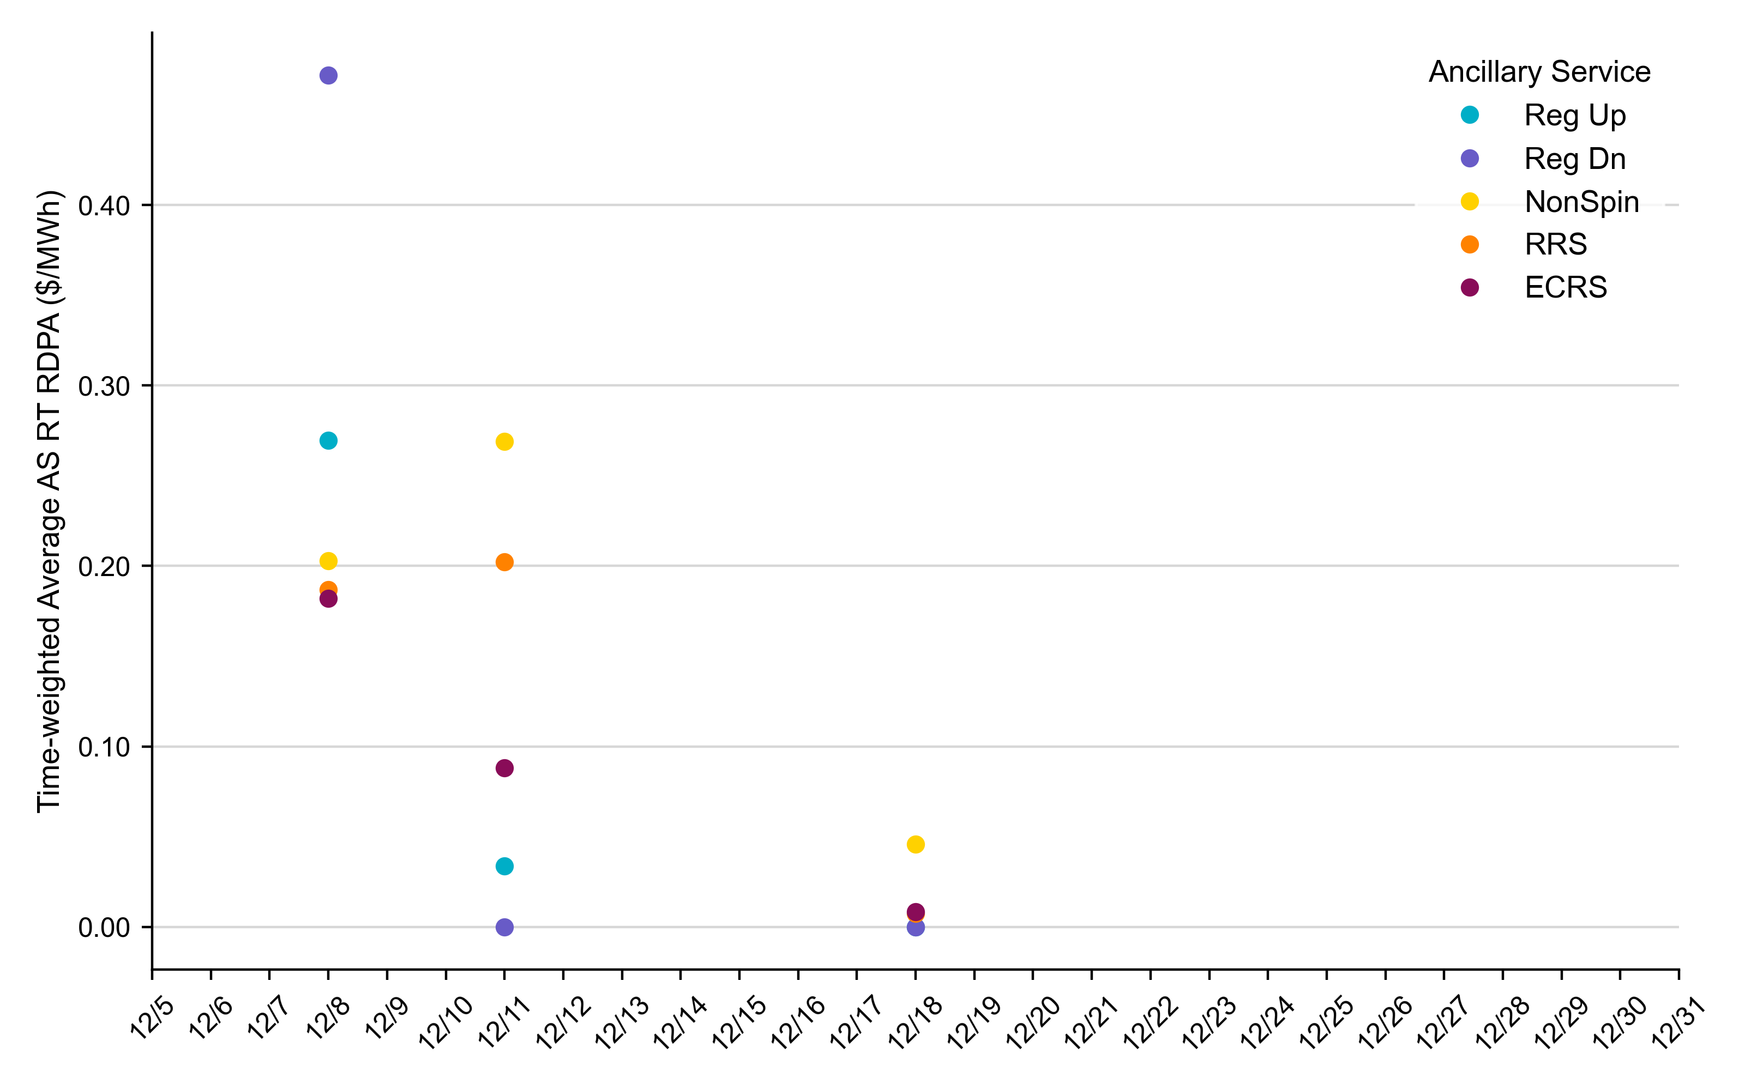
Reliability Deployment Price Adder for Ancillary Services: December 2025 OD 12/8 had the highest daily time-weighted average RT RDPA for Ancillary Services.
RDPA | Monthly Time Weighted Average ($/MWh)*
Regulation Up (Reg-Up) | 0.15
Regulation Down (Reg-Down) | 0.08
Non-Spinning Reserves (Non-Spin) | 0.14
Responsive Reserve Service (RRS) | 0.11
ERCOT Contingency Reserve Service (ECRS) | 0.11
* RDPAs for Ancillary Services are only available after RTC+B implementation on December 5, 2025
The daily average values are calculated as time-weighted average Real-Time Reliability Deployment Price Adders for each Ancillary Service during SCED intervals with RDPA active for any reliability event trigger.
The RDPAs on 12/8 were triggered by both RUC and the deployment of Non-Spin from Non-Controllable Load Resources.
The RDPAs on 12/11 were triggered by the deployment of Non-Spin from Non-Controllable Load Resources.
The RDPAs on 12/18 were triggered by RUC only.

Slide 14
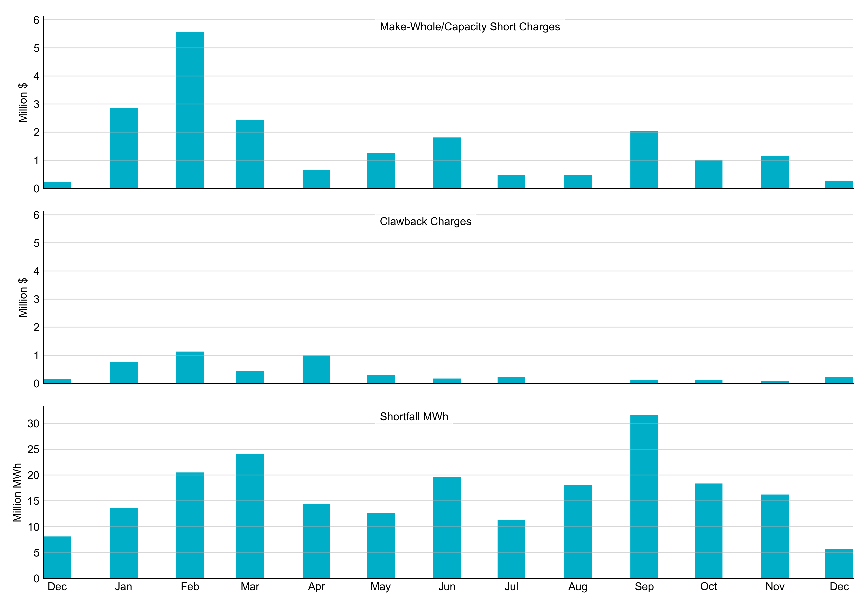
RUC Make-Whole, Clawback, and Shortfall For December 2025, the total Make-Whole Payment was $271,995 and was lower than in previous months. The total Clawback Charge was $233,499, slightly higher than in previous months.
Of the $271,995 in Make-Whole Payments made in December 2025, $0.82 was uplifted to load due to rounding.
The remaining amount was collected through Capacity-Short Charges.
Data as of December 9th, 2025

Slide 15
RUC Make-Whole by Settlement Type For December 2025, the total Make-Whole Payment was $271,995 in Initial Settlement. It was almost exclusively covered by Capacity Short Charge, and only $0.82 was uplifted to load due to rounding.
Month | Initial Settlement ($) | Final Settlement Change ($) | True-up Settlement Change ($) | Net as of Jan 4, 2026 ($)
Dec ‘24 | -179,587 | 0 | -53,342 | -232,929
Jan ‘25 | -834,867 | -80,530 | -1,947,157 | -2,862,554
Feb ‘25 | -1,198,579 | -17,762 | -4,344,131 | -5,560,472
Mar ‘25 | -1,701,707 | 0 | -111,462 | -1,813,169
Apr ‘25 | -594,864 | -3,693 | 104,830 | -493,728
May ‘25 | -493,728 | 0 | - | -
Jun ‘25 | -1,285,661 | 0 | - | -
Jul ‘25 | -382,594 | -294 | - | -
Aug ‘25 | -487,773 | 0 | - | -
Sep ‘25 | -2,035,251 | - | - | -
Oct ‘25 | -1,016,193 | - | - | -
Nov ‘25 | -1,119,452 | - | - | -
Dec ‘25 | -271,995 | - | - | -
Negative dollars represent a payment from ERCOT to a market participant
“-” indicates settlement has yet to be completed.
Net figures may differ slightly due to rounding.

Slide 16
RUC Clawback by Settlement Type For December 2025, the total Clawback Charge was $233,499 in Initial Settlement.
Month | Initial Settlement ($) | Final Settlement Change ($) | True-up Settlement Change ($) | Net as of Jan 4, 2026 ($)
Dec ‘24 | 147,389 | -3 | 0 | 147,386
Jan ‘25 | 1,037,717 | 0 | -294,094 | 743,623
Feb ‘25 | 3,272,312 | 0 | -2,138,639 | 1,133,673
Mar ‘25 | 545,642 | 0 | -87,084 | 458,558
Apr ‘25 | 993,341 | 119 | -418,816 | 574,643
May ‘25 | 574,643 | 0 | - | -
Jun ‘25 | 173,176 | 0 | - | -
Jul ‘25 | 246,345 | 134 | - | -
Aug ‘25 | 12,319 | 0 | - | -
Sep ‘25 | 122,634 | - | - | -
Oct ‘25 | 128,343 | - | - | -
Nov ‘25 | 61,933 | - | - | -
Dec ‘25 | 233,499 | - | - | -
Negative dollars represent a payment from ERCOT to a market participant
“-” indicates settlement has yet to be completed.
Net figures may differ slightly due to rounding.

