Slide 1
Considerations for Electronic Load Ride-Through
Brett Ross
Electrical Engineer
This work (PNNL-SA-205803) is supported by the protective relaying program under Office of Electricity, U.S. Department of Energy (DOE). The Pacific Northwest National Laboratory (PNNL) is operated by Battelle for the U.S. DOE under Contract DE-AC05-76RL01830.
Notes:
Stock Image

Slide 2
Purpose
What should the load current do during, immediately following the fault?
  I.e., what inverter controls do we actually use?
A good solution will:
  Minimize need for tradeoff between voltage and frequency stability
  Minimize need for site- or condition-specific settings/configuration
  Minimize complexity of new feature development for OEMs (timeline, human performance risk)
  Conform with IBR behaviors that power engineers are familiar with and can represent with existing models (e.g., REGC, REEC)
  Avoid hardware modifications (firmware only)
  Not impact load performance*
*Requires short-term energy storage downstream of the power electronics device that can support the load during the fault

Slide 3
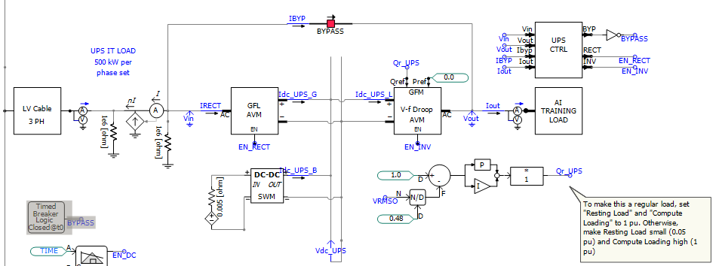
Methodology
Focus on UPS response to grid faults
  3 phase, 150 ms fault, 0.5 pu fault voltage
150 MVA UPS capacity, loaded to 80 MW.
Fairly weak system

Slide 4
Applicability
Supporting load for all faults unlikely to be tenable with traditional capacitors; batteries, supercapacitors, etc. required
Unidirectional 1 PH PSU
Non-critical IT load (e.g., cryptominer)
Not feasible
Double Conversion UPS
Most datacenters today
Can rely on internal battery
Some datacenters today—rack-level backup
Bidirectional 1 PH PSU
Needs short-term energy storage
Future datacenters—DC-level distribution
3 PH Inverter

Slide 5
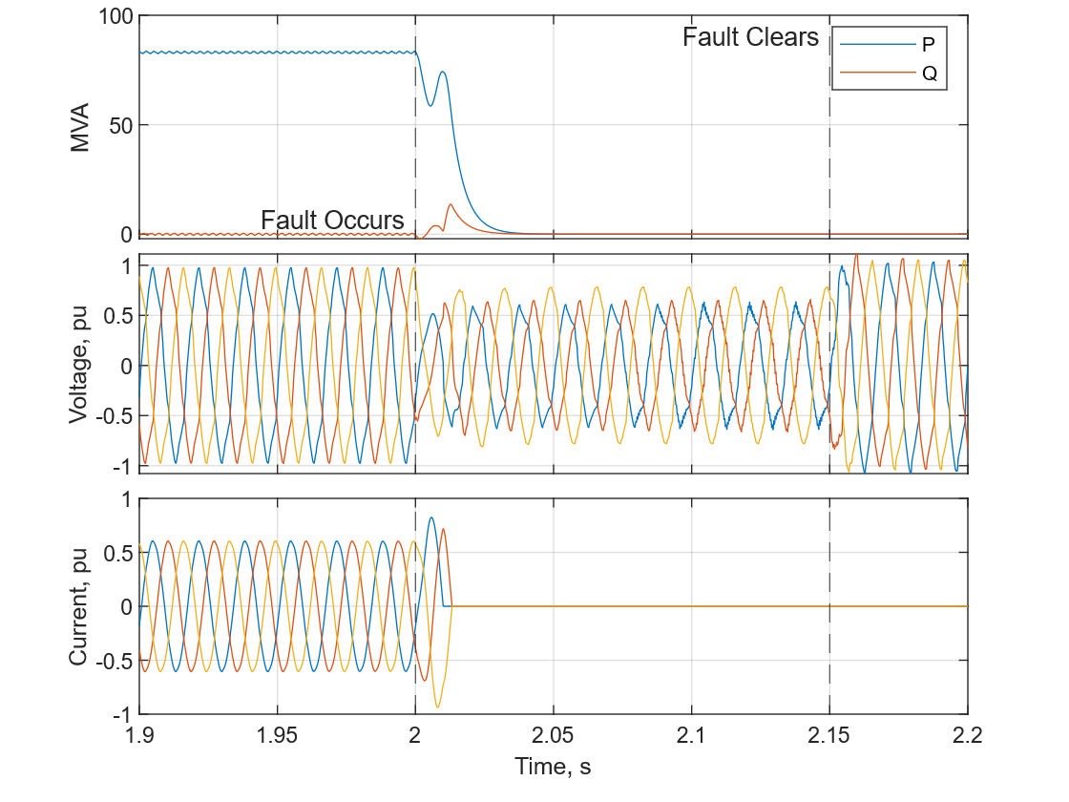
Fast Trip
Our “base case”
UPS simply trips offline during fault

Slide 6
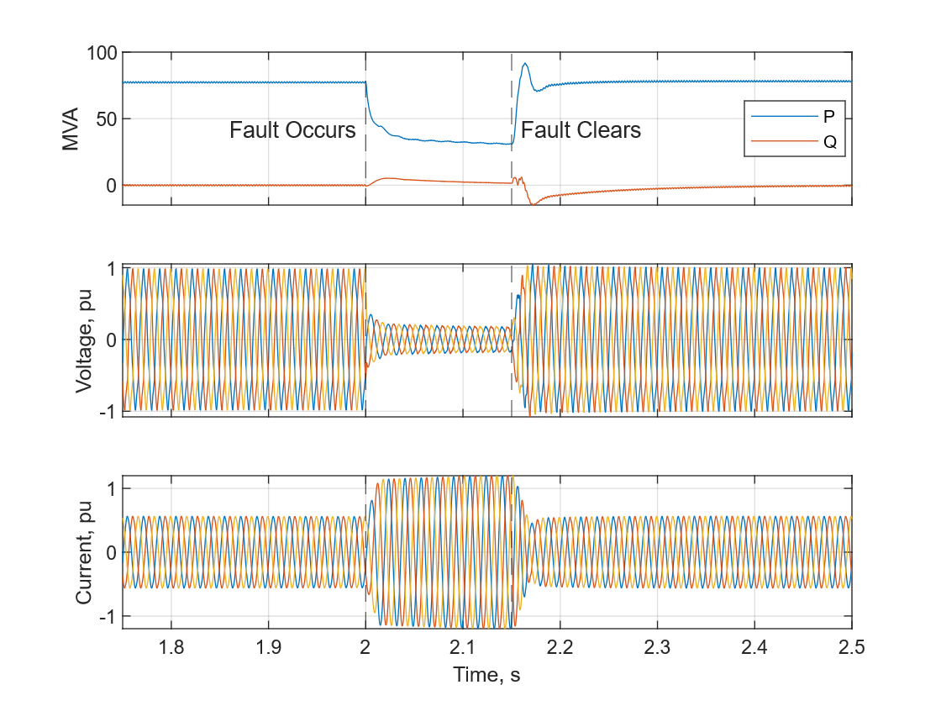
Current-Limited Constant Power
The “default” behavior if the load doesn’t trip (least effort).
Supplies 2X normal load current
Will worsen voltage sags, postfault voltage recovery
Possible protection misoperations

Slide 7
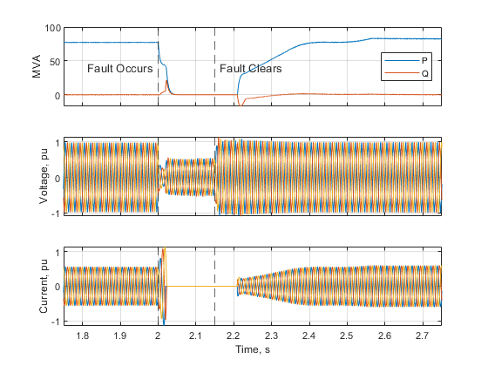
Momentary Cessation
Proven IBR function in theory, but nontrivial to add
  Ensuring stability, adequate current limiting under various fault/post-fault conditions
  Lots of room for varying timings, interpretations, lots of settings
Timing configurable (used 50 ms dropout, 150 ms walk-in here)

Slide 8
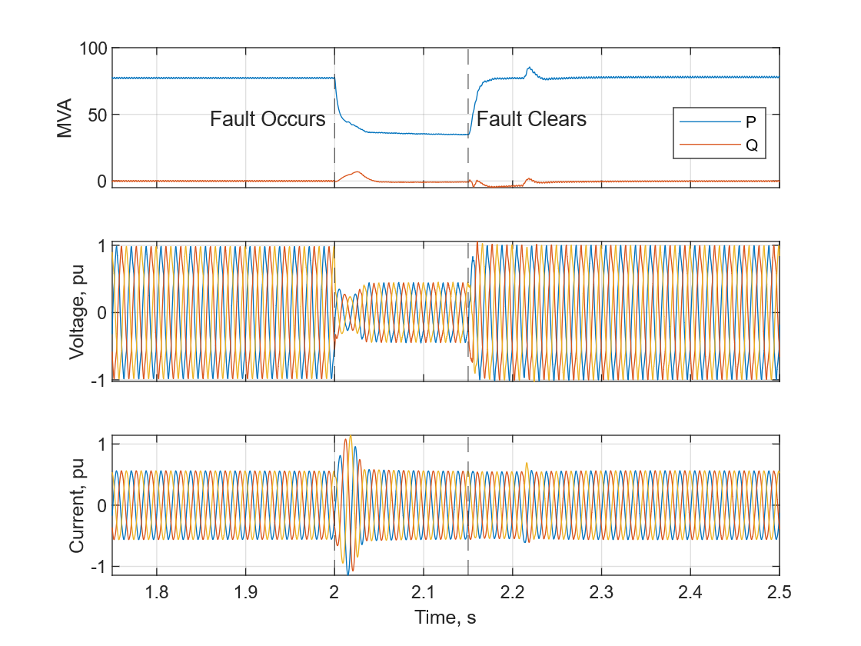



Current Freeze
Not a common IBR approach, but technically feasible
Approximates a “constant current” load during fault
LPF
$$T≈0.5 s$$
Sampler
$$I_{dq}^{∗}$$
To current regulator
Freeze
$$|V|$$
Definite Time Undervoltage

Slide 9
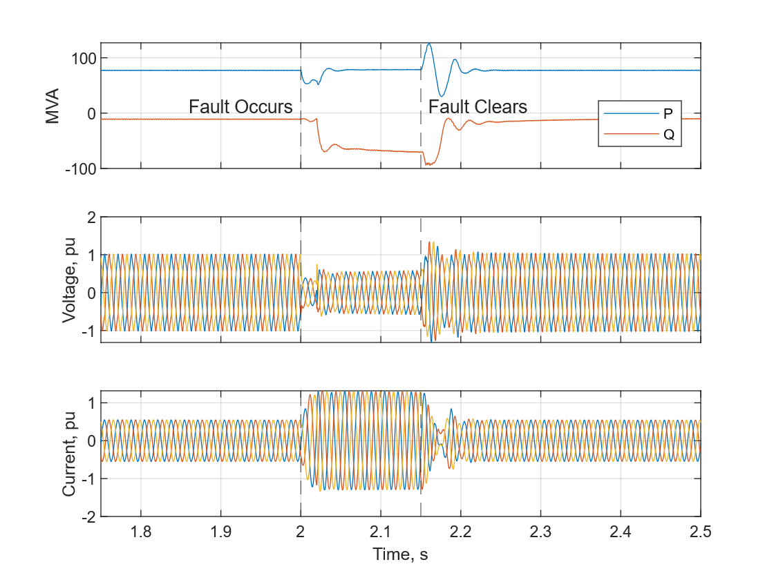
Dynamic Voltage Support
Current limiter prioritizes reactive power during voltage sags
Proven IBR function in theory, but nontrivial to add
  Ensuring stability, adequate current limiting under various fault/post-fault conditions
Overhead UPS capacity permits significant voltage support
  Sufficient to allow true constant power

Slide 10
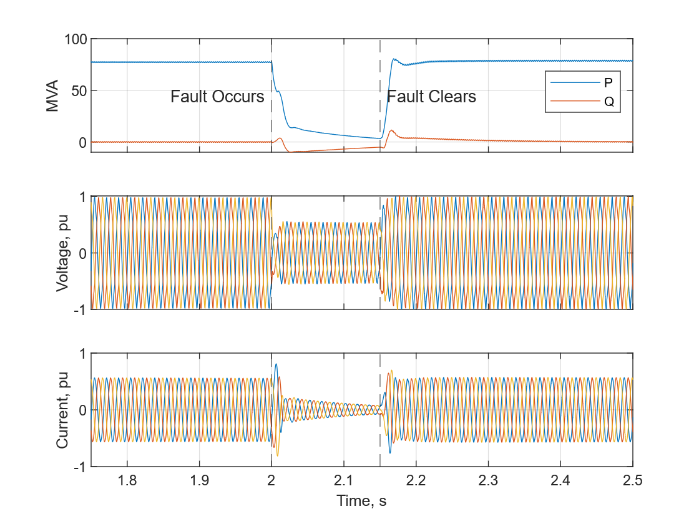
Voltage-Dependent Current Limits
Reduce current limit below set voltage threshold
Middle ground between momentary cessation & support
Current Limit
pu
1.2
Voltage, pu
0.3
0.7
1

Slide 11
Summary
Fault Response | Frequency Support | Voltage Support | Control Complexity¹ | Protection Impact
Trip | N | N | N/A | N/A
Constant Power | Y | N | Low | High
Current Freeze | Y | N | Medium | Medium
Momentary Cessation | Y | N | Medium | Low
Dynamic Voltage Support | Y | Y | Medium | High
V-Dependent I Limits | Y² | Y or N | Medium | Medium
¹Relatively speaking. If the feature is new to the product, it is still a “major” feature from a product development perspective.
²Yes, but at a reduced level based on proximity of the fault and prioritization
One Approach: near-term focus on momentary cessation or current freeze. Longer term, assess benefits of dynamic voltage support
Recommendation: leverage language, visuals from IBR performance standards and standard IBR models (e.g., REGC, REEC)

Slide 12
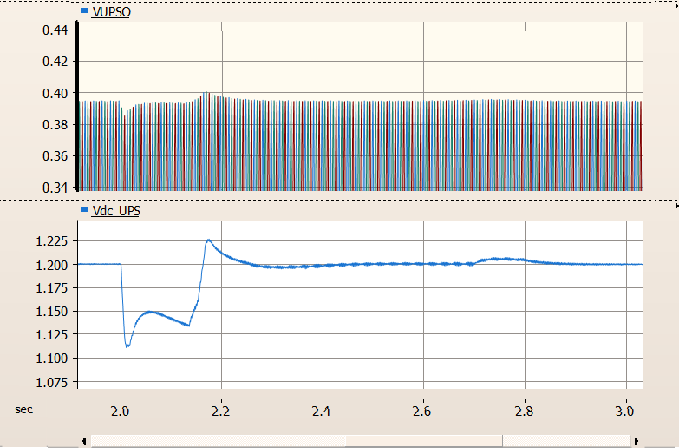
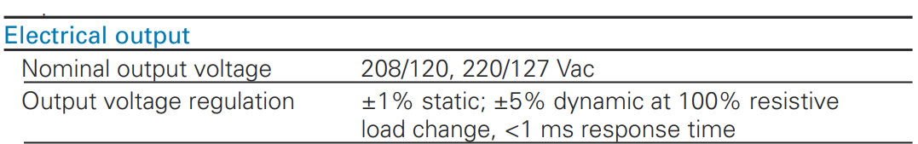
OEM-Level Concerns
Feature additions require OEM to revisit ability to meet other design specifications. Potential sources for issues:
  PLL instability during and following faults
  Excessive DC link voltage fluctuations
  Exceeding rectifier short-time overload capabilities
  Tripping due to voltage, current transients when transitioning control modes
All the above factors contributed to unwanted IBR tripping events—misunderstandings and miscommunications between domains a key challenge
UPS AC Output
UPS DC Link

Slide 13
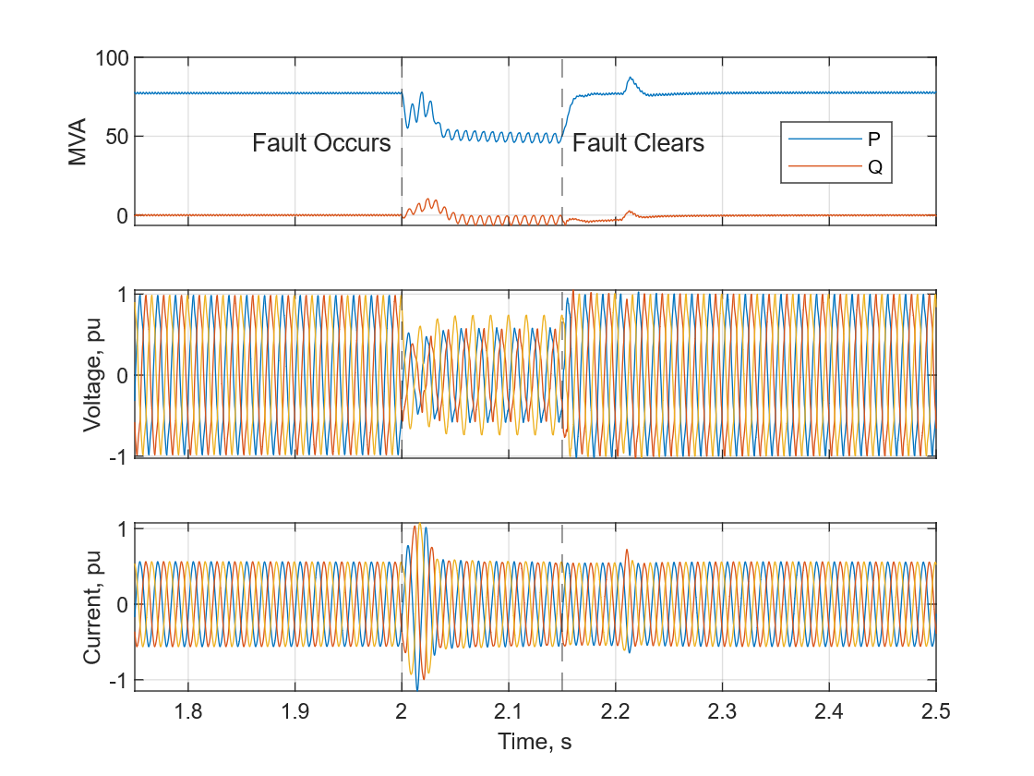
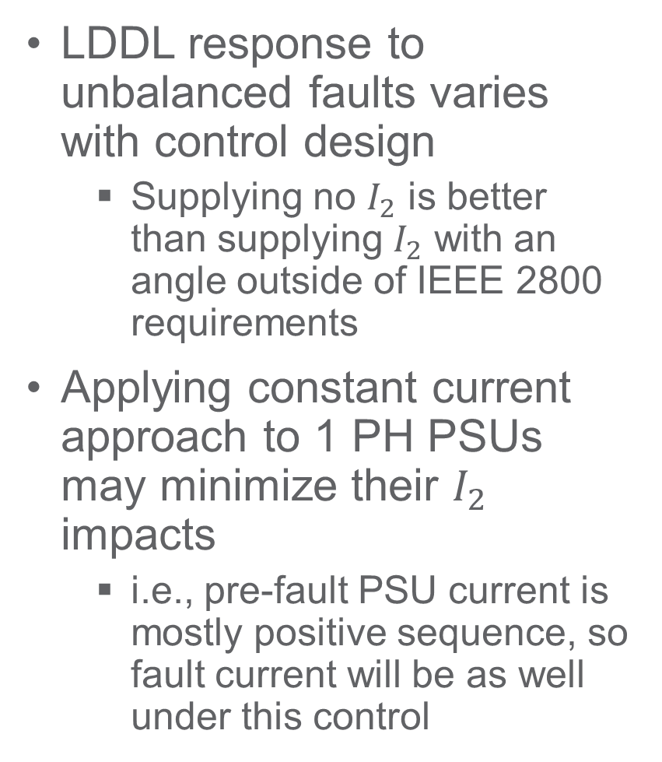
Unbalanced Faults
Response of Current Freeze Control to L-L Fault: $I_{2}≈0$
LDDL response to unbalanced faults varies with control design
  Supplying no $I_{2}$ is better than supplying $I_{2}$ with an angle outside of IEEE 2800 requirements
Applying constant current approach to 1 PH PSUs may minimize their $I_{2}$ impacts
  i.e., pre-fault PSU current is mostly positive sequence, so fault current will be as well under this control

Slide 14
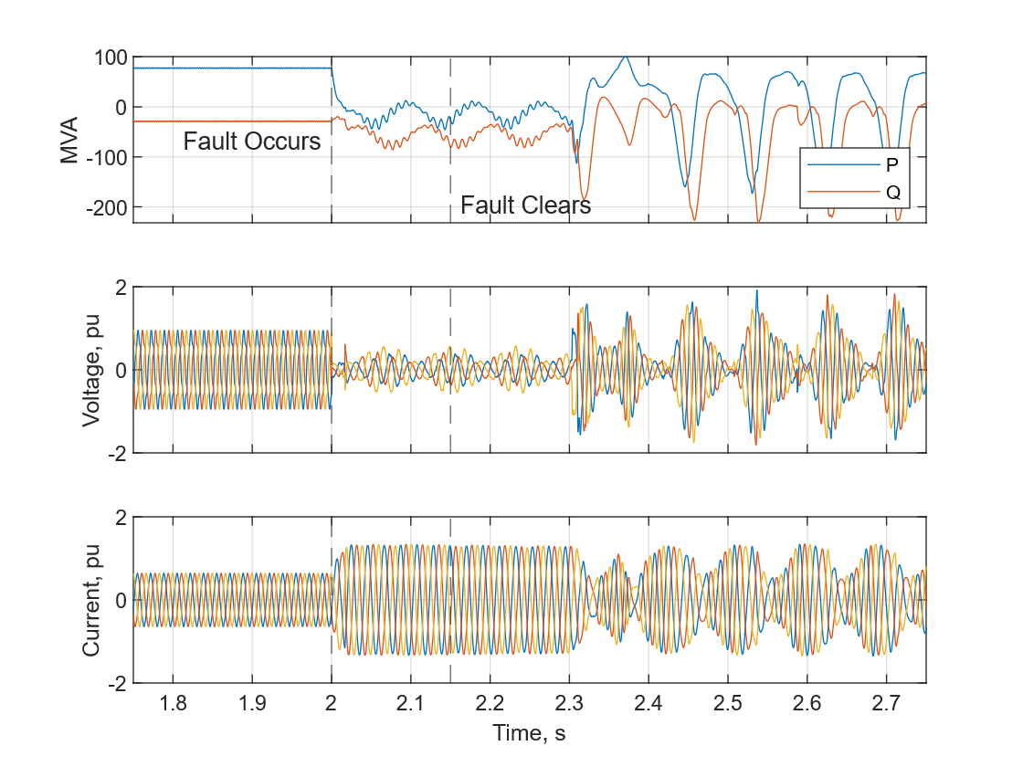
PLL Stability Considerations
PLL Loss of Synch Following L-L Fault in Weak Grid
Small signal
  Weak grid issue; worse if providing AC voltage regulation/support.
Large signal
  Worsens for faults with large V_2 (L-L or L-L-G the worst)
  Extra requirements to transition control modes can worsen this.
These issues/limitations can be avoided using PLL-free (e.g., GFM) control approaches
  Long term solution; major control re-design

