Slide 1
CRR Updates at CMWG
Samantha Findley
January 20, 2026

Slide 2
Agenda
LTAS transactions and solution times
CRR auction limits table – no changes
Draft – Annual CRR Activity Calendar update

Slide 3
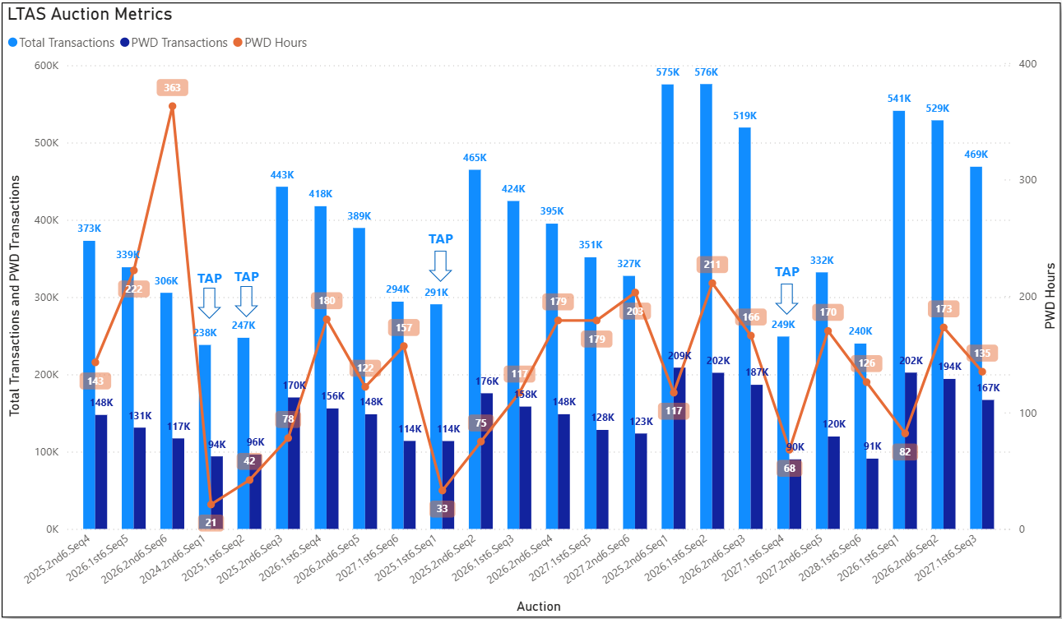
Historical LTAS transactions and solution times

Slide 4
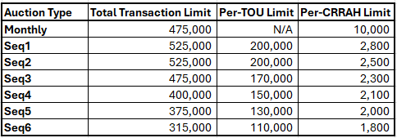
CRR auction transaction limits – no changes

Slide 5
CRR activity calendar – overview
Protocol 7.5.1(4)(c) requires ERCOT to post an updated calendar no later than April 1 of each calendar year
  Each calendar includes auction activity dates for the remainder of the current calendar year and for the two subsequent calendar years
  The calendar must be approved by WMS prior to the annual posting
Would like feedback today from CMWG on the draft calendar before seeking final approval from WMS on February 4. Feedback can also be submitted to ercotcrr@ercot.com.

Slide 6
CRR activity calendar – general reminders
The model build process begins 3 weeks prior to the model posting date (get outages and Common Information Model snapshot)
  Added a 3rd week at the beginning of 2023 due to changes to model build tools
We hold a monthly auction and a long-term auction every month of the year
  Typical pattern is monthly auction bid window in the first half of the month followed by the long-term auction bid window the very next week (occasionally, there will be a one-week gap to avoid holidays)
  Monthly auction results are posted one week after the bid window closes; long-term auction results are posted two weeks after the bid window closes

Slide 7
CRR activity calendar – general reminders
There are two additional tabs on the calendar
  “Calendar Protocol References” includes any specific protocol sections related to the selection of dates
  “PCRRs” contains activity dates and protocol sections related to the annual PCRR allocation process

Slide 8
CRR activity calendar – description of changes
Current calendar goes through the 2028.MAR.Monthly.Auction
Draft dates cover CRR activities through the 2029.MAR.Monthly.Auction
  Applied the same patterns to assign the dates as have been used for previous calendars to maintain Protocol requirements and consistency
PCRR-eligible NOIEs are encouraged to view the dates on the “PCRRs” tab of the calendar

