Slide 1
Credit Exposure Update
Credit Finance Sub Group
ERCOT Public
January 16, 2026

Slide 2
Monthly Highlights: November 2025 – December 2025
Market-wide average Total Potential Exposure (TPE) slightly decreased from $1.60 billion in November to $1.59 billion in December
Forward adjustment factors on average slightly decreased during the month
    Discretionary Collateral is defined as Secured Collateral in excess of TPE,CRR Locked ACL and DAM Exposure
  Average Discretionary Collateral increased from $3.74 billion in November compared to $3.93 billion in December
No unusual collateral call activity

Slide 3
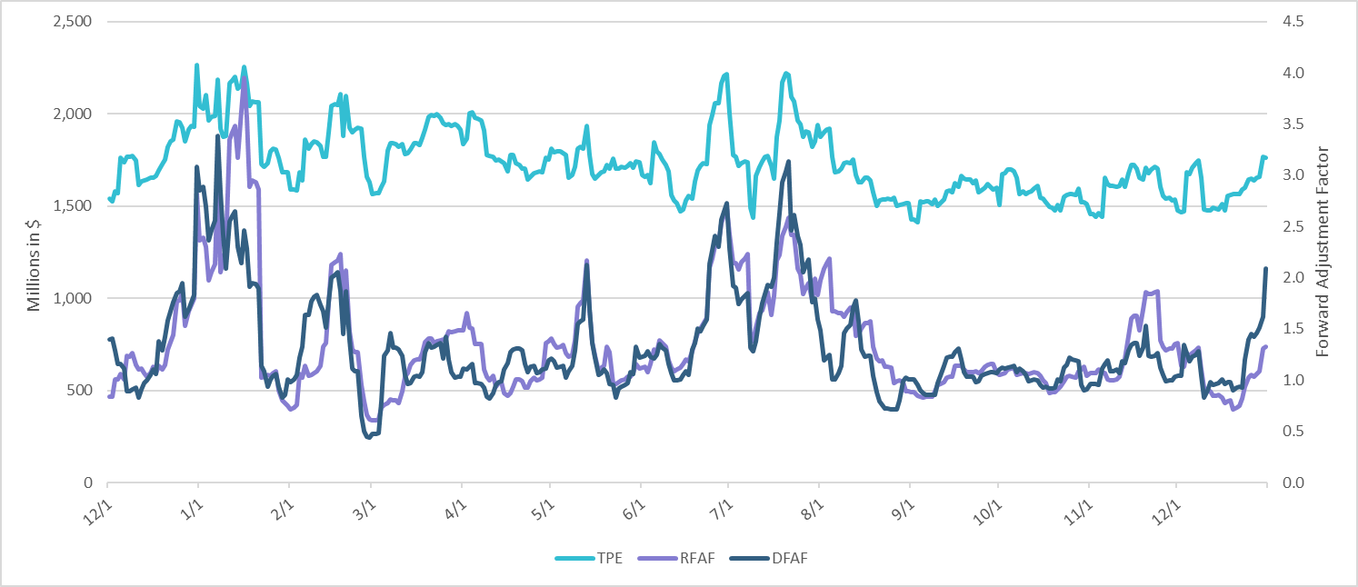
TPE and Forward Adjustment Factors: December 2024 – December 2025

Slide 4
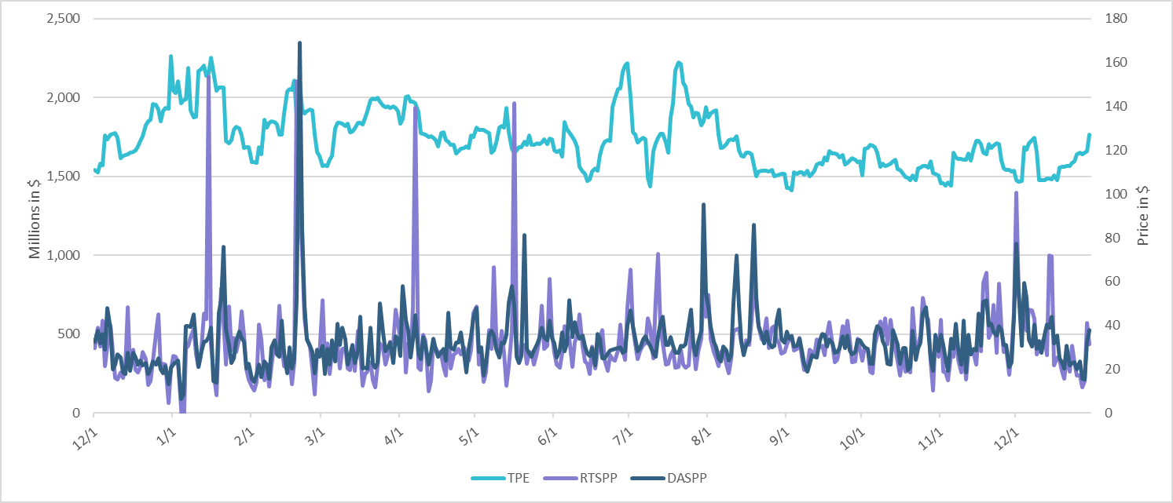
TPE/Real-Time & Day-Ahead Daily Average Settlement Point Prices for HB_NORT:H December 2024 – December 2025

Slide 5
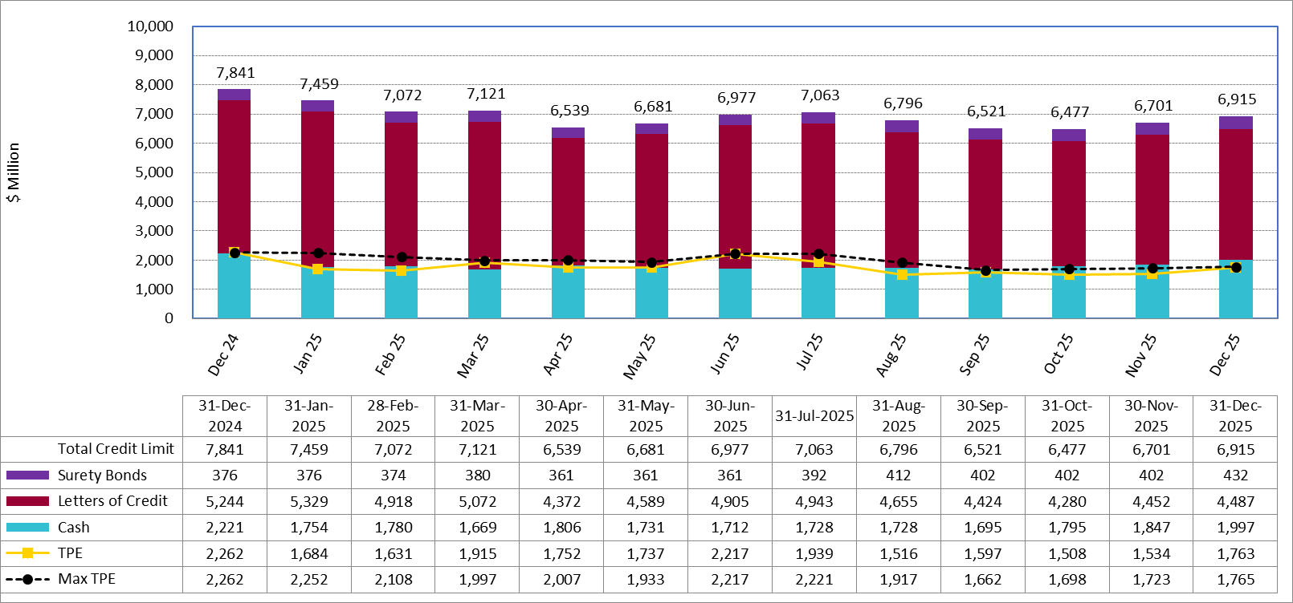
Available Credit by Type Compared to Total Potential Exposure (TPE):
December 2024 – December 2025
Numbers are as of month-end except for Max TPE
Max TPE is the highest TPE for the corresponding month

Slide 6
Issuer Credit Limits vs Total LC Amounts Per Issuer: December 2025
As of December 31, 2025
There are a total of 36 banks that have issued LCs.

Slide 7
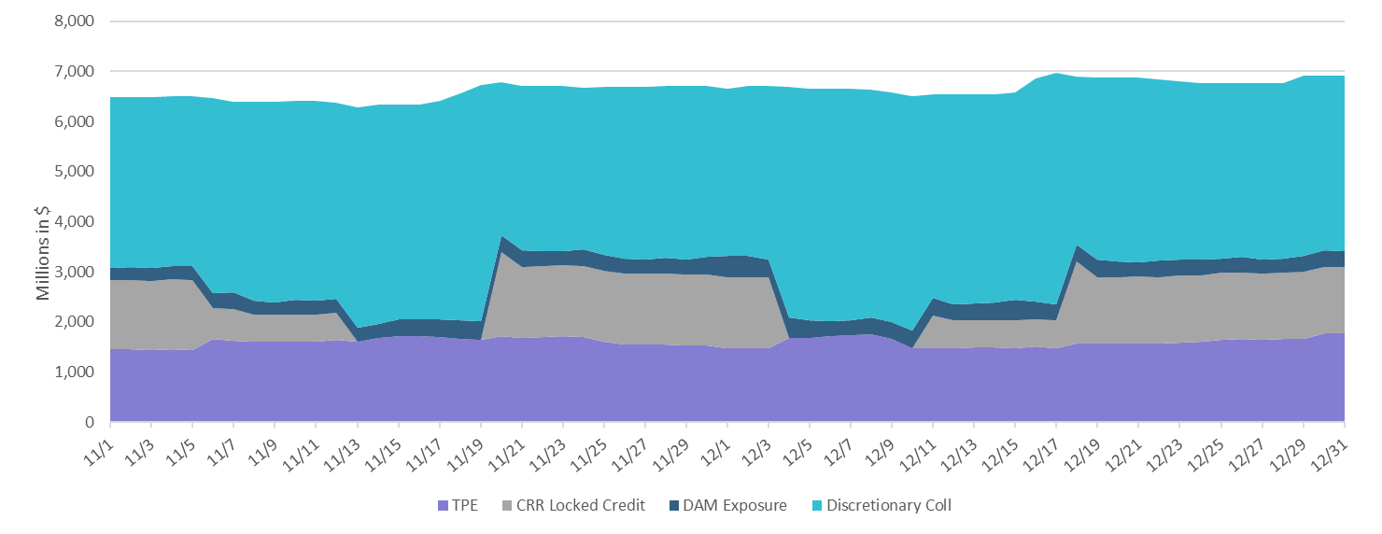
Discretionary Collateral November 2025 – December 2025

Slide 8
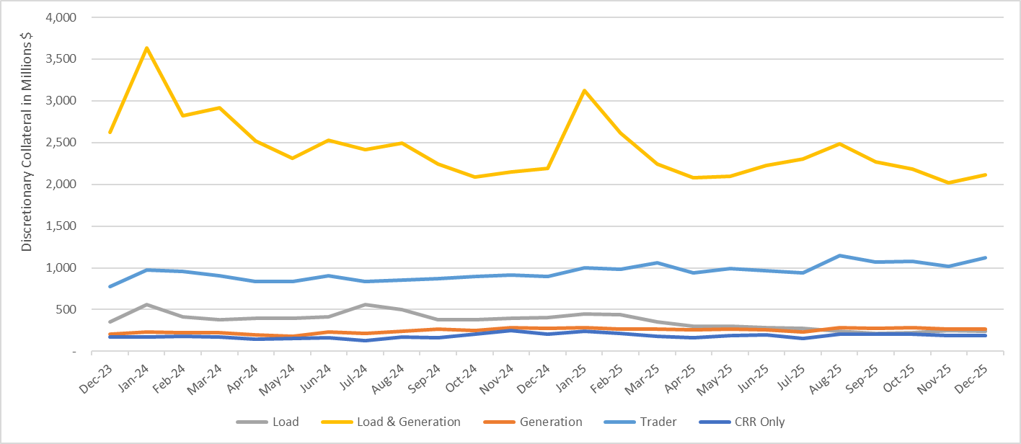
Discretionary Collateral by Market Segment December 2023 - December 2025

Slide 9
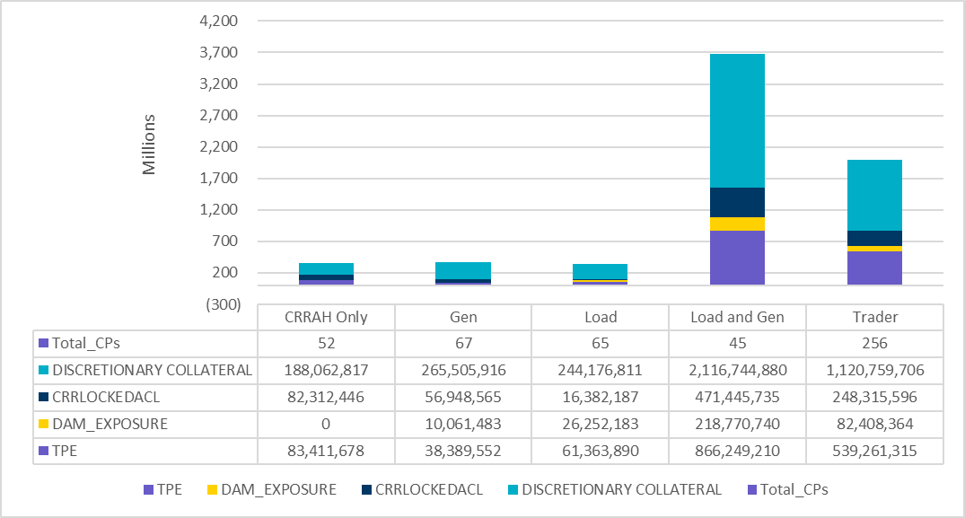
TPE and Discretionary Collateral by Market Segment - December 2025
Load and Generation entities accounted for the largest portion of discretionary collateral

Slide 10
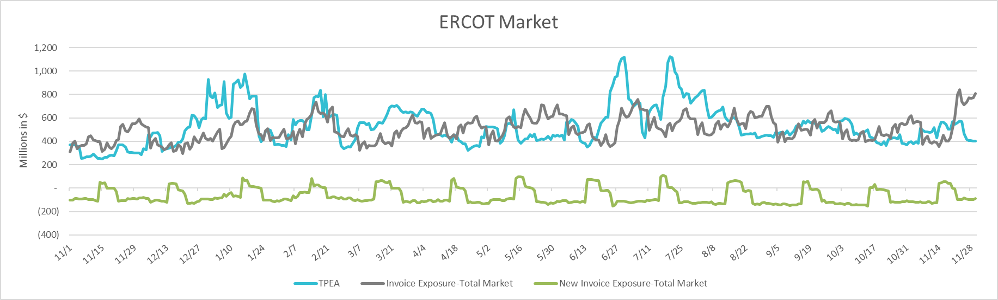
TPEA Coverage of Settlements November 2024 - November 2025
Invoice Exposure | Historical | Future
Existing Invoice Exposure | RTLCNS + UDAA | M1 Days (including current day) Forward Charge Invoice Amounts
New Invoice Exposure | 7 Days Back Net Invoice Amounts (Charges & Credits) | M1 Days (including current day) Forward Net Invoice Amounts (Charges & Credits); Excluding: 1) Securitization Invoices; 2) CRR Auction Invoices; and 3) Subchapter N Funds Distribution Invoice

Slide 11
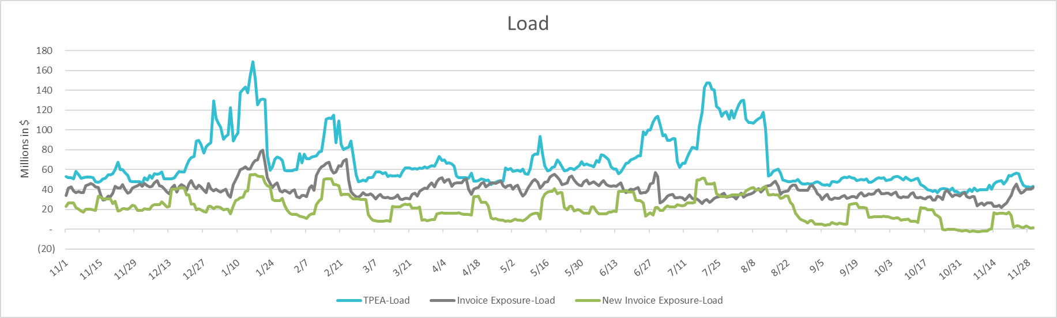
TPEA Coverage of Settlements November 2024 - November 2025
Invoice Exposure | Historical | Future
Existing Invoice Exposure | RTLCNS + UDAA | M1 Days (including current day) Forward Charge Invoice Amounts
New Invoice Exposure | 7 Days Back Net Invoice Amounts (Charges & Credits) | M1 Days (including current day) Forward Net Invoice Amounts (Charges & Credits); Excluding: 1) Securitization Invoices; 2) CRR Auction Invoices; 3) Subchapter N Funds Distribution Invoice

Slide 12
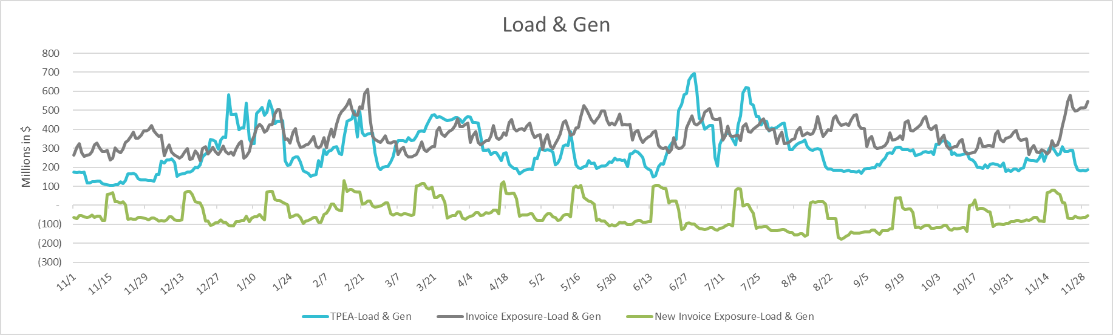
TPEA Coverage of Settlements November 2024 - November 2025
Invoice Exposure | Historical | Future
Existing Invoice Exposure | RTLCNS + UDAA | M1 Days (including current day) Forward Charge Invoice Amounts
New Invoice Exposure | 7 Days Back Net Invoice Amounts (Charges & Credits) | M1 Days (including current day) Forward Net Invoice Amounts (Charges & Credits); Excluding: 1) Securitization Invoices; 2) CRR Auction Invoices; 3) Subchapter N Funds Distribution Invoice

Slide 13
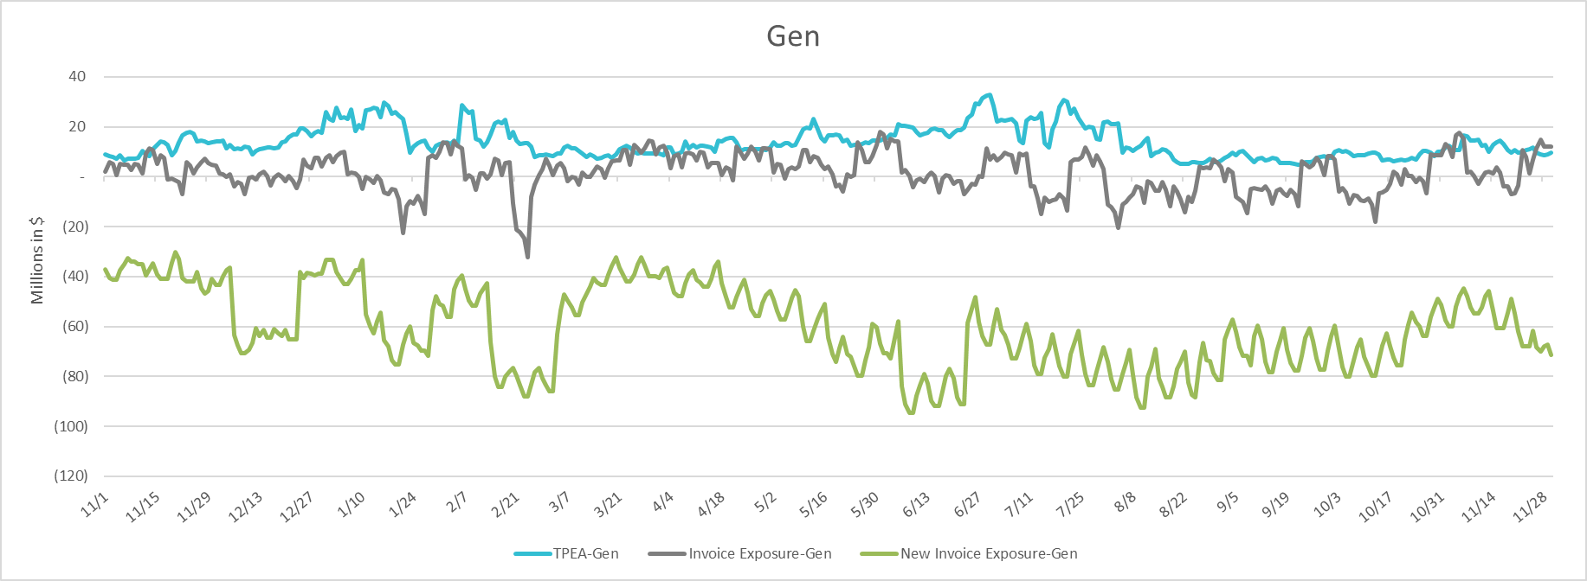
TPEA Coverage of Settlements November 2024 - November 2025
Invoice Exposure | Historical | Future
Existing Invoice Exposure | RTLCNS + UDAA | M1 Days (including current day) Forward Charge Invoice Amounts
New Invoice Exposure | 7 Days Back Net Invoice Amounts (Charges & Credits) | M1 Days (including current day) Forward Net Invoice Amounts (Charges & Credits); Excluding: 1) Securitization Invoices; 2) CRR Auction Invoices; 3) Subchapter N Funds Distribution Invoice

Slide 14
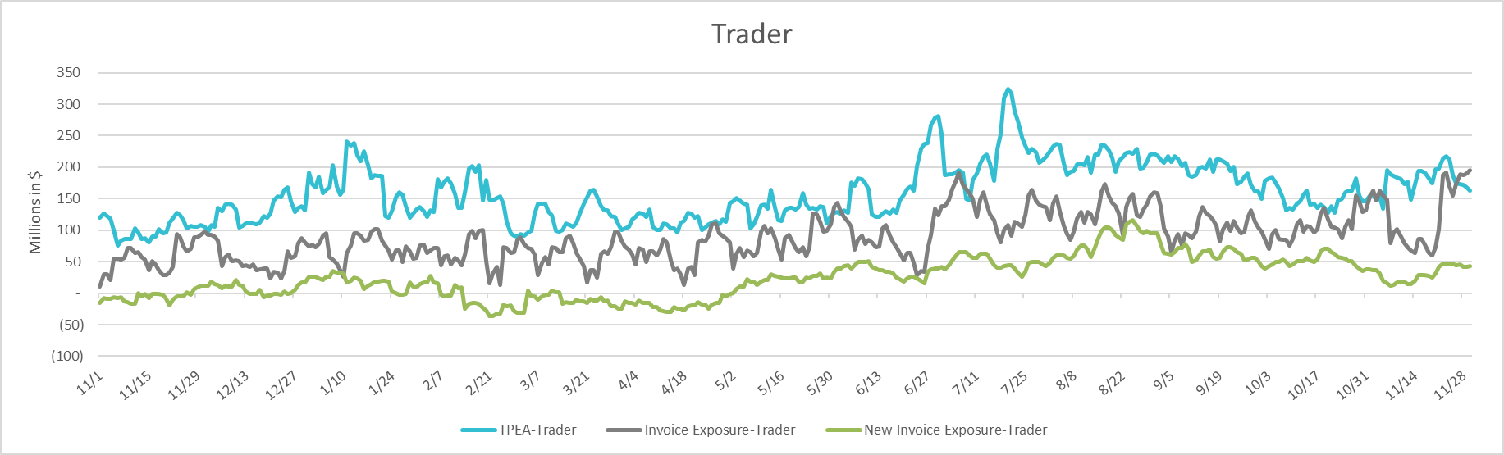
TPEA Coverage of Settlements November 2024 - November 2025
Invoice Exposure | Historical | Future
Existing Invoice Exposure | RTLCNS + UDAA | M1 Days (including current day) Forward Charge Invoice Amounts
New Invoice Exposure | 7 Days Back Net Invoice Amounts (Charges & Credits) | M1 Days (including current day) Forward Net Invoice Amounts (Charges & Credits); Excluding: 1) Securitization Invoices; 2) CRR Auction Invoices; 3) Subchapter N Funds Distribution Invoice

Slide 15
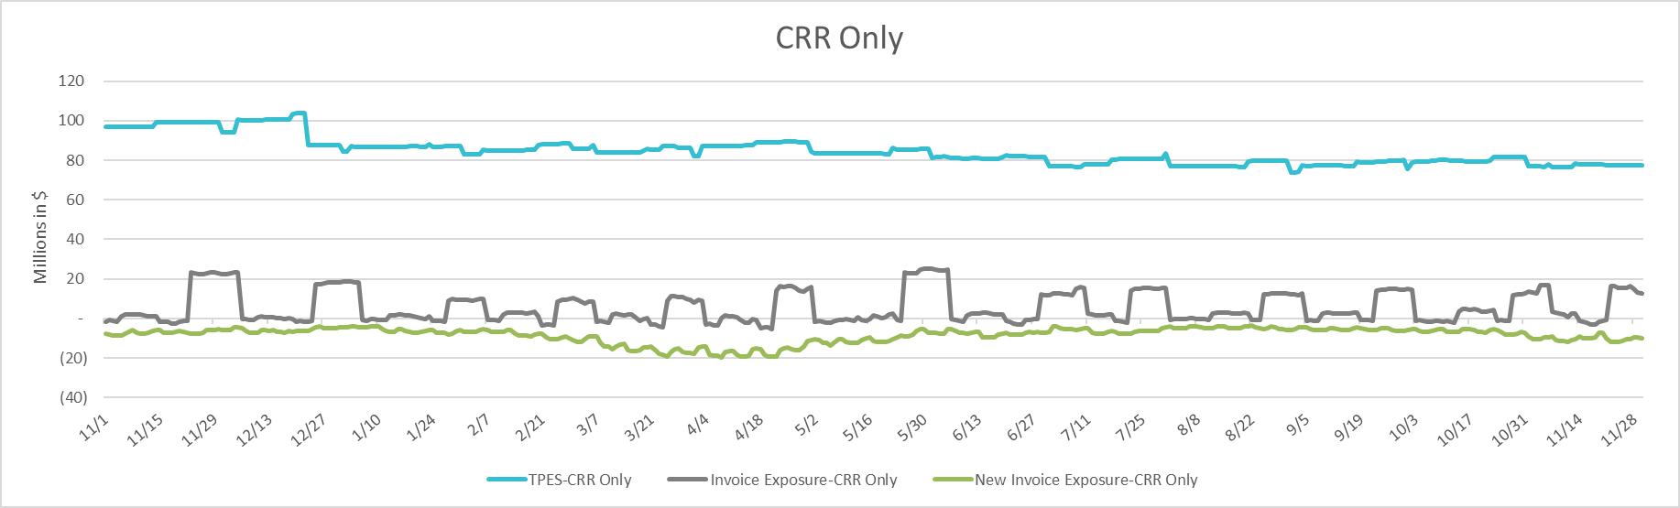
TPEA Coverage of Settlements November 2024 - November 2025
Invoice Exposure | Historical | Future
Existing Invoice Exposure | RTLCNS + UDAA | M1 Days (including current day) Forward Charge Invoice Amounts
New Invoice Exposure | 7 Days Back Net Invoice Amounts (Charges & Credits) | M1 Days (including current day) Forward Net Invoice Amounts (Charges & Credits); Excluding: 1) Securitization Invoices; 2) CRR Auction Invoices; 3) Subchapter N Funds Distribution Invoice

Slide 16
Questions

