Slide 1
Project Update
January 14, 2026
Troy Anderson
ERCOT Portfolio Management

Slide 2
Project Update Agenda
2025 Release Targets
2026 Release Targets
Priority/Rank Recommendations for Revision Requests with Impacts
PGRR127 – Addition of Proposed Generation to the Planning Models
Technology Working Group (TWG)
Next meeting is 1/22/2026
Prioritization Update
Status Notes
2026 Project Planning
Location of Revision Request Project Information: http://www.ercot.com/services/projects

Slide 3
2025 Release Targets – Approved NPRRs / SCRs / xGRRs
R1
R3
R5
January 1/30 | February 2/27 | March 3/27 | April 4/24 | May 5/29 | June 6/26
NPRR945 NPRR1219 | NPRR1254 RTC+B Market Trials Sandbox Deployed | NPRR1145 | RTC+B Market Trials begin on 5/5/2025 | NPRR1253
R2
R4
R6
ü
ü
ü
RTC QSE Submission Testing
3/1
ü
RTC QSE Telemetry Check-out
1/1
3/7
ü
ü
RTC+B
12/5
July 7/31 | August 8/28 | September 9/25 | October 10/23 |  | December 12/18
NPRR1234(a) |  |  | NOGRR245 |  | PGRR091 NPRR1234(b) PGRR115(a) SCR828
R7
R8
R9
R10
ü
R11
Open-loop RTC SCED
Closed-loop SCED/LFC
NPRR1007-1013
RTC+B Stabilization begins
NPRR963(a)
NPRR1000
NPRR1014
NPRR1029(a)
NPRR1054
NPRR1058
NPRR1172
NPRR1204
NPRR1216(a)
NPRR1236
NPRR1245
NPRR1246
NPRR1268
NPRR1269
NPRR1270
NPRR1282
NOGRR211
NOGRR268
NOGRR277
OBDRR020
OBDRR052
PGRR118
QSE Telemetry Tests
Day-Ahead Market
ü
7/21
ü
ü
ü
ü
ü
Go-live dates can differ from Protocol effective dates – Please refer to market notices for more details
APPENDIX
Red Text: New additions and target release changes
Strike-Through Text: Previous target release
(a), (b), etc.: Multiple phase release
Project Status Codes
NS = Not Started
I = Initiation
P = Planning
E = Execution
H = On Hold
NPRR963(a) – Portion of NPRR
NPRR1029(a) – Market suspension of ESRs portion
NPRR1216(a) – Invoice workaround
NPRR1234(a) – Section 3.10.7.2, paragraphs 14-19
NPRR1234(b) – See market notice
PGRR115(a) – All except Sect. 5.2.10
RTC+B Market Trials
RTC+B Stabilization
Release targets are subject to change

Slide 4
2026 Release Targets – Approved NPRRs / SCRs / xGRRs
R1
R3
R5
January 1/28-1/29 | February 2/25-2/26 | March 3/25-3/26 | April 4/29-4/30 | May 5/27-5/28 | June 6/24-6/25
NPRR1234(c) PGRR131 | NPRR1299 |  |  |  | SCR820
R2
R4
R6
E
E
NS
E
RTC+B Stabilization
July 7/29-7/30 | August 8/26-8/27 | September 9/30-10/1 | October 10/28-10/29 | December 12/16-12/17
R7
R8
R9
R10
R11
Numerous projects are initiating in 2026
and will eventually have go-live targets
Go-live dates can differ from Protocol effective dates – Please refer to market notices for more details
APPENDIX
Red Text: New additions and target release changes
Strike-Through Text: Previous target release
(a), (b), etc.: Multiple phase release
Project Status Codes
NS = Not Started
I = Initiation
P = Planning
E = Execution
H = On Hold
NPRR1234(c) – RIOO changes for End-Use
Industry Classification to Loads
Release targets are subject to change

Slide 5
Priority / Rank Recommendations for Revision Requests with Impacts
Recommendations for…
Revision Request | Description | Priority | Rank | Comments
NPRR1214 | Reliability Deployment Price Adder Fix to Provide Locational Price Signals, Reduce Uplift and Risk | TBD | TBD | $800k-$1.2M, 12-18 months Impacted Systems: MMS, Settlements, Reporting ERCOT requests a continued table at PRS due to RTC+B resource constraints and design concerns
PGRR127 | Addition of Proposed Generation to the Planning Models | 2026 | 430 | $20k-$40k, 3-4 months Impacted System: RIOO Regulatory
PPL Rank Information
Next 2025 Rank in Business Strategy = 4580 Next 2028 Rank in Business Strategy = 5110
Next 2026 Rank in Business Strategy = 4820 Next 2029 Rank in Business Strategy = 5300
Next 2027 Rank in Business Strategy = 4910 Next Rank in Regulatory = 430

Slide 6
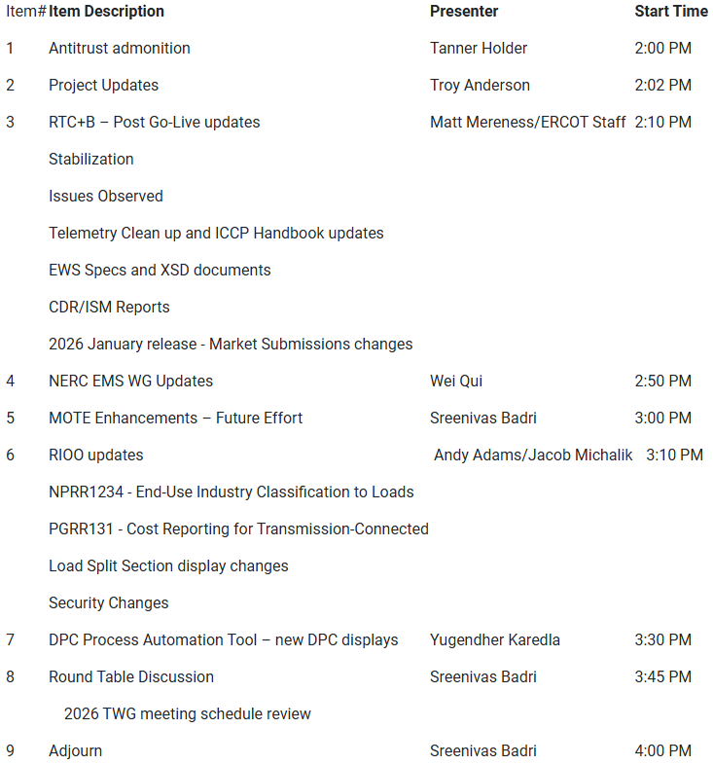
Technology Working Group (TWG)
Agenda for TWG meeting held on 12/18/2025:
Next TWG scheduled for 1/xx/2026

Slide 7
2026 Project Planning
ERCOT understands that Market Participants need lead time to implement changes in their systems for many Revision Requests
Approved Revision Request Project Starts
NPRR936 – CRR Account Holder Limits
NPRR1188 – Implement Nodal Dispatch and Energy Settlement for Controllable Load Resources
NPRR1238 – Voluntary Registration of Loads with Curtailable Load Capabilities
NPRR1244 – Clarification of CLR Primary Frequency Response Responsibilities
NPRR1277 – Revisions to EAL Formula
NPRR1281 – Improvements to Alternate FFSS Resource Designation
NPRR1288 – Remove Multiple Month Transactions in CRR Auctions
Revision Request Projects with Potential for 2026 Implementation
NPRR1198 – Congestion Mitigation Using Topology Reconfigurations
NPRR1201 – Limitations on Resettlement Timeline & Default Uplift Exposure Adj
NPRR1290 Phase 2 – Gap Resolutions and Clarifications for RTC+B
SCR818 Phase 2 – Changes to Incorporate GIC Modeling Data into Existing Modeling Applications
SCR829 – API for the NDCRC Application
SCR831 – Short Circuit Model Integration
Other priority Review Request projects may start in 2026 with a future year Go-Live
DRRS (NPRR1309, NPRR1310), Residential Demand, Firming
Green Text: Deemed “High Priority” at Prioritization Workshop

