Slide 1


TDTMS Update
Leadership 2025:
Chair - Sheri Wiegand, Vistra
Co-Vice Chairs – Monica Jones, CNP
Sam Pak, Oncor
RMS
January 13th, 2026

Slide 2
TDTMS
ERCOT Project Update
MarkeTrak API – rewrite tentatively planned for Q3 2026; no external impacts – only possible URL change. More modern API functionality being considered to add – REST vs SOAP, yet both would be available initially.
FlighTrak Rewrite – project to kick off late 2026; ERCOT to review scope and consider input from stakeholders.
MIS Retail API & UI – future rewrite in EWS where “look and feel” will be updated/standardized; still in planning phase; a few suggested changes have been submitted.
NAESB – revisions tested during last couple of Flight Tests; scheduled for production in January 2026.
MT & Siebel – internal project, not market facing; may require extended outage in 2026.
Digital Certificates – ongoing effort to modernize the platform for digital certificates, currently tied to NPRR 1302 which was table at PRS; expect update in Q1 2026
Listserv – upgrade to platform (improved user security) on January 15, 2026; previous users will need to reset password upon next login; does not impact users that have not previously used application.

Slide 3
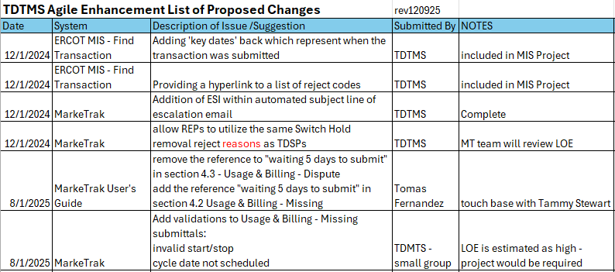
TDTMS
TDTMS Enhancement List

Slide 4
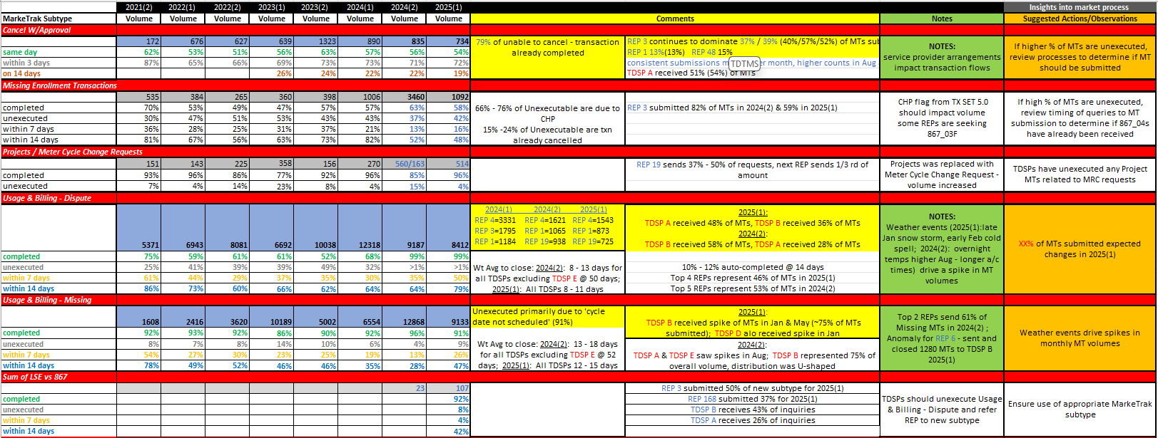
TDTMS
MarkeTrak Subtype Volumes Analysis

Slide 5
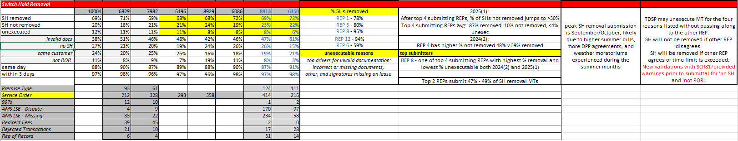
TDTMS
MarkeTrak Subtype Volumes Analysis
The two new subtypes of SCR817 (Meter Cycle Change Requests & Sum of LSE vs 867) have seen activity, an indication the new addition was warranted
Switch Hold volumes are seasonal – higher during the second half of the year
Switch Hold volumes may have seen lower unexecutable volumes due to the new validations put in place
Missing Enrollment Transactions saw a decrease possibly due to new validations and warning messages preventing submission
Usage & Billing – Missing spikes are primarily weather related

Slide 6
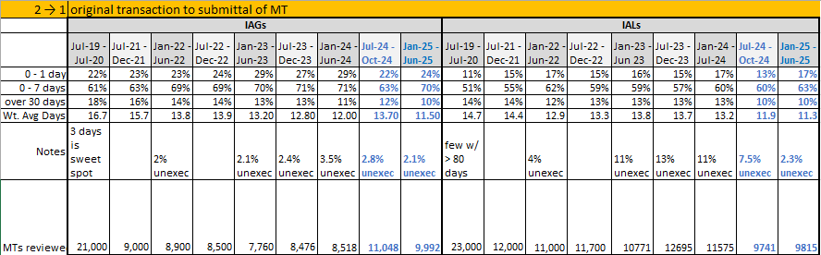

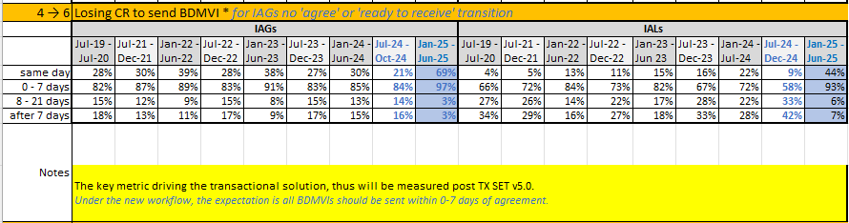
TDTMS
Inadvertent Gain & Inadvertent Loss Data Analysis - highlights
Fewer unexecutables perhaps due to validations in place when submitting IAGs and IALs
Significant improvement in submittal of BDMVIs with removal of ‘Ready to Receive’ transition
SUCCESS!

Slide 7
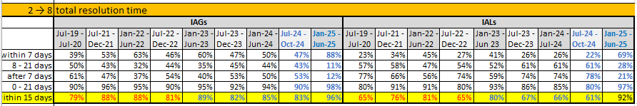
TDTMS
Inadvertent Gain & Inadvertent Loss Data Analysis - highlights
Total processing time for Inadvertent Gains completion within 7 days increased from 47% to 88%.
Total processing time for Inadvertent Losses completion within 7 days increased from 22% to 69%.
MISSION ACCOMPLISHED! The key metric driving the transactional solution executed in TXSET v5.0 and SCR817 has shown to significantly improve the IAG/IAL market process with average times for completion improving 87% for IAGs and over 200% for IALs. Total completion times in 2025 consistently moved from double-digit days (13-IAG & 17-IAL) down to single-digit days (5-IAG & 8-IAL).

Slide 8
TDTMS
Next Meeting – Thursday, January 22, 2026 @ 9:30 AM [WebEx Only]
DRAFT Agenda:
Elections – Please remember to submit your nominations to StakeholderServices@ercot.com
System Instances & MT Performance
Listserv Update
Projects
MIS – Retail API & UI
NAESB upgrade
MT & Siebel upgrade
Enhancements list
MarkeTrak User’s Guide suggested revisions
Goals 2026/ Accomplishments 2025
Inadvertent Gains 2024(2) and 2025(1) – analysis
Overall Volumes for 2025(2)
TDTMS Main Meeting Page - housekeeping
Lights Out Situations – Inadvertent Gains w/Switch Holds
MarkeTrak Subtype Volumes –
ERCOT Reports

