Slide 1
Agenda Item #4: ERS/Crypto Mining Load
WMS Meeting
January 7, 2026
Presenter: Mark Patterson, ERCOT Manager Demand Integration

Slide 2
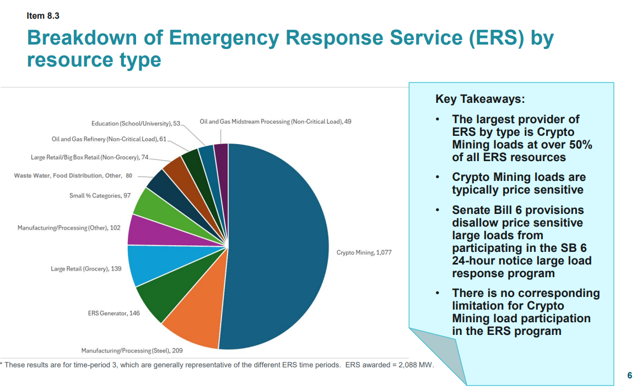
Commercial Operations Update (Sept 15, 2025)
Note: As of the Dec25-Mar26 SCT the participation from Crypto Mining Loads has increased to 64% of the total capacity procured.

Slide 3
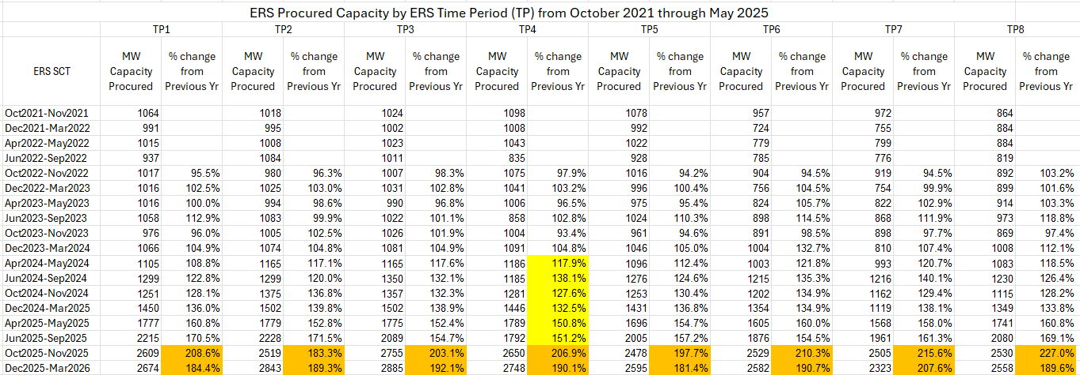
ERS Observations
Over the past 18 months, there has been a significant increase in ERS participation.
Given the fixed budget ($75M per year), increased capacity procurement will decrease the clearing price.

Slide 4
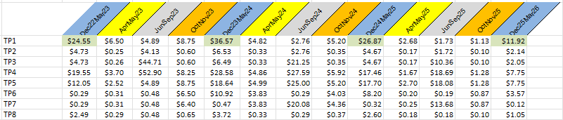
Clearing Price History
Key Takeaways:
As the participation in ERS has increased over the past couple years the clearing price for the service has decreased accordingly. The highlighted clearing prices show the impact to the TP1 prices for the winter contract term but similar impacts are have occurred for all time periods across this period.
ERCOT has received comments from ERS providers that this trend will likely result in lower participation from past participants.
0.956455 |  | Combined Score

Slide 5
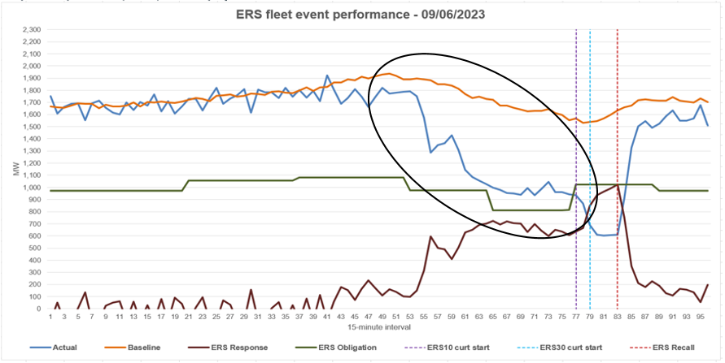
Pre-Deployment During Events
The September 6, 2023 deployment was the most recent deployment event of the service
Approx 60% of the ERS capacity self-deployed prior to the ERCOT instruction.
At that time there were only a few small crypto mining resources believed to be participating in the service.
Self-deployment is a term used to describe an ERS resource that is changing its consumption behavior prior to an instruction from ERCOT.
Self-deployment may be triggered by various factors such as energy price signals, potential 4CP day, ERCOT-wide appeals through public voluntary energy appeal, normal variations in operating energy needs, etc.

Slide 6
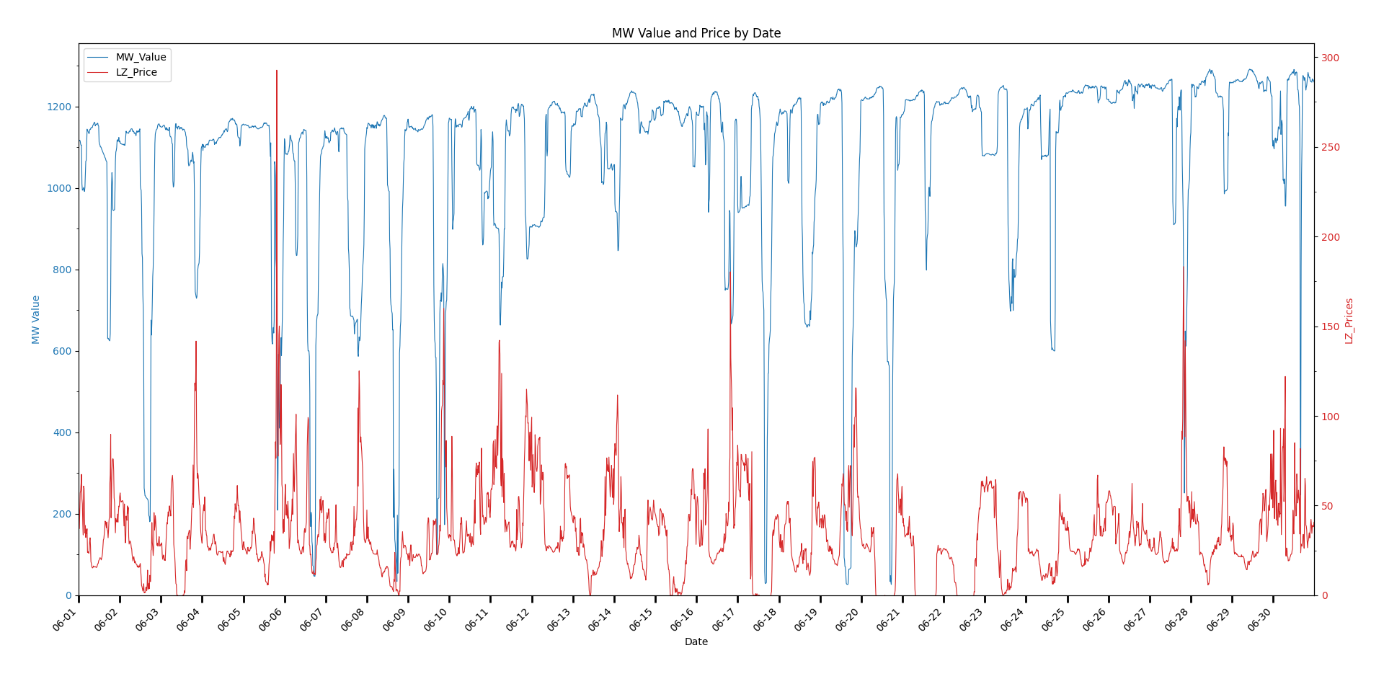
June MW/ West Load Zone Price Relationship
MW Values range from 27 to 1292
West Load Zone Prices range from (-$5.58) to $293

Slide 7
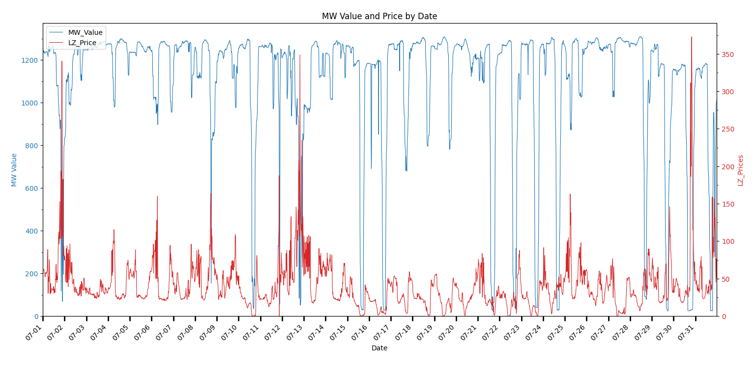
July MW/West Load Zone Price Relationship
High LZ_Price of $1759.06 on 7/11 at 2115 has been omitted from this chart
Response to that price remains
MW Values range from 24 to 1310
West Load Zone Prices range from (-$0.29) to $1759

Slide 8
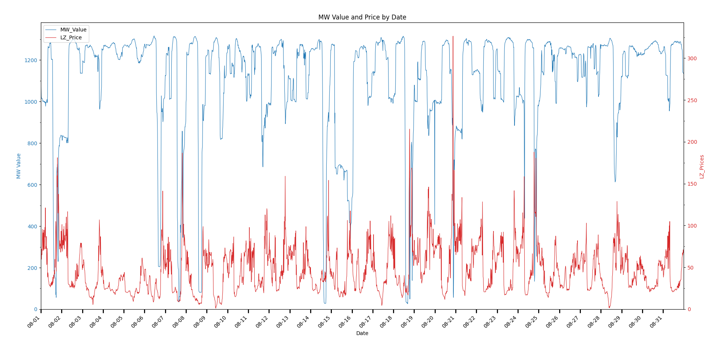
August MW/West Load Zone Price Relationship
MW Values range from 26 to 1316
West Load Zone Prices range from $1.03 to $326

Slide 9
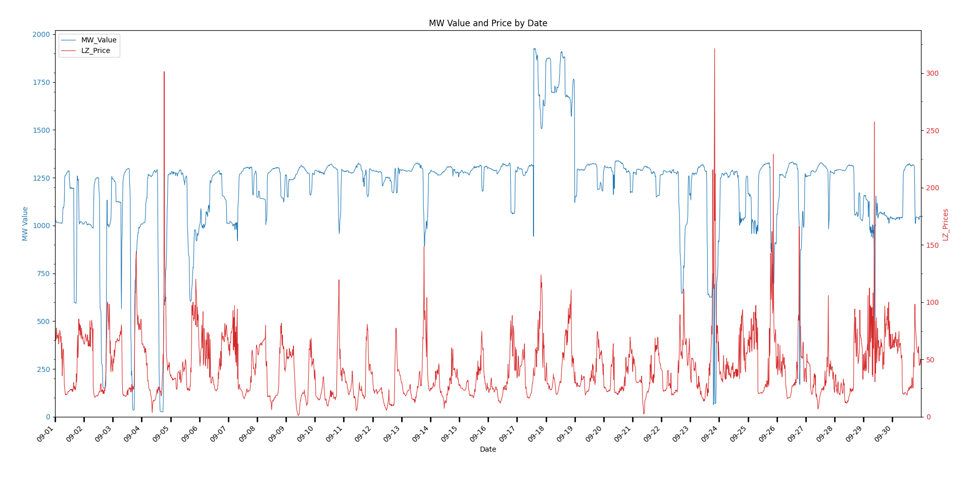
September MW/West Load Zone Price Relationship
MW Values range from 26 to 1925
West Load Zone Prices range from $1.16 to $321.15

Slide 10
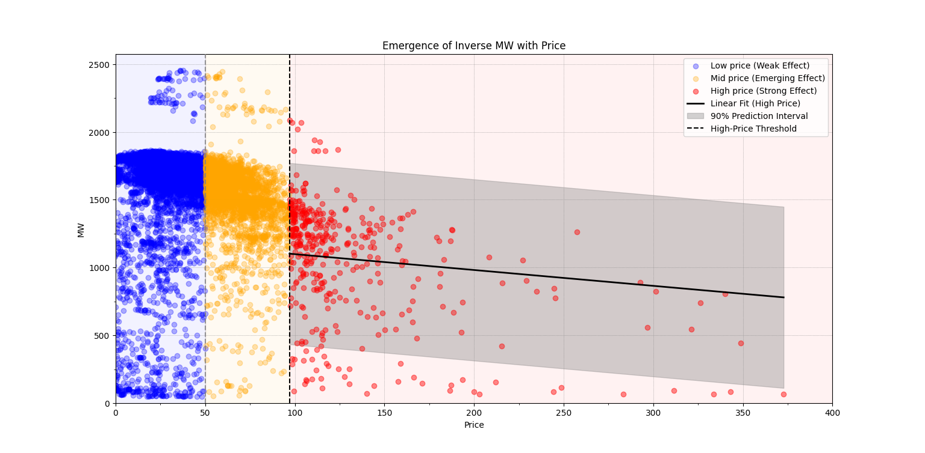
JunSep SCT MW/Price Relationship (Crypto Mining Loads )
Each 15-minute interval in the SCT, with Aggregate Crypto Mining Loads (MW value) plotted against (???) price, is one data point
Data points are divided into 3 categories: Low/Medium/High price points
8229 low price points, 3083 mid price points, 400 high price points
11,712 total data points
Outlier price of $1759/MW has been excluded from this chart

Slide 11
ERS Crypto Mining and Non-Crypto Load – 7/30/2025
In the following slide we will explore all Crypto mining resources in ERS and how they performed against ERS non-crypto load on a specific day.
These slides look across all ERCOT territory and not a single load zone.
There is a hypothetical event on 07/30/2025 at 19:00:00.
Additionally, we will look at time periods with High-Risk factor during JunSep25 SCT.

Slide 12
ERS Crypto Load on 07/30/2025

Slide 13
ERS Non-Crypto Load on 07/30/2025

Slide 14
ERS Gen on 07/30/2025

Slide 15
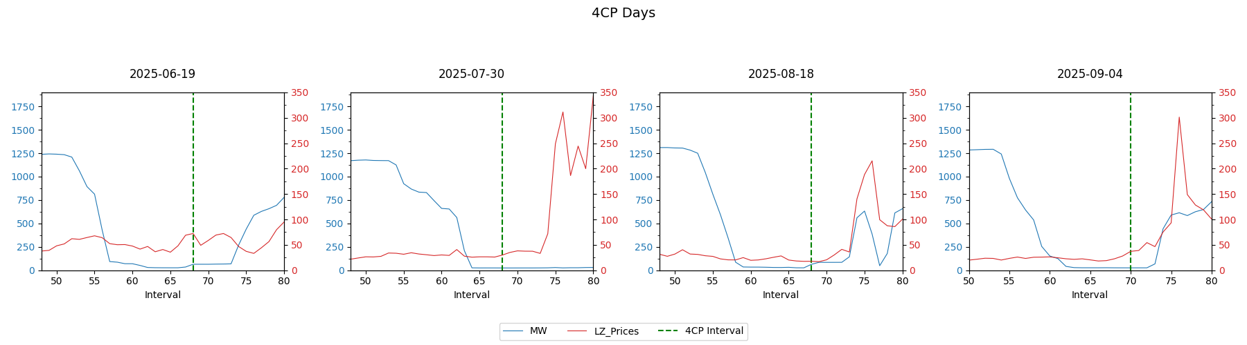
JunSep25 SCT MW/Price Relationship and with 4CP Days
On the days that coincided with the 4CP intervals, the crypto loads demonstrated they would reduce their consumption prior to the pricing event and would resume operation, price considered, post-event in the West Load Zone.

Slide 16
ERS Resource and QSE Availability

Slide 17
QSE Availability Factor (ERSAFCOMB) & Resource Availability Factor (ERSAF)
Level | ERSAFCOMB/ERSAF | Action
QSE Portfolio | greater or equal to 0.95 (pass availability metric) | QSE portfolio passes.
Resource | less than 0.85 (in a portfolio with greater or equal to 0.95) | Resource is put back on the test list for the subsequent Standard Contract Term
QSE Portfolio | less than 0.95 (fail availability metric) | QSE is deemed to have failed to meet its availability requirement and each Resource in the Portfolio is reviewed.
Resource | greater or equal to 0.85 (in a portfolio with less than 0.95) | Resource passes.
Resource | less than 0.85 (in a portfolio with less than 0.95) | Resource's ERSAF is squared & the portfolio level ERSAFCOMB for the QSE is recomputed with the lower values Resource is suspended for 1 Standard Contract Term but not allowed to participate in ERS until the reinstatement process is completed which includes a test. Reinstatement process can not begin until suspension period is completed. Reported to ERCOT Compliance

Slide 18
QSE A – Availability Example
QSE Availability shown includes combined availability for ~900 resources.
A QSE and its’ Resources can pass availability while failing an individual time periods.
Resources with combined availability less than .85 will be put on the test list for the next SCT.
Resource 2 and QSE A would only have received an additional reduction if QSE A had failed the SCT.

Slide 19
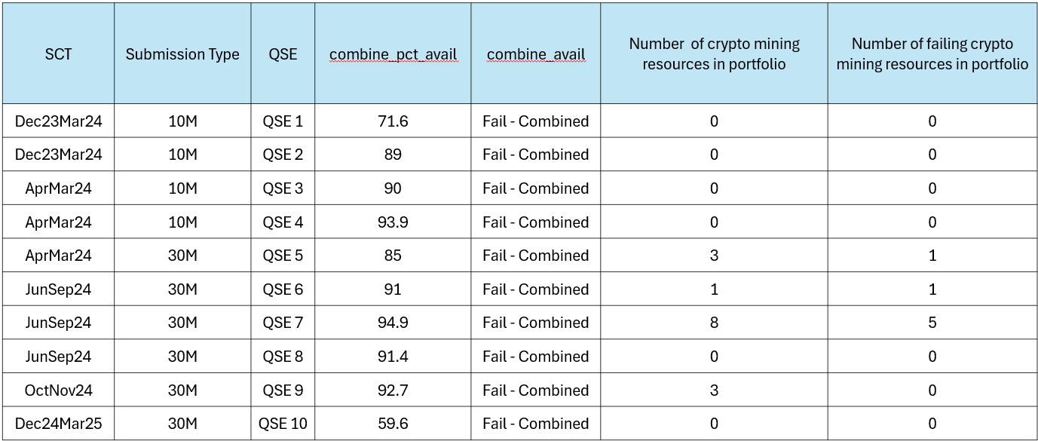
QSEs who Failed Availability Metric
combine_pct_avail is the capacity weighted availability for all time periods with obligations
QSE Combined Availability - Fail < 95%

Slide 20
Number of Participating Crypto Mining Resources
SCT | Number of resources with 1 or more crypto mining sites
OctNov23 | 9
Dec23Mar24 | 14
AprMay24 | 17
JunSep24 | 20
OctNov24 | 25
DecMar25 | 31
AprMay25 | 41
JunSep25 | 57
OctNov25 | 65
DecMar26 | 75
SCT | Availability Failures | Availability Passes
OctNov23 | 1 | 8
Dec23Mar24 | 0 | 14
AprMay24 | 7 | 10
JunSep24 | 9 | 11
OctNov24 | 4 | 21
DecMar25 | 7 | 24
AprMay25 | 6 | 35
JunSep25 | 11 | 46
OctNov25 | N/A | N/A
DecMar26 | N/A | N/A

Slide 21
Resource Availability June-September 2024 (Crypto Mining)
Resources | Time Period Fails | Time Period Passes
Resource 1 | 8 | 0
Resource 2 | 8 | 0
Resource 3 | 8 | 0
Resource 4 | 0 | 7
Resource 5 | 2 | 6
Resource 6 | 4 | 0
Resource 7 | 1 | 7
Resource 8 | 5 | 0
Resource 9 | 0 | 8
Resource 10 | 8 | 0
Resource 11 | 1 | 4
Resource 12 | 8 | 0
Resource 13 | 8 | 0
Resource 14 | 8 | 0
Resource 15 | 8 | 0
Resource 16 | 1 | 7
Resource 17 | 8 | 0
Resource 18 | 4 | 4
Resource 19 | 0 | 8
Resource 20 | 8 | 0
Grand Total | 98 | 51
Resources | Resource Availability Fails | Resource Availability Passes
Resource 1 | 1
Resource 2 | 1
Resource 3 | 1
Resource 4 |  | 1
Resource 5 |  | 1
Resource 6 | 1
Resource 7 |  | 1
Resource 8 |  | 1
Resource 9 |  | 1
Resource 10 | 1
Resource 11 |  | 1
Resource 12 |  | 1
Resource 13 |  | 1
Resource 14 | 1
Resource 15 | 1
Resource 16 |  | 1
Resource 17 | 1
Resource 18 |  | 1
Resource 19 |  | 1
Resource 20 | 1
Grand Total | 9 | 11
The number of Time Periods Failed or Passed by the Crypto Mining Resource.
Whether same Resource failed or passed availability for the SCT.
Note: There are 8 time periods in an ERS Standard Contract Term. The table on the left represents the number of time periods a resources failed/passed the availability metric of 85%. The table on the right represents the failed/passed combined available metric for the resource of 95%.

Slide 22
Baselines for Crypto Mining ERS Resources
ERS Crypto Mining resources currently assigned an ‘Alternate’ Baseline for one of the two reasons below:
Resources with little or no meter data.
Resources with meter data but are not good fit for default baseline.
For those resources with sufficient meter data to calculate a ‘Default’ Baseline, the most common baselines reported are:
Nearest-20 (Near 20)
Middle 8-of-10 (Mid 8-of-10)
Meter-Before/Meter-After (MBMA)*
*Resources with MBMA baseline are expected to have a consistently flat load. The load for a Load site at any point in time can be accurately predicted based on the load immediately preceding that point in time. Therefore, resources that have a MBMA baseline cannot be price sensitive or chase 4CP.

Slide 23
JunSep25 SCT MW/ West Load Zone Price Relationship Summary
Consumption becomes price-sensitive at higher price levels
At low prices, crypto loads appear to have little price sensitivity in their activity
At mid-level (≈ $50/MW) a negative response begins to emerges
Relationship strengthens as price increases
At higher prices (≈ $88/MW) a clearer inverse relationship between price and consumption appears
There is large variability at these high price points, but the trend is evident
This persists across the whole SCT
Crypto mining loads reduced their usage in advance of the 4CP periods
Crypto miners appear to curtail their activity when they need to avoid higher charges on their own accord.

Slide 24
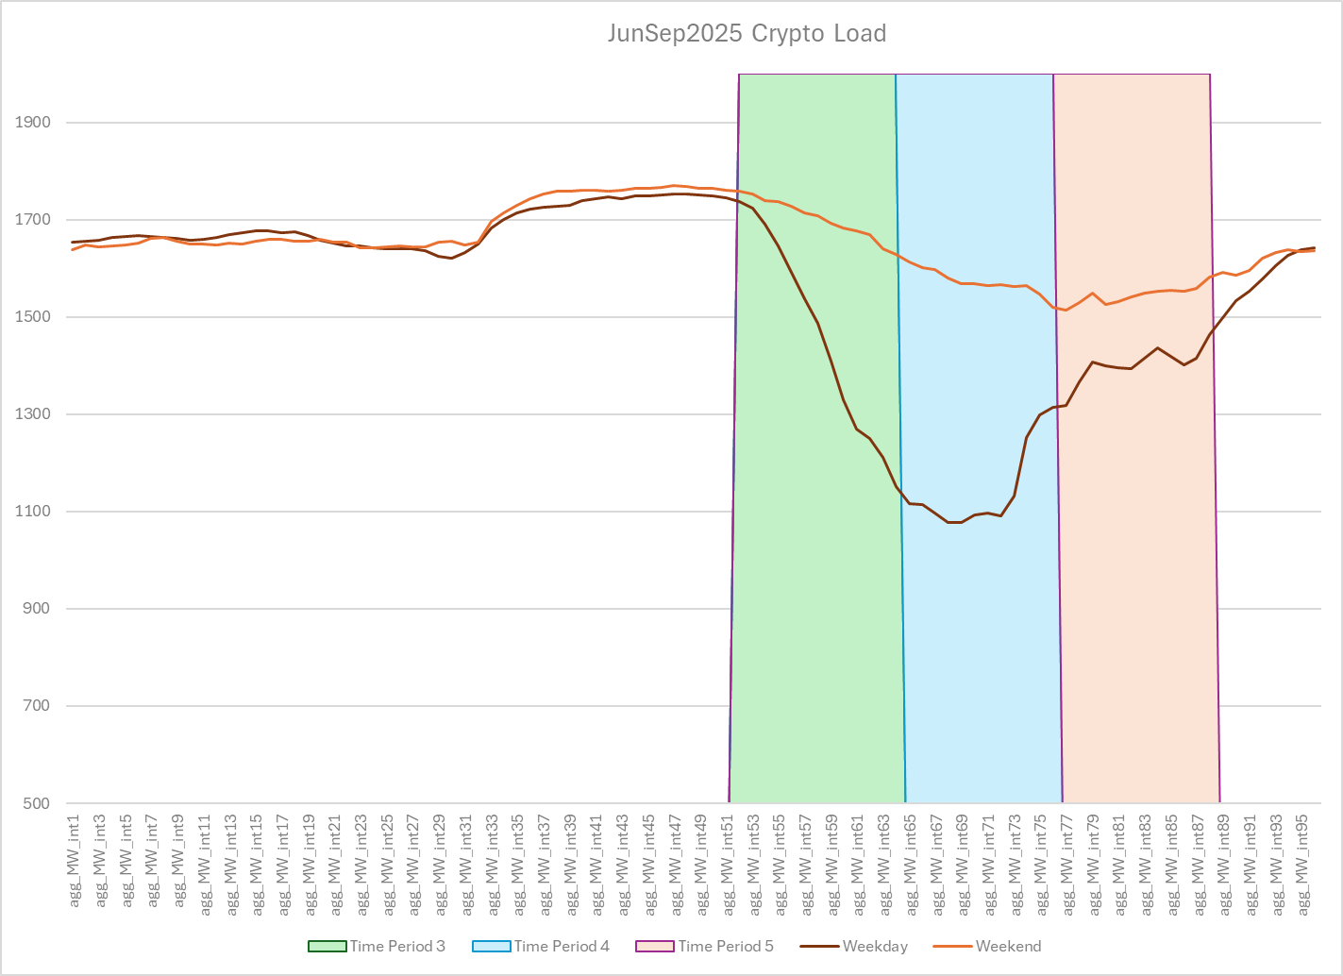
Crypto Mining Load during High-Risk Time Period
For JunSep25 SCT, Time Periods 3,4,5 (weekdays) and Time Period 7 (Weekends) were considered high-risk.
Plot shows the average MW value for the Crypto Loads dropped considerably during Time Periods 3, 4 & 5.
For JunSep25 SCT, Time Periods 3,4,5 (weekdays) and Time Period 7 (Weekends) were considered high risk
Above plot shows the average MW value for the Crypto Loads dropped considerably during TP 3, 4 & 5

Slide 25
ERS Suspensions
ERS Resources can be suspended for test, availability and event failures. ERS has not suspended any crypto mining resources.
In 2013 NPRR 564, with stakeholder discussion, implemented tiered payment reductions replacing automatic suspensions for test, availability and event failures.
ERS suspensions were reinstated in the Dec24Mar25 Standard Contract Term.
The requirement to identify the “Load and Types of Processes to be Curtailed” in ERS submissions was implemented in the JunSep25 SCT.
After assigning load types to each ESIID awarded in the JunSep25 SCT, we reviewed the previous Standard Contract Terms for any suspensions related to crypto mining and found none.

