Slide 1
RTC+B Update
Matt Mereness
TWG
December 18, 2025

Slide 2
Outline
Discussion today:
Update on Overall RTCBTF Issues List
Summary of Defects and emergency fix later this week
Follow-up on Reports
Rest of Today’s Agenda

Slide 3
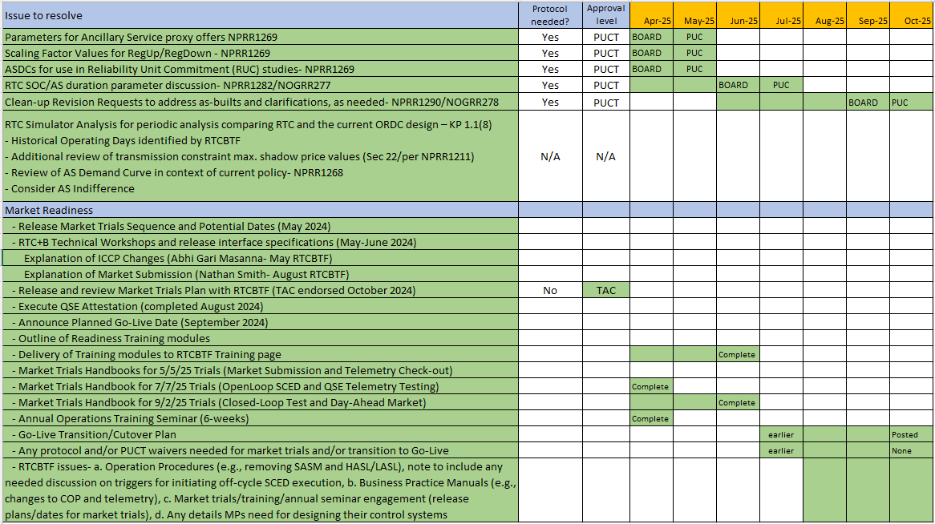
RTCBTF Remaining Items for Go-Live
RTCBTF- Completed market trials and transition plan details
Market Trials
COMPLETED

Slide 4
RTC+B Scope
Final 2025 Refinements for Go-Live
Related NPRRs
within Program

Slide 5
Sequence and Dates for Market Trials to Go-Live
30-day Market Notice
11/5/25
March/April
2025
Start
5/5/25
Start
7/7/25
Start
9/2/25
Go-Live
12/5/25*
May 2025
June 2025
July 2025
Aug 2025
Sep 2025
Oct 2025
Nov 2025
Dec 2025
QSE Scorecards & Exit Criteria for each Trial Phase
RTC QSE Submission Testing
(Submit COP, RT AS Offers,
DAM Virtual AS, Outages for ESRs)
Open-loop RTC SCED
(QSE offers, SCED non-binding award/dispatch)
Ongoing Open-Loop
& Periodic Closed-loop SCED/LFC
(QSE RTC offers and telemetry to support closed-loop frequency control test 2-3 tests of 2-4 hour durations)
Transition to Go-Live
Upon completion of testing, confirmation of ERCOT and market readiness for Go-Live.
QSE/Vendor Submission Sandbox and Telemetry Points added Prod EMS model.
COMPLETED
RTC QSE Telemetry Check-out (QSEs add/verify new telemetry points for UDSP, New ramp rates, ESR telemetry)
QSE Telemetry Tests
(Individual QSE to follow UDSP and support new ramp rate and ESR telemetry)
Day-Ahead Market
(Non-binding DAM using QSE offers for at least 2 tests)
* Go-Live date reflects 12/5/2025 as first Operating Day
where 12/4/2025 is planned software migration.

Slide 6
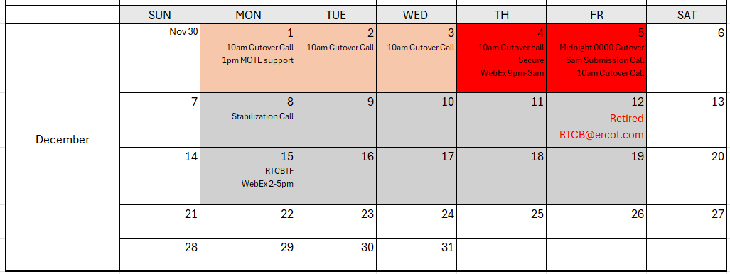
Stabilization release this week
ERCOT is deploying a final package of emergency releases this week prior to the holidays
Competitive Constraint Test logic fix
Pricing during Load Shed – NPRR1131
AS Trades (market notice on next slide)
AS Manager deployment/recall messages issue

Slide 7
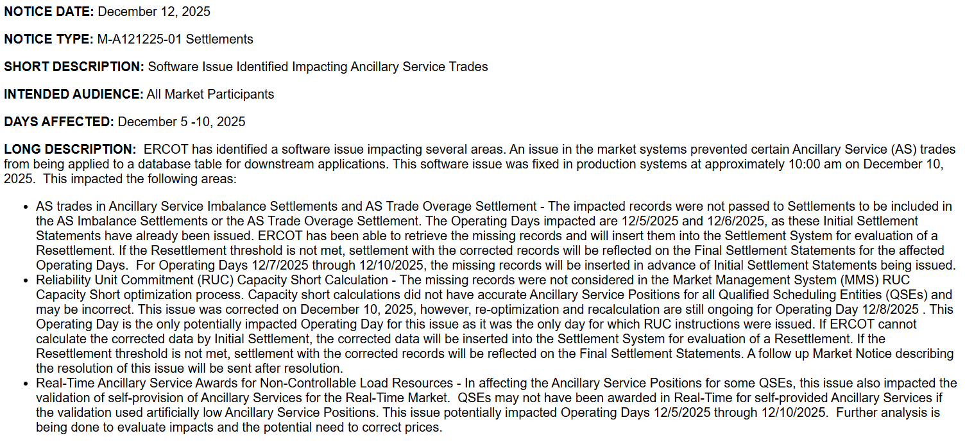
Market Notice regarding AS Trades

Slide 8
RTC Cutover Information: Missed Reports
The following reports have the highest probability of being missed during cutover activities. ERCOT will not be able to repost these reports.
EMIL_ID | RPT_ID | Product Name
np3-157-cd | 13446 | Consolidated Transmission Outage Report
NP3-233-CD | 13103 | Hourly Resource Outage Capacity
np4-738-cd | 13484 | Solar Power Production - Actual 5-Minute Averaged Values
np4-746-cd | 21810 | Solar Power Production - Actual 5-Minute Averaged Values by Geographical Region
np5-649-cd | 12352 | Temporarily Removed Contingencies
np4-733-cd | 13071 | Wind Power Production - Actual 5-Minute Averaged Values
np4-743-cd | 14788 | Wind Power Production - Actual 5-Minute Averaged Values by Geographical Region
NP6-329-CD | 24889 | RTD Indicative Real-Time MCPC
NP6-330-CD | 24890 | RTD Indicative Ancillary Service Awards by Resource
NP6-328-CD | 24887 | Total Capability of Resources Available to Provide Ancillary Service
NP6-332-CD | 24891 | Real-Time Clearing Prices for Capacity by SCED Interval
Additionally, NP3-763-CD Short Term System Adequacy (Rpt ID 12315) was missed and RERUN for the first hourly interval of the day on 12/5.

Slide 9
RTC Cutover Information: Expired Reports
EMIL_ID | RPT_ID | Product Name
np5-758-cd | 13079 | Deselected Hourly RUC Recommendations
NP8-143-CD | 11025 | QSE Ancillary Services Capacity Monitor
np6-291-cd | 12309 | Topology Consistency
np6-619-cd | 12308 | State Estimator Real-Time Transmission Line Flows
NP6-327-CD | 21114 | LMP By SOG Including Price Adders
np6-787-cd | 11485 | LMPs by Electrical Bus
np6-788-cd | 12300 | LMPs by Resource Nodes, Load Zones and Trading Hubs
np6-914-cd | 12351 | Manual Overriding of HDLs and LDLs
NP6-323-CD | 13221 | Real-Time Price Adders by SCED Interval
np6-322-cd | 13114 | SCED System Lambda
np6-915-cd | 13081 | Summary Report of HDL and LDL
np12-218-cd | 23995 | ERCOT System Limit Exceedances
np6-6-cd | 12305 | NSA Active Constraints
np5-911-cd | 12345 | NSA Inactive Constraints
NP6-324-CD | 13220 | Real-Time Price Adders for 15-Minute Settlement Interval
np6-326-cd | 21115 | Real-Time Price for SOG
np6-905-cd | 12301 | Settlement Point Prices at Resource Nodes, Hubs and Load Zones
eia-930-cd | 13457 | Hourly Balancing Authority Operations Report
sys-608-cd | 12354 | SCED Resource Shift Factors
np6-607-cd | 16013 | SCED Settlement Point Shift Factors
np6-86-cd | 12302 | SCED Shadow Prices and Binding Transmission Constraints
np6-235-cd | 12340 | System-Wide Demand
np6-346-cd | 14836 | Actual System Load by Forecast Zone
np6-344-cd | 15954 | Actual System Load by Study Area
np6-345-cd | 13101 | Actual System Load by Weather Zone
np5-757-cd | 13080 | Deselected Daily RUC Recommendations
The reports listed here, for the first 12/5 posting interval, will be EXPIRED due to inaccurate data.

Slide 10
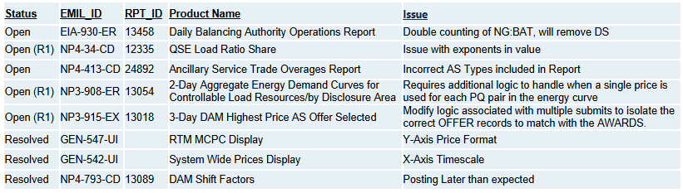
RTC Cutover Information: Stabilization Issues
The following products are being tracked for stabilization issues:

Slide 11
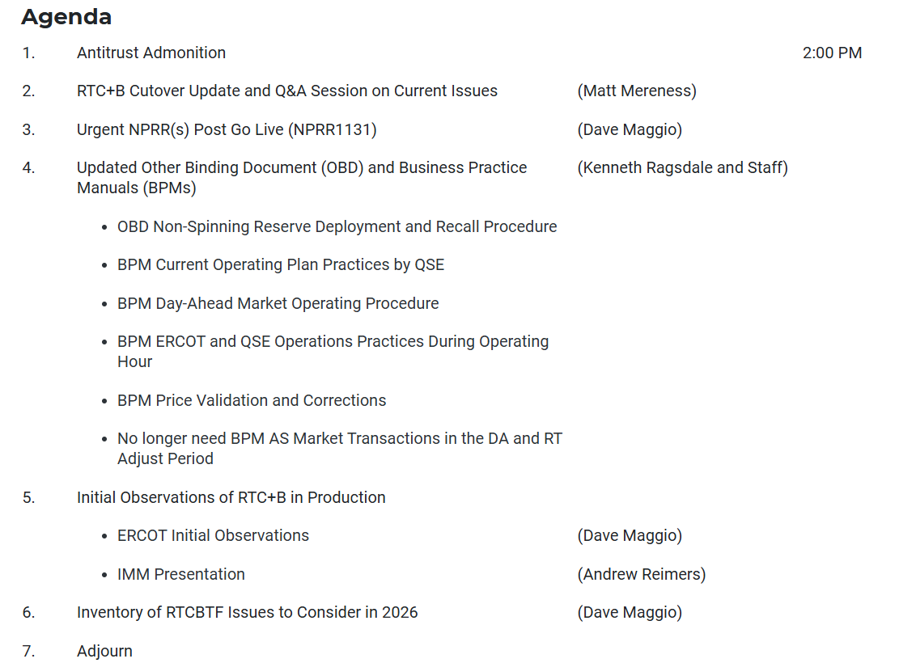
RTCBTF Discussion:

