Slide 1

NERC EMSWG Update
Wei Qiu, NERC EA
ERCOT TWG Conference Call
November 20, 2025

Slide 2
2025 Monitoring and Situational Awareness Technical Conference
Location: SPP in Little Rock, AR
Date and Time:
  Tuesday, October 21, 2025
  Wednesday, October 22, 2025
Theme: Supporting Energy Management and Planning for Our Future

Slide 3
Lessons Learned - Ongoing
  SCADA Failover Event
  A large utility was performing maintenance on network switches at its primary transmission operations servers location when all the online servers failed over to the backup servers. The entity did a site failover to resolve the outstanding issues, including the intermittent SCADA data visibility and control problems . Some ICCP links were disconnected over the course of this event, and OpenNet services were also affected. During each failover, SCADA control was lost for 10-15 minutes at a time over the course of about an hour. The event impacted the entity’s operations over its entire footprint.

Slide 4
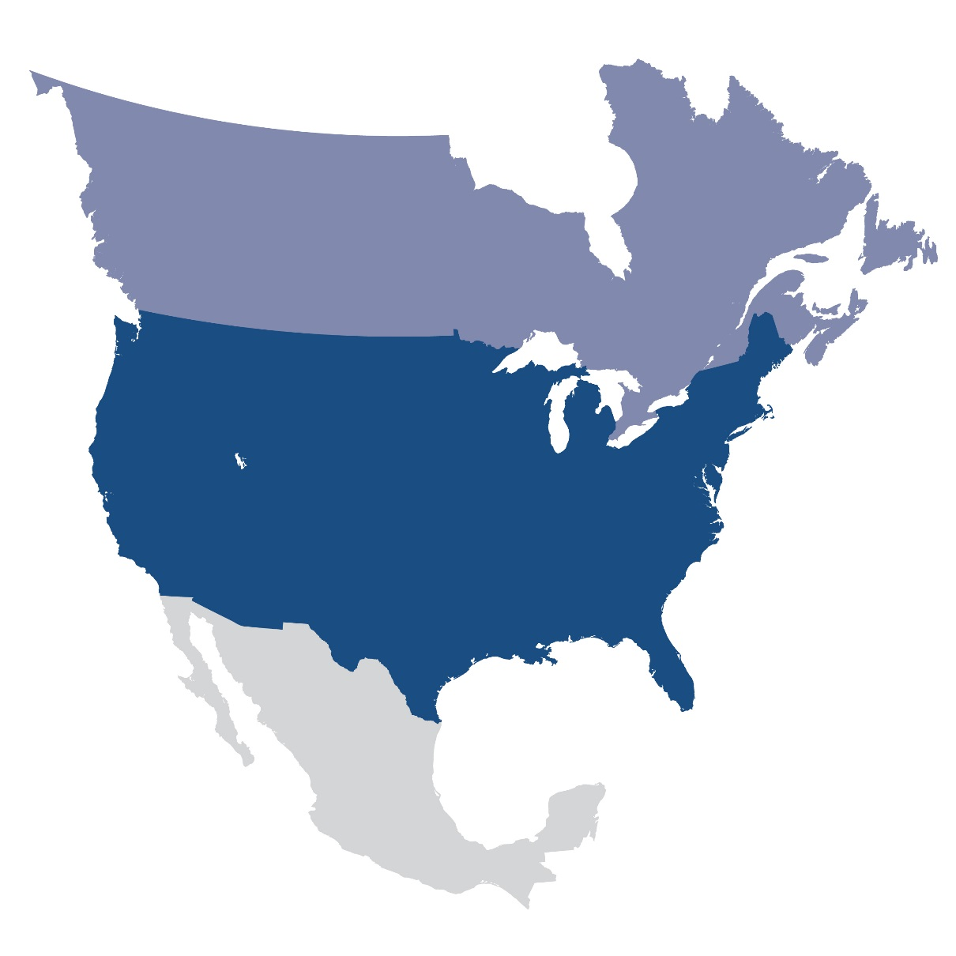
Questions and Answers
Contact Information:
wei.qiu@nerc.net

