Slide 1
ERCOT Technology Working Group (TWG)
December 18, 2025

Slide 2
ERCOT TWG
WELCOME

Slide 3
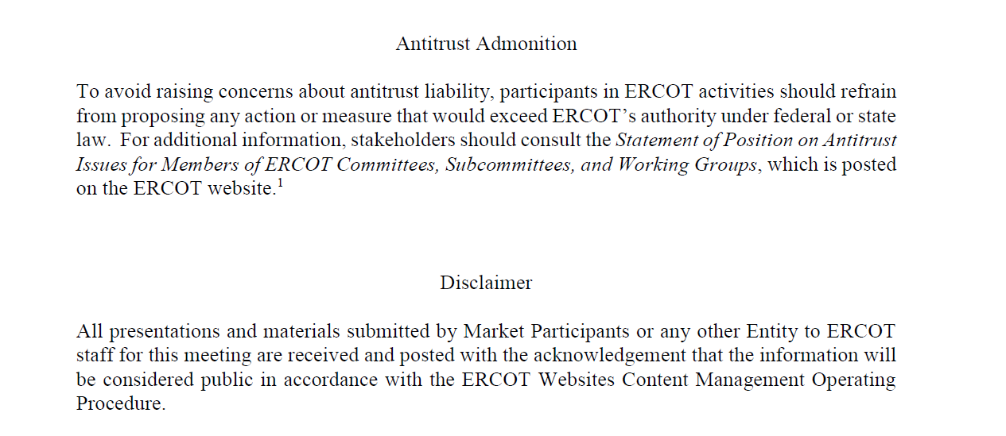
ERCOT TWG

Slide 4
ERCOT TWG Agenda
Item # | Item Description | Presenter | Start Time
1 | Antitrust admonition | Tanner Holder | 2:00 PM
2 | Project Updates | Troy Anderson | 2:02 PM
3 | RTC+B – Post Go-Live updates Stabilization Issues Observed Telemetry Clean up and ICCP Handbook updates EWS Specs and XSD documents CDR/ISM Reports 2026 January release - Market Submissions changes | Matt Mereness/ERCOT Staff | 2:10 PM
4 | NERC EMS WG Updates | Wei Qui | 2:50 PM
5 | MOTE Enhancements – Future Effort | Sreenivas Badri | 3:00 PM
6 | RIOO updates NPRR1234 - End-Use Industry Classification to Loads PGRR131 - Cost Reporting for Transmission-Connected Load Split Section display changes Security Changes | Andy Adams/Jacob Michalik | 3:10 PM
7 | DPC Process Automation Tool – new DPC displays | Yugendher Karedla | 3:30 PM
8 | Round Table Discussion 2026 TWG meeting schedule review | Sreenivas Badri | 3:45 PM
9 | Adjourn | Sreenivas Badri | 4:00 PM

Slide 5
RTC+B – Post Go-Live Updates
  Project Updates – Troy Anderson

Slide 6
RTC+B Updates
  RTCBTF and Post Go-Live updates – Matt Mereness
  Telemetry Clean up and ICCP Handbook updates – Sreenivas Badri/Kevin McGarrahan
  EWS Specs and XSD documents – Susan Jinright
  CDR/ISM Reports – Jamie Lavas
  2026 January release - Market Submissions changes – Katherine Li

Slide 7
NERC EMS WG Updates
  NERC EMS WG Updates – Wei Qui

Slide 8
MOTE Enhancements – Future Effort
MOTE Enhancements – Future Effort – Sreenivas Badri

Slide 9
RIOO updates
  NPRR1234 - End-Use Industry Classification to Loads - Jacob Michalik
  PGRR131 - Cost Reporting for Transmission-Connected - Jacob Michalik
  Load Split Section display changes - Jacob Michalik
  Security changes – Andy Adams

Slide 10
DPC Process Automation
DPC Process Automation Tool – new DPC displays
– Yugendher Karedla

Slide 11
ERCOT TWG – Round Table Discussion
ERCOT TWG – Round Table Discussion
  Future Topics of Interest
  Topics and presentations from TWG members
  Review 2026 TWG Meeting Schedule

Slide 12
ERCOT TWG
Thank You
You can reach Sreenivas at
Sreenivas.Badri@ercot.com and Tanner at tholder@tnsk.com

