Slide 1
Pre-RTC Telemetry Cleanup and ICCP Handbook Updates
Sreenivas Badri/Kevin McGarrahhan
December 2025

Slide 2
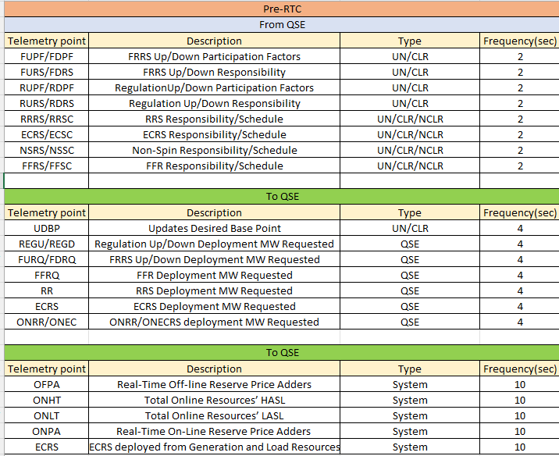
Pre-RTC Telemetry Cleanup
Below telemetry points were deleted from ERCOT ICCP system during DEC_ML2 Model on Operating Day 12/10.
RST telemetry point was deleted from ERCOT ICCP system during DEC_ML3 Model on Operating Day 12/17.

Slide 3
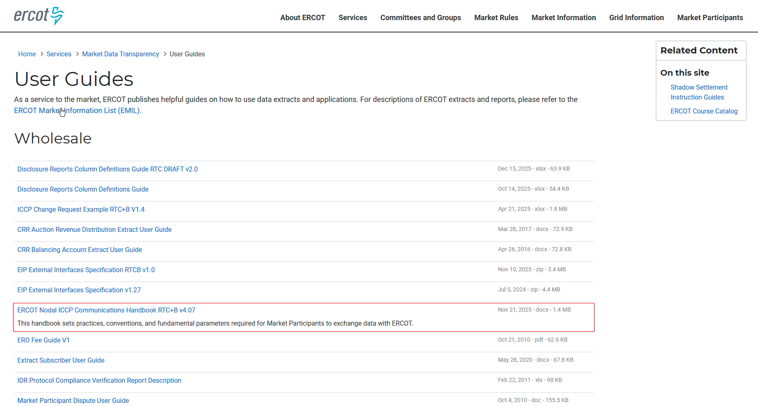
ICCP Handbook Updates
Removed old ICCP Handbook from ercot.com, now it has only RTC+B version.
https://www.ercot.com/services/mdt/userguides
More ICCP Handbook cleanup will happen soon
  Remove RTCB name from file name and keep it same as pre-RTC
  Remove system wide telemetry points not used.

