Slide 1
RTC+B Post Go-Live - EIP External Interfaces Specification Updates
Susan Jinright
December 18, 2025
TWG

Slide 2
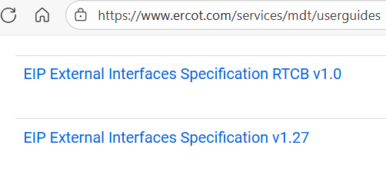
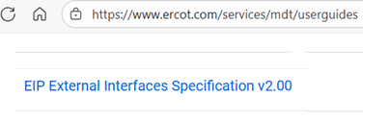
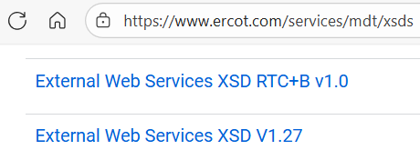
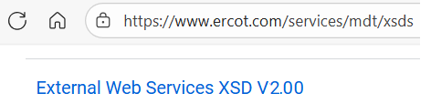
API External Specification and XSDs
EIP External Interfaces Specification and XSDs Update
RTC+B gray box changes have been incorporated into the External Interfaces Specification v2.00 document on ercot.com.
XSDs have also been updated to include RTC+B changes.

Slide 3
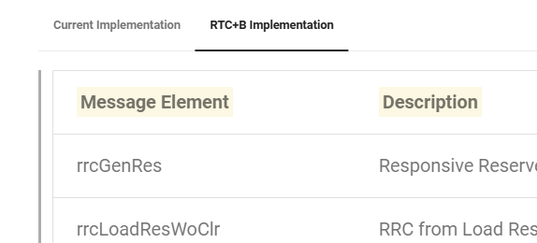
API External Specification and XSDs
Developer Portal Update
“RTC+B implementation” changes have been permanently included on the Developer Portal documentation. The tabs with “Current Implementation” have been removed.
The Developer Portal will continue to be updated for any External Web Service Specification and XSD changes. The word document and XSDs on ERCOT.com will be phased out and replaced by links to the Developer Portal. This will happen with future updates to the API Spec or XSDs.
Developer Portal documentation: ERCOT Developer Portal
XSDs: ews at main · ercot/api-specs

