Slide 1
RIOO Updates
Jacob Michalik
December 2025

Slide 2
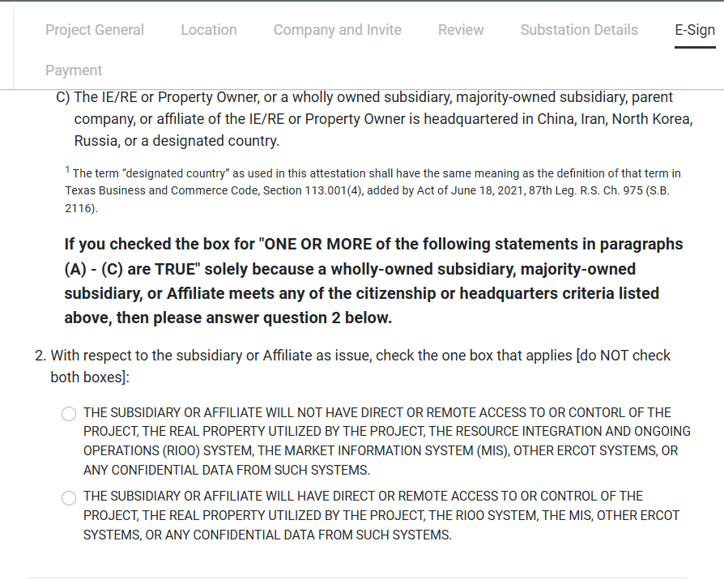
RIOO PGRR125 - LSIPA Update
Additional question for the E-Sign for the Lonestar Attestation

Slide 3
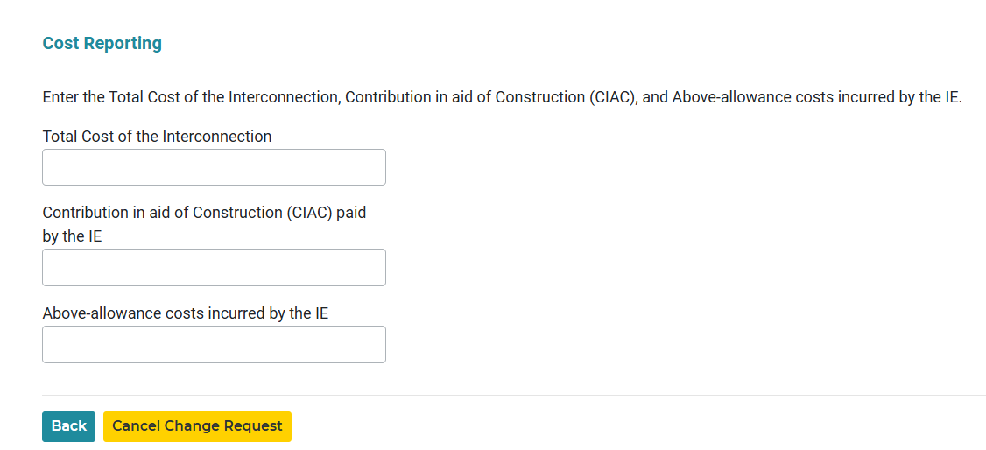
RIOO PGRR131 - Cost Reporting for TSP
Removal of PGRR088 fields, Financial Security Amount and Redacted Financial Security Amount from RE/IE INR Change Request
New TSP Change Request workflow will be introduced to provide transmission connected INR cost
TSPs are allowed to change/enter cost at any time
TSPs can submit a Change Request to provide cost even after INR is marked as operational

Slide 4
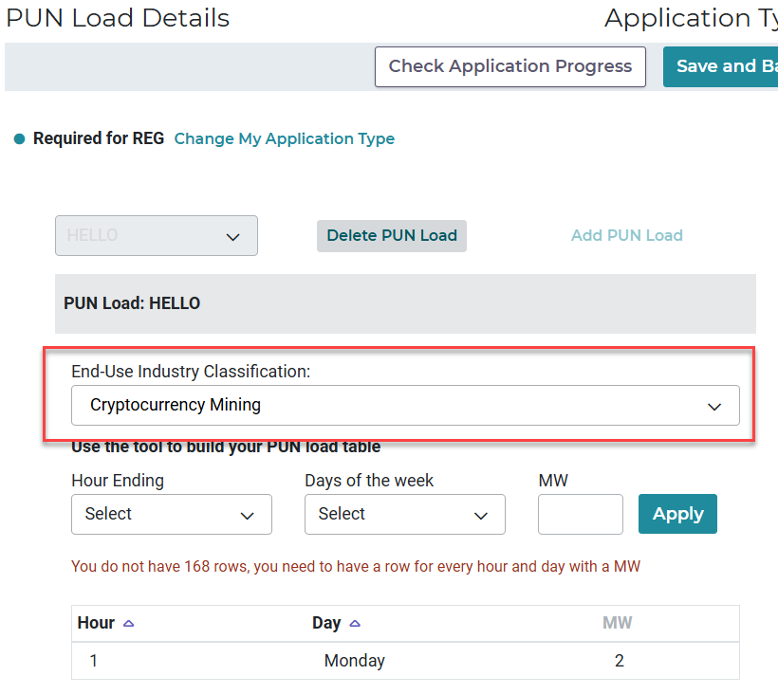
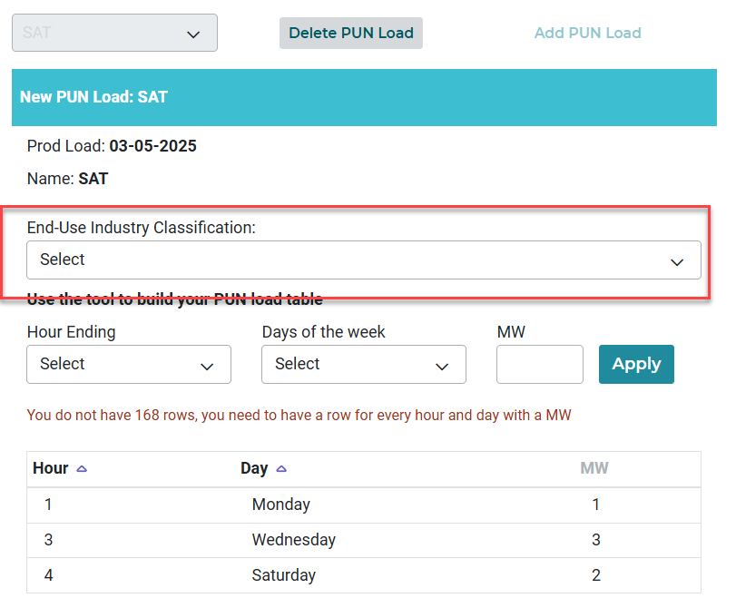
RIOO NPRR1234 – End Use Industry Classification
User can now optionally enter End-Use Industry Classification when inputting PUN Loads
IS
RS

Slide 5
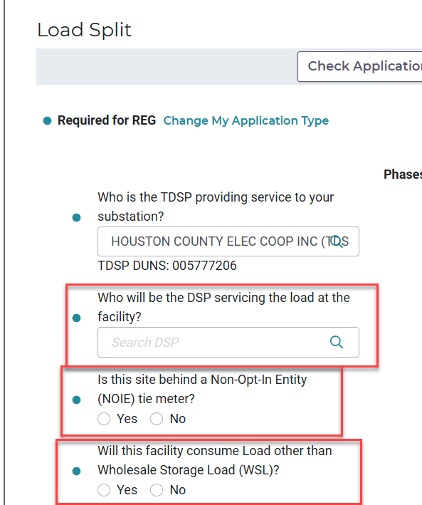
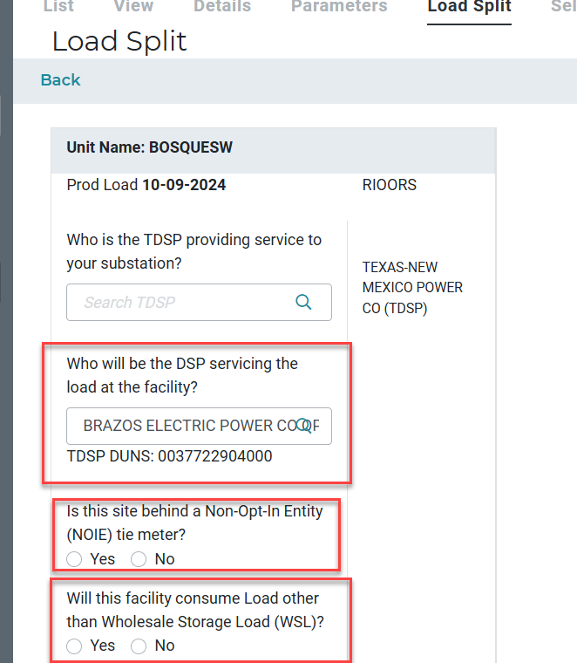
RIOO - Load Split Changes
Current WSL/NOIE question is split into two questions
If NOIE is yes, ESIID is NOT necessary and WSL question NOT necessary
If WSL is yes, ESIID is then necessary
Separate DSP question is added in addition to the TDSP question
IS
RS

