Slide 1
RIOO Updates
Andy Adams
December 2025

Slide 2
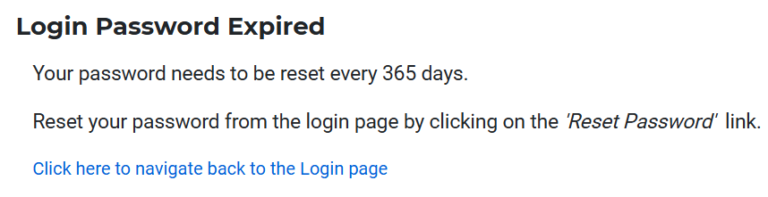
RIOO
Goal of Today’s Presentation
Communicate to Market about the two new features (Password Rotation and Disabling of Inactive Users) that will be added in RIOO and delivered to Production end of January of 2026 (with ERCOT 2026 R1 release)
Security:
Follow ERCOT standards and best practices for Password Rotation
Disable inactive users. More than half of the RIOO User base currently is inactive.
Password Rotation
After Password Rotation is live, all Market Users are expected to reset their password in RIOO every 365 days.
RIOO application will redirect the User to the custom error page, renders a clear message to the User that their password has been expired, and it needs to be reset.

Slide 3
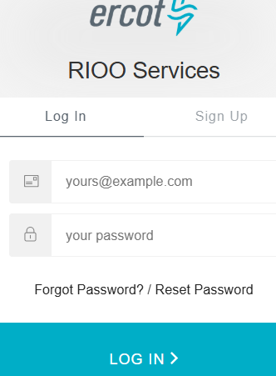
RIOO
User can reset their password by clicking on the ‘Reset Password’ link on the login page.

Slide 4
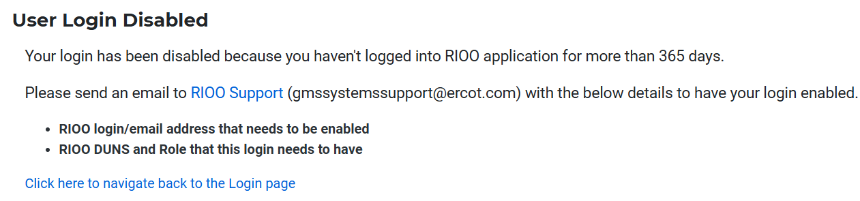
RIOO
Disable Inactive Users
To make application more secure RIOO will disable Inactive Market Users.
RIOO will send notifications to all Market Users who have been inactive more than 365 days that their account has been disabled.
Going forward RIOO will send a reminder notification 10 days prior to disabling the User account.
If a disabled User attempts to login, RIOO application will redirect the User to a custom error page and renders a clear message to the User that this account has been disabled, and User will need to contact RIOO Support to have account their account enabled.

