Slide 1
RTC Non-Spin Deployment Trigger
Ancillary Services and Operations Analytics
12/15/2025

Slide 2
Background
Identification for need to update Other Binding Document related to Non-Spin Deployment Procedure to align with RTCB
Review logic updates and Non-Spin Deployments since Go-Live
Next steps for procedure updates and OBDRR submission and approval

Slide 3
RTC Non-Spin Deployment Trigger Changes
To prepare for RTC+B cutover and support Non-Spin Deployments, ERCOT shared a draft OBD for Non-Spinning Reserve Deployment and Recall Procedure.
Previous Trigger:
HASL – (GTBD + GTBD Offset) – IRR Curtailment – 30 min Net Load Ramp Forecast
RTC Go-Live Trigger:
HSL – AS Awards – (GTBD + GTBD Offset) – IRR Curtailment – 30 min Net Load Ramp Forecast
HASL was replaced with a system level HSL – AS Awards calculation, due to the removal of AS schedules in RTC.
Worth noting, historically HASL’s definition has protected all up reserves including online Non-Spin that is not released to SCED. Under RTC, the appropriate parallel was to include all up AS awards. Long term goal is to deploy offline non-spin and protect online non-spin on energy storage resources.
2 Non-Spin Deployments under this trigger. See Slide 4.
Current Trigger (as of 12/10):
HSL – Gen AS Awards – (GTBD + GTBD Offset) – IRR Curtailment – 30 min Net Load Ramp Forecast
The Go-Live trigger inadvertently included AS Awards from NCLRs and CLRs, this has been corrected to only include AS Awards from Generation Resources and ESRs on 12/10/2025.
A limitation of this formula is that it doesn’t handle the situations where Non-Spin awards are more than the plan.
1 Non-Spin Deployment under this trigger. Trigger was driven by under forecast of net load. See Slide in Appendix.

Slide 4
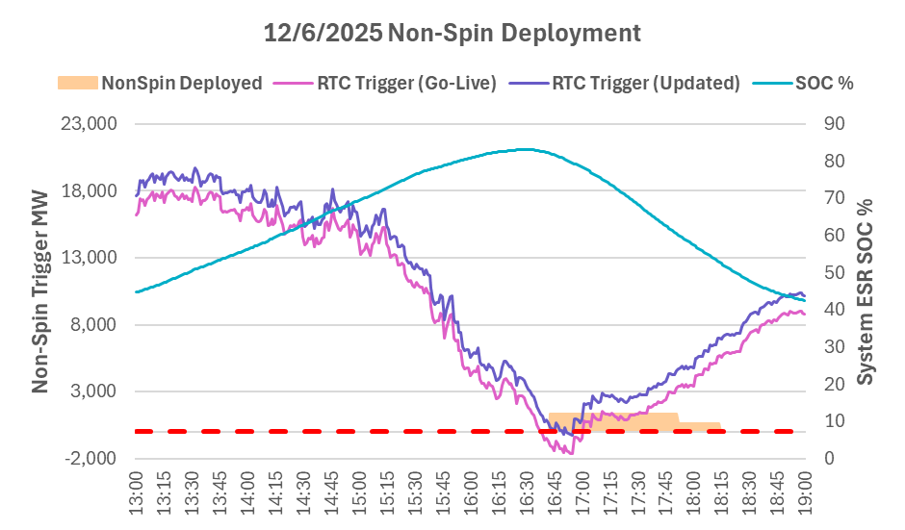
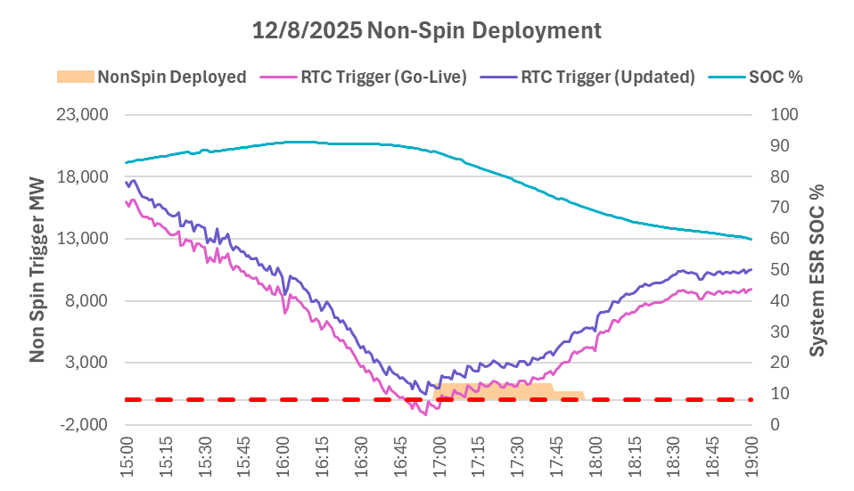
RTC Non-Spin Deployments (Go-Live Logic)
Trigger was driven by under forecast of net load.
Non-Spin would have been deployed a few minutes later, under the updated RTC Trigger.
Non-Spin may not have been deployed on 12/8/2025 under the updated RTC Trigger.
Key Takeaway: Identified the need modify the logic to exclude Load Resources AS awards from the calculation.

Slide 5
Next Steps
ERCOT is performing analysis to determine improvements for the trigger which:
Preserves the AS plan, without considering the excess Online Non-Spin procurements
Accounts for Non-Spin shortages, when the Non-Spin plan is not fully procured
Is aware of ESR State of Charge energy constraints
Is developed bottom up at unit level instead of top down at system level
Next Steps:
Perform analysis and determine new Non-Spin Trigger formula
Update and submit OBD based on new trigger criteria
Timeline for change to be effective is for Summer 2026
April 1st deadline leaves little time for stakeholders to review and provide feedback

Slide 6
Quesitons?

Slide 7
Appendix

Slide 8
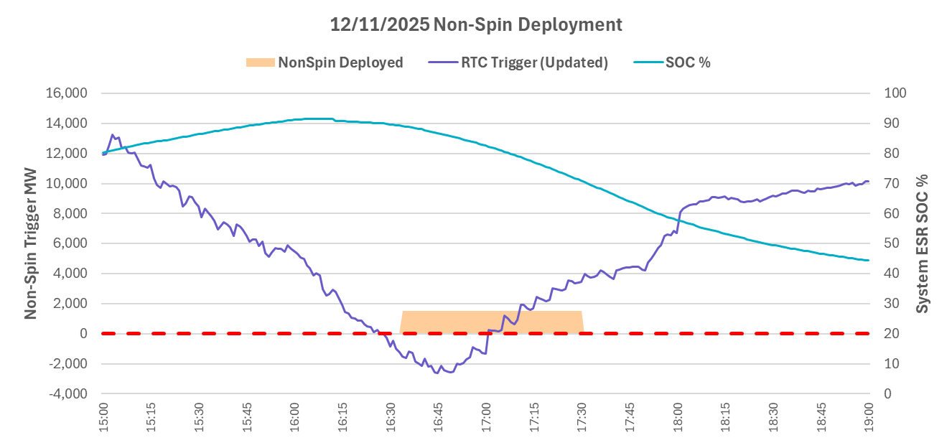
RTC Non-Spin Deployments (Update Logic)
Trigger was driven by under forecast of net load.

