Slide 1
NSPIN Pricing Trends Since RTC Go-Live
Presented to:
RTCBTF
Andrew Reimers, Ph.D.
Potomac Economics
December 15, 2025

Slide 2
What We’re Seeing So Far
The RTM is consistently going long on NSPIN with the price set by the NSPIN ASDC
Despite going long on NSPIN, it is frequently clearing higher than other AS, particularly RRS and ECRS
The ratio of NSPIN MCPCs to ECRS and RRS prices suggests that AS duration requirements are a driving factor in these pricing outcomes
4x ratio of NSPIN to ECRS (4-hour vs. 1-hour duration)
8x ratio of NSPIN to RRS (4-hour vs. 30-min duration)
RTM offer prices for RegUp are higher than other AS, as expected, so ratio of NSPIN to RegUp is not as consistent
RTM offer prices for NSPIN do not appear to be the primary driver for this trend
Excess cost of this outcome is approximately $176k per day, which amounts to $64MM per year

Slide 3
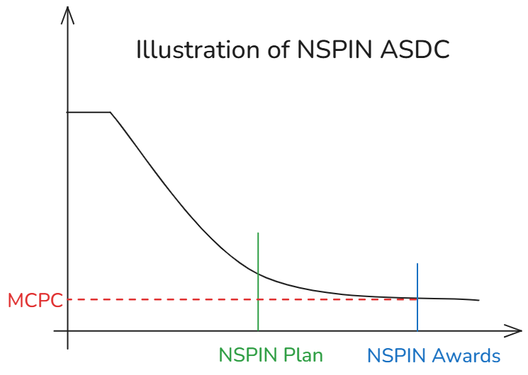
Extending ASDC Beyond the AS Plan Results in Excess Procurement and Elevated MCPCs
The NSPIN ASDC is extended beyond the AS Plan for NSPIN to fill the AORDC up to 10,000 MW
SCED only sees the AS Plan through the formulation of the ASDCs, ie, SCED procures to the ASDCs, not to the AS Plan
The result of this decision is excess procurement of NSPIN and pricing that reflects a false shortage condition when procurement is long.

Slide 4
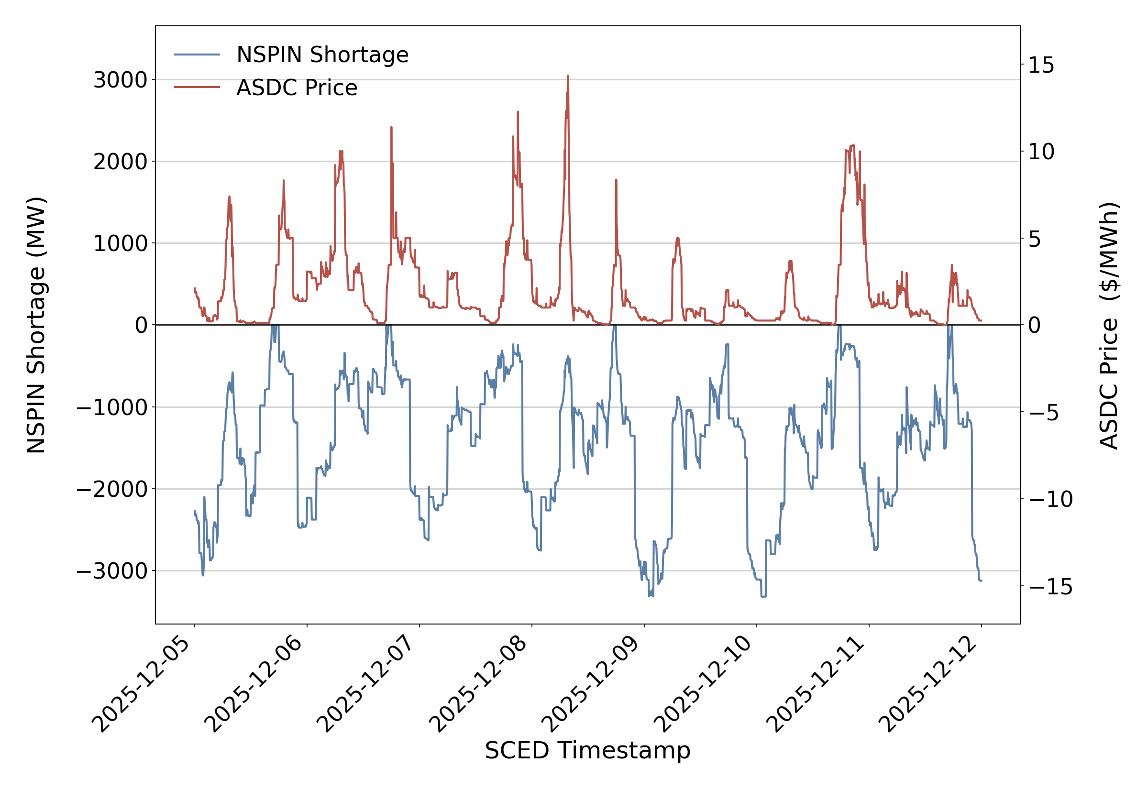
The RTM is consistently going long on NSPIN with the price set by the NSPIN ASDC

Slide 5
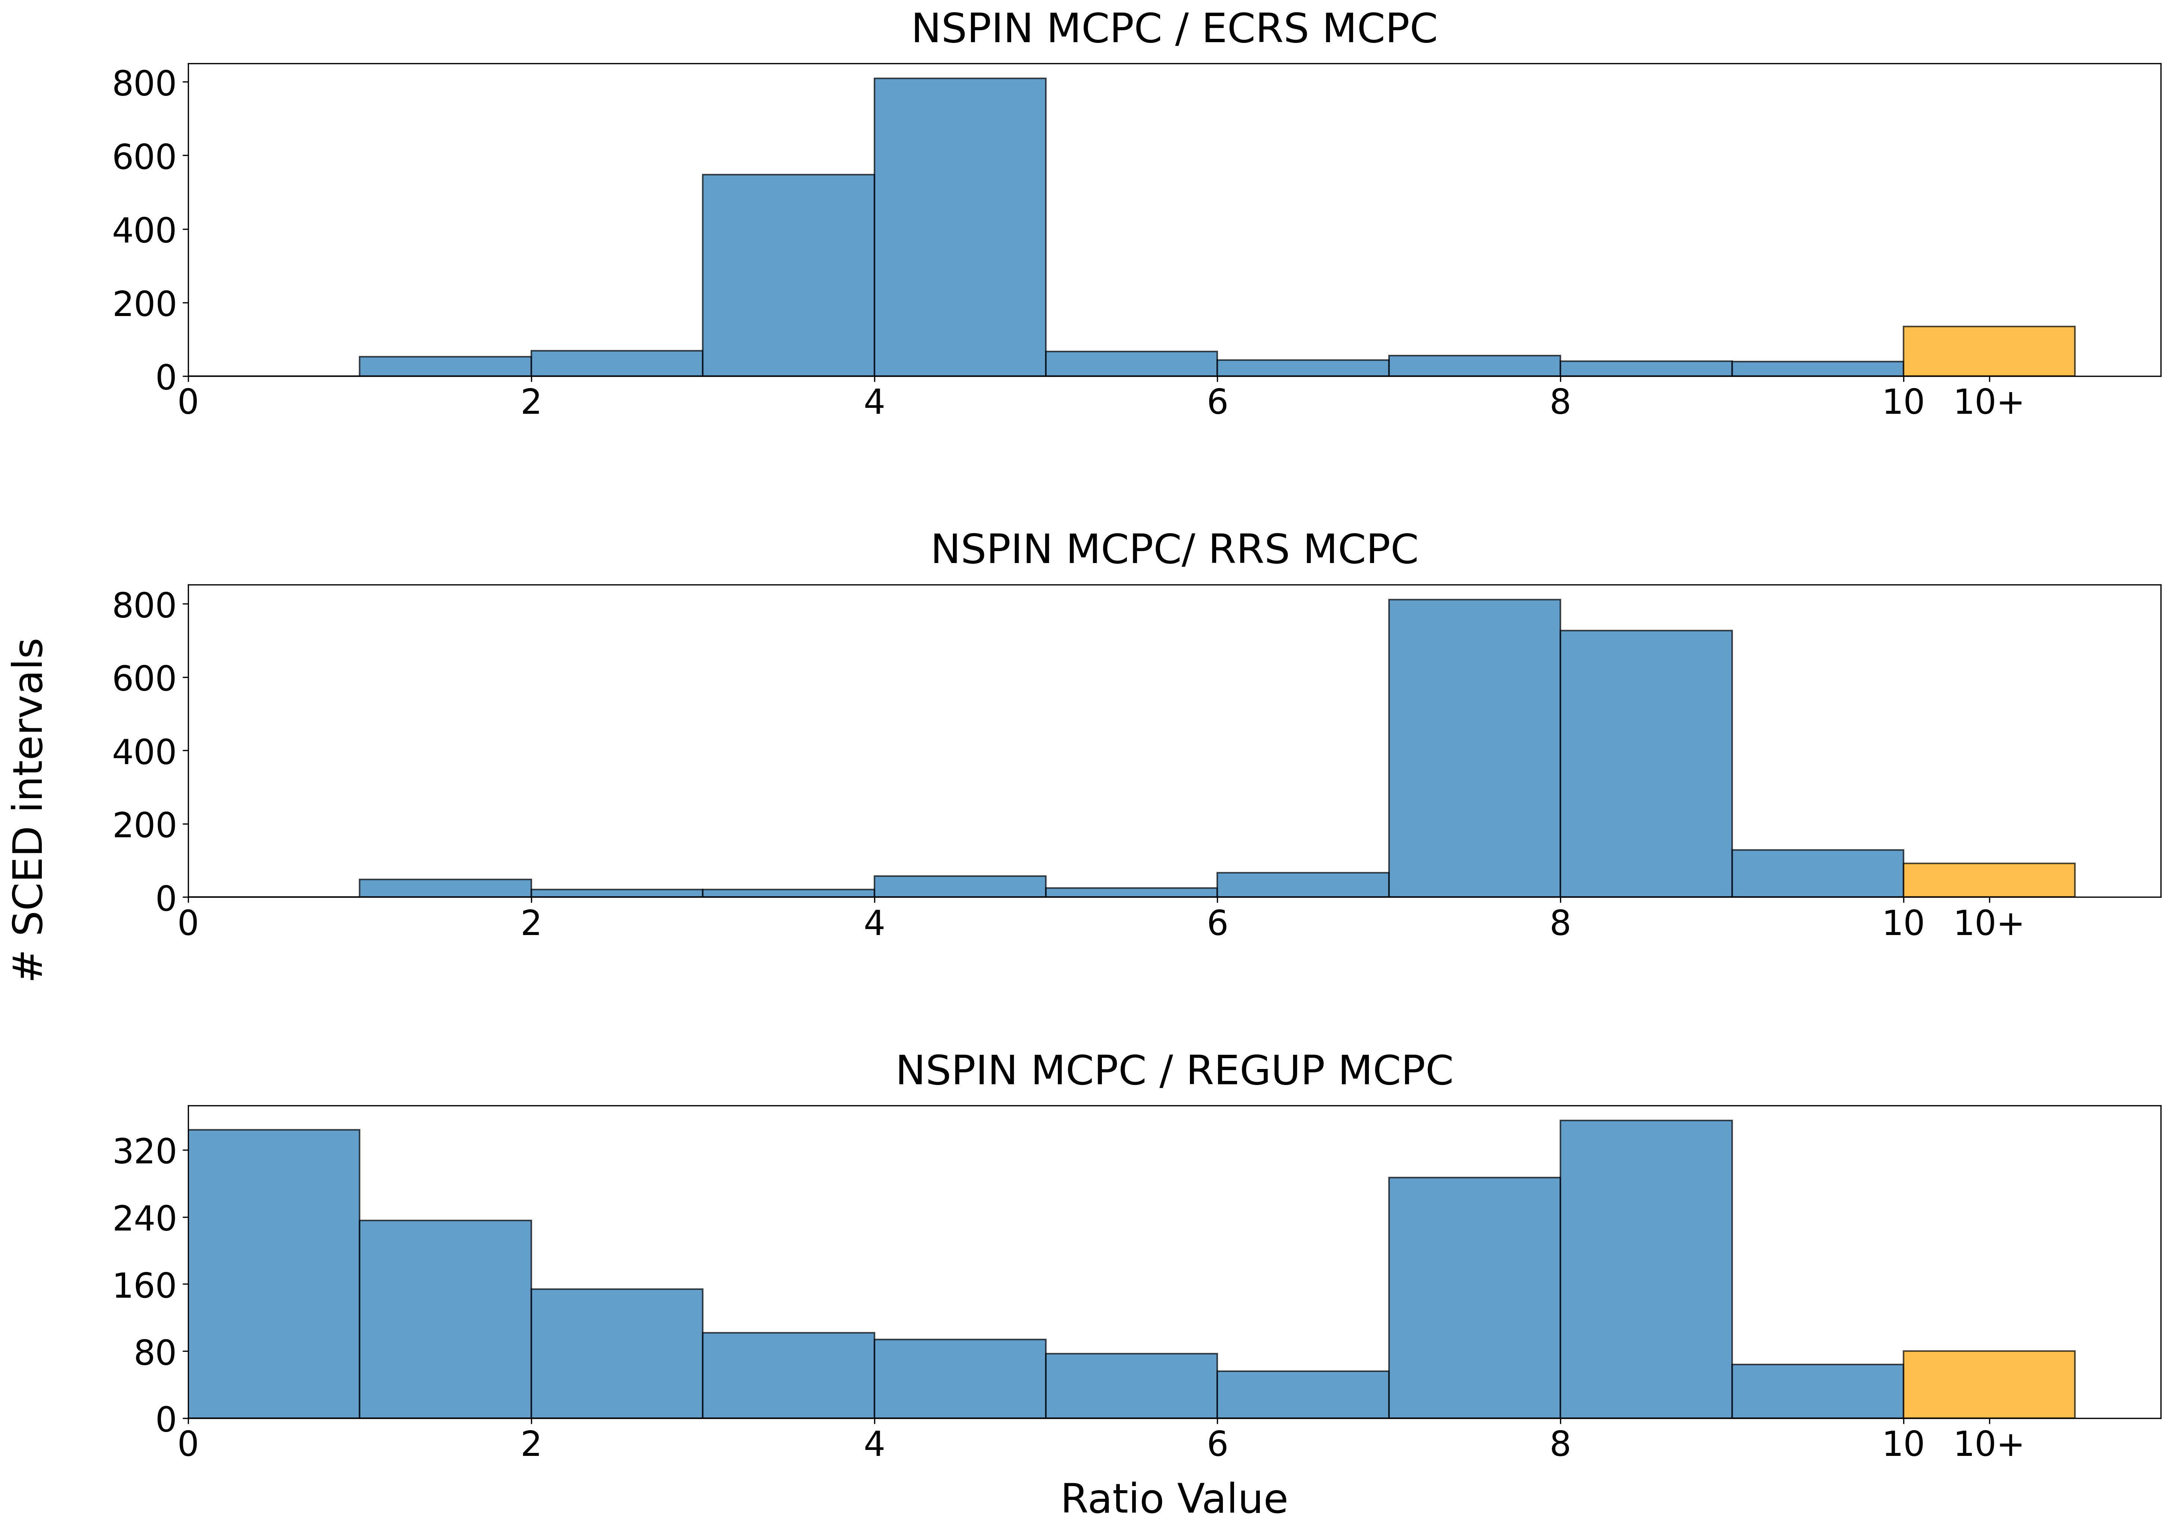
The Ratio of NSPIN MCPCs to Other AS Indicates That AS Duration Requirements Are Driving Pricing Outcomes

Slide 6
Cost Impact of Excessive NSPIN Pricing
To estimate the excess cost of this pricing trend, we use the ECRS MCPC as a proxy for the NSPIN price and cap awards at the AS Plan, like so:
Excess Cost = NSPIN MCPC*NSPIN Awards – ECRS MCPC* NSPIN Plan
Note that this estimation only accounts for the direct impact on AS cost and does not account for the impact on energy prices
From 12/5-12/10, this calculation produced an estimate of $176k per day. Extrapolating for a whole year, the excess cost is estimated as approximately $64MM
The ECRS price is a reasonable proxy for the NSPIN price if NSPIN had a duration of 1 hour. If anything, it is a conservative estimate, because the supply stack for ECRS is inherently smaller than NSPIN, i.e., 10-min vs 30-min available capacity

Slide 7
Conclusions and Recommendations
RTM is producing higher prices for NSPIN relative to other AS products.
This trend is driven by 1) the extension of the NSPIN ASDC beyond the AS Plan and 2) AS duration requirements
We continue to recommend that the duration requirement for NSPIN be set at 1-hour
Extending the ASDC beyond the AS Plan is incoherent and produces unreasonable pricing outcomes:
SCED doesn’t procure according the AS Plan. The ASDC determines how much NSPIN SCED will procure
SCED should only produce shortage prices when we’re going short on reserves and not when we’re over-procuring them
In the short term, the ASDC should be cut off at the AS Plan
Ultimately, the ASDCs should be reformulated to scale with the AS plan

