Slide 1
CRR Updates at CMWG
Samantha Findley
December 15, 2025

Slide 2
Agenda
LTAS transactions and solution times
CRR auction limits table – no updates

Slide 3
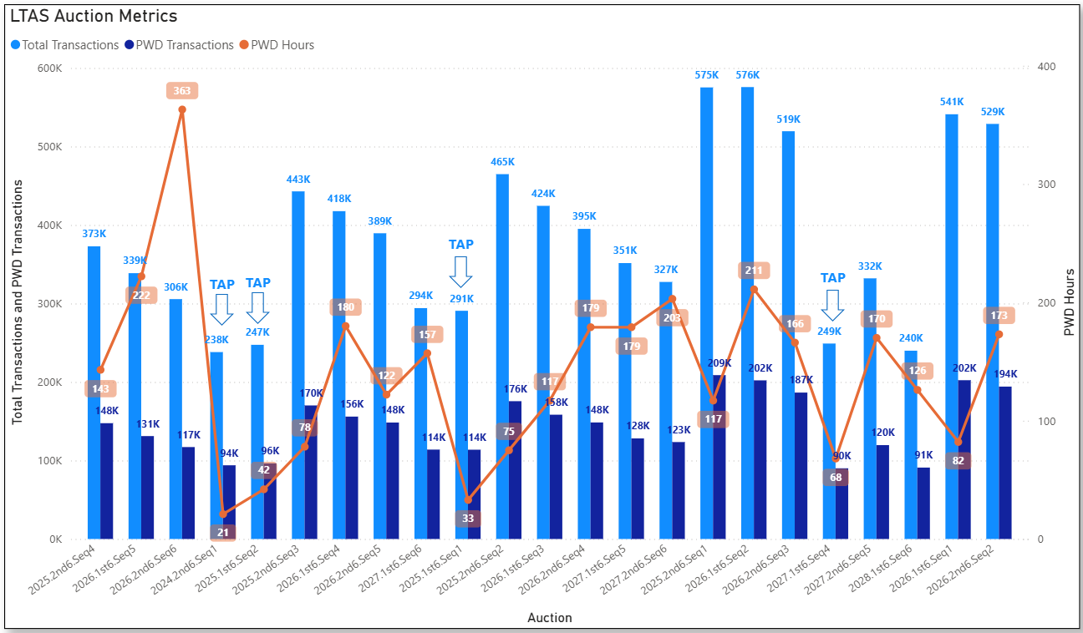
Historical LTAS transactions and solution times

Slide 4
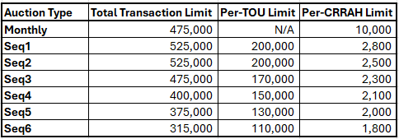
CRR auction transaction limits – no changes

