Slide 1
Initial Observations of RTC+B in Production
ERCOT Initial Observations
David Maggio
Principal, Market Design & Analytics
Real-Time Co-optimization plus Batteries Task Force (RTCBTF)
December 15, 2025

Slide 2
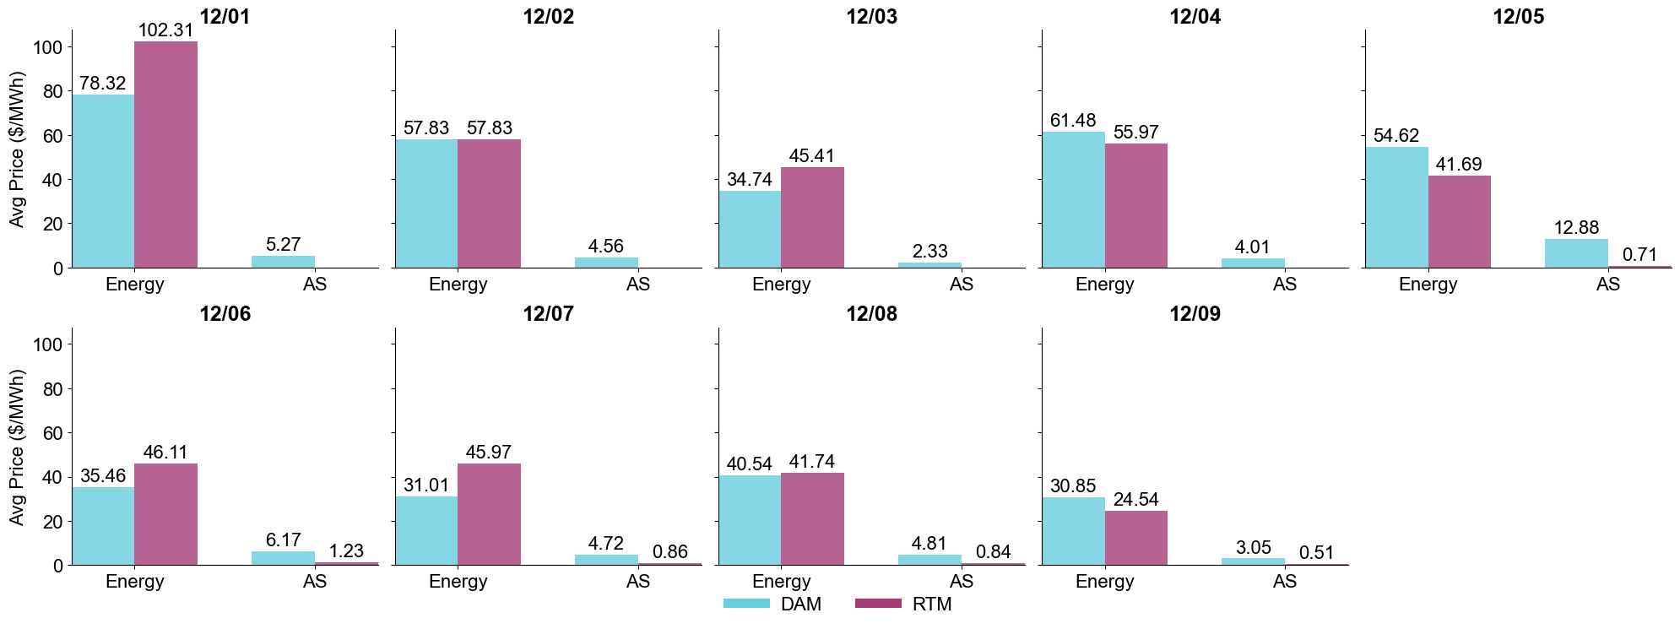
Daily average energy and Ancillary Services prices for the Day-Ahead and Real-Time Market (DAM and RTM)
As of 12/9/25, energy and Ancillary Service prices under RTC+B have been relatively mild. This has been driven more by weather and system conditions than the change in market design.
DAM Ancillary Services prices for 12/5/25 were somewhat elevated, relative to energy, but this appears to be transitory in nature.

Slide 3
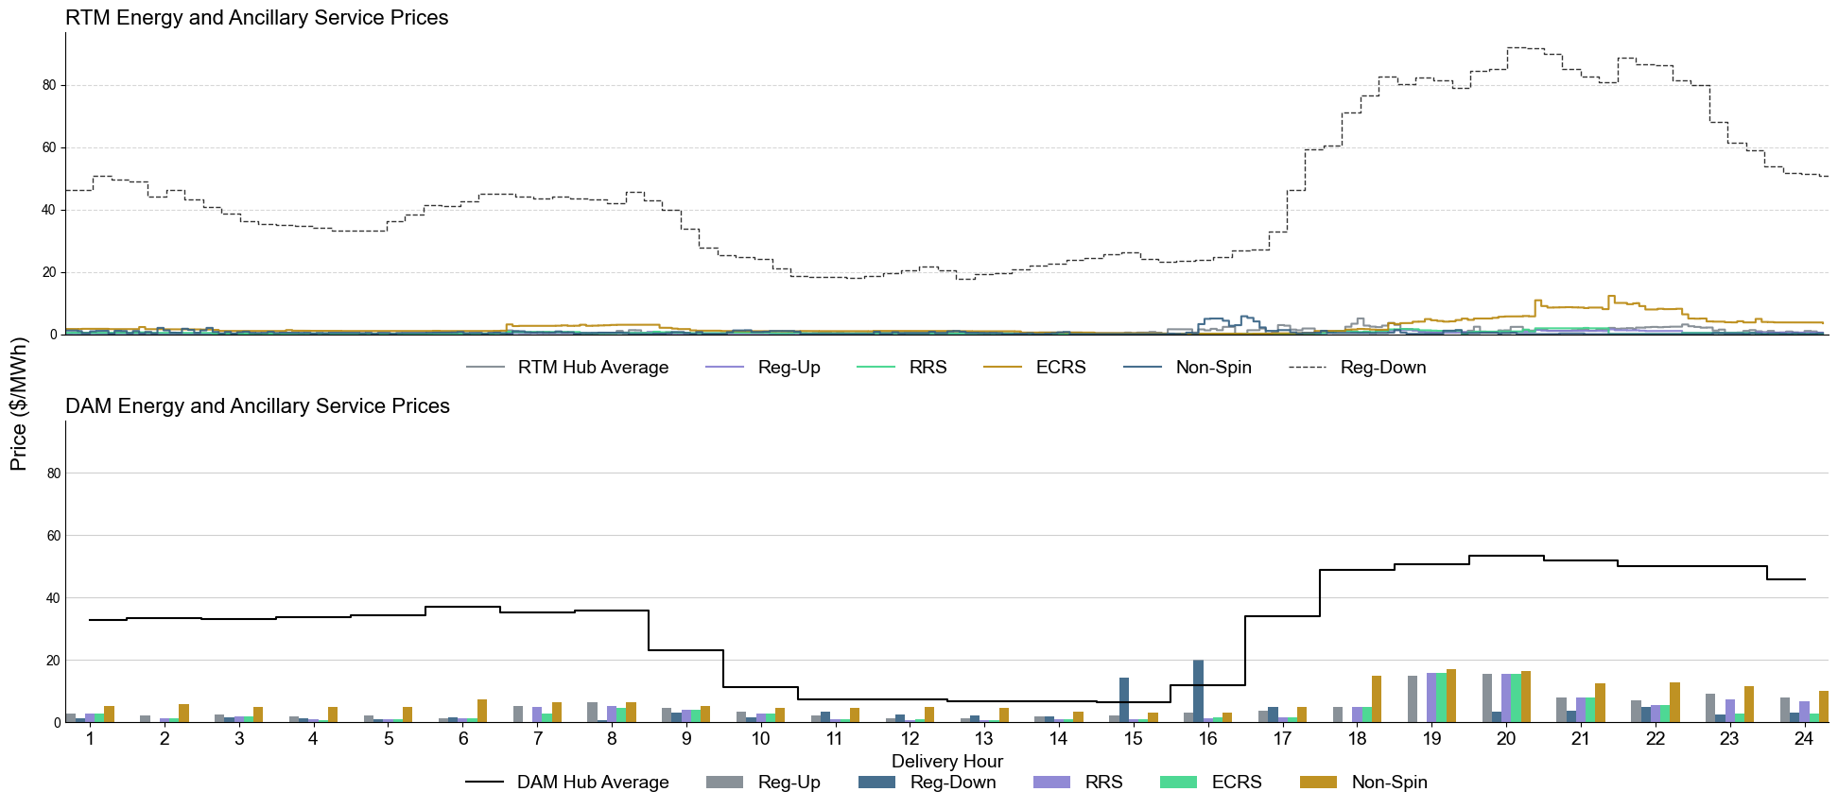
Example of RTM and DAM energy and Ancillary Service prices for 12/7/25
This example day provides an illustration of what is being observed up to this point with the mild conditions. Two initial observations include that:
  RTM Ancillary Services are largely clearing below the prices seen in the DAM; and
  In many hours, we’re observing Non-Spin prices exceeding those of other Ancillary Services. This is at least in part driven by the distinction in duration requirements between products.

Slide 4
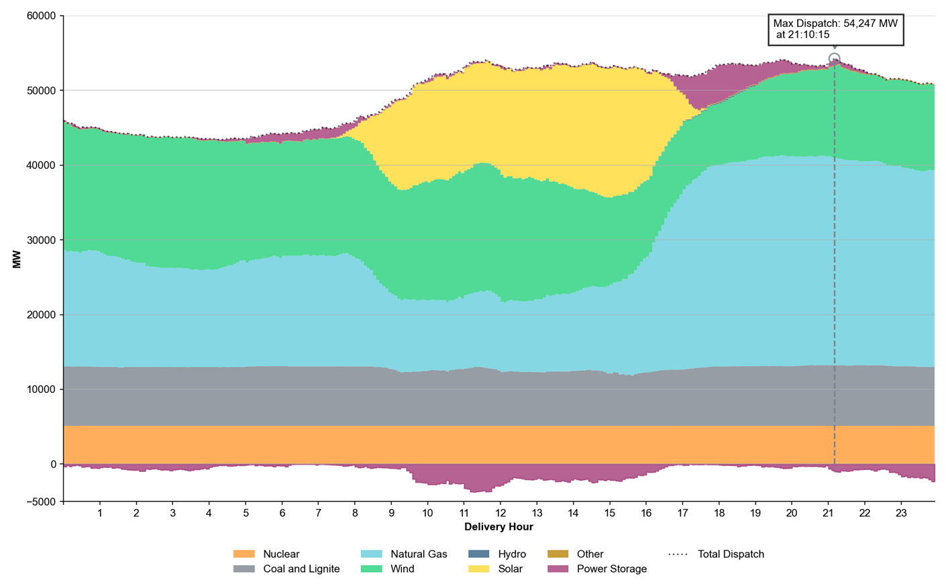
Energy by Resource fuel type using 12/7/25 as an example
The energy by fuel type provides context for the mild conditions and observed pricing outcomes, with significant levels of output from renewables and peak demand levels at ~55,000 MW.

Slide 5
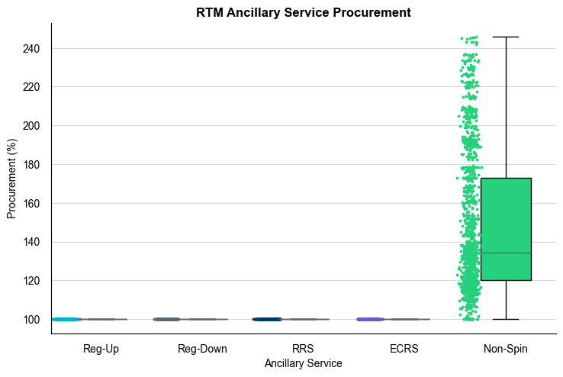
Real-time Ancillary Service procurement under RTC+B
Through 12/9/25, with the milder conditions and Resource availability, no instances of Ancillary Service procurement below the Ancillary Service Plan have been observed.
For Non-Spinning Reserve Service (Non-Spin) specifically, with the design of the Ancillary Service Demand Curves (ASDCs), quantities beyond the plan are often being awarded.
There have been no instances of proxy Ancillary Service offers being awarded

Slide 6
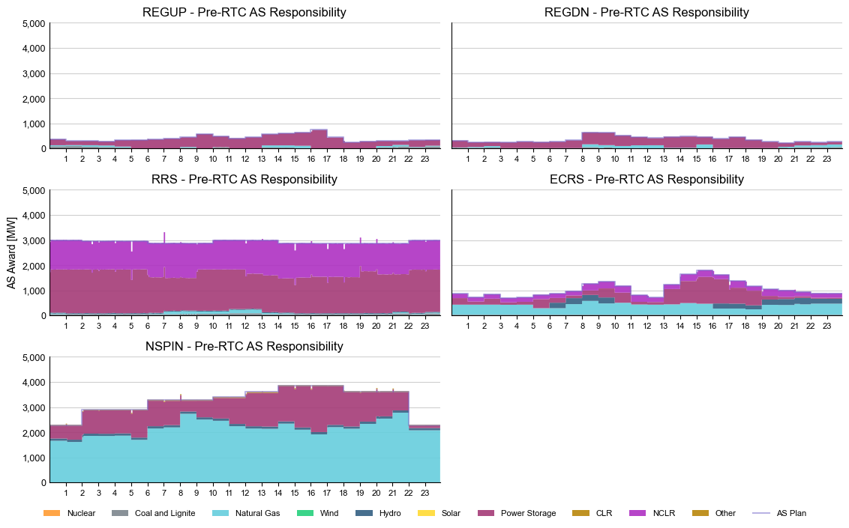
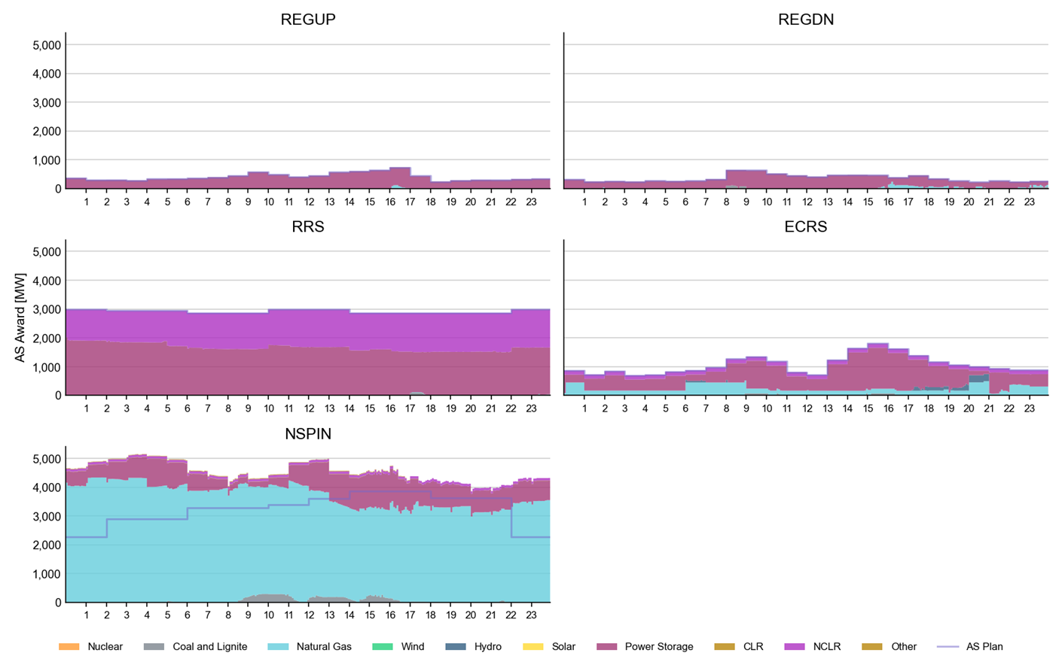
Examples of pre- vs. post-RTC+B provision of Ancillary Services in Real-Time
With duration requirements and the modeling of constraints under RTC+B, some shift in the types of Resources providing Ancillary Services in Real-Time is being observed.
  For ERCOT Contingency Reserve Service (ECRS), the difference is subtle but there seems to be a slight increase in the amount awarded to Energy Storage Resources (ESRs). For Non-Spin, there appears to be at least some reduction in the amount being provided by ESRs to this point.
Again, for Non-Spin, the total procurement is higher under RTC+B, often exceeding the Non-Spin Ancillary Service plan, with much of that being awarded to gas-powered generators.
Real-Time Responsibilities for 12/3/25 (pre-RTC+B)
Real-Time Awards for 12/7/25 (post-RTC+B)

Slide 7
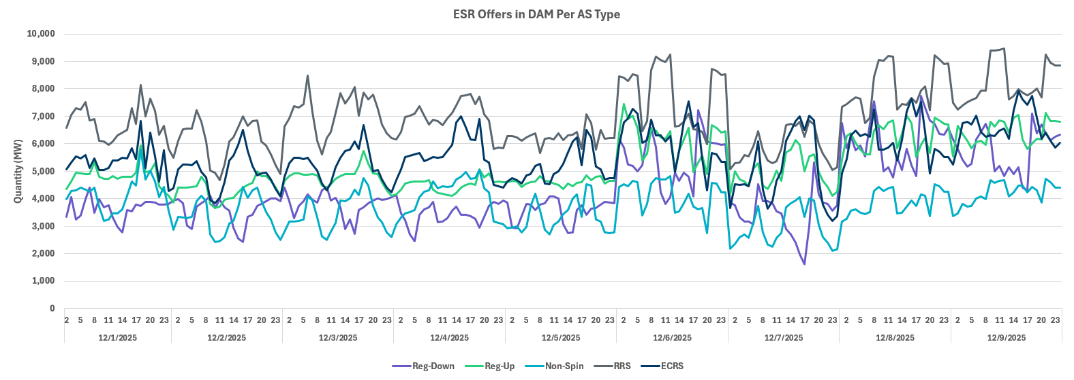
Ancillary Service offer behavior for ESRs in the DAM
As the market transitioned into RTC+B, questions had been raised regarding how Qualified Scheduling Entities (QSEs) for ESRs may change their Ancillary Offer behavior, specifically for the DAM.
There has been no clear change in the amount of total MW being offered by ESRs into the DAM. However, a significant change in the prices associated with those offers has been observed (continued on the next slide). This is the case across all Ancillary Services starting with 12/6/25.

Slide 8
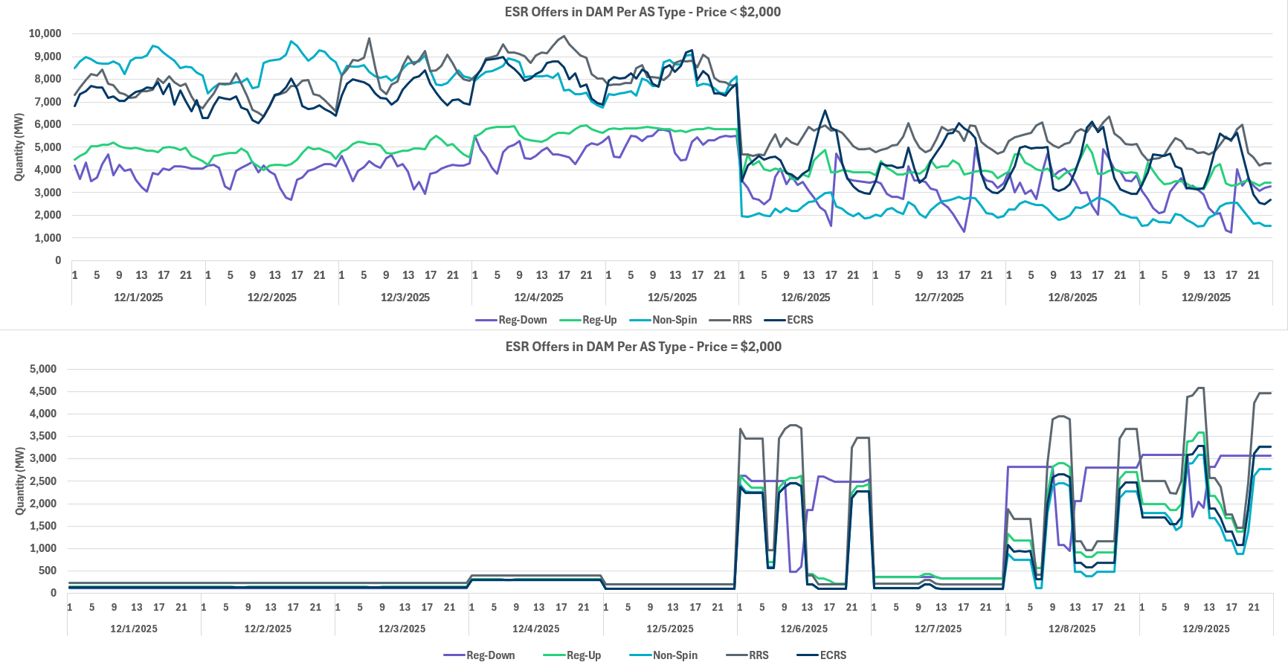
Ancillary Service offer behavior for ESRs in the DAM cont.

Slide 9
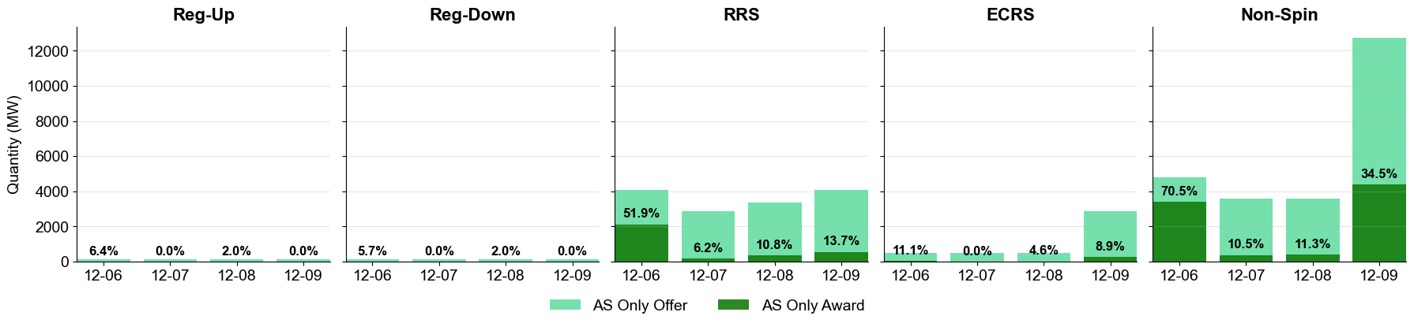
Utilization of Ancillary Service Only Offers in the DAM
While still early, some QSEs have started to utilize the new Ancillary Service Only Offers in the DAM, particularly for RRS and Non-Spin.
  Functionality only became available with the DAM for Operating Day 12/6/25

Slide 10
Real-Time Transmission Congestion
While there are likely other factors at play between these days, lower levels of daily congestion rent and constraint violations have been observed under RTC+B, which had been an expected benefit of co-optimizing energy and Ancillary Services in Real-Time.

Slide 11
Reliability Unit Commitment (RUC) Optimization Recommendations
Again, while there are likely other factors at play, lower levels of generator commitments are being recommended by the RUC optimization under RTC+B. The largest change appears to be for Resources that have start times less than 1 hour.

Slide 12
Questions and Discussion

