Slide 1
Load Loss Threshold Analysis
Luis Hinojosa
ERCOT Operations Planning
LLWG
12/11/2025

Slide 2
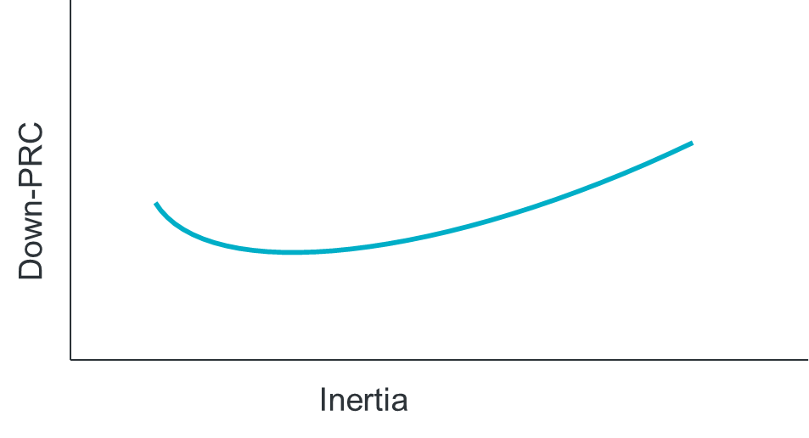
LL Frequency Limit Study
Questions to Answer:
How do different inertia and down-PRC conditions impact the previously-identified¹ 2,600 MW loss of load frequency stability limit?
What would be the benefit of a down-frequency response Ancillary Service?
Scope:
TSAT snapshot cases for various inertia and down-PRC conditions
Identify load loss level that causes steady-state frequency to exceed 60.4 Hz for each case
Goals:
Identify frequency stability limit for loss of load.
Table showing load loss limit for various inertia and down-PRC conditions
  This will serve as input into SOL monitoring criteria (see LL VRT SOL Study)
Identification of amount of down-PRC needed to increase loss of load frequency stability limit at various inertia levels
https://www.ercot.com/files/docs/2025/05/19/Large_Load_Loss_Analysis_051625_LLWG.pptx

Slide 3
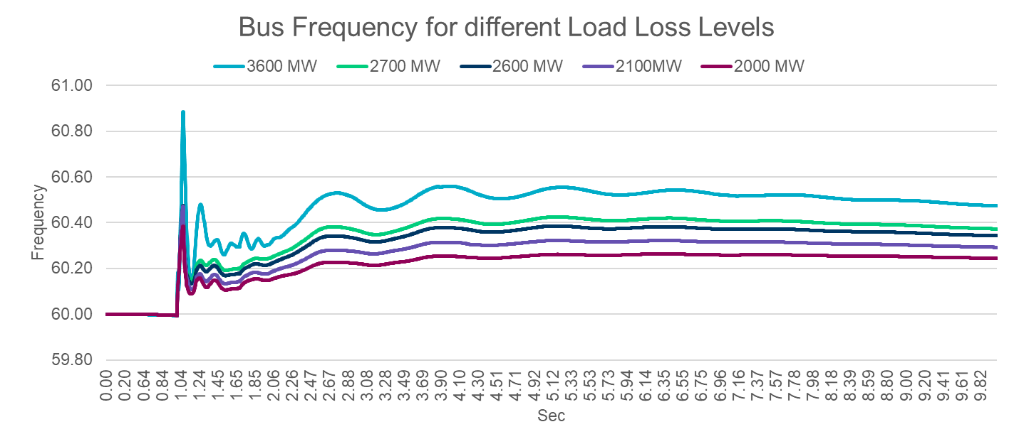
Initial Frequency Study May 2025 - (2,600 MW)
MW Load Loss | Frequency Max
~3,600 | 60.58
~2,700 | 60.42
~2,600 | 60.37
~2,100 | 60.27
~2,000 | 60.25
Key Takeaway: DWG has used a 60.4 Hz threshold in the overshoot studies conducted in 2002 and 2009 based on feedback from generator operations (see page 19 of this DWG report*). Respecting this limit would set a threshold approximately around ~2,600 MW.
*Increasing the overfrequency limit above 60.4 Hz should not be done without coordination with plant operators and a detailed study of plant equipment in the ERCOT system.
Notes:
https://www.ercot.com/files/docs/2009/05/06/09._2008_2009_laars_study_draft04_24_09.doc

Slide 4
Study Validations
Review Primary Frequency Response (PFR) from all available Resources
  Identified logic in our study to disable models for units at or near 0 output
  Historically this was used to identify operating below their minimum operating limit or Offline
  This inherently disabled Energy Storage Resources sitting idle which could respond negatively for PFR.
  We have re-run the studies to analyze the impacts
Utilizing Models provided by Market Participants
  Identified some poor performing dynamic models that were affecting the limit as well and those models have been disabled.
  Other model issues identified, but have minimal impacting on the limit
  ERCOT will do outreach to request improved models.

Slide 5
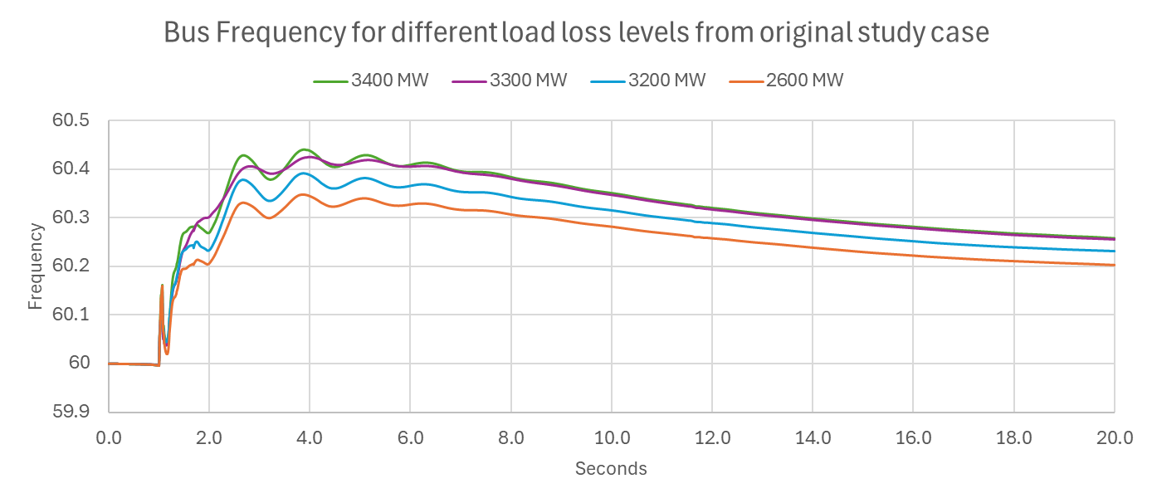
Updated Frequency Study Dec 2025 - (3,200 MW)
MW Load Loss | Frequency Max
~3,400 | 60.43
~3,300 | 60.43
~3,200 | 60.38
~2,600 | 60.21
Key Takeaway: We validated our cases and identified an issue which limited Primary Frequency Response from units sitting near 0 MW output which limited ESRs from providing PFR in the negative direction when idle. We have updated the logic to allow response as expected and identified a new limit of 3,200 MW.
Additionally, we have done some model validation and are doing outreach for models which responded incorrectly.

Slide 6
Next Steps
ERCOT continue to validate the studies and results.
We are actively running studies to build a table with a frequency stability limit based on varied historical system conditions such as inertia and down PRC.
  Intend to share results in Q1 2026
We continue to analyze impact of potential for Fast Frequency Response (FFR) down studies
  FFR is applied to the same studies utilized to build the above mentioned
  Intend to share results after shortly after the above frequency stability limit table.

Slide 7
Questions?

