Slide 1
RTC+B – Go-Live Cutover Plan
Sreenivas Badri
Sruthi Hariharan
November 24, 2025

Slide 2
Agenda
Parallel Operations Expectations
Go-Live - ICCP/EMS and Market/Outage Scheduler Systems Configurations
Dual Submissions for Go-Live
Go-Live – Cutover Plan Review

Slide 3
RTC+B – Parallel Operations
Currently we are in “Parallel Operations”, will continue to be in this state until Go-Live.
Parallel Operations expectations:
  QSEs should continue to send Production Quality and Consistent Telemetry to ERCOT RTC+B ICCP system in parallel to current production.
  QSEs control room operators should perform the dual entry of telemetry manual overrides etc. based on grid conditions.
  QSEs should continue to make Production quality real-time Market submissions to ERCOT RTC+B market systems in parallel to current production.
  QSE Telemetry issues (identified by ERCOT and communicating to QSEs) should be fixed no later than 11/28/2025
  ERCOT will continue to validate RTC+B telemetry and Market Submissions and communicate issues to QSEs.
  ERCOT will continue to validate RTC+B EMS and SCED applications results based on RTC+B telemetry and market submissions and send UDSP, AS Awards etc. through ICCP and post SCED prices.

Slide 4
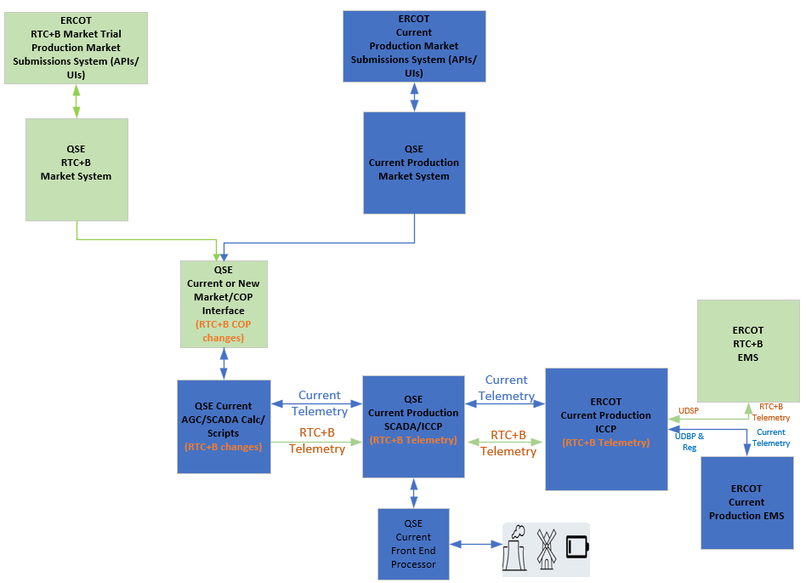
RTC+B – Parallel Operations – Current State of ERCOT and QSE ICCP/EMS Systems Setup

Slide 5
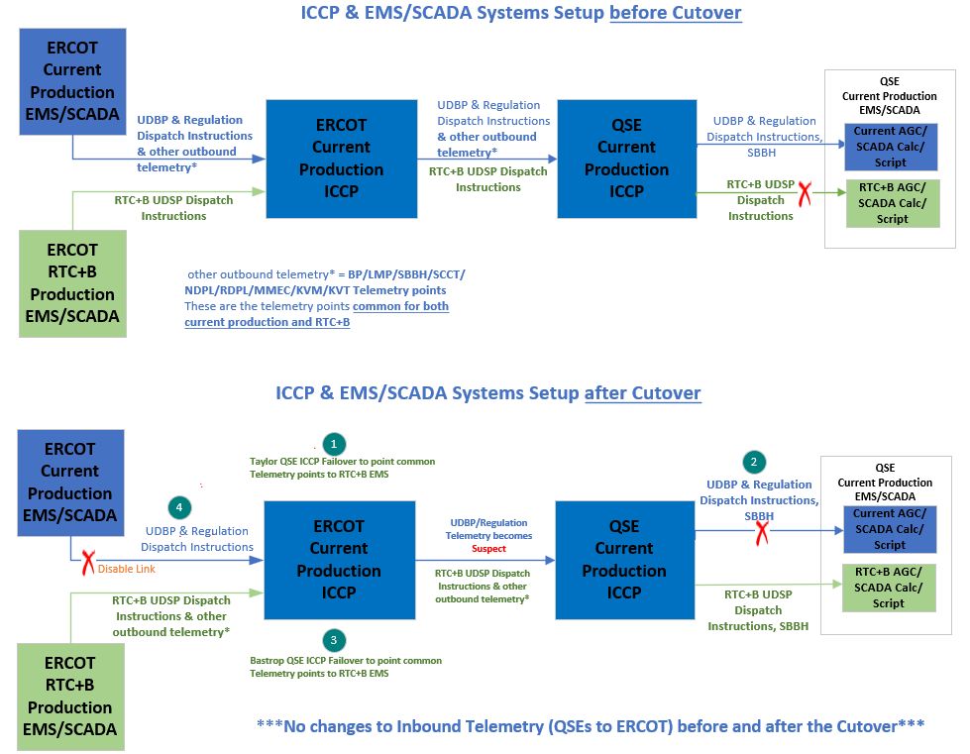
ICCP/EMS Go-Live Cutover Key Steps

Slide 6



RTC+B - ERCOT/QSE Market and Outage Submissions Systems Go-Live Configurations
Go-Live – 12/05 00:05
Current Production
QSE
ERCOT
QSE
ERCOT
Current Production
- Market/Outage Submissions System
(Deploy RTC+B Code + Configure New API URLs)
Current Production MIS
Current Production – Market/Outage Submissions System
Current Production MIS
RTC+B Market Trials
QSE
ERCOT
QSE
ERCOT
RTC+B – Market/Outage Submissions System
RTC+B
Go-Live API URLs
RTC+B – Market/Outage Submissions System
RTC+B Market Trials API URLs

Slide 7
QSEs RTC+B Systems configurations for Go-Live
EMS/AGC/SCADA Calc/Scripts
  QSEs will utilize System level switch of their EMS/AGC/SCADA Calc/Scripts to cutover their entire system to RTC+B mode. Switchover time must be within 30-60 seconds.
Market Submissions and Notifications
  QSEs are utilizing parallel RTC+B Market Systems Production system to submit real-time market submissions into ERCOT RTC+B Market Trial Production System in parallel to current production.
  Some QSEs are using current production to support dual real-time market submissions into ERCOT RTC+B Market Trial Production System in parallel to Current Production starting from Open Loop Testing till Go Live.
  QSEs Go-Live Market System APIs will have to be updated to point to new RTC+B Go-Live Internet and WAN API URLs during Go-Live.
Outages Submissions
  QSEs/TSPs Go-Live Outage Submission APIs will have to be updated to point to new RTC+B Go-Live Internet and WAN API URLs during Go-Live.

Slide 8
MMS/Outage Submissions – Go-Live Systems configurations
System/ Environment | Effective Dates | Digital Certificate | MMSUI/ OSUI | API/WAN URL
Current Prod (pre-RTC) | Till 12/4 23:56 | Current Prod | mis.ercot.com/mmsui mis.ercot.com/osui | https://misapi.ercot.com/2007-08/Nodal/eEDS/EWS/ https://api.wan.ercot.com:8443/2007-08/Nodal/eEDS/EWS/
RTC+B Market Trials and Dual Submissions | Till 12/4 23:56 | Current Prod (no change) | https://markettrials.ercot.com/mmsui/mmsui/displayTradesLanding.action https://markettrials.ercot.com/osrui/osrui/Summary.action | https://markettrialsapi.ercot.com/NodalAPI/EWS/ https://markettrialsapi.wan.ercot.com/NodalAPI/EWS/
RTC+B Go-Live Production | From 12/5 00:05 | Current Prod (no change) | mis.ercot.com/mmsui mis.ercot.com/osui | https://misapi.ercot.com/NodalAPI/EWS/ https://api.wan.ercot.com/NodalAPI/EWS/
Make sure that current production certificates and API Public Key (available at link https://www.ercot.com/services/mdt/webservices) are installed in Go-Live Market API System and Outage Submissions API System.
*** Any Market submissions submitted into RTC+B Market Trials before December 1, 2025, will be deleted in preparation for Go-Live***

Slide 9
RTC+B Go-Live - Listener Requests and Setup
ERCOT will not copy current prod listener URLs (pre- RTC) to RTCB environment where ERCOT is going to cutover on Dec 4-5^{th.}
Few Scenarios of Listener request form submission:
If MPs don't have Listener Setup in RTCB environment, we request MPs to submit the Listener URLs Request form by 12/01/2025, to configure listeners in RTCB environment.
If MPs already have listener URLs setup in RTCB environment and MPs want to continue to receive notification messages on same Listener URLs after go live, then MPs don’t have to submit listener URLs request form to configure in RTCB environment.
If MPs want to use current prod listener URLs (pre- RTC) after RTCB go live, we still want to request MPs to submit listener URLs request form by 12/01/2025 to configure into RTCB environment.
Once we configure listener URLs in RTCB environment, we will start sending notification messages from RTCB environment, if you don’t want receive notification messages from RTCB environment you can request us to DISABLE sending notification messages until go live. After go live we can ENABLE to send notification messages on configured listener URLs.
More details you can refer Market Notice: M-B111325-01 RTC+B: ERCOT API/XML Interface Listener Setup for QSEs without Resources

Slide 10


RTC+B Go-Live – Listener Configurations
ERCOT
QSE
At 12/04 23:56
Active QSE Listeners URLs in Current Production
Current Production Listener
Current Production
Active QSE RTC+B Market Trials Listeners URLs
12/01 -12/04
QSE RTC+B Market Trials Listener
RTC+B Market Trials
QSE RTC+B Go-Live Listeners URLs submitted to ERCOT
At 12/05 00:05
RTC+B Go-Live Listener
RTC+B Go-Live
RTC+B Go-Live Listener URLs:
If QSE uses RTC+B Market Trials Listener URL for Go-Live, Notifications will continue to be sent out from ERCOT RTC+B to QSE except during 12/4 23:56-12/5 00:05 due to cutover.
If QSE uses current Production Listener URL for Go-Live, Notifications will be sent out from ERCOT RTC+B to QSE from 12/5 00:05 (after cutover) or even before Go-Live depending on the information in the Notification Listener URL form submitted by QSEs.
If QSE uses NEW Listener URL than what is being used currently in RTC+B market trials for Go-Live, Notifications will be sent out to QSE from the time listener URLs are configured in RTC+B system except during 12/4 23:56-12/5 00:05 due to cutover.

Slide 11
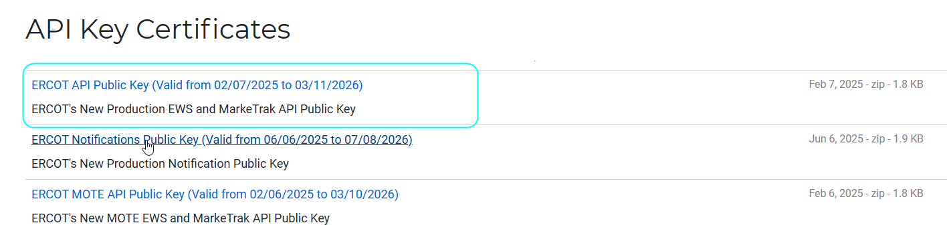
RTC+B – Go-Live API URL changes - FAQ
API URLs port numbers are not changed but we do support WAN API end point URL on default port 443. ERCOT encourages QSEs to use default port for WAN API end point URL.
ERCOT DNS and IP Addresses remain same as Pre-RTC.
Make sure that current production certificates and API Public Key (available at link https://www.ercot.com/services/mdt/webservices) are installed in Go-Live Market API System and Outage Submissions API System.

Slide 12
RTC+B Cutover Timeline - MMS/OS submission systems
 | Start Time | End Time | Tasks / Steps
RTC+B Pre Go-Live Steps | 11/13/2025 | 12/1/2025 | QSEs to send the Notifications listener URLs to ERCOT for Go-Live (needed even if QSE plans to use existing listeners post go-live)
Dual Market Submissions | 12/1/2025 | 12/4/2025 | To Current Production (Pre-RTC), QSEs to submit RTM Submissions even for OD 12/05 To RTC+B Market Trials Systems, QSEs to continue to submit production quality RTM submissions (COP, TPO, AS Offers, ESR Bids/Offers, Output Schedules etc.) for all ODs until Go-Live.
RTC+B Go-Live Cutover Steps | 12/4/2025 23:30 | 12/4/2025 23:35 | Shutdown Current Production (Pre-RTC) and RTC+B Market Trials Outage Scheduler UI and API Services.
 | 12/4/2025 23:56 | 12/4/2025 23:57 | Shutdown Current Production (Pre-RTC) and RTC+B Market Trials Market Manager UI and Market Submissions API Services.
 | 12/5/2025 0:05 | 12/5/2025 0:15 | ** QSEs to wait until ERCOT gives instructions through Webex Call on this step ** QSEs to cutover their Go-Live Market Systems/APIs to new RTC+B Production API/WAN End-point URLs QSEs to start submitting market submissions (real-time for OD 12/5+, day ahead for OD 12/6+ and trades etc.) into ERCOT RTC+B Production
 | 12/5/2025 0:05 | 12/5/2025 0:15 | ** QSEs/TSPs to wait until ERCOT gives instructions through Webex Call on this step** QSEs/TSPs to Cutover their Go-Live Outage Scheduler Systems/APIs to new RTC+B Production API/WAN End-Point URLs. QSEs/TSPs to start the Outage submissions into ERCOT RTC+B outage scheduler (new Production).

Slide 13
Example of cutover planning – DAM submissions
Activity | Start Time | End Time | System/ Environment | API/WAN URL
MMS DAM submissions for OD 12/5 |  | 12/4/2025 10 AM | Current Prod (pre-RTC) | https://misapi.ercot.com/2007-08/Nodal/eEDS/EWS/ https://api.wan.ercot.com:8443/2007-08/Nodal/eEDS/EWS/
MMS DAM submissions for OD 12/6 | 12/1/2025 12 PM | 12/4/2025 11:56 PM | RTC+B Market Trials | https://markettrialsapi.ercot.com/NodalAPI/EWS/ https://markettrialsapi.wan.ercot.com/NodalAPI/EWS/
MMS DAM submissions for OD 12/6 | 12/5/2025 12:05 AM | 12/5/2025 10 AM | RTC+B Go-Live Production | https://misapi.ercot.com/NodalAPI/EWS/ https://api.wan.ercot.com/NodalAPI/EWS/

Slide 14
RTC+B Dual Submissions References
RTC+B Cutover handbook - https://www.ercot.com/files/docs/2025/11/13/2-RTCB_Market_Trials_Handbook_7_Transition_Cutover_10152025_FINAL.docx
Link to dual submissions details spreadsheet (shown below) - https://www.ercot.com/files/docs/2025/11/13/3a-Cutover-Strategy_Dual-Submissions_20251015_v.xlsx

Slide 15
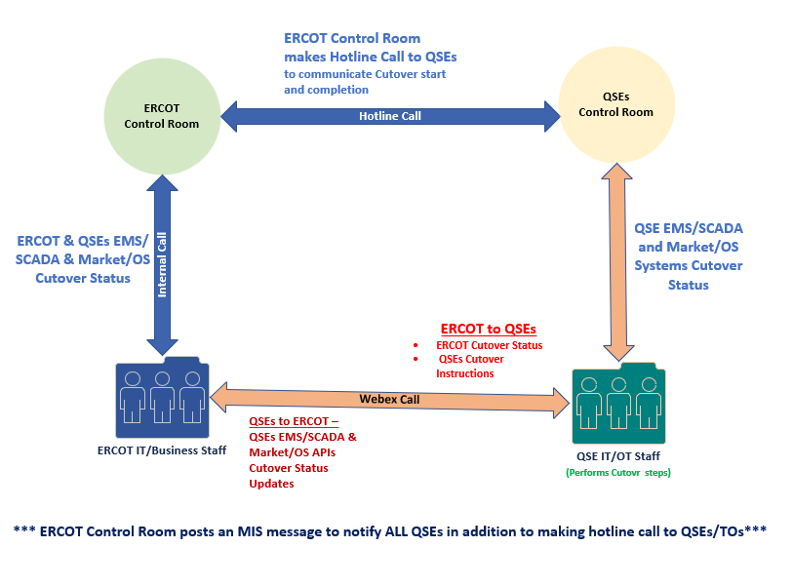
RTC+B - Go-Live Cutover - Communication

Slide 16
Pre-RTC Production System status after RTC Go-Live
ERCOT Pre-RTC EMS will be up and running post go-live on OD 12/05 to support cutback if needed post go-live.
  ERCOT requests QSEs to continue to send parallel telemetry to both RTC and pre-RTC systems at least until12/05 06:00AM
Pre-RTC market submissions, outage scheduler
  ERCOT requests QSEs to complete real time submissions for OD12/05 in the pre-RTC system before go-live. This is required to support cutback if needed post go-live.
Pre-RTC market applications will be down post go-live.

Slide 17
RTC+B – Go-Live Cutover Plan Review
Go-Live cutover plan spreadsheet is available on RTCBTF site under Technical RTC+B Details section.
https://www.ercot.com/committees/tac/rtcbtf
QSEs should follow this Go-Live cutover plan along with their Internal Procedures for the Go-Live.
  It is important for QSEs to line up EMS/Market/OS Scheduler vendors support to get support immediately on any potential critical issues during Go-Live.
ERCOT Control room makes final Go/No-Go decision few minutes before start of the Go-Live activities based on Grid Conditions.
  Start & End Times of the Go-Live are subjected to change based on Grid conditions.

Slide 18
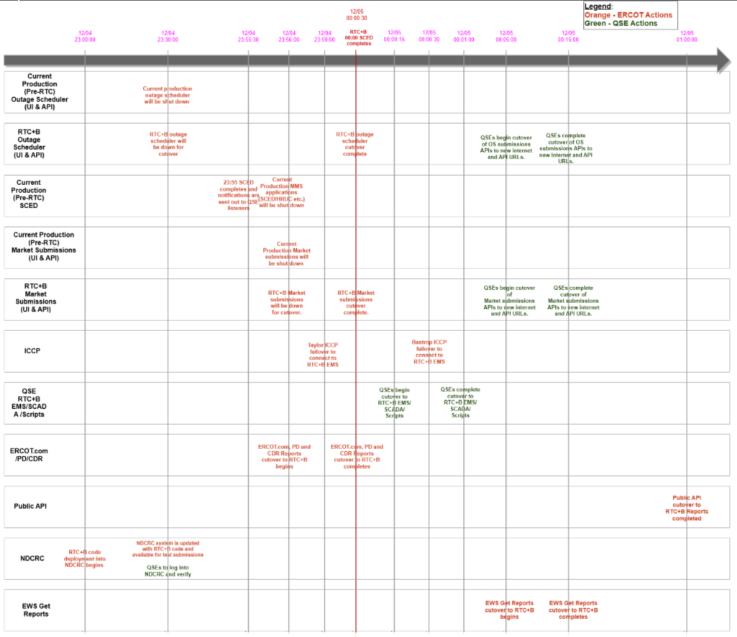
RTC+B - Go-Live ERCOT/QSE Systems Cutover Sequence

Slide 19
RTC+B – Cutover Plan – Key Steps
Outage Scheduler
(UI/API)
23:30 – Pre-RTC and RTC+B Outage Scheduler (OS) API services and OS UI will be down for cutover
00:00 – RTC+B Outage Scheduler API services will be up with new API URL Outage Scheduler UI URL is same as Pre-RTC.
Market Submissions
(UI/API)
23:56 – Pre-RTC and RTC+B Market Submissions API services and Market Manager UI will be down for cutover
00:00 – RTC+B Market Submissions API services will be up with new API URL. Market Manager UI URL is same as Pre-RTC.
EWS Get Reports and Public API
ICCP/
EMS/
SCADA
QSE/TSP
APIs Cutover
23:59:00 – ERCOT Taylor ICCP failover to RTC+B EMS
00:00:00 – RTC+B SCED execution starts and completes by 00:00:30 seconds. QSE Resources will be following UDSP based on 00:00 interval SCED Solution.
00:00:15 – QSE’s cutover their EMS AGC/SCADA Calcs/Scripts to RTC+B – cutover shall complete within 30-60 seconds.
00:00:30 – ERCOT Bastrop ICCP failover to RTC+B EMS
00:05:00 – QSEs and TSPs to cutover their Outage Submissions system APIs to new Go-Live API URLs (listed below)
00:05:00 – QSEs to cutover their Market Submissions system APIs to new Go-Live API URLs (listed below)
Internet API URL: https://misapi.ercot.com/NodalAPI/EWS/
***QSE/TSP API systems cutovers shall complete within10 minutes***
WAN API URL: https://api.wan.ercot.com/NodalAPI/EWS/
00:05:00 - EWS Get Reports APIs cutover to RTC+B will be complete.
01:00:00 - Public API cutover to RTC+B Reports will be complete.
00:04:30 - Disable Old Production (Pre-RTC) UDBP, Regulation and other non-RTC+B outbound telemetry points in ERCOT Bastrop and Taylor ICCP Systems.
These telemetry points value will be stale with suspect quality approximately from 12/05 00:04:30 AM until these points are removed during DEC_ML2 Model on Operating Day 12/10
No Digital certs and API Public Keys are required if QSEs are going live on Pre-RTC systems

Slide 20
RTC+B – Cutback Plan Review
Cutback will be initiated in the unlikely event where:
  a critical issue is identified immediately after Go-Live that has significant impacts on Grid Reliability and
  issue can not be fixed immediately and
  control room makes the decision to cutback
Pre-RTC Market applications will be started and SCED will be run in pre-RTC system using real time market submissions that came into pre-RTC system before Go-Live.
Cutback plan will focus on
  Cutback of ERCOT ICCP to ERCOT pre-RTC EMS
  QSEs will be requested to cutback to their pre-RTC EMS AGC/SCADA Calc/Scripts.
If issue resolution is expected to take several hours
  QSEs will be requested to cutback to their pre-RTC market and outage scheduler submission APIs.
  TSPs will also be requested to cutback to pre-RTC outage scheduler APIs.

Slide 21
RTC+B – Go-Live Cutover Plan Deeper Dive Timelines/Details
Deeper Dive Timeline/Details
  Review posted spreadsheet

Slide 22
RTC+B – Go-Live Cutover Plan
Questions?
Provide feedback to ERCOT on any concerns/questions at rtcb@ercot.com

