Slide 1
PDCWG Report to ROS
Chair: Chad Mulholland, NRG
Vice Chair: N/A
ROS
December 4th, 2025

Slide 2
Report Overview & Notes
Report Overview
Meeting Minutes
Frequency Control & Regulation Reports (October)
TRE Report
Analysis of Disturbances
BAL-001-TRE-2 FMEs and IMFR
No FMEs in October
Frequency Control Report

Slide 3
Frequency Measurable Events Performance

Slide 4
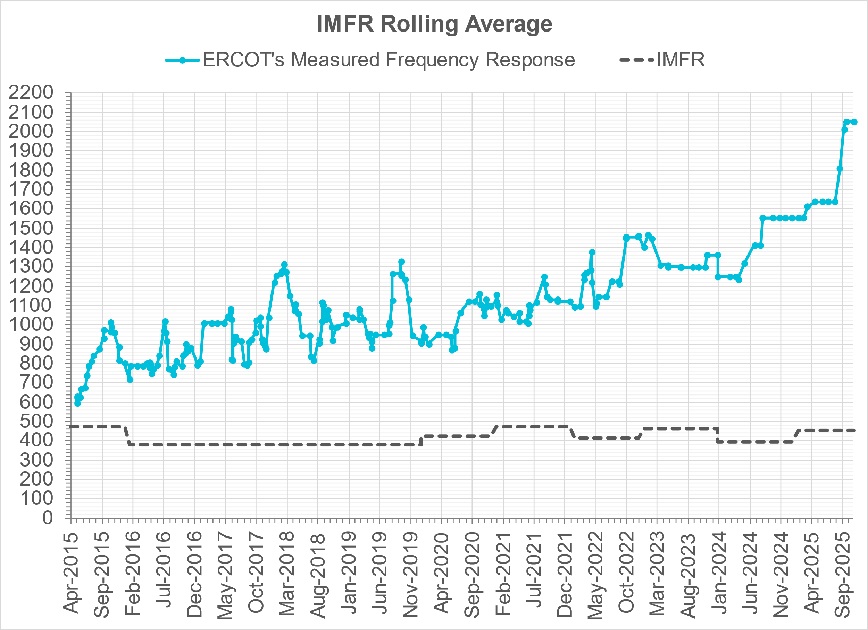
Interconnection Minimum Frequency Response (IMFR) Performance
IMFR Performance currently
2053.83 MW/0.1HZ
Frequency Response Obligation (FRO): 455 MW/0.1 Hz

Slide 5
Questions?

Slide 6
Frequency Control Report
October 2025

Slide 7
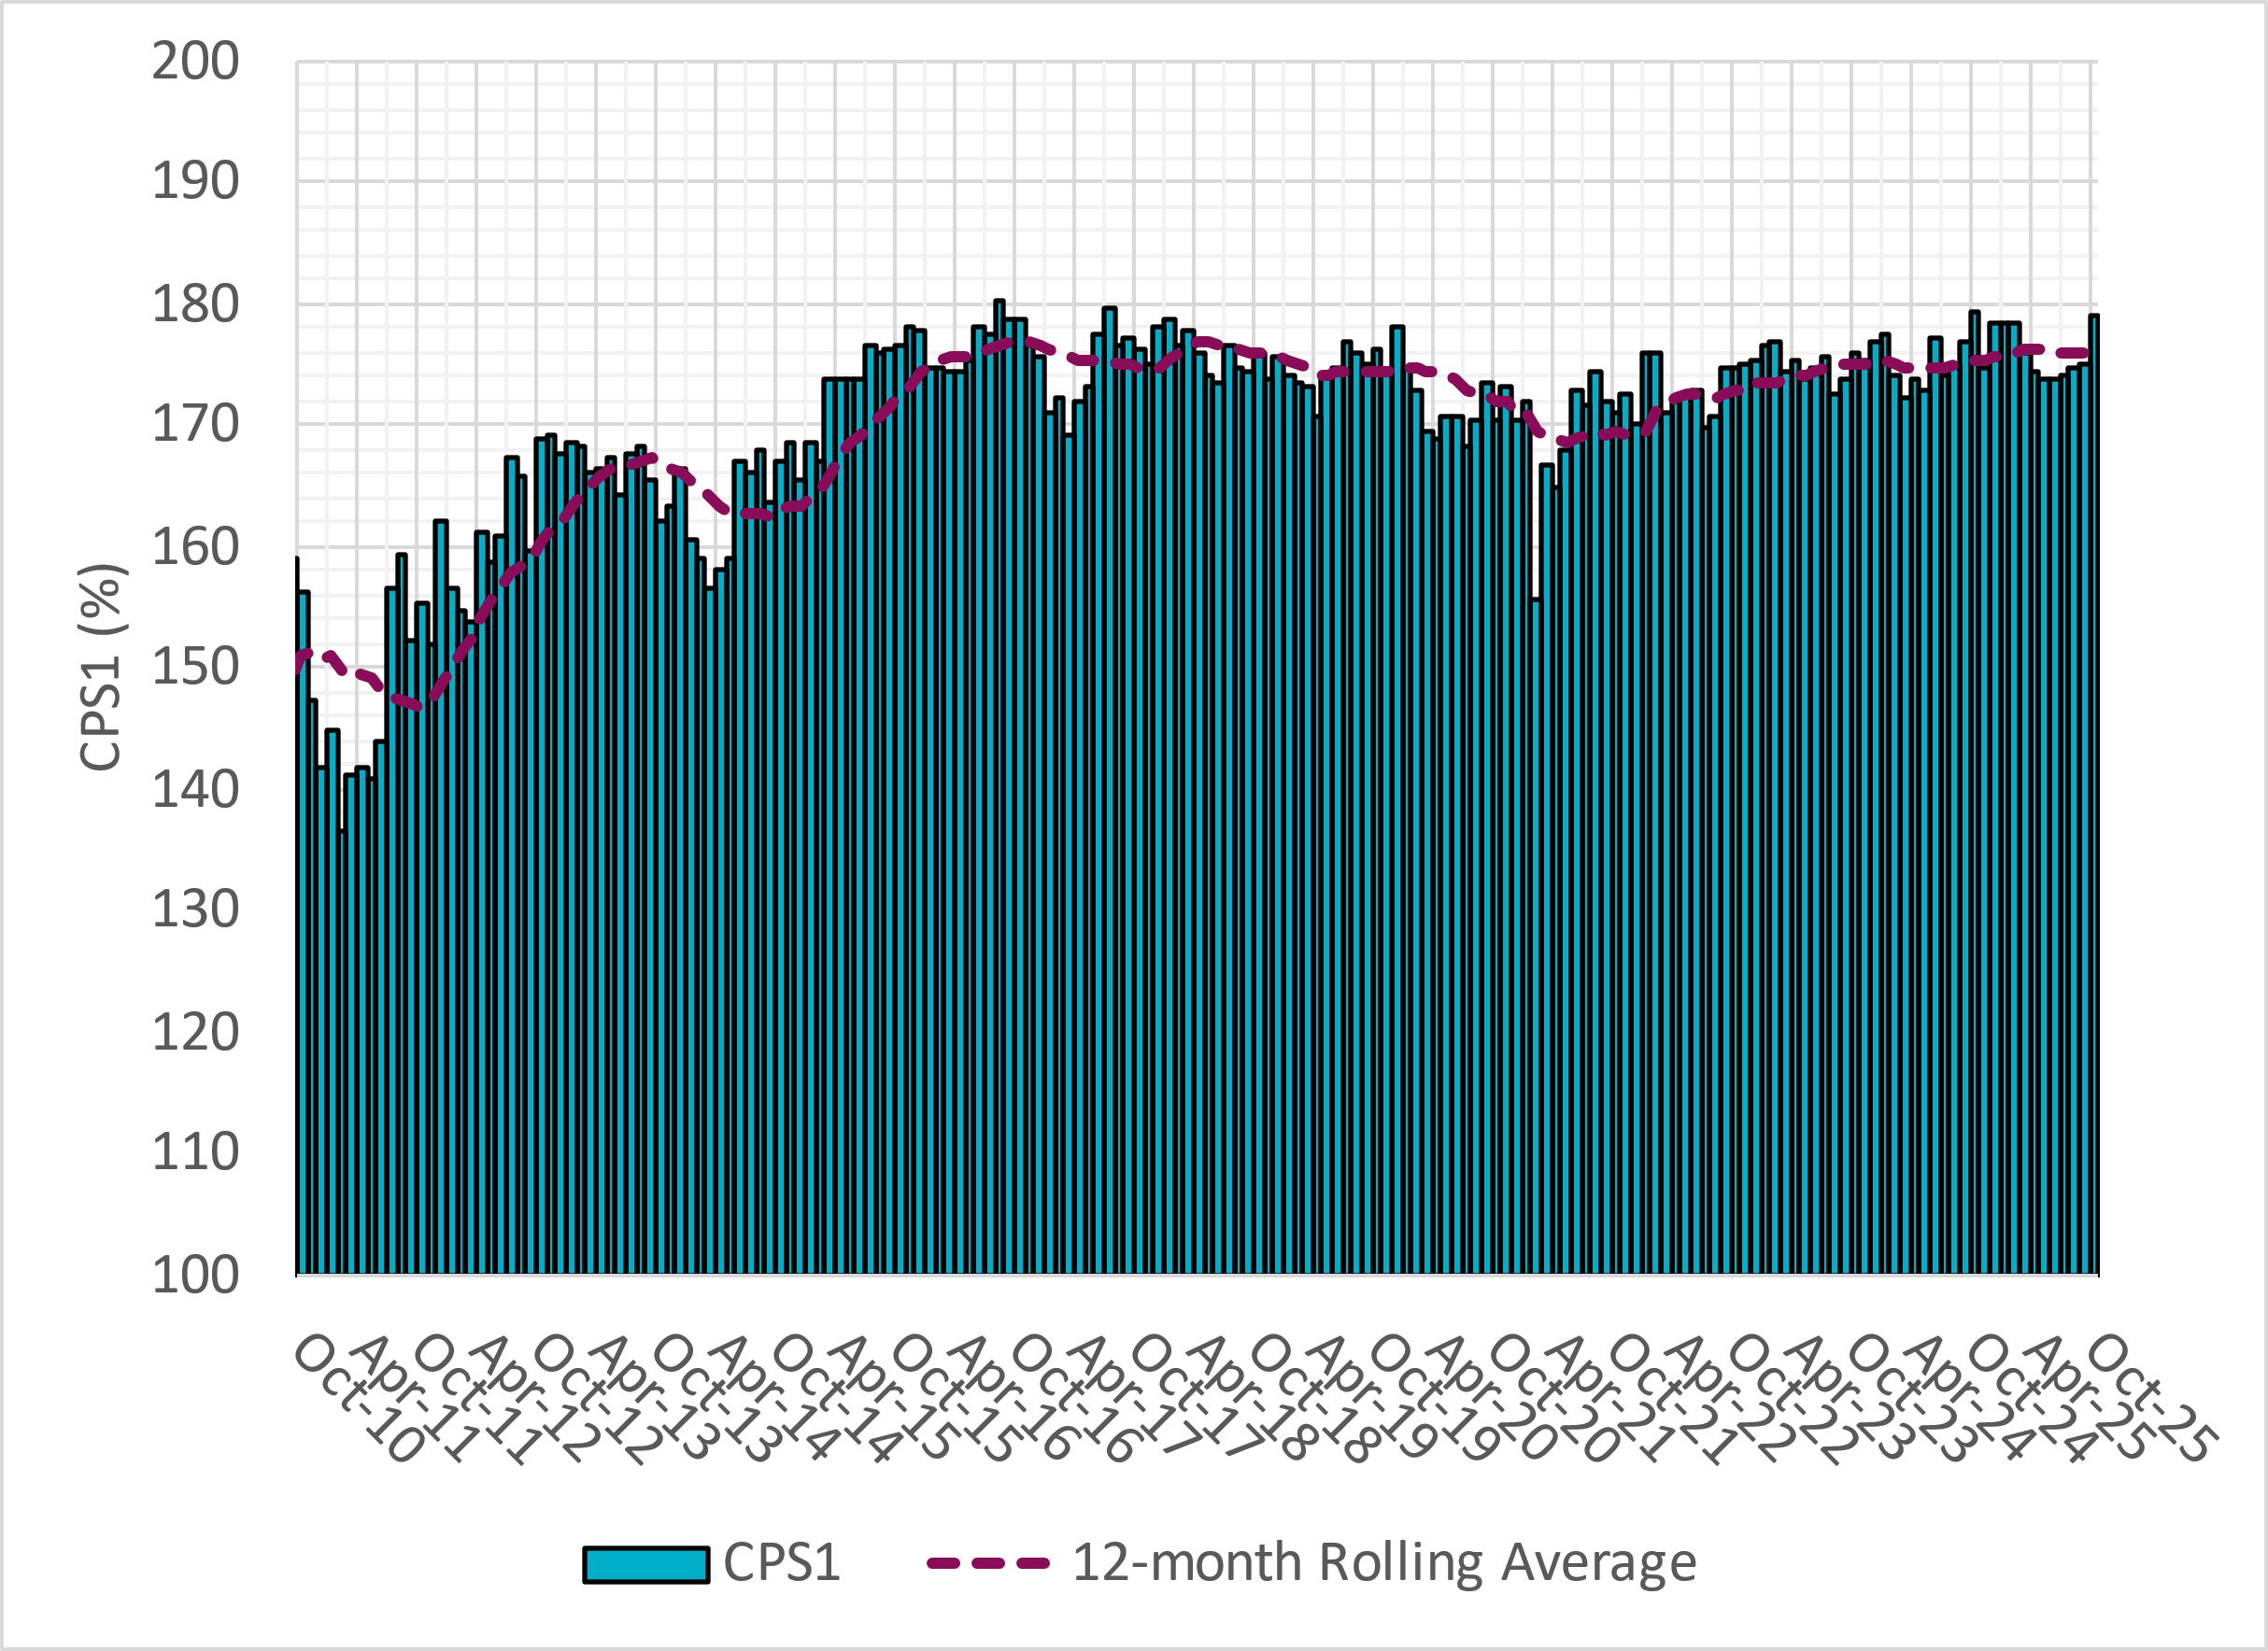
CPS1 Performance
Current 12-Month Rolling Average: 175.84%

Slide 8
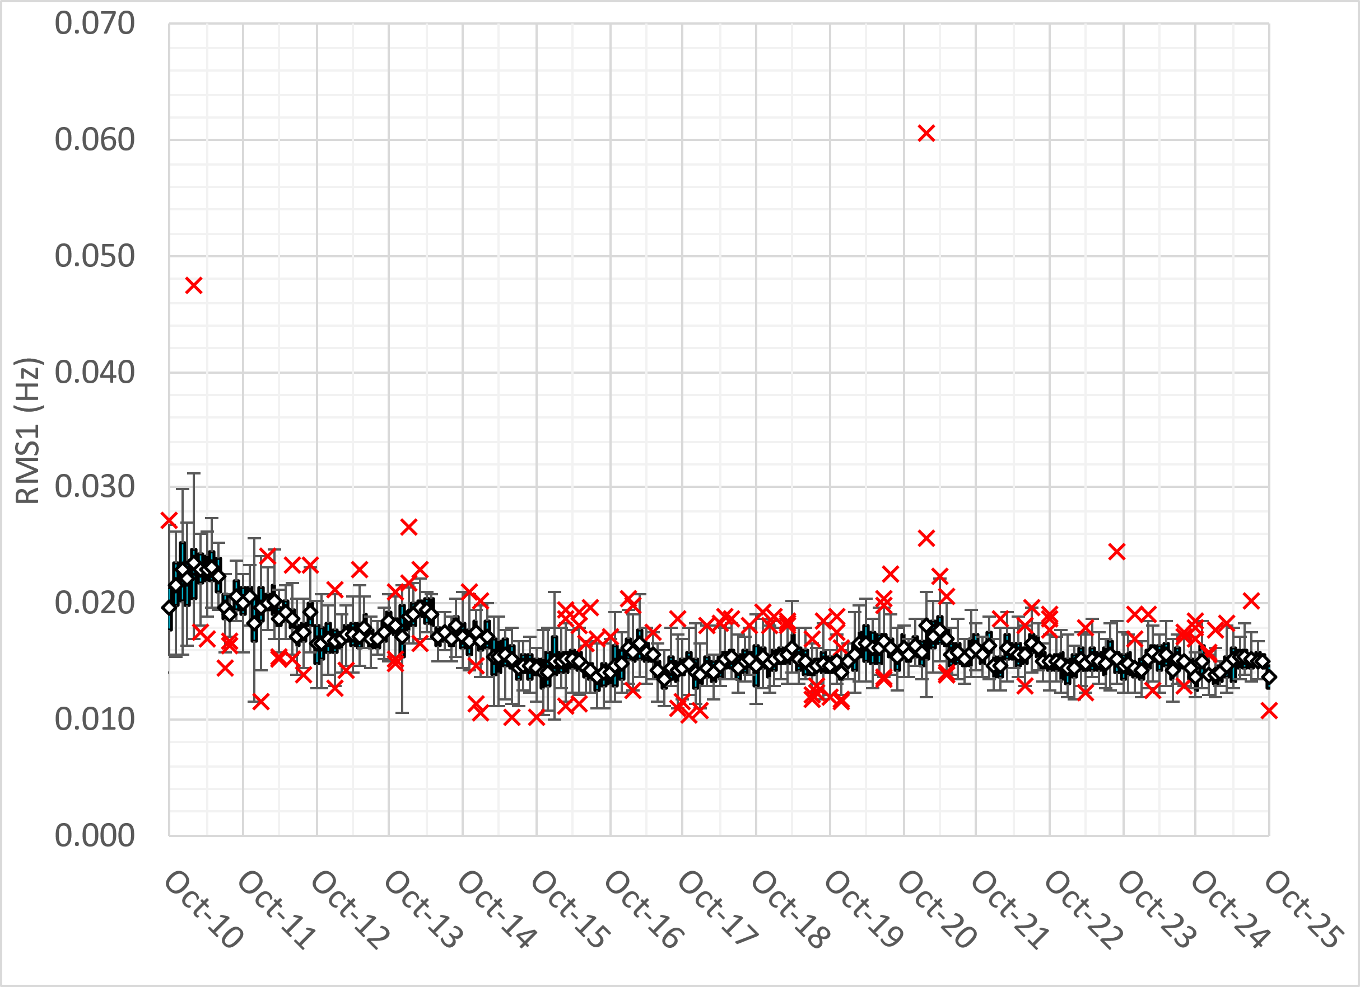
RMS1 Performance of ERCOT Frequency
Notes:
14.98 mHz on avg for September 2025

Slide 9
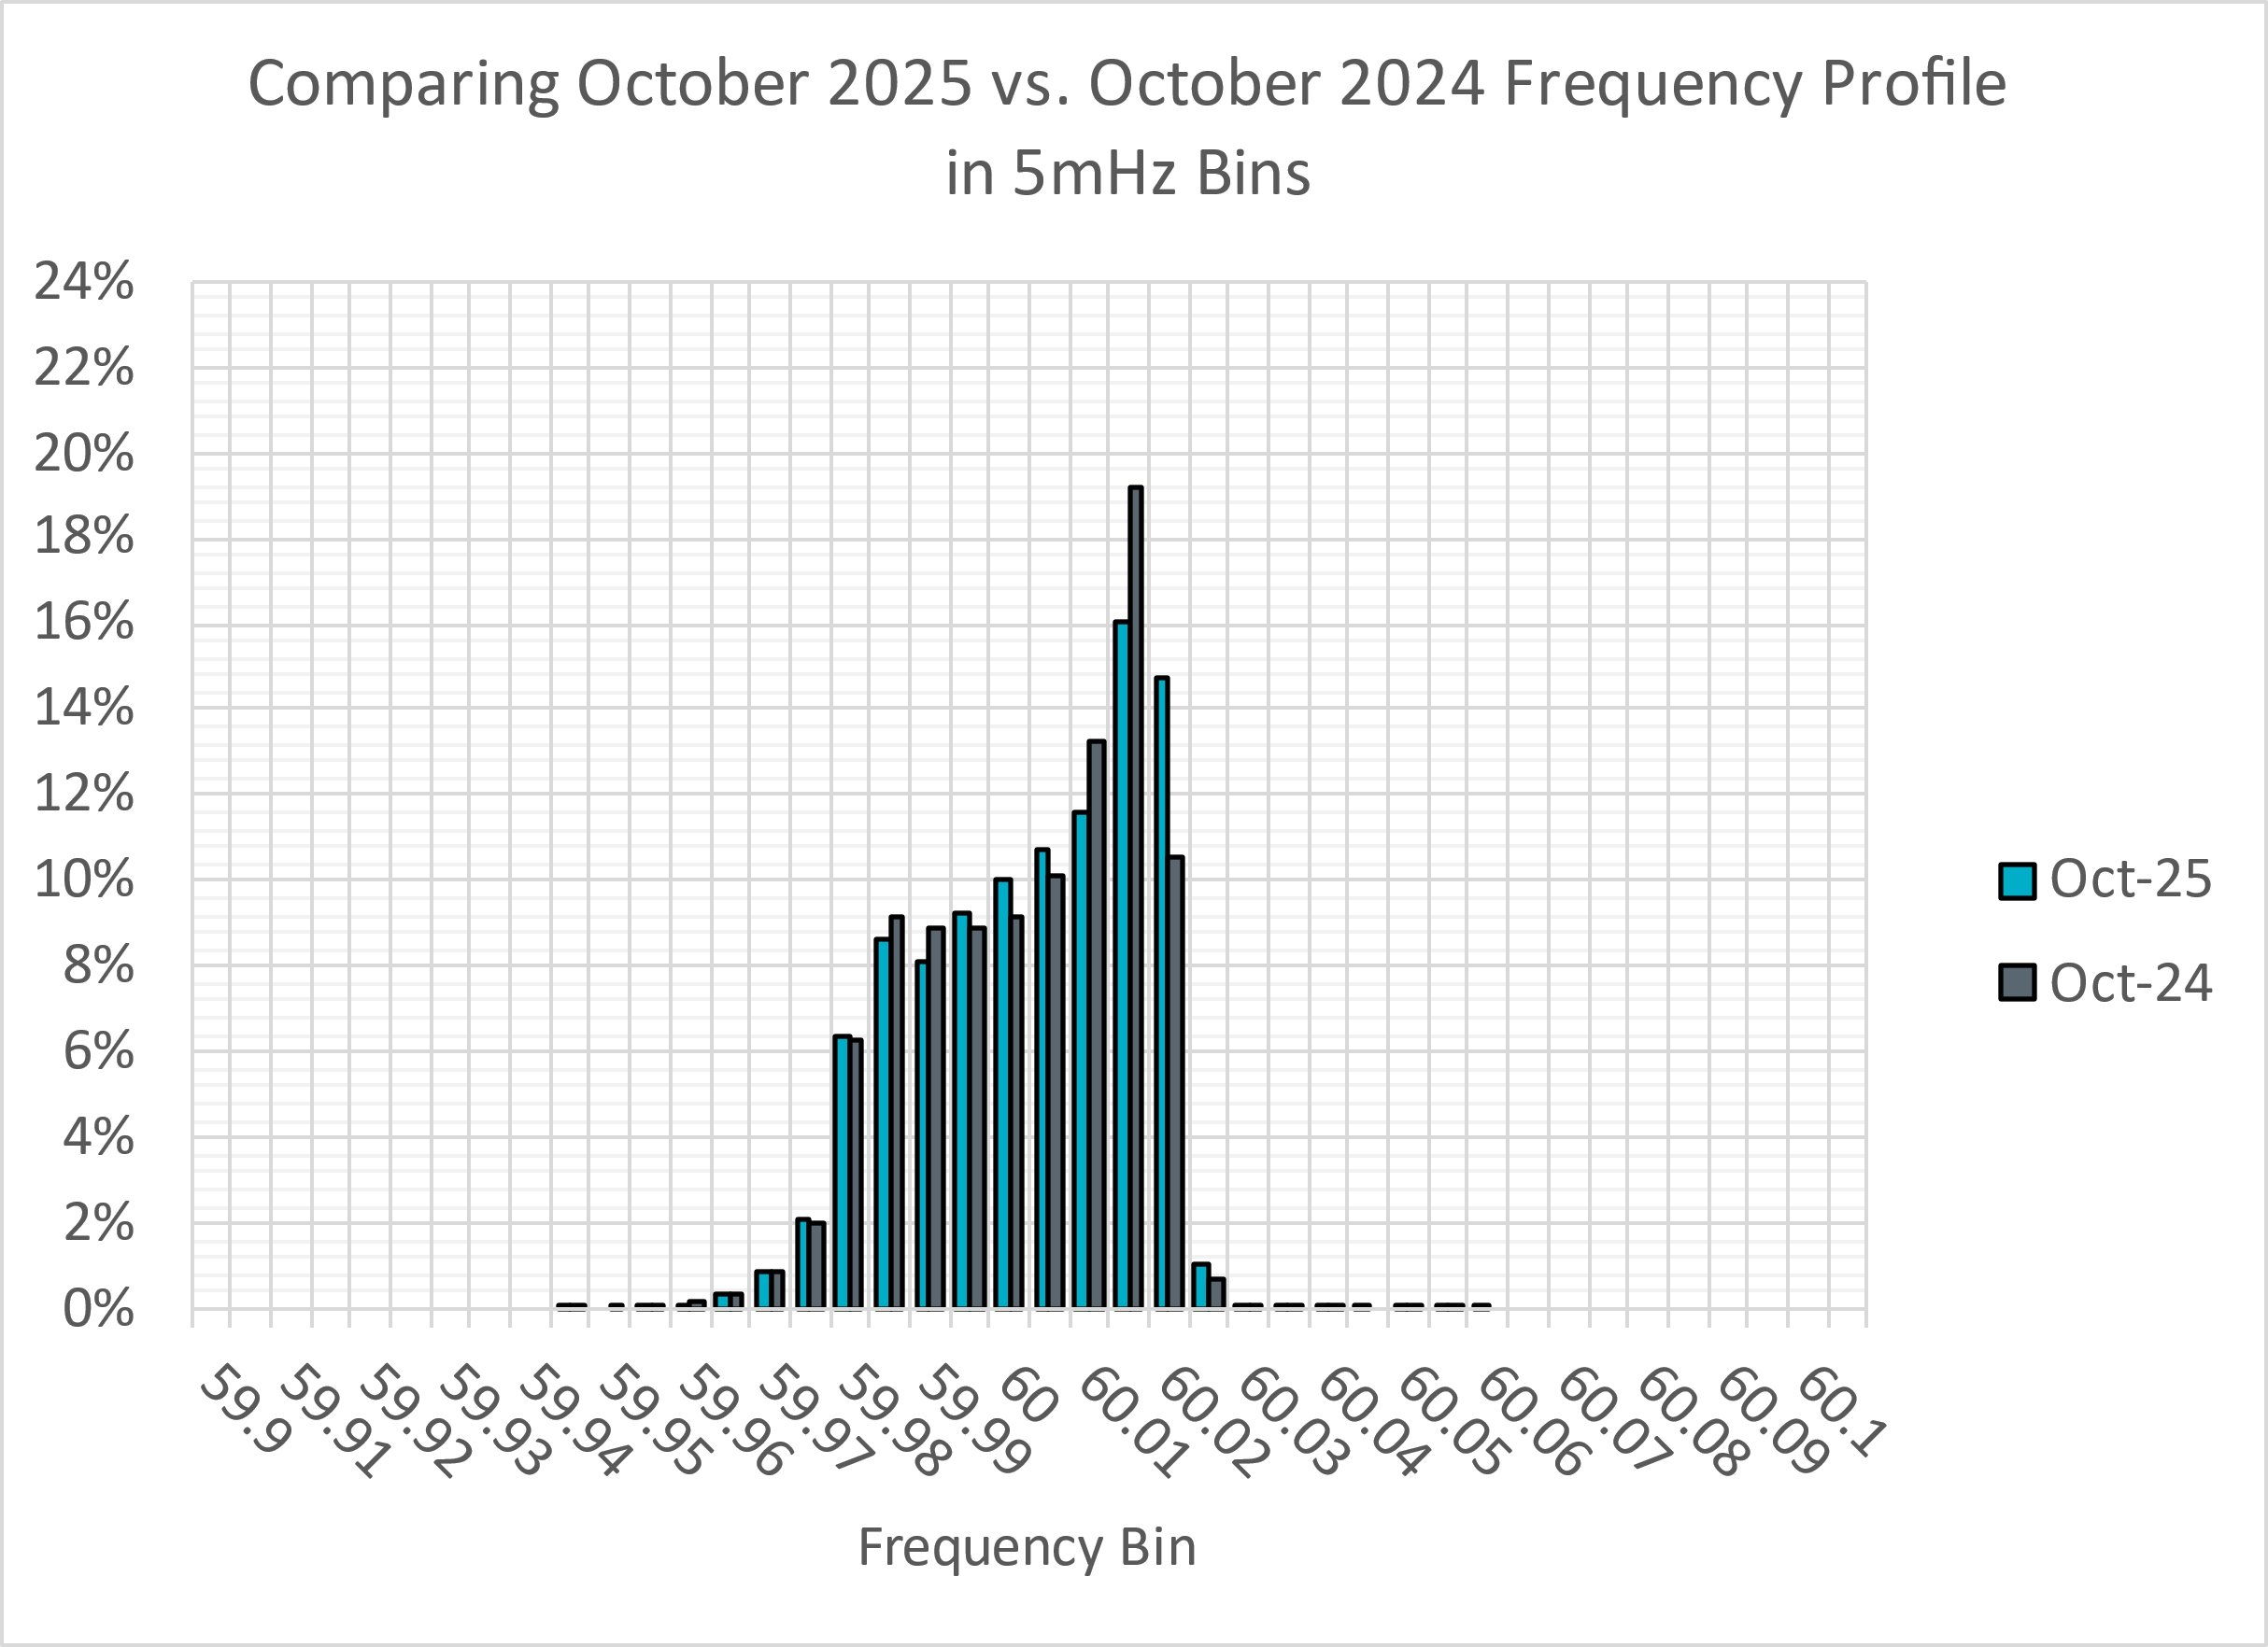
Frequency Profile Analysis
Notes:
Comparison of frequency profile between October 2024 and October 2025. Compared to last year, there are slightly less instances of frequency hovering around the lower dead bands.

Slide 10
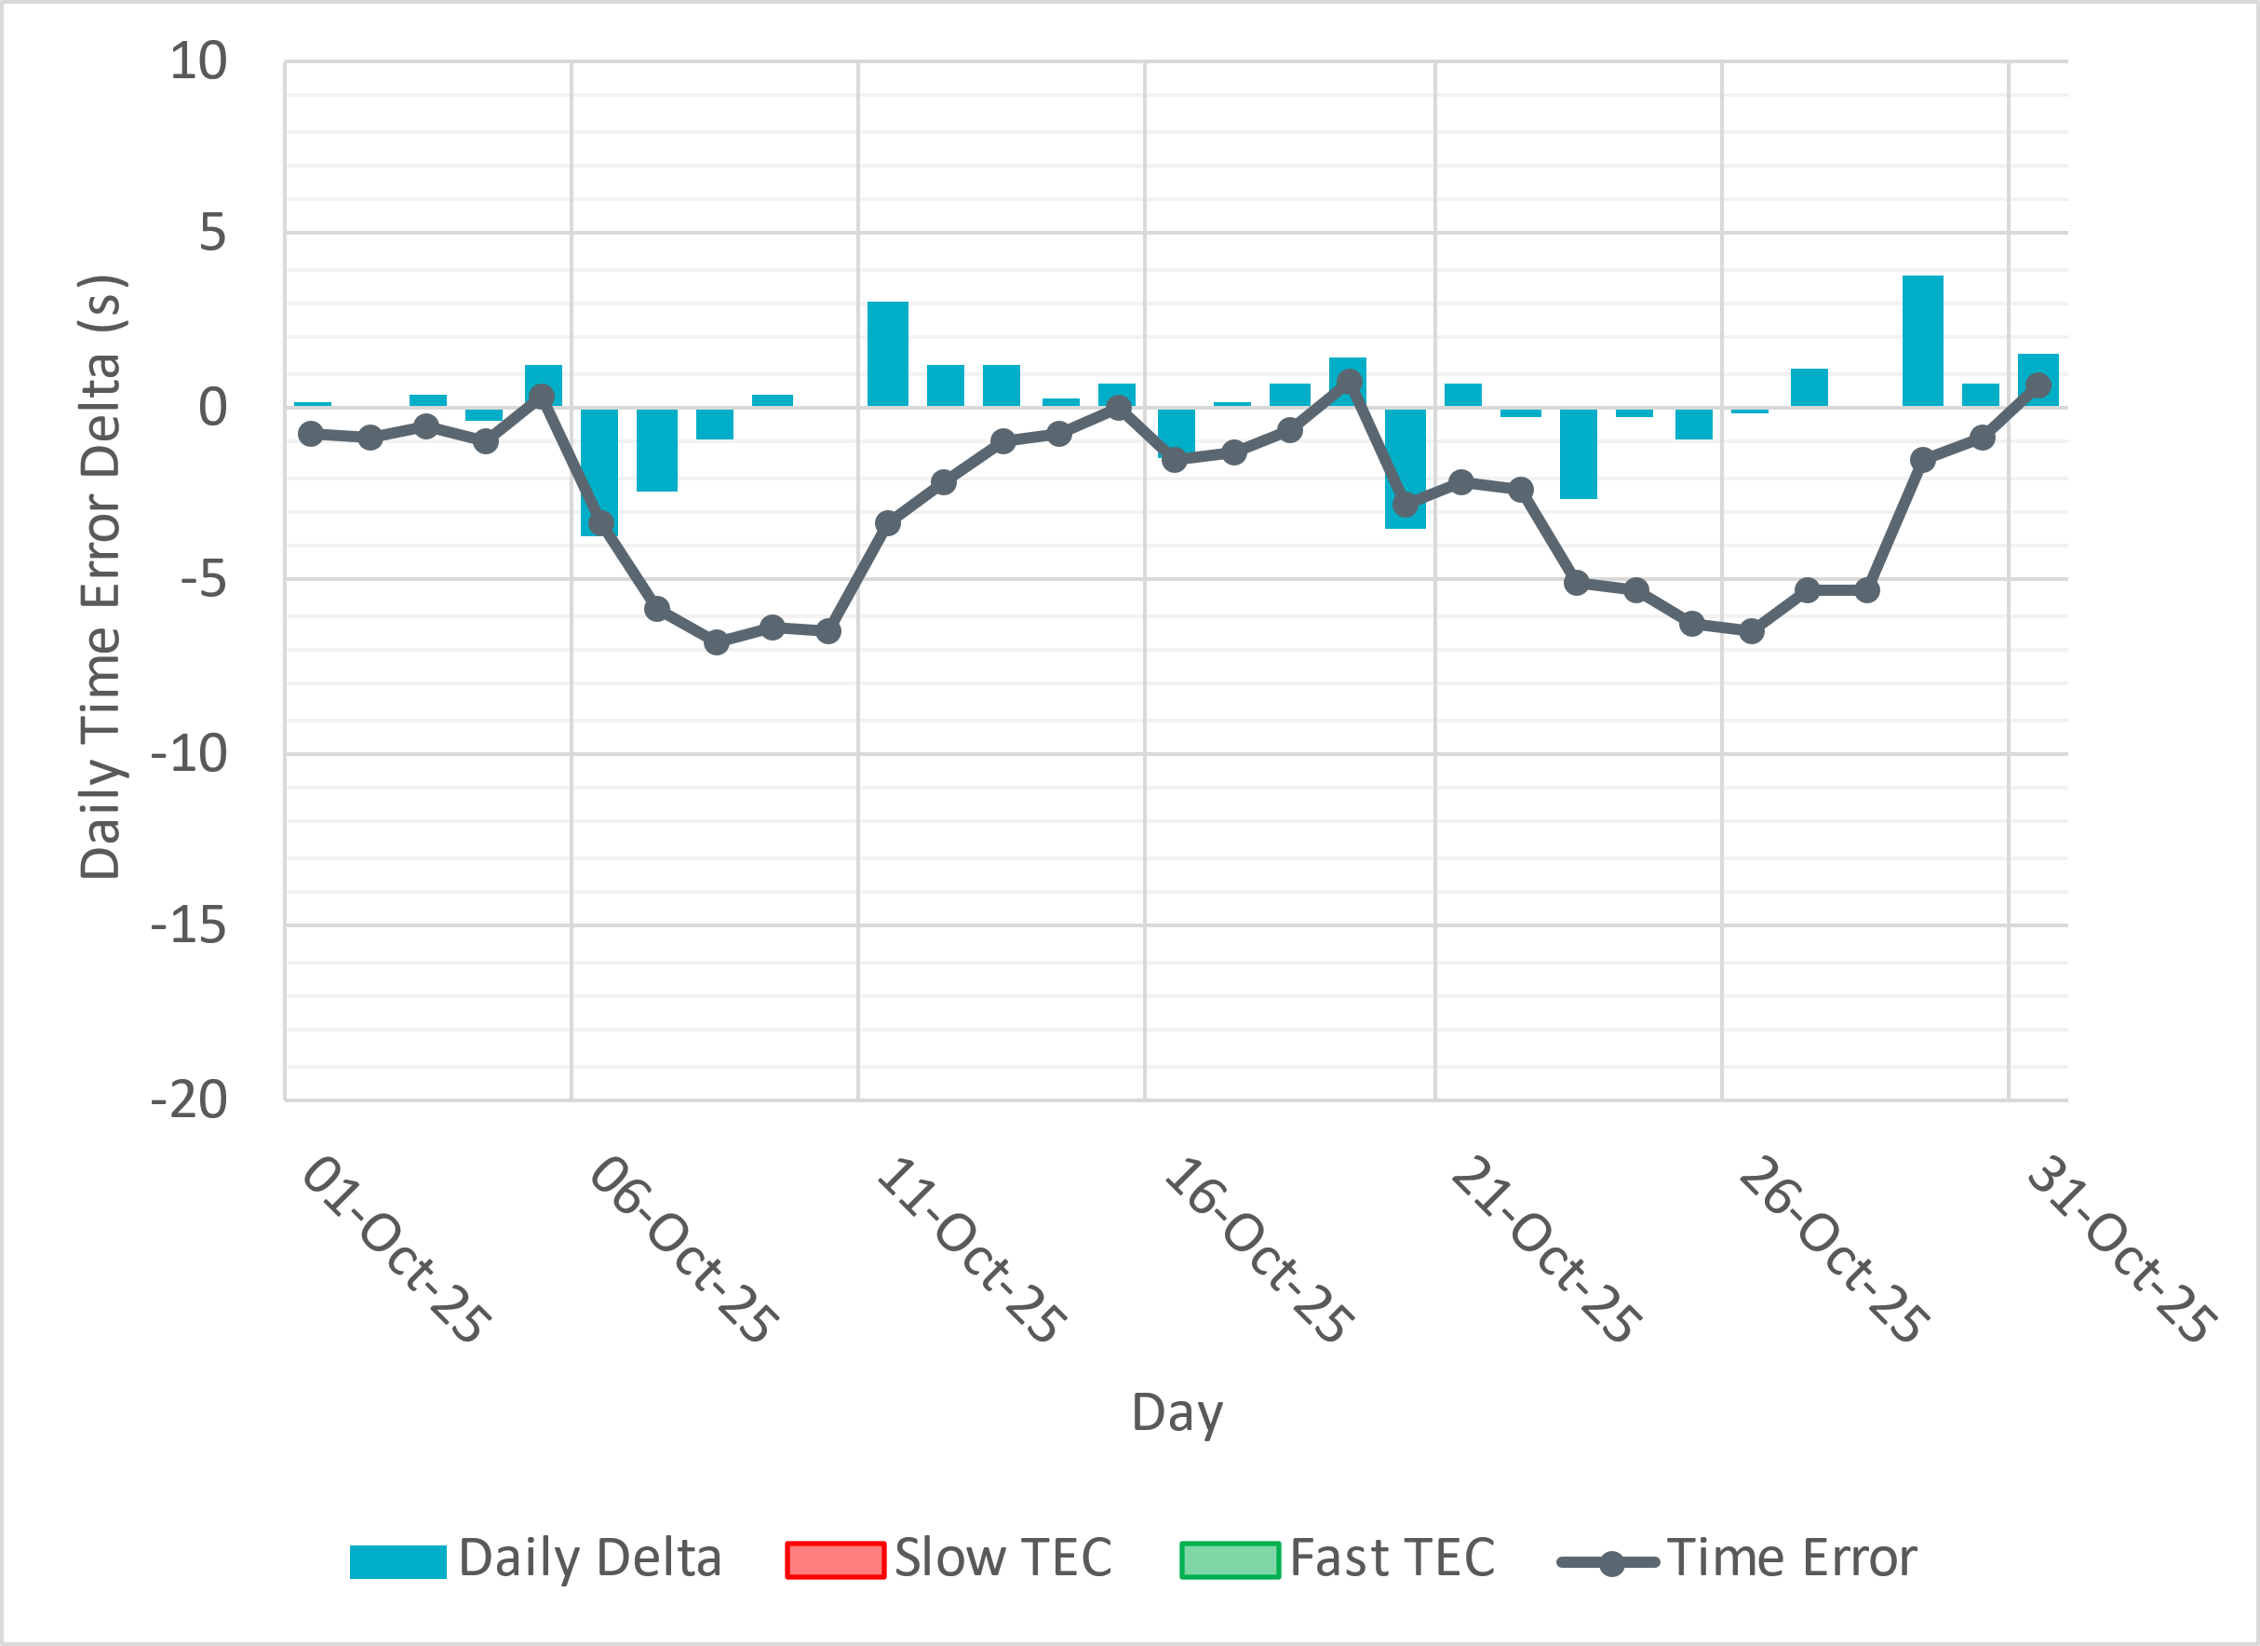
Time Error Corrections

Slide 11
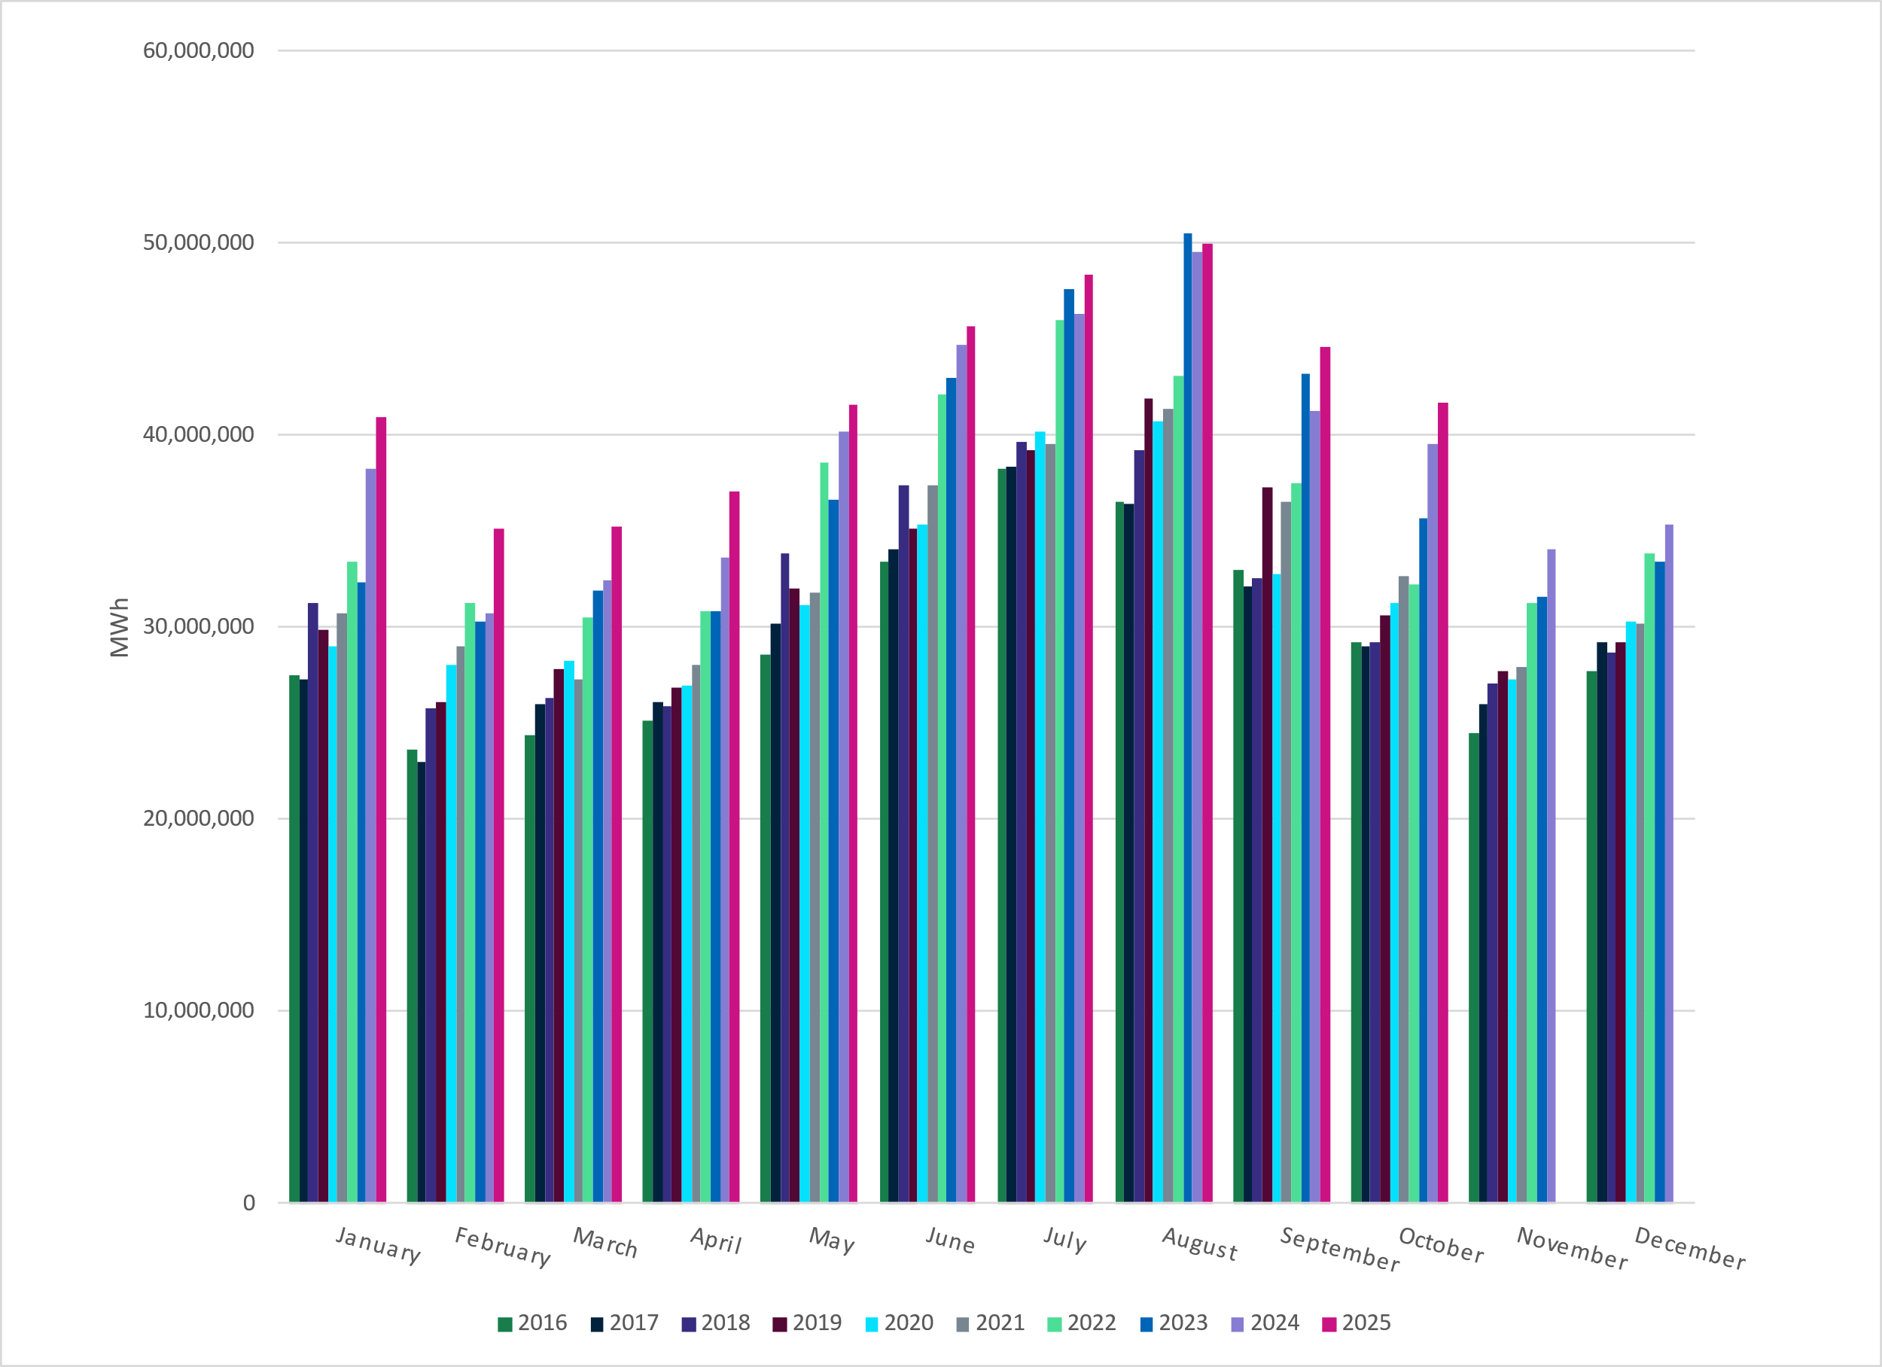
ERCOT Total Energy
Notes:
41,656,305 MWh – Decrease in total energy compared to last month

Slide 12
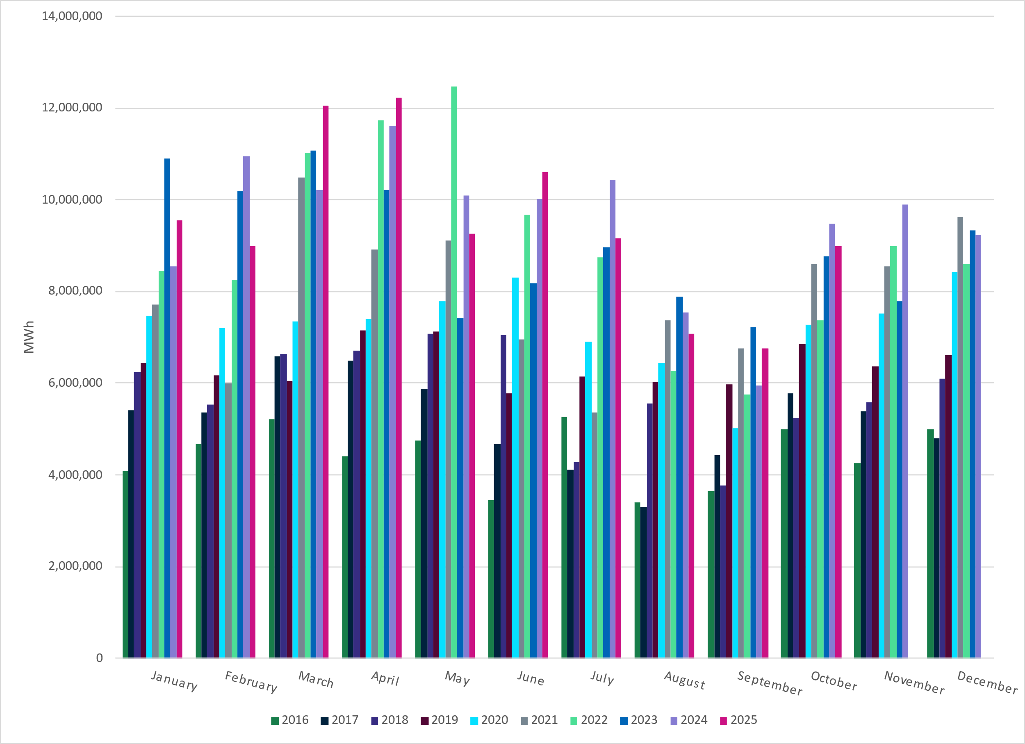
ERCOT Total Energy from Wind Generation
Notes:
8,997,426 MWH – Increase in total energy from wind compared to last month

Slide 13
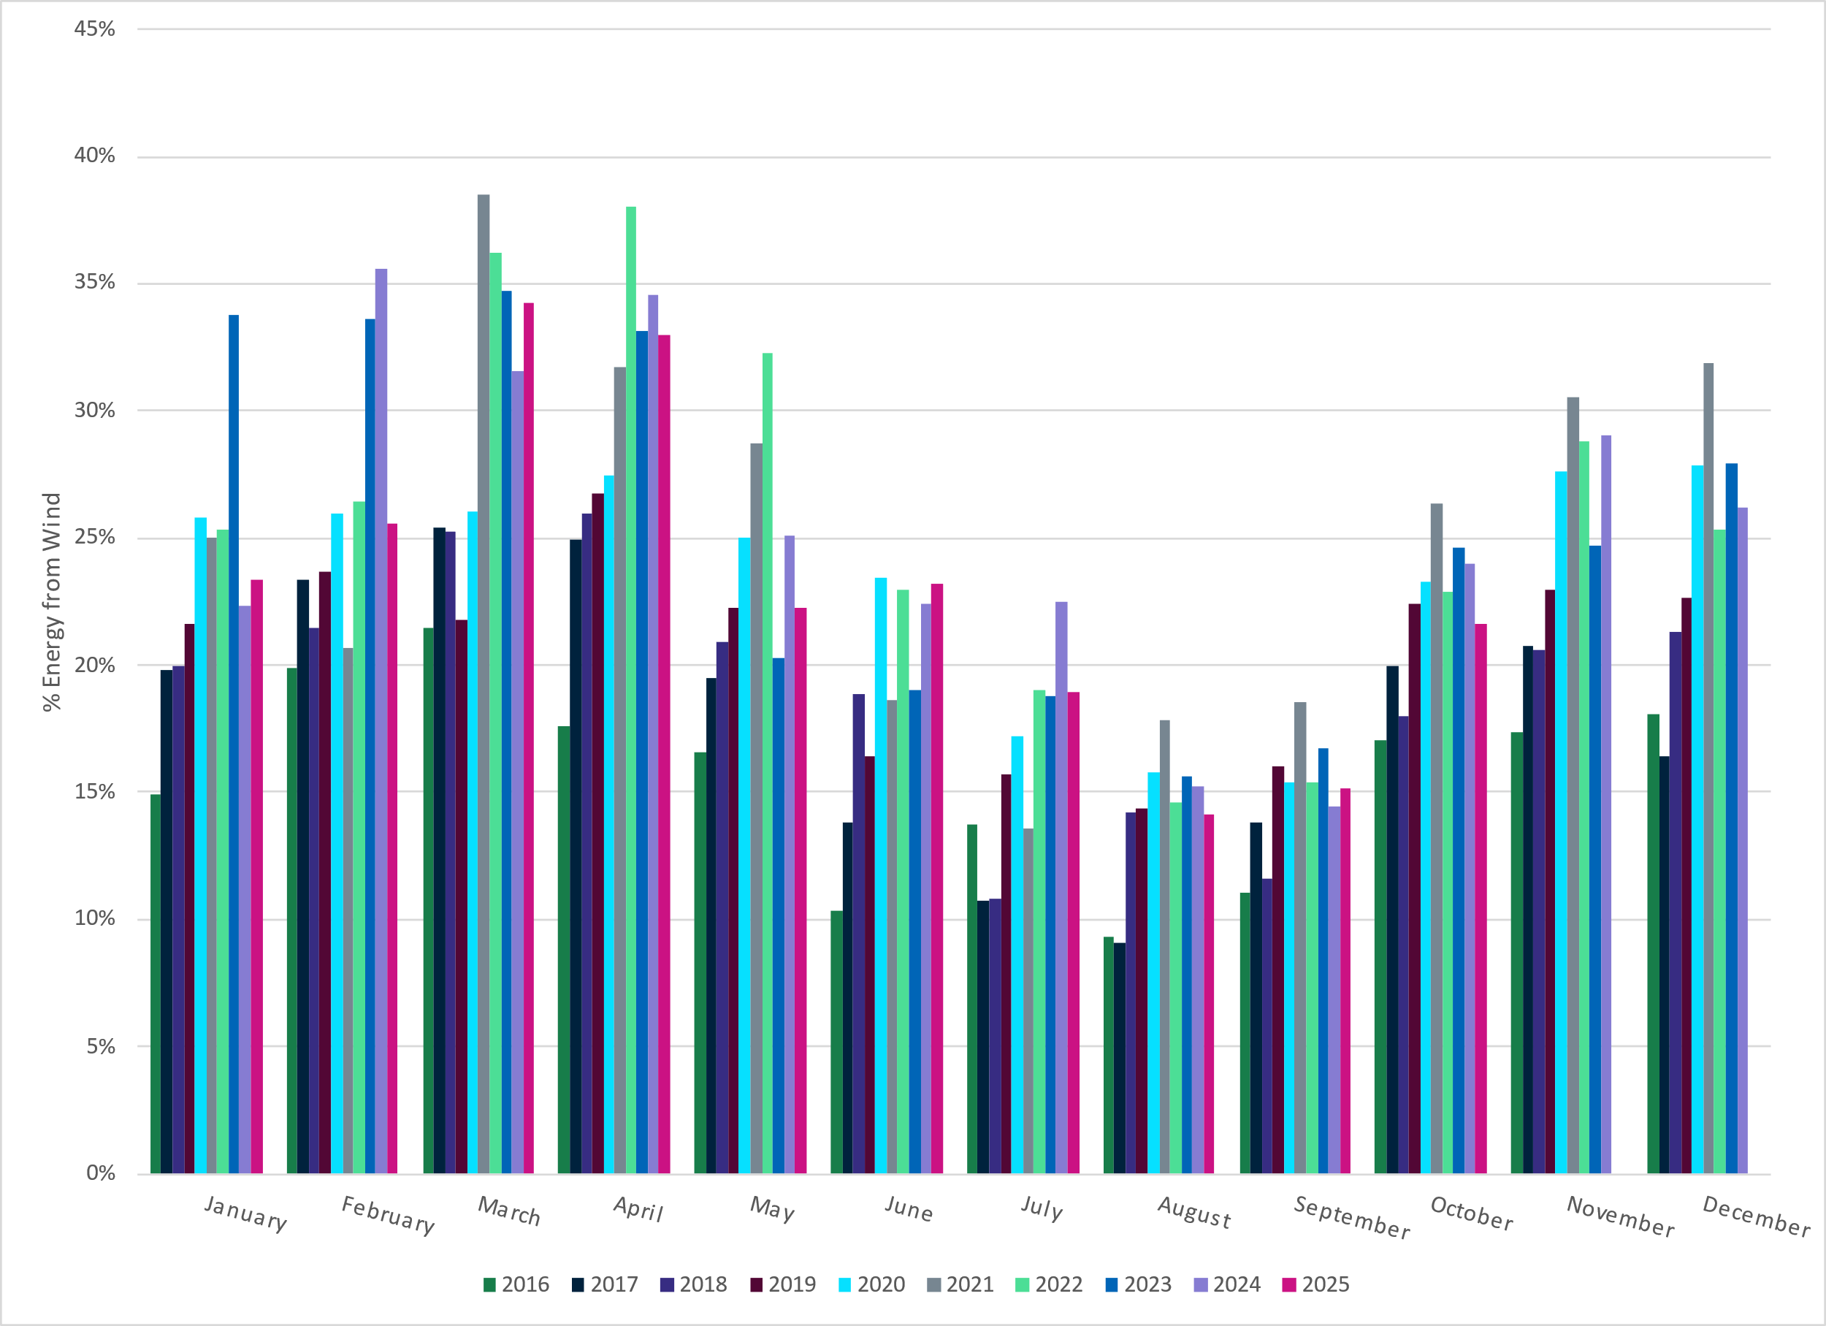
ERCOT % Energy from Wind Generation
Notes:
21.60% of total energy was provided by wind generation

Slide 14
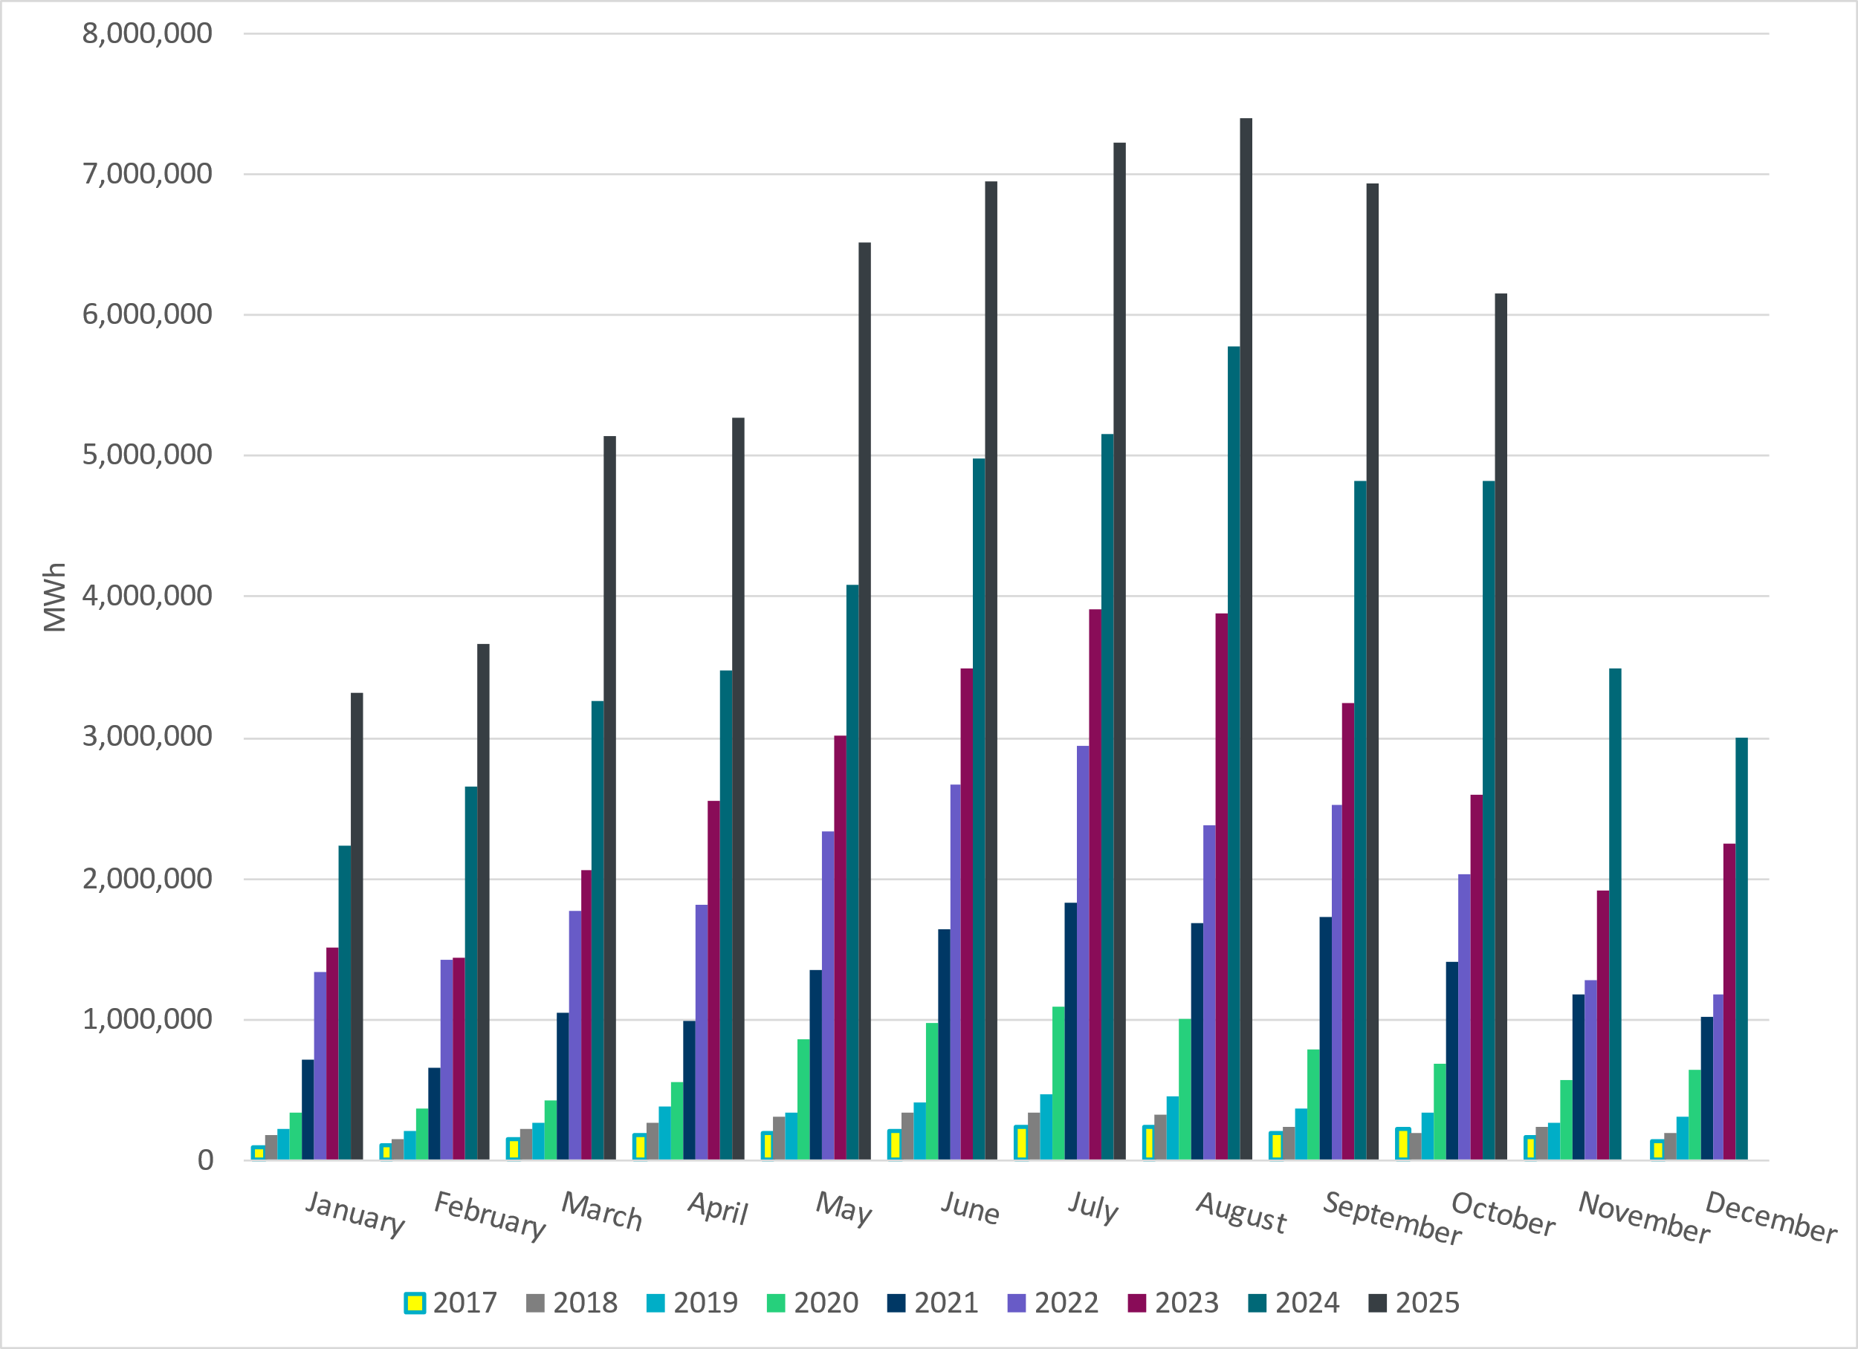
ERCOT Total Energy from Solar Generation
Notes:
6,153,563 MWh – Decrease in total energy from Solar

Slide 15
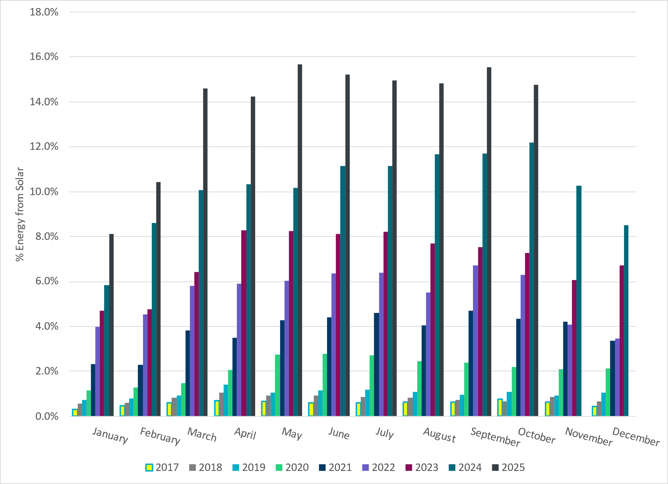
ERCOT % Energy from Solar Generation
Notes:
14.77% of total energy was provided by solar generation

Slide 16
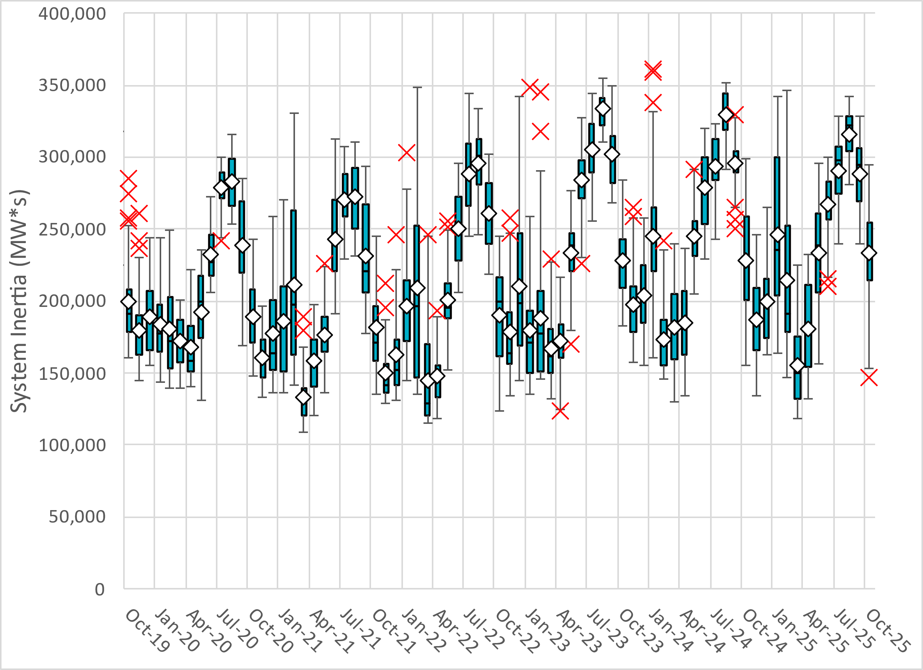
ERCOT Daily Minimum System Inertia
Notes:
Minimum Inertia in October 2025 = 146,821 MW*s on October 29th
Historical Overall Minimum was 109,029 MW*s on 3/22/2021
October Data:
Mean: 232,909 MW*s
Max: 294,108 MW*s on October 7th
Min: 146,821 MW*s on October 29th

Slide 17
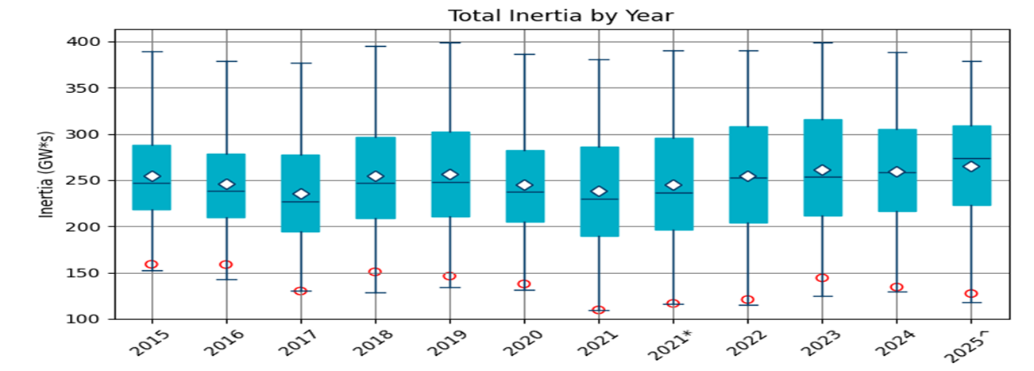
ERCOT Inertia Trend
Date and Time | 2015 11/25 2:00 AM | 2016 4/10 2:00 AM | 2017 10/27 4:00 AM | 2018 11/03 3:30 AM | 2019 3/27 1:00 AM | 2020 05/01 2:00 AM | 2021 03/22 00:00 AM | 2022 03/21 01:00 AM | 2023 04/18 02:00 AM | 2024 03/29 03:00 AM | 2024 03/29 03:00 AM | 2025 03/18 12:00 AM
Min synch. Inertia (GW*s) | 152 | 143 | 130 | 128.8 | 134.5 | 131.1 | 109 | 115 | 124 | 130 | 130 | 118.3
System load at minimum synch. Inertia (MW) | 27,190 | 27,831 | 28,425 | 28,397 | 29,883 | 30,679 | 32,599 | 33,365 | 35,799 | 37,297 | 37,297 | 48,973
Non-synch. Gen. in % of System Load | 42 | 47 | 54 | 53 | 50 | 57 | 65 | 66 | 61 | 68 | 68 | 74
Notes:
Summary of ERCOT inertia for the previous 10 years. Lowest inertia this year was on March 18th.
For each box, the central mark (red line) is the median, the edges of the box (in blue) are the 25th and 75th percentiles, the whiskers correspond to +/- 2.7 sigma (i.e., represent 99.3% coverage, assuming the data are normally distributed. The corresponding lowest inertia in each year is given in the table.
The circle on each boxplot is showing inertia during time when highest portion of load was served by wind/solar generation in that year.

